Slide 1
Sharing Software Configuration via Specified Links and
Transformation Rules
Markus Raab
Vienna University of Technology
Institute of Computer Languages, Austria
Email: markus.raab@complang.tuwien.ac.at
Notes:
<Nummer>

Slide 2

Outline
Motivation
Demo
Evaluation
Conclusion
Elektra's Logo

Slide 3
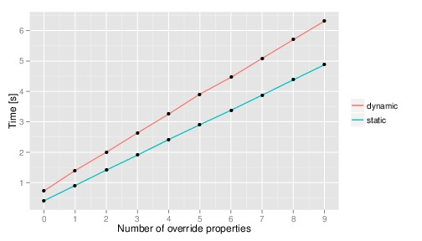
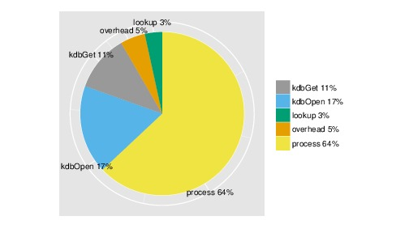
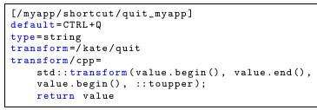
Evaluation
two implementations
  dynamic
  static
result: dynamic
  slower by factor 1.8
  time grows 22% faster
comparision
static variant

Slide 4
Conclusion
integration of existing configuration files
links between any configuration items
specification is only key/value data
  access by tools
  enforced on access
  configurable specification
contributions
  access to others application configurations
  implementations available
  performance measurements for static/dynamic
  case study

Slide 5
Thank you for your attention!
Markus Raab
Vienna University of Technology
Institute of Computer Languages, Austria
Email: markus.raab@complang.tuwien.ac.at
Notes:
<Nummer>

Slide 6
Benchmark Setup
Laptop: hp ® EliteBook 8570w ™
  CPU Intel ® Core i7-3740QM @ 2.70GHz
  7939 MB Ram
GNU/Linux Debian Wheezy 7.5
gcc compiler Debian 4.7.2-5
  with the options -std=c++11, -O2
measured the time using gettimeofday
Median of eleven executions

