Slide 1
Global and Thread-Local Activation of Contextual Program Execution Environments
Markus Raab
Vienna University of Technology
Institute of Computer Languages, Austria
Email: markus.raab@complang.tuwien.ac.at

Slide 2

Outline
Introduction
  Context-Oriented Programming
  Program Execution Environment
  Earlier Work
CoElektra
  Contribution
Evaluation
  Benchmarks
Conclusion
Elektra's Logo

Slide 3
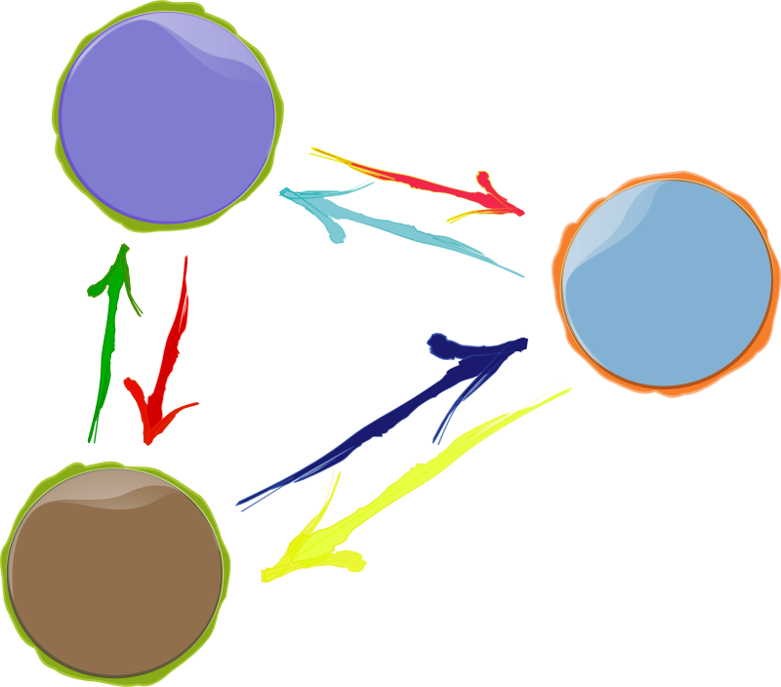

Motivation
Context-Aware
  e.g. (body) temperature
Customizable
  adapt to user
Multi-Core Processors
  should to be utilized
  we will focus on threads
Notes:
Why is multi-core a problem?

Slide 4

Context-Oriented Programming: Layers
Originates from object-oriented programming
Layers represents context
Can be activated anywhere in the program
  dynamic scope
Motivation: Extend idea for multi-thread activation
(e.g. globally activate InPocket layer)
Many Layers
can be active
Name of Layer
void rcvPhoneCall () {
e.context().with()<PhoneCall>()([&]{
vibrate();
});
// vibrate();
}
Part of dynamic Scope

Slide 5
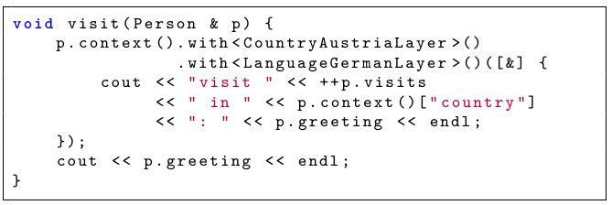


Contextual Values
“Trivial generalization of thread-local values” with Layers
Use dynamic scoping as in context-oriented programming
Usage and access performance identical to variables
“Griaß enk!”
Different Context,
Same Thread
“Tēnā koutou!”

Slide 6

Program Execution Environment
Consists of: Configuration Files, Commandline Arguments, ...
Program Execution Env. is defined using a specification
  /: Denotes hierarchy of contextual values
  %: Placeholders for layers
Needed for Customization
  Initialize and persist every contextual value
[/%language%/%country%/%dialect%/person/greeting]
type=String
[/%country%/person/visits]
type=Integer
default=0
Notes:
Explanation: Last Part of title

Slide 7
CoElektra
Notes:
We finished Introduction
CoElektra is the projects name?
Contributions

Slide 8
Usage
Contribution with CoElektra
Code
Generator
Thread-aware
Contextual
Values
generates
uses
Specification
Layers
And Other
Code
Written by User

Slide 9
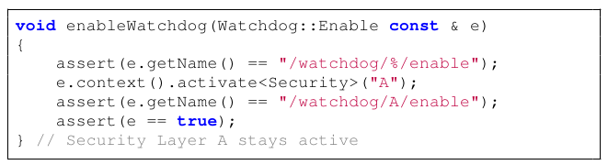
Global Activation
with() is bound to one thread
activate() is global for device
  Needed for sensor and device states

Slide 10

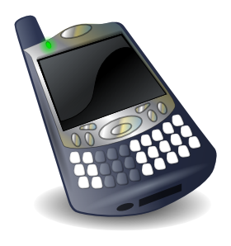


Example: Battery low
Thread 1
Thread 2

Slide 11

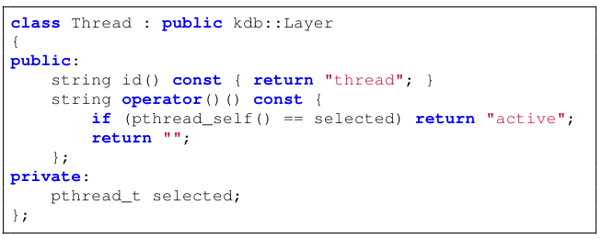
Thread Based Layer
limit activate()
  to single thread
  to a group of threads
implementation: layer uses thread ID
  e.g. to decide if active

Slide 12

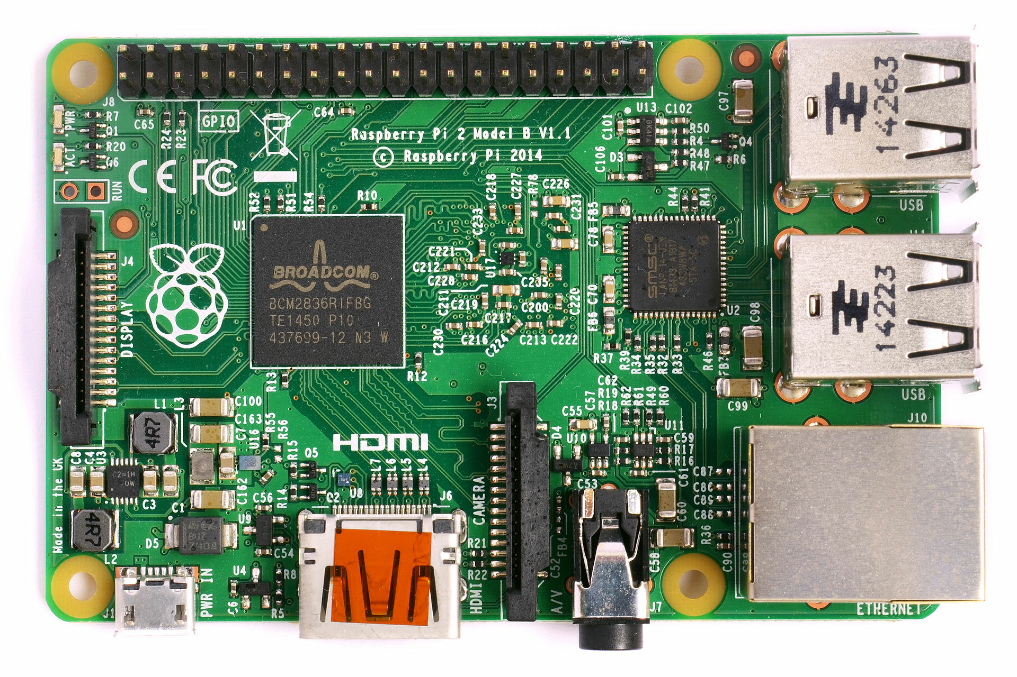
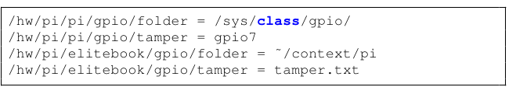
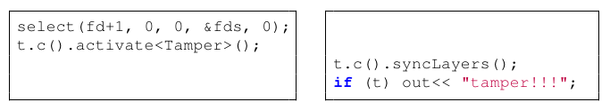
Hardware Abstraction
Hardware by Context:
Layer Activations for Sensor States:
(This is a configuration file, not a specification!)

Slide 13
Source Code
Source Code released as free software within Elektra
  code generator for contextual values
  many configuration file standards ↔ contextual values
http://www.libelektra.org
  Version 0.8.11 released at 03/04/2015

Slide 14
Evaluation

Slide 15
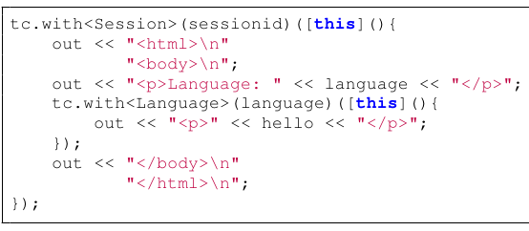
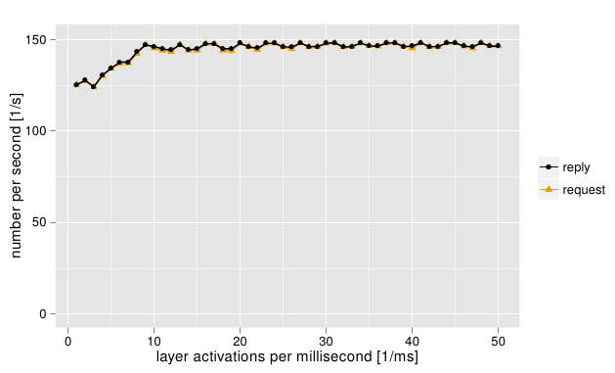
Layer Activation
On single-core CPU
delay between layer activation [ms]

Slide 16
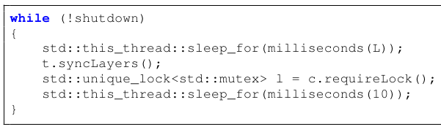
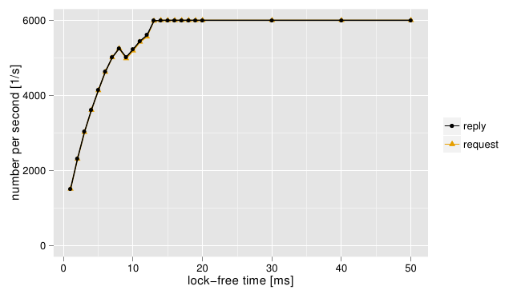
Lock-Free Time
On multi-core CPU
previous benchmark
lock all syncLayers

Slide 17
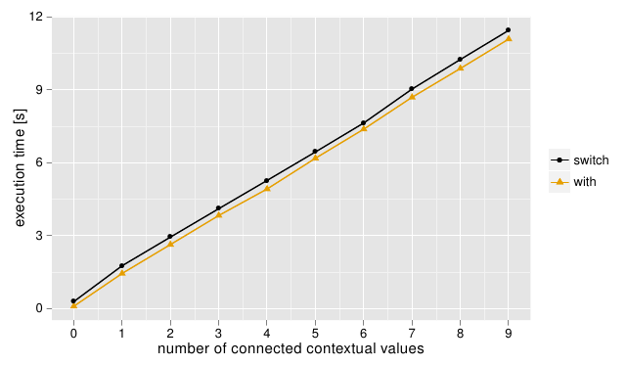
Connection of Contextual Values
[/%language%/%country%/%dialect%/..
type=String
[/%country%/person/visits]
type=Integer
default=0
Connection
Linear growth
activate/deactivate
with

Slide 18

Library Size
Heap Size: 1568 + 1248 kilobytes (10,000 keys)
Binary Size: 98,456 bytes (armhf)
Compared to e.g. libxml2 (i386) 1,384,616 bytes

Slide 19
Conclusion
Multi-threaded Support for Contextual Values
  easy to use: CoElektra takes care of necessary synchronization
  read access of contextual values without overhead
Switching Context
  efficient (de)activation for one or more threads
  no overhead on multi-core CPUs (in background)
  correlates with connected contextual values
Case Study: Web Server
  eases development, context-aware, customizable
  suitable for context-aware ubiquitous computing

Slide 20
Thank you for your attention!
Markus Raab
Vienna University of Technology
Institute of Computer Languages, Austria
Email: markus.raab@complang.tuwien.ac.at

Slide 21
Benchmark Setup
Laptop: hp ® EliteBook 8570w ™
  CPU Intel ® Core i7-3740QM @ 2.70GHz
  7939 MB Ram
GNU/Linux Debian Wheezy 7.5
gcc compiler Debian 4.7.2-5
  with the options -std=c++11, -O2
measured the time using gettimeofday
Median of eleven executions

Slide 22
Related Work
context variables (check on every usage)
M. von Löwis, M. Denker, and O. Nierstrasz, “Context-oriented
programming: Beyond layers,” in Proceedings of the 2007 International Conference on Dynamic Languages
ensure-active-layers (global layer activation)
P. Costanza, R. Hirschfeld, and W. De Meuter, “Efficient layer activation for switching context-dependent behavior,” in Modular Programming Languages
partial evaluation avoids usage of libxml2
M. Jung, R. Laue, and S. A. Huss, “A case study on partial evaluation
in embedded software design,” in SEUS 2005
hybrid mediator-observer pattern
O. Riva, C. di Flora, S. Russo, and K. Raatikainen, “Unearthing design patterns to support context-awareness,” in Pervasive Computing and Communications Workshops

Slide 23

Specification
C-Code
(e.g. option parsing)
Specification
C++-Code
generate
provides
Docu,
Manuals,
GUIs
Persistence
get value derived
from env
Runtime Checks
Validation
Upgrades
Integration
Contextual
Values
Connection
/%/%/%/person/greeting=Hi!
/German/%/%/person/greeting=Guten Tag!
/German/Austria/%/person/greeting=Servus!
/German/Austria/t/person/greeting=Griaß enk!

