Slide 1

Software Integration using a Global Configuration Storage
FOSDEM 2016
Markus Raab <elektra@markus-raab.org>
xmpp: jabber@markus-raab.org
<Nummer>
Notes:
Geplante Zeit: 20 min
Ich freue mich im Rahmen der Grazer Linuxtage 2010 die Präsentation mit dem Titel “” halten zu dürfen.
Umfrage: Wer hat unter Linux eine Konfigurationsdatei editiert?
Wer hat schon mit Programmen Konfiguration verändert?
Wer hat schon Elektra verwendet?
Einstieg: Genauer Blick was mit Konfiguration gemeint ist.

Slide 2
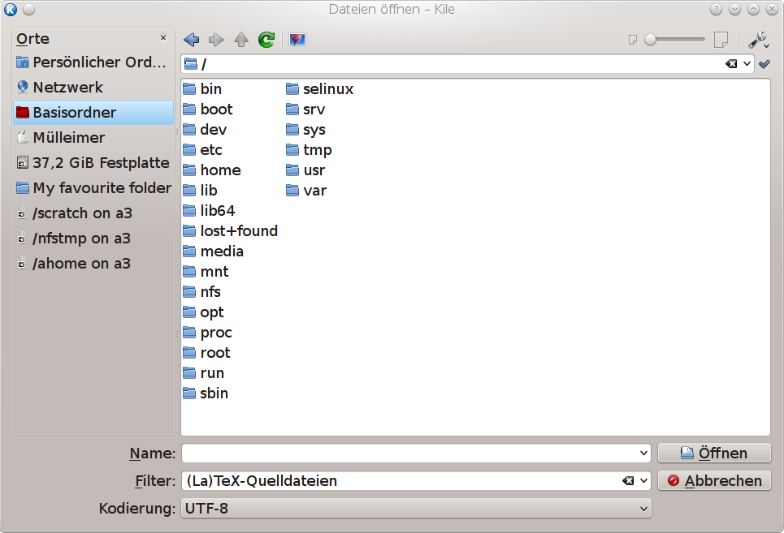
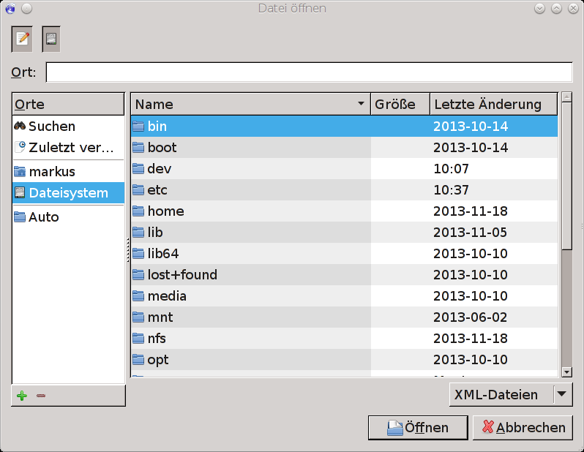
Why (shared) configuration matters
Shortcuts
Look&Feel
Favourite Places
Language
Sorting Criteria
Hidden files
Size of Icons
Proxy Settings
...
<Nummer>
Notes:
Dieses Problem ist natürlich schon länger bekannt. Deshalb gibt es unter Linux/BSD/Unix sehr gute Insellösungen für verschiedene Plattformen und Desktopumgebungen.
Was fehlt ist die Integration untereinander und der Zugriff auf andere Konfiguration.

Slide 3
What about a Configuration Daemon?
Certainly gives some advantages and can be useful, but:
Leaves the underlying problem unsolved
(where does the daemon reads its configuration from?)
Needs to reimplement OS security
Single Point of failure
Makes system more complex
Moves Problem of multiple syntactic representations to multiple protocols → makes it even harder
(DBus, LDAP, SNMP, DHCP, Zeroconf ..)
  So we are best off with configuration files
<Nummer>
Notes:
Dieses Problem ist natürlich schon länger bekannt. Deshalb gibt es unter Linux/BSD/Unix sehr gute Insellösungen für verschiedene Plattformen und Desktopumgebungen.
Was fehlt ist die Integration untereinander und der Zugriff auf andere Konfiguration.

Slide 4





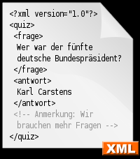



What about Configuration Files?
Gnome platform
with GSettings
KDE platform
with KConfig XT
No Access
DConf
Xorg
ini
KConfig
Great technology availaible
Not integrated
JSON
XDG
NIH*
/etc/distribution_specific
DBus
*not invented here
<Nummer>
Notes:
Dieses Problem ist natürlich schon länger bekannt. Deshalb gibt es unter Linux/BSD/Unix sehr gute Insellösungen für verschiedene Plattformen und Desktopumgebungen.
Was fehlt ist die Integration untereinander und der Zugriff auf andere Konfiguration.

Slide 5

How to (not) change the situation?
Thanks to xkcd.com
<Nummer>
Notes:
Dieses Problem ist natürlich schon länger bekannt. Deshalb gibt es unter Linux/BSD/Unix sehr gute Insellösungen für verschiedene Plattformen und Desktopumgebungen.
Was fehlt ist die Integration untereinander und der Zugriff auf andere Konfiguration.

Slide 6
Integration
of current Standards and Technologies leads to better integrated software
<Nummer>
Notes:
Dieses Problem ist natürlich schon länger bekannt. Deshalb gibt es unter Linux/BSD/Unix sehr gute Insellösungen für verschiedene Plattformen und Desktopumgebungen.
Was fehlt ist die Integration untereinander und der Zugriff auf andere Konfiguration.

Slide 7
Global Key Database
Markus Raab <elektra@markus-raab.org>
<Nummer>
Notes:
This presentation takes about 20 minutes for me.
Umfrage: Wer hat unter Linux eine Konfigurationsdatei editiert?
Wer hat schon mit Programmen Konfiguration verändert?
Wer hat schon Elektra verwendet?

Slide 8





What is the Goal?
Portable and non-portable software
Java, Apache, Samba, KDE, /sbin/init, ...
DBus
Bridges/
Bindings
Elektra Datastructures
FileSystem
/etc
dconf
SingleFile
xorg
FileSystem
FileFormat
INI
FileSystem
XML
FileSystem
WinReg
SingleFile
ConfigFile
YAML
OpenDir
SingleFile
JSON
SingleFile
Plugins/
Storages
<Nummer>
Notes:
Aber das Hauptziel ist die Integration zwischen verschiedenen Programmen. Elektra schafft somit eine Abstraktion von Konfiguration.
Ziel ist es dass beliebige Programme auf die gesamte Systemkonfiguration zugreifen können. Dabei soll die verwendte Programmiersprache oder Plattformen irrelevant sein.
3 Punkte: Betriebsysteme, Programme und Administrator können entscheiden wo Konfiguration tatsächlich gespeichert werden soll.

Slide 9
Mountpoints
We want whole configuration in one hierarchy, but need support for:
Administrative concerns
Performance concerns
Application specific
Legacy files
system/
user/
sw/
sw/
C
ini
apache/
kde/
fstab/
dump
fstab
apache
ini
system/sw/apache/site1.com/DocRoot
<Nummer>

Slide 10

What is libelektra?
sh$ ldd /lib/libelektra.so
libc.so.6 => /lib/tls/libc.so.6
/lib/ld-linux.so.2 => /lib/ld-linux.so.2
Technology-neutral datastructures which allow access to global configuration storage
Portable (ANSI C)
For embedded Systems (small, can be static)
No daemon, Security by OS
Can bootstrap itself with mountpoints
<Nummer>
Notes:
Elektra ist eine Library um so etwas umzusetzen.
Elektra benötigt dabei keinen anderen Bibliotheken. Dadurch ist sie verwendbar trotz Restriktionen.
Dabei ist kein Dämon zwingend vorgeschrieben, wodurch sich einige Vorteile ergeben.

Slide 11
Modular Approach
Markus Raab <elektra@markus-raab.org>
<Nummer>
Notes:
This presentation takes about 20 minutes for me.
Umfrage: Wer hat unter Linux eine Konfigurationsdatei editiert?
Wer hat schon mit Programmen Konfiguration verändert?
Wer hat schon Elektra verwendet?

Slide 12
What is the goal?
Application
Separation of Concerns
Unix philosophy
Can be changed at runtime
Dependencies only to single plugins
Libelektra
Filter Plugin
...
n Plugins = 1 Backend
Storage Plugin
<Nummer>

Slide 13
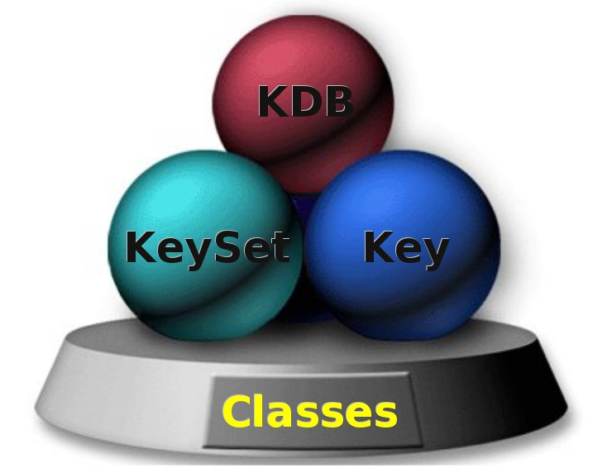
Data structures to be passed around
Allow passing around the key/value pairs
KDB: handle to key database
KeySet: holds together keys
Key: A single key/value with meta data
<Nummer>
Notes:
Althought it is pure C, it follows an Object Oriented design.
Elektra API is very simple, providing only 3 classes.
KDB, to access the key database
Key, as the entity for all key properties
KeySet, as a linked list of keys, for grouping and better handling
Speak out about more things you can do with the API based on the 2 pages located after the end of presentation.

Slide 14
Resolver Plugin
Responsible for OS-dependent functionality
  Resolves filename
  Detects conflicts: no changes on errors!
  Detects if updates needed: no change → no read!
file.ini
Resolver
Conflict? Update?
/home/markus/.config/file.ini
/etc/file.ini
<Nummer>

Slide 15

Storage Plugins
Dump
XML
Augeas:
  Hosts
  Fstab
INI
JSON
TCL
Line
CSV
Hosts
...
ksNew( 17 ,
keyNew
("user/fstab/rootfs",
KEY_TYPE,
KEY_TYPE_STRING,
KEY_END),
keyNew
("user/fstab/rootfs/device",
KEY_VALUE, "LABEL=/",
KEY_TYPE, KEY_TYPE_STRING,
KEY_END),
keyNew
("user/fstab/rootfs/type",
KEY_VALUE, "ext3",
KEY_TYPE, KEY_TYPE_STRING,
KEY_END),
KS_END);
kdbOpen 1
ksNew 3
keyNew 10 8
user/dumprootkey
keyEnd
keyNew 15 7
user/dump/key1value1
keyEnd
keyNew 15 7
user/dump/key2value2
keyEnd
ksEnd
<?xml version="1.0" encoding="UTF-8"?>
<keyset xmlns=""
xsi:schemaLocation=""
parent="user/env/alias">
<key basename="ls"
type="string"
value="ls -Fh"
<comment></comment>
</key>
<key basename="vnc"
type="string">
<value>vncserver
-geometry
900x650</value>
<comment></comment>
</key>
</keyset>
<Nummer>

Slide 16
Demo
Mounting of Plugins, Validation
<Nummer>
Notes:
Highlights about the Elektra API...

Slide 17
Software Integration
How can you integrate your technology or application?
<Nummer>
Notes:
Highlights about the Elektra API...

Slide 18
0. Define the Name (Hierarchy)
/sw/org/myapp/#0/current uses all of below
system namespace is stored below /etc/config/
user namespace is stored below ~$USER/.config/
dir namespace is for the current directory (.git like)
proc namespace is for the current process (cmdline)
spec namespace allows you to specify access
<Nummer>
Notes:
The key tree is as simple as possible, and we have only 2 trees:
system/
user/
The user/ tree is dynamic and it is an alias to the current user tree, which full name is user:$USER/....
Having this user:$USER name, one user can access other users configurations (if he'll have permissions for that).

Slide 19
1. Define the Value
Value is just a string, so we define in spec:
type of the key (e.g. int)
links so that keys of other applications are used instead
explanation for the key value
default value to be used if no value found
range allowed for the key e.g. min/max
interpretation of the value (e.g. units)
<Nummer>
Notes:
The key tree is as simple as possible, and we have only 2 trees:
system/
user/
The user/ tree is dynamic and it is an alias to the current user tree, which full name is user:$USER/....
Having this user:$USER name, one user can access other users configurations (if he'll have permissions for that).

Slide 20
2. Define your mountpoint's semantic
Key very simple: only Name and Value
Name of the key identifies the key uniquely
Root: User and System (Elektra 0.8)
Key names are hierarchical
Keys do not have constraints to be in a folder
Every key is independent
No FS-Semantics: No links or hidden keys
Plugins can change (5)-(7)
<Nummer>
Notes:
It is designed to Unix systems, by Unix guys, to Unix guys.
It can't be a solution only for some programs. It must be available anywhere, and has absolutely no dependencies.
Available to all systems, POSIX complient, Unicode, so then it can be used in all platforms by cross-platform software.
Elektra is stupid software by design. Otherwise it would be an endless project.
Security is handled like this: “Security is not my business. Is Kernel's”
Deamons are single point of failures and performance bottlenecks.
Unix sysadmins need vi, grep, etc for living.

Slide 21

4. Use or write bindings
Available
  C
  C++
  Shell
  Python
  Lua
  Java
To be reintroduced
  JS (soon)
  Haskell
  Scheme
  Ruby
<Nummer>
Notes:
Thanks to a strong ecosystem, you can already develop in these other languages.
If you are fluent in some other languge, please write and contribute Elektra bindings to it.

Slide 22
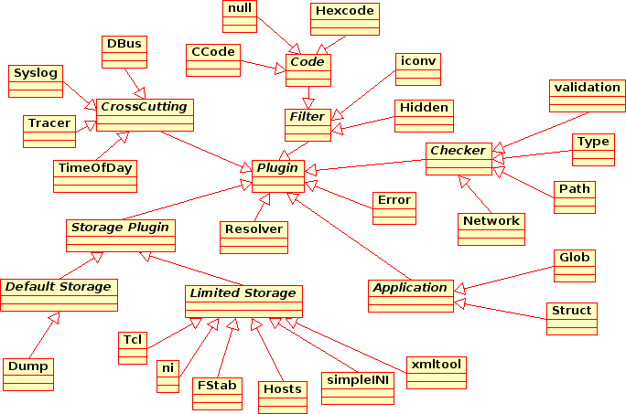
5. Use or write Plugins
Recently added:
Calculate
CVS
Validators
JSON
Rebase
C-Export
<Nummer>

Slide 23
Demo
Actually all applications already use Elektra... (getenv)
+ elektrify in 5 min
<Nummer>
Notes:
Hide the presentation and show some things:
The kdb command
Editing with “kdb edit” with different editors
Regedit
“kdb monitor”
NSS plugin with the users and groups database

Slide 24
Conclusion
Markus Raab <elektra@markus-raab.org>
<Nummer>
Notes:
This presentation takes about 20 minutes for me.
Umfrage: Wer hat unter Linux eine Konfigurationsdatei editiert?
Wer hat schon mit Programmen Konfiguration verändert?
Wer hat schon Elektra verwendet?

Slide 25
The kdb Command
$ kdb get system/filesystems/boot/mpoint
# kdb set system/sw/xorg/Screen/Display/Modes 1280x1024
$ kdb ls system/sw/myapp
$ kdb rm user/env/alias/vnc
Help in administrative work
Perfect for scripts
Can be used during package installation/upgrades
<Nummer>
Notes:
These are the things you can do with the kdb command. Some really cool ones are:
Create a key that is a symbolic link to another key
Monitor changes on keys
Edit many keys in one shot, with any editor
XML import and export
kdb is perfect for Shell scripts.

Slide 26

Syntax independence
You can use any editor
You can use any syntax or fileformat to edit keys
It is possible to add, remove and delete keys.
<Nummer>
Notes:
Another supercool feature: Edit many keys in batch, represented as an XML document.
As you can see, we can use the editor we want, from simples vi, to even a true XML editor.

Slide 27
Import, Export and Convert
$ kdb export user/env/alias > file.xml
$ kdb import file.xml
$ kdb convert file.xml file.ini
<?xml version="1.0" encoding="UTF-8"?>
<!-- Output of a 'kdb export user/env/alias' command -->
<keyset xmlns="http://www.libelektra.org"
xsi:schemaLocation="http://www.libelektra.org elektra.xsd"
parent="user/env/alias">
<key basename="ls"
type="string" uid="aviram" gid="aviram" mode="0664"
value="ls -Fh --color=auto"
<comment>Make 'ls' command more cleaver</comment>
</key>
<key basename="vnc"
type="string" uid="aviram" gid="aviram" mode="0664">
<value>vncserver -geometry 900x650</value>
<comment>Instant creation of a VNC server</comment>
</key>
</keyset>
<Nummer>
Notes:
One supercool kdb feature is to let you import and export to a standarized XML.
This is usefull for
Transfering entire program's keys from one machine to another
Make backups
Package default configurations that will be imported at package installation time (as a post script)
Edit them with XML editors
kdb XML support was implemented to handle Unicode and different charsets. Actually, Elektra was implemented with this issue in mind.

Slide 28
Technology Integration
App
App
Gnome platform
with GSettings
KDE platform
with KConfig XT
Elektra's Datastructures
DBus
DConf
KConfig
XDG
ini
/etc
Xorg
XML
JSON
<Nummer>
Notes:
Dieses Problem ist natürlich schon länger bekannt. Deshalb gibt es unter Linux/BSD/Unix sehr gute Insellösungen für verschiedene Plattformen und Desktopumgebungen.
Was fehlt ist die Integration untereinander und der Zugriff auf andere Konfiguration.

Slide 29
Configuration Managment
Puppet
Chef
Use for node configuration
System Configuration Manage-ment Tools on top of it
Benefit from known Semantics and Types of underlying system
CFEngine
Global Node
Configuration
Global Node
Configuration
App A
App B
App C
App A
App B
App C
<Nummer>
Notes:
Wie wollen wir dort hin kommen?
The elektrification process of any software consists of 2 steps
Reorganizing its configuration atoms into an Hierachie of key/value pairs
Rewriting its configuration retrieval modules using the Elektra standard API.

Slide 30
Handling of Cross-Cutting-Concerns
  Logging (Syslog)
Aug 31 10:25:05 markusbyte elektra[4149]:
committed configuration user/syslog with 1 keys
Aug 31 10:25:14 markusbyte elektra[4150]:
committed configuration user/syslog with 2 keys
  Notification (D-Bus)
signal sender=:1.9 -> path=/org/libelektra/configuration;
interface=org.libelektra; member=changed
<Nummer>
Notes:
Es gibt viele Situationen in denen man Plugins verwenden kann.

Slide 31
Validate Configuration Values
  Validation
# kdb set system/sw/xorg/Screen/Display/Modes 12y80x1024
Could not validate “12y80x1024”, needed [0-9]+x[0-9]+
Network
$ kdb set user/hosts/hostname 192.168.0.x
Value of key is not a valid IP Address
Name or service not known
Filename
$ kdb set user/fstab/rootfs/device /dev/none
Warning: No such file or directory from key:
user/fstab/rootfs/device with path: /dev/none
<Nummer>
Notes:
Es gibt viele Situationen in denen man Plugins verwenden kann.

Slide 32
Type Checker
LABEL=stable / jfs defaults,errors=remount-ro 0 1
proc /proc proc defaults 0 0
LABEL=swap none swap sw 0 0
LABEL=home /home jfs rw,suid,dev,exec,auto,nouser 0 2
/etc/fstab does not accept everything
Checks value of an key
Basic CORBA Typesystem
Min/Max
enum FSType {fat,ntfs,ext2,jfs,proc,swap};
string
unsigned_short [5..20]
<Nummer>
Notes:
Alle Möglichkeiten Konfiguration zu speichern haben gewisse syntaktische und semantische Restriktionen was gespeichert werden kann.
Z.b. /etc/fstab akzeptiert nur bestimmte Werte in den Spalten. Aber die Einträge an sich müssen vorhanden sein.
CORBA IDL ist eine Möglichkeit diesen Typ zu beschreiben, es gibt aber auch andere. Offen ist auch die Frage ob Plugins dadurch allgemein beschreiben können was sie akzeptieren bzw. Wo die Grenzen verlaufen.

Slide 33
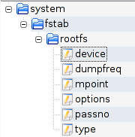
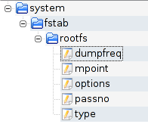
Validate Configuration Structure
LABEL=stable / jfs defaults,errors=remount-ro 0 1
proc /proc proc defaults 0 0
LABEL=swap none swap sw 0 0
LABEL=home /home jfs rw,suid,dev,exec,auto,nouser 0 2
struct FStab {
string device;
string mpoint;
FSType type;
string options;
unsigned_short dumpfreq;
unsigned_short passno;
};
Struct
list <FStab>
Änderungen
  Some entries must/must not be available
<Nummer>
Notes:
Alle Möglichkeiten Konfiguration zu speichern haben gewisse syntaktische und semantische Restriktionen was gespeichert werden kann.
Z.b. /etc/fstab akzeptiert nur bestimmte Werte in den Spalten. Aber die Einträge an sich müssen vorhanden sein.
CORBA IDL ist eine Möglichkeit diesen Typ zu beschreiben, es gibt aber auch andere. Offen ist auch die Frage ob Plugins dadurch allgemein beschreiben können was sie akzeptieren bzw. Wo die Grenzen verlaufen.

Slide 34
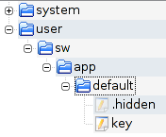
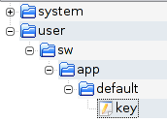
Batteries included
  Character Reduction
kdb set set user/ccode/key "'val x'"
in storage: \'val\tx\'
kdb set user/hexcode/key value=abc xyz
in storage: value%3Dabc%20xyz
  Iconv
  Application Specific Concerns
Hidden
Keys
<Nummer>

Slide 35



Who uses Elektra? What are the targets?
  Embedded Systems
  Cross Plattform Software (Desktop)
Oyranos
  Administrators (Servers)
<Nummer>
Notes:
Es gibt viele Situationen in denen man Plugins verwenden kann.

Slide 36
Roadmap
Guaranteed steady development for next years
Multiple Thesis are written on that topic
0.8 stable Releases in 2 month cycle
0.9 will be development version with ABI/API breakage (when it is needed) for 1.0 dev
Many ideas for plugins can be found in doc/todo
0.8.5
0.8.6
0.8.*
0.9.*
0.8.*
0.9.*
Feb2014
Apr2014
Master (0.8)
Development (0.9, API breakage)
<Nummer>

Slide 37
The End
Thank you for your attention!
Questions?
Markus Raab <elektra@markus-raab.org>
<Nummer>

Slide 38
Resources
Homepage: http://www.libelektra.org
Docu: http://doc.libelektra.org/api/current/html/
Build-Server: http://community.libelektra.org:8080/
Mailing Liste: registry-list@sf.net
<Nummer>

