Slide 1
Unanticipated Context Awareness for Software Configuration Access using the getenv API
Markus Raab
Vienna University of Technology
Institute of Computer Languages, Austria
Email: markus.raab@complang.tuwien.ac.at
Notes:
<Nummer>

Slide 2

Outline
Motivation
  Background
  Goals
  Research Questions
EnvElektra
Evaluation
  Contributions
  Benchmarks
Conclusion
Elektra's Logo

Slide 3

Example
mobile device
many contexts
  location
    inmeeting
    outdoor
    inpocket
desired behavior depends on context
context often not considered
  (although it is available by sensors)

Slide 4

Context-Oriented Programming: Layers
originates from object-oriented programming
layers represents context
can be activated anywhere in the program
  dynamic scope
many layers
can be active
name of layer
void rcvPhoneCall () {
e.context().with()<Location>()([&]{
vibrate();
});
// vibrate();
}
part of dynamic scope

Slide 5


Contextual Values
“trivial generalization of thread-local values” with layers
use dynamic scoping as in context-oriented programming
use and access performance identical to variables
void visit (Person & p) {
p.context().with()<Location>()([&]{
cout << “visit “ << ++ p.visits
<< “in” p.greeting;
});
cout << p.greeting;
}
Griaß enk
Different Context
今日は

Slide 6
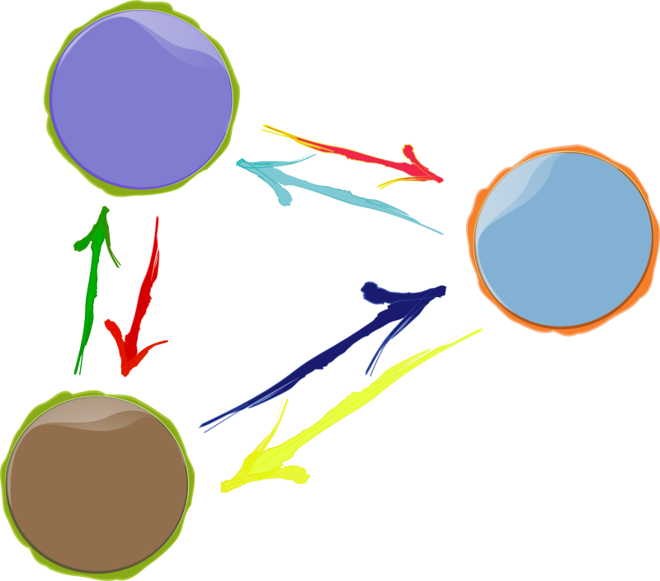
Goals
Context-Aware
  e.g. location
Customizable
  adapt to user
Reuse
  use unmodified applications
Notes:
Why is multi-core a problem?

Slide 7
Research Questions
RQ1: What are the usage patterns of getenv() in
popular applications?
RQ2: For which applications can we actually exploit getenv() to be used for unanticipated context awareness? What are the fundamental limitations?
RQ3: What is the overhead that occurs in a system
using EnvElektra?

Slide 8
EnvElektra
Notes:
<Nummer>
We finished Introduction
CoElektra is the projects name?
Contributions

Slide 9
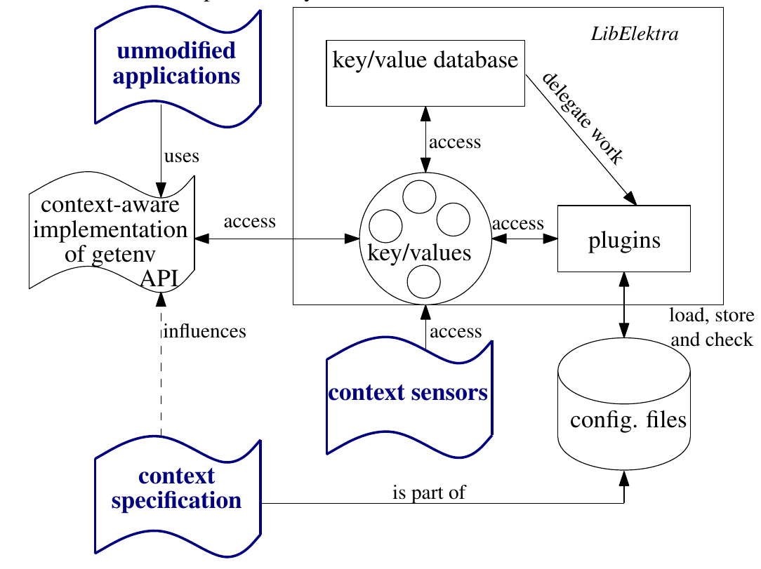
Architecture

Slide 10


Context Specification
within configuration
getenv(“vibration”)
Context Specification:
  /: denotes hierarchy of contextual values
needed for customization
  initialize and persist every contextual value
[/env/vibration]
type=boolean
Notes:
Explanation: Last Part of title

Slide 11
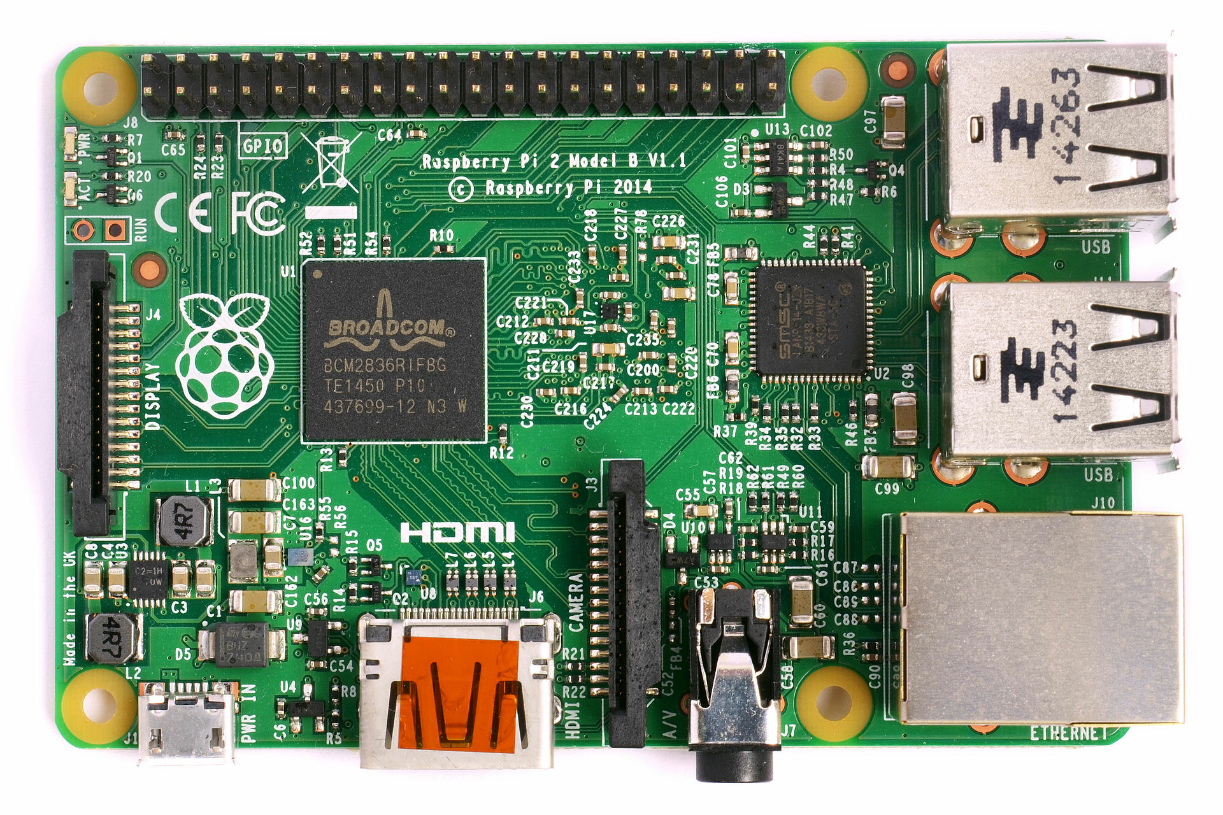

Contextual Lookup
Context Specification:
  %: placeholders for layers
adaptable configuration
[/env/vibration]
type=boolean
context=/phone/call/%location%/vibration
/phone/call/inmeeting/vibration = off
/phone/call/outdoor/vibration = off
/phone/call/inpocket/vibration = on

Slide 12
Evaluation
Notes:
<Nummer>
We finished Introduction
CoElektra is the projects name?
Contributions

Slide 13

Case Studies
applied EnvElektra on 15 applications/systems
works very well if:
  getenv() is called often (also indirectly)
  external applications are executed
needs restart otherwise
examples:
  proxy for browsers/wget/curl
  gimp open/help
  UNIX man utiliy

Slide 14
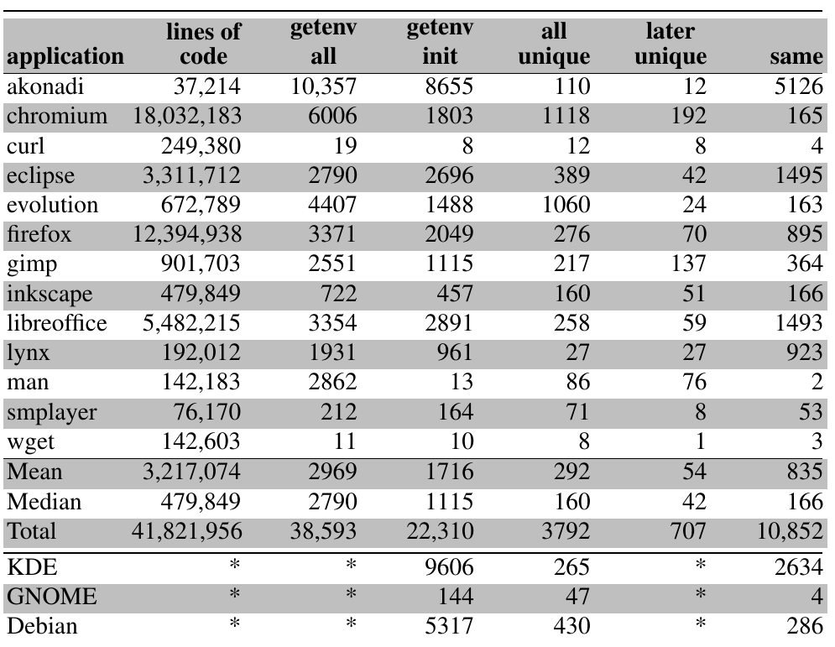
Usage Patterns

Slide 15

Overhead
without run-time changes 2.6% (gimp)
to 14% (compilation)
curl http-proxy-transition
  dynamic reload 10%
  per-change 4%

Slide 16
Source Code
source code released as free software within Elektra
  >60 predefined plugins
  support for hundreds kinds of configuration files
  specification is also configuration (e.g. in XML, JSON)
http://www.libelektra.org
  version 0.8.17 released at 14. June 2016

Slide 17
Conclusion
context-awareness without modifications
getenv used pervasive
external context specification
evaluation
  can be exploited in many cases
  acceptable overhead
Markus Raab
Vienna University of Technology
Institute of Computer Languages, Austria
Email: markus.raab@complang.tuwien.ac.at
http://elektra.limequery.org/625192

Slide 18
Thank you for your attention!
Markus Raab
Vienna University of Technology
Institute of Computer Languages, Austria
Email: markus.raab@complang.tuwien.ac.at
Notes:
<Nummer>

Slide 19
Benchmark Setup
Laptop: hp ® EliteBook 8570w ™
  CPU Intel ® Core i7-3740QM @ 2.70GHz
  7939 MB Ram
GNU/Linux Debian Wheezy 7.5
gcc compiler Debian 4.7.2-5
  with the options -std=c++11, -O2
measured the time using gettimeofday
Median of eleven executions

Slide 20
Related Work
context variables (check on every usage)
M. von Löwis, M. Denker, and O. Nierstrasz, “Context-oriented
programming: Beyond layers,” in Proceedings of the 2007 International Conference on Dynamic Languages
ensure-active-layers (global layer activation)
P. Costanza, R. Hirschfeld, and W. De Meuter, “Efficient layer activation for switching context-dependent behavior,” in Modular Programming Languages
partial evaluation avoids usage of libxml2
M. Jung, R. Laue, and S. A. Huss, “A case study on partial evaluation
in embedded software design,” in SEUS 2005
hybrid mediator-observer pattern
O. Riva, C. di Flora, S. Russo, and K. Raatikainen, “Unearthing design patterns to support context-awareness,” in Pervasive Computing and Communications Workshops

Slide 21

Specification
C-Code
(e.g. option parsing)
Specification
C++-Code
generate
provides
Docu,
Manuals,
GUIs
Persistence
get value derived
from env
Runtime Checks
Validation
Upgrades
Integration
Contextual
Values
Connection
/%/%/%/person/greeting=Hi!
/German/%/%/person/greeting=Guten Tag!
/German/Austria/%/person/greeting=Servus!
/German/Austria/t/person/greeting=Griaß enk!

