Slide 1
Persistent Contextual Values as Inter-process Layers
Markus Raab
Vienna University of Technology
Institute of Computer Languages, Austria
Email: markus.raab@complang.tuwien.ac.at
Notes:
<Nummer>

Slide 2
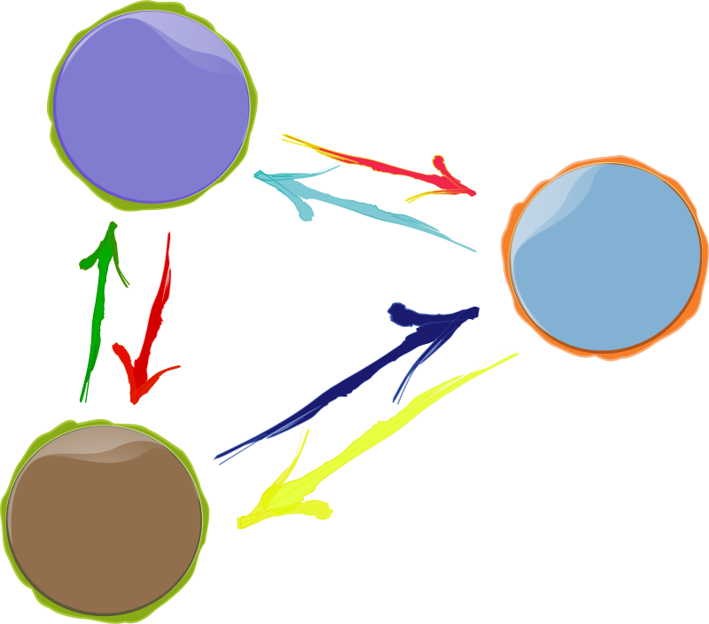
Goals
Context-aware
  e.g. battery status
Customizable
  adapt to user
Mobile
  consistent context changes across apps
  performance/battery life
Notes:
Why is multi-core a problem?

Slide 3

Context-Oriented Programming
originates from object-oriented programming
layers represents context
can be activated anywhere in the program
  dynamic scope
many layers
can be active
name of layer
void rcvPhoneCall () {
e.context().with()<PhoneCall>()([&]{
vibrate();
});
}
Part of dynamic Scope

Slide 4
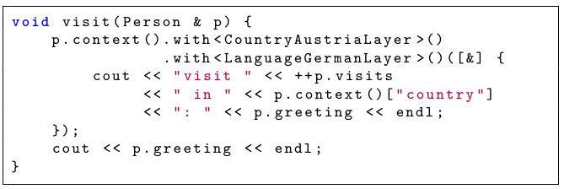


Contextual Values
“Trivial generalization of thread-local values”
layers and dynamic scoping as in context-oriented programming
access performance and usage identical to variables
“Griaß enk!”
Different Context,
Same Thread
“Hallo!”

Slide 5


Program Execution Environment
consists of: Configuration Files, Commandline Arguments, ...
Program Execution Env. is defined using a specification
  /: denotes hierarchy of contextual values
  %: placeholders for layers
needed for customization
  initialize and persist every contextual value
[/%language%/%country%/%dialect%/person/greeting]
type=String
[/%country%/person/visits]
type=Integer
default=0
[/%location%/country]
type=String
Notes:
Explanation: Last Part of title

Slide 6
Problem
no synchronization between processes
dependencies between activations
implementation of layer tedious
class PhoneCall
{ ??? };
void rcvPhoneCall () {
e.context().with()<PhoneCall>()([&]{
vibrate();
});
// vibrate();
}

Slide 7

Elektra
Notes:
<Nummer>
We finished Introduction
CoElektra is the projects name?
Contributions

Slide 8

Usage
Contribution with Elektra
Code
Generator
Persistent
Contextual
Values (=Layers)
generates
uses
Specification
Code
runs on
Written by User

Slide 9
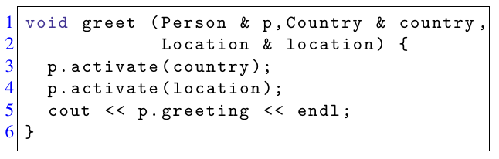
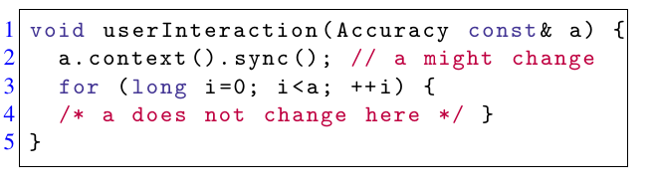
Solution
directly activate CVs (every CV works as layer!)
sync CVs between processes

Slide 10
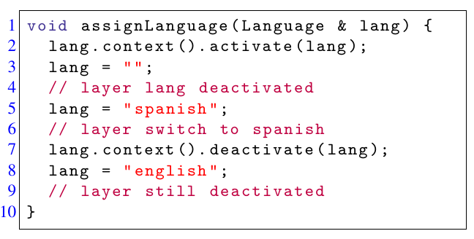
Activation via Assignment
assignments on CVs trigger layer activations
sync triggers all necessary assignments
implication: we do not need extra layers anymore

Slide 11
Evaluation
Notes:
<Nummer>

Slide 12
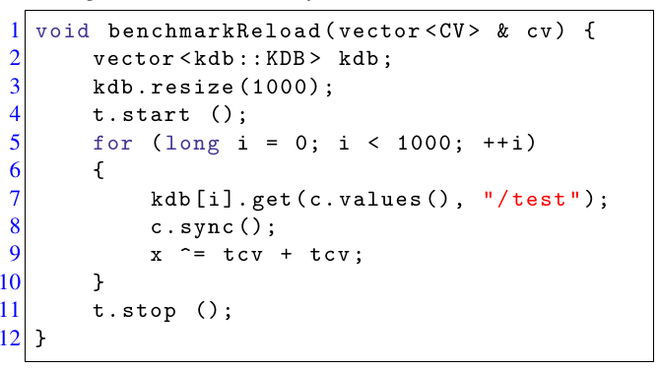
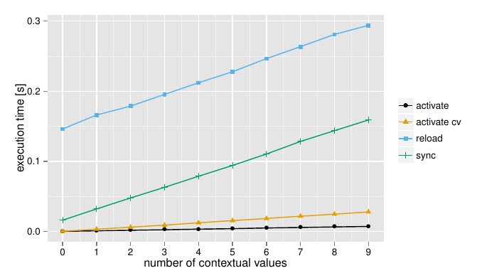
Benchmark
access: no overhead
4 benchmarks

Slide 13
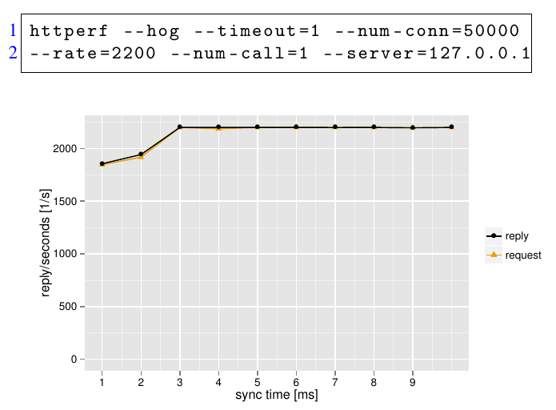
Case Study Webserver

Slide 14
Source Code
Source Code released as free software within Elektra
  >70 predefined plugins
  support for hundreds kinds of configuration files
  integrate standard software
  specification is configuration (e.g. in XML, JSON)
http://www.libelektra.org
  version 0.8.18 released at 2016-09-16

Slide 15
Conclusion
combination of performance, context awareness and customization
CVs with code generation in multi-threaded and multi-process applications
CVs can be shared across applications
implementation is free software and can be downloaded from http://www.libelektra.org
supports mobile development in C++, Java, and more
benchmark: overhead increases linearly with CVs
case study: only with dominant layer activations performance decreases

Slide 16
Thank you for your attention!
Markus Raab
Vienna University of Technology
Institute of Computer Languages, Austria
Email: markus.raab@complang.tuwien.ac.at
Notes:
<Nummer>

Slide 17

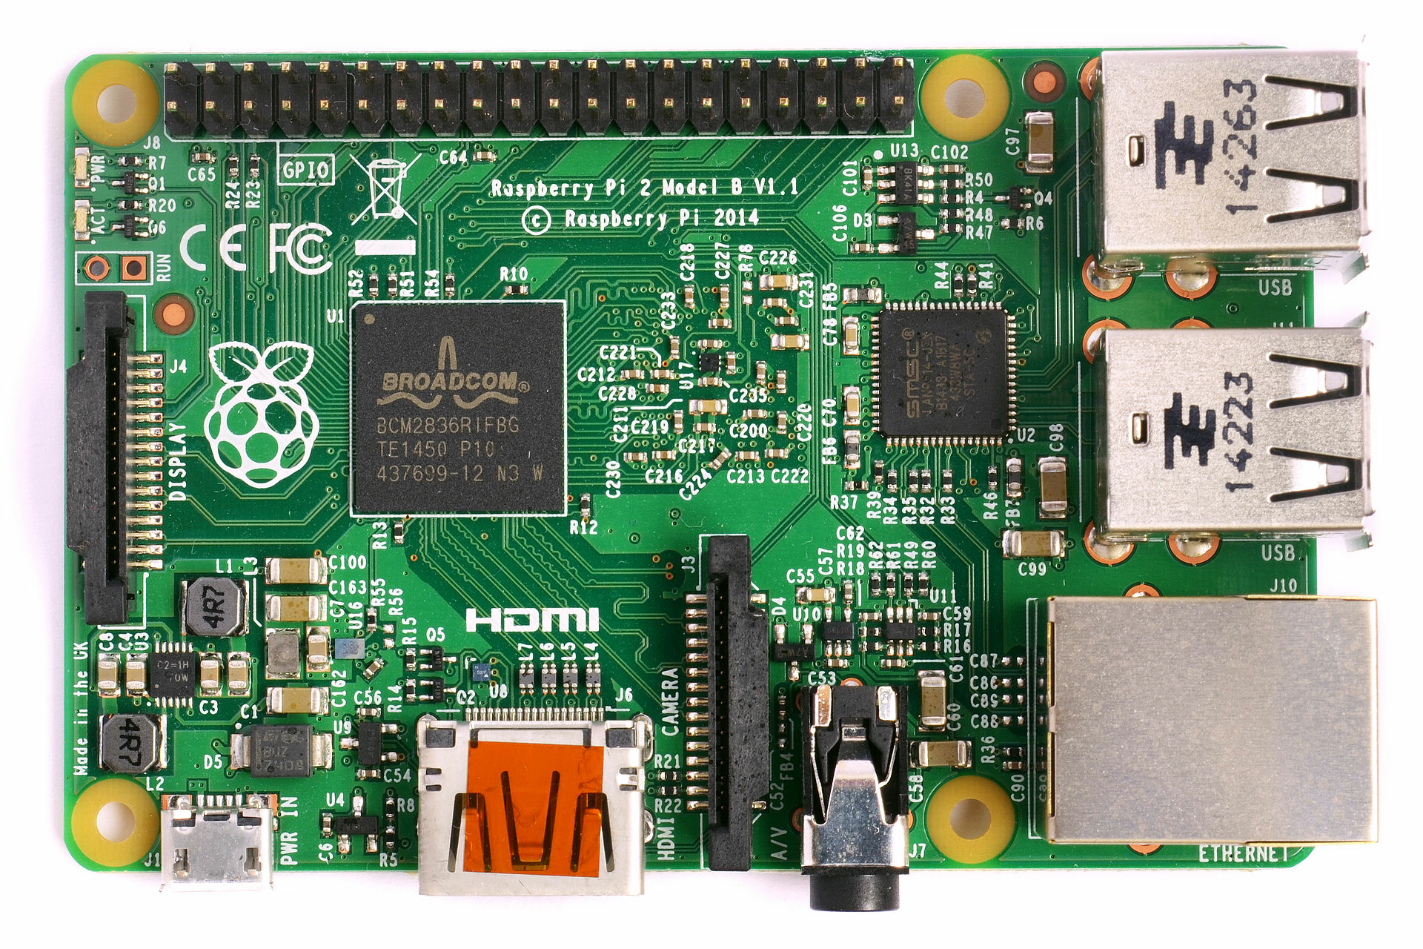
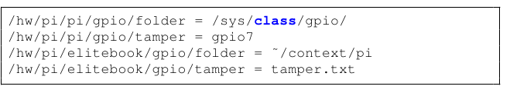
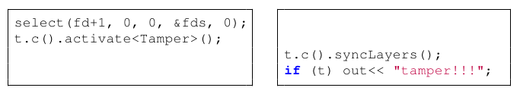
Example: Hardware Abstraction
hardware as context
layer activations for sensor states
(this is a configuration file, not a specification!
But they are both part of Program Execution Environment)

Slide 18
Benchmark Setup
hp ® EliteBook 8570w ™
  CPU Intel ® Core i7-3740QM @ 2.70GHz
  7939 MB Ram
GNU/Linux Debian Jessy 8.4
gcc compiler Debian 4.9.2-10
  with the options -std=c++11, -O2
measured the time using gettimeofday
median of eleven executions

Slide 19
Some Related Work
context variables (check on every usage)
M. von Löwis, M. Denker, and O. Nierstrasz, “Context-oriented
programming: Beyond layers,” in Proceedings of the 2007 International Conference on Dynamic Languages
ensure-active-layers (global layer activation)
P. Costanza, R. Hirschfeld, and W. De Meuter, “Efficient layer activation for switching context-dependent behavior,” in Modular Programming Languages
partial evaluation avoids usage of libxml2
M. Jung, R. Laue, and S. A. Huss, “A case study on partial evaluation
in embedded software design,” in SEUS 2005
hybrid mediator-observer pattern
O. Riva, C. di Flora, S. Russo, and K. Raatikainen, “Unearthing design patterns to support context-awareness,” in Pervasive Computing and Communications Workshops

Slide 20




Example: Battery low
Thread 1
Thread 2

Slide 21

Big Picture
C-Code
(e.g. option parsing)
Specification
C++-Code
generate
provides
Docu,
Manuals,
GUIs
Persistence
get value derived
from env
Runtime Checks
Validation
Upgrades
Integration
Contextual
Values
Connection
/%/%/%/person/greeting=Hi!
/German/%/%/person/greeting=Guten Tag!
/German/Austria/%/person/greeting=Servus!
/German/Austria/t/person/greeting=Griaß enk!

