Slide 1
ROS Concepts
PhD Student:
Daniele Caradonna
Lesson for RO course of Prof. Fagiolini.

Slide 2
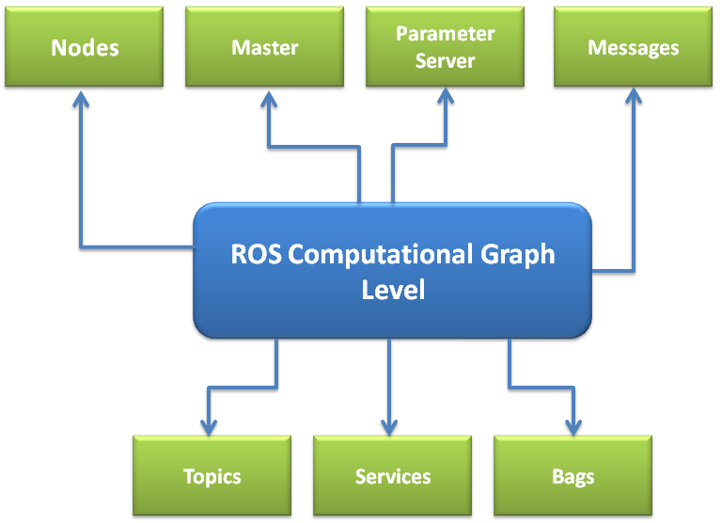
ROS Computation Graph
The computation in ROS is done using a network of a process called ROS Nodes.
This computation network can be called the Computation Graph.
The main concepts in the computation graph are:
Nodes
Master
Parameter Server
Messages
Topics
Services
Bags

Slide 3
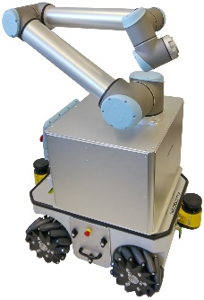
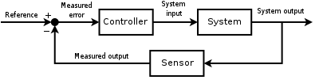
ROS Nodes
ROS Nodes are the process that perform computation. Each ROS Node is written using ROS client libraries, that implement different ROS functionalities, such as the communication methods. Using ROS communication methods, Nodes can communicate each other and exchange data. For this reason, it is strongly recommended to build different and simple nodes instead than a single and complex application.
This peculiarity makes the robot application easy to debug and robust to node crashes.
ROS Nodes are usually written in C++ and Python language. Thanks to modularity of ROS, a robot application can be composed by different nodes written in different languages.
From control theory to software implementation:
Sensor Nodes
camera
motors
control_node
IMU
encoders
filtered_data
sensor_fusion_node
sensor_data

Slide 4
ROS Messages
ROS Messages are data structures containing the typed field, which can hold a set of data and that can be sent to another node. The ROS messages supports standard primitive datatypes (int, float, ecc.) and array of primitive types. Furthermore, many useful messages for Robotics have been developed, like quaternion or sensor-specific msgs (Imu, Encoder, Camera, etc.).
Primitive Type | Serialization | C++
bool (1) | unsigned 8-bit int | uint8_t (2)
int8 | signed 8-bit int | int8_t
uint8 | unsigned 8-bit int | uint8_t
int16 | signed 16-bit int | int16_t
uint16 | unsigned 16-bit int | uint16_t
int32 | signed 32-bit int | int32_t
uint32 | unsigned 32-bit int | uint32_t
int64 | signed 64-bit int | int64_t
uint64 | unsigned 64-bit int | uint64_t
float32 | 32-bit IEEE float | float
float64 | 64-bit IEEE float | double
string | ascii string (4) | std::string
time | secs/nsecs unsigned 32-bit ints | ros::Time
duration | secs/nsecs signed 32-bit ints | ros::Duration
Table of Primitive Types implemented in ROS msgs.

Slide 5
ROS Topics
Each message in ROS is transported using named buses called ROS Topics. When a node sends/receives a message through a topic, then we can say the node is publishing/subscribing a topic.
Topics can anonymously publish and subscribe. The ROS Nodes are not interested in knowing which node is publishing the topic or subscribing topics: production and consumption of messages are decoupled (asynchronous comm.). The communication using ROS Topics is unidirectional, typically used for a continous flow of data, like sensors.
Sensor Nodes
camera
/camera
/motor_com
In the previous example, we can use ROS Topics for the communication of our Nodes.
control_node
IMU
/imu
encoders
/encoder
/filtered_data
sensor_fusion_node

Slide 6
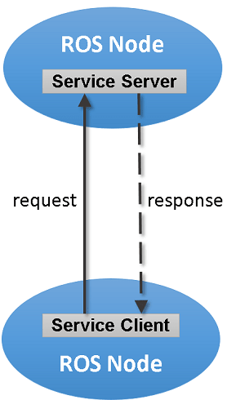
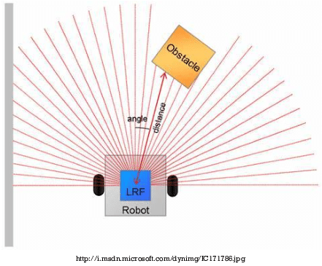
ROS Services
When we want a synchronous communication, we have to use ROS Services that implement a request/response communication. The ROS Services are mainly used in a distributed system. In ROS Services, one node acts as a ROS server in which the service client can request the service from the server. If the server completes the service routine, it will send the results to the service client.
Simple Robotic Applications:
Stopping after a obstacle is detected
planner_node
stop_motor
stop_confirm
obstacle_detector

Slide 7


ROS Services
When we want a synchronous communication, we have to use ROS Services that implement a request/response communication. The ROS Services are mainly used in a distributed system. In ROS Services, one node acts as a ROS server in which the service client can request the service from the server. If the server completes the service routine, it will send the results to the service client.
Simple Robotic Applications:
Important note on ROS Services: The reqeust/responde communication is blocking for your code. Use ROS Services only for rapid computation or discrete events!
Assignement of tasks in a distribuited robotic system:
leader
Position
Position
Leader
Task
Task
…
position
task
robot_1
Robot #1
Robot #2
Robot #3
Robot #4

Slide 8
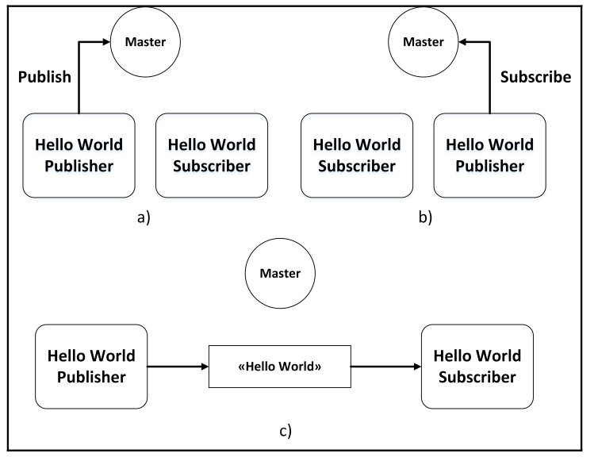
ROS Master and Parameter Server
The ROS Master provides the name registration and lookup to the rest of the nodes. Nodes will not be able to find each other, exchange messages or invoke services without ROS Master. In a distributed system, we should run the master on one computer and other remote nodes (ex. robots) can communicate each other thanks with this master.
When a node starts publishing a topic, the node will give the details of the topic, such as name and data type, to the ROS Master. The ROS Master will check whether any other nodes are subscribed to the same topic. If any nodes are subscribed to the same topic, the ROS Master will share the node details of the publisher to the subscriber node. After connecting to the two nodes, the ROS Master has no role in controlling them. If we stop any nodes, it will check with the ROS Master once again. This same method is used for the ROS services.
Communication between ROS Master and Hello World publisher and subscriber.

Slide 9
ROS Master and Parameter Server
The Parameter Server allows to keep the data to be stored in a central location It is a shared server in which all ROS nodes can access/modify parameters from this server. This is a useful tool expecially in robotics applications, that use a lot of parameters (a.e. controller gains, geometrical parameters of the robot, calibration data, etc.).
We can use also the YAML file to save the parameters contained in ROS Parameter Server. A YAML file can be also used to load parameters in ROS Parameter Server.
Looking the previous example, we could need to these parameters:
camera:
width: 720
length: 430
fps: 60
…
wheel_radius: 0,05
…
PID:
k_p: 5,3
k_i: 0,2
k_d: 0,04
Sensor Nodes
camera
/camera
/motor_com
An example of YAML file. This file stores a possible set of parameters for the robot represented in the previous example.
control_node
IMU
encoders
/filtered_data
sensor_fusion_node

Slide 10
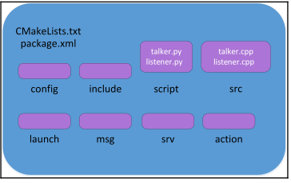
ROS Bags
ROS provides a logging system for storing data, such as sensor data, which can be difficult to collect but is necessary for developing and testing robot algorithms: the bagfiles. ROS bags can store ROS messages from topics and services.
ROS Packages
ROS packages are the most basic unit of ROS software. They can contain one or more ROS nodes, libraries, parameters and also message and service definitions.
config: This folder contains configuration files, like YAML files.
include: This folder contains headers and libraries.
src: This folder contains the source code of C++ Nodes.
scripts: This folder contains the executable of Python Nodes.
Launch: This folder contains the launch files that are used to launch one or more nodes.
msg: Custom messages definitions.
srv: Custom services definitions.
package.xml: It’s the package manifest, that contains information about package, author, license, dependencies and so on.
CMakeLists.txt: This files contains the directives to compile the package.
Structure of a typical ROS pkg.

Slide 11
Useful commands
A summary scheme of useful commands for the ROS Concepts. These commands have to be typed in your terminal.
ROS Nodes:
$ rosnode info [node_name] : This will print the information about the node.
$ rosnode kill [node_name] : This will kill a running node.
$ rosnode list : This will list the running nodes
$ rosnode machine [machine_name] : This will list the nodes running on a particular machine or a list of machines.
$ rosnode ping : This will check the connectivity of a node.
$ rosnode cleanup : This will purge the registration of unreachable nodes.
ROS topics:
$ rostopic echo /topic: This command will print the content of the given topic in a human readable format. Users can use the "-p" option to print data in a csv format.
$ rostopic find /message_type: This command will find topics using the given message type.
$ rostopic hz /topic: This command will display the publishing rate of the given topic.
$ rostopic info /topic: This command will print information about an active topic.
$ rostopic list: This command will list all active topics in the ROS system.
$ rostopic pub /topic message_type args: This command can be used to publish a value to a topic with a message type.
$ rostopic type /topic: This will display the message type of the given topic
ROS msgs:
$ rosmsg show [message] : This shows the message description.
$ rosmsg list : This lists all messages.
$ rosmsg package [package_name] : This lists messages in a package.

Slide 12
Useful commands
A summary scheme of useful commands for the ROS Concepts. These commands have to be typed in your terminal.
ROS Services:
$ rosservice call /service args: This tool will call the service using the given arguments.
$ rosservice find service_type: This command will find services in the given service type.
$ rosservice info /services: This will print information about the given service.
$ rosservice list: This command will list the active services running on the system.
$ rosservice type /service: This command will print the service type of a given service.
ROS Parameters:
$ rosparam set [parameter_name] [value]: This command will set a value in the given parameter.
$ rosparam get [parameter_name]: This command will retrieve a value from the given parameter.
$ rosparam load [YAML file]: The ROS parameters can be saved into a YAML file and it can load to the parameter server using this command.
$ rosparam dump [YAML file]: This command will dump the existing ROS parameters to a YAML file.
$ rosparam delete [parameter_name]: This command will delete the given parameter.
$ rosparam list: This command will list existing parameter names.
ROS bags:
$ rosbag record [topic_1] [topic_2] -o [bag_name]: This command will record the given topics into a bag file that is given in the command. We can also record all topics using the -a argument.
$ rosbag play [bag_name]: This will playback the existing bag file.

Slide 13
OK, let’s code!

