Slide 1
Designing and Testing Asynchronous FIFO Queues
Tommy Levi and Ilya Lipovan
Date: April 26, 2024
Bar-Ilan University

Slide 2
Purpose of the paper
Implementing an asynchronous FIFO queue to solve Clock Domain Crossing (CDC) synchronization problems.
Show that the system is metastability containing with metastable inputs
Verifying for metastability containing for calculations correctness of the addresses of read and write pointers

Slide 3
What are FIFO Queues?
A type of data structure used in computing for managing data elements where the order of processing is strictly based on their arrival times.
The first element to enter the queue is the first to be processed and removed.
One of the most basic data structures.

Slide 4
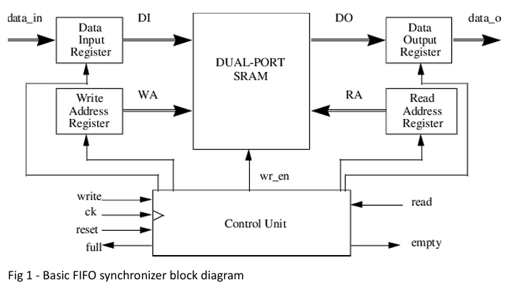
FIFO Queues in Digital Systems
A FIFO queue is used as an intermediate between two systems with different clock rates.
Because the rates are different, for the data to transfer from one system to enter the other it needs to be synchronized.
In our paper – Dual port memory FIFO Queue with 2 controllers (READ/WRITE)

Slide 5

Challenges of Asynchronous FIFO
The FIFO is a dual port memory with two pointers each used by read and write domain: read pointer and write pointer.
The pointers themselves are in two different clock domains, two calculation units that communicate between each other are placed in each domain.
If the communication between the two controllers were just simple wire – their will be a problem!
Metastability in the communication between the read control pointer unit and write control pointer unit.
The solution: Using synchronizers and gray code calculations.

Slide 6
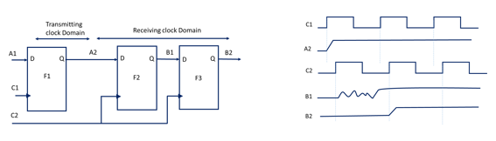
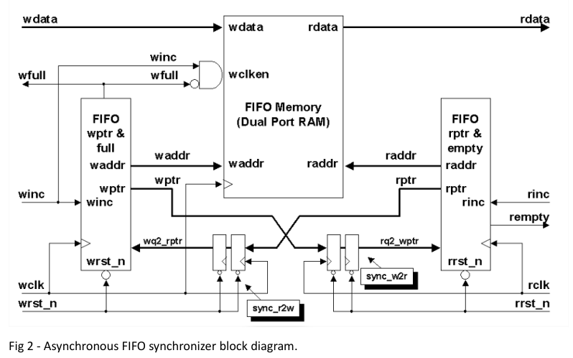
Handling Metastability in Design
Pointer Synchronization: Ensures safe transfer of pointer values across clock domains using synchronization registers.
Gray Coding: Reduces synchronization errors by ensuring only one bit changes at a time, minimizing metastable states inside the controllers.

Slide 7
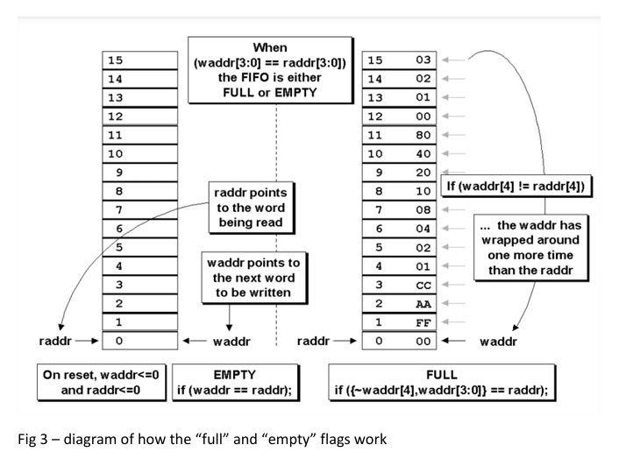
Design Principles of Asynchronous FIFO Queues
Memory Structure: Circular buffer efficiently utilizes space, managed by pointers tracking the positions of the queue's head and tail.
Control Logic: Manages write and read operations to ensure data integrity and prevent overwriting or premature reading.

Slide 8
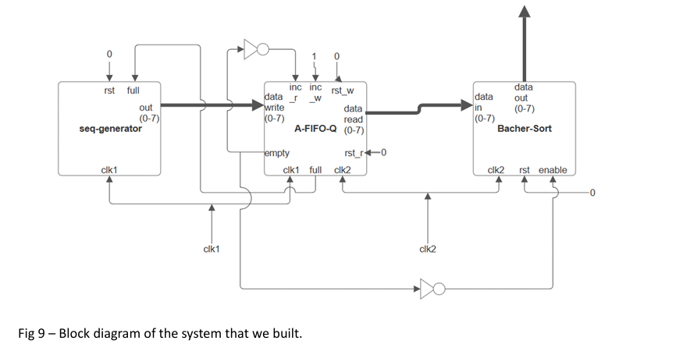
Experiment Setup
Divided to 3 systems:
Sequence Generator: Produces 8-bit data with potential metastable bits. (A.K.A – “manufacturer”)
Asynchronous FIFO Queue: Manages data, handling metastable inputs. (A.K.A – “mediator”)
Pipelined Batcher Sorting Network: Sorts data using a bitonic sorting network, handling inputs correctly even if metastable. (A.K.A – “consumer”).

Slide 9

Testing and Results
Simulated scenarios with and without metastable inputs to assess system behavior.
Confirmed importance of Gray coding in maintaining system function and preventing data corruption.
We found how metastability may affect synchronization and CDC

Slide 10
Conclusion
The system demonstrates robustness against metastability through careful design and the use of Gray coding and Synchronizers
Findings emphasize the critical role of proper pointer calculations using Gray code and synchronization techniques in Asynchronous FIFO design.
The system can solve CDC synchronization problems efficiently.

Slide 11
References and Resources
List of cited works and links to additional resources is in the paper.

