Slide 1
Web Server Nodes
(operating on ports such as /80, /443, /8xxx)
OR
Internet
Single Node
(with a single process simulating
the entire internet interactions)
DNS Node:
Holds a dictionary of domain names for routing to the simulated internet above.
Web Client (malicious):
- Traffic is following a
Poisson distribution
- Requests are going
through the DNS node
- Logged side-effects
labeled as malicious
Web Client (legit):
- Traffic is following a
Poisson distribution
- Requests are going
through the DNS node
Internal Network

Slide 2

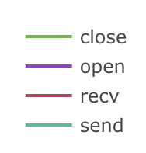
Simulation Flow
Web Client 1
(legit)
Socket Open
Send
Receive
Socket Close
Web Client 2
(malware)
Socket Open
Send
Receive
Socket Close
Timeline
Telemetry Output
Web Server 1
Web Server 2
Web Client 1
(legit)
Web Client 2
(malware)
Malicious Activity

