Slide 1
A Lightweight Convolutional Neural Network Model for Traffic Sign Classification Based on Enhanced LeNet-5 Network
Members
Mengqi Li (320190940141)
Chenxu Liu (320190940251)
Shiyuan Wang (320190940501)
Jin Kang (320190940121)

Slide 2
Content
1. Reference
2. Background
3. Dataset
4. Pre-processing
5. Structure Algortihm
6. Training process

Slide 3
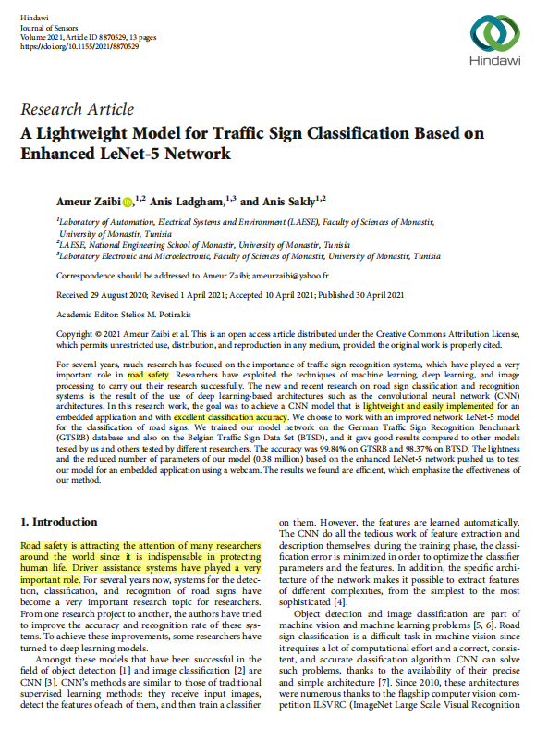
Reference
Zaibi, Ameur & Anis, Ladgham & Sakly, Anis. (2021). A Lightweight Model for Traffic Sign Classification Based on Enhanced LeNet-5 Network. Journal of Sensors. 2021. 10.1155/2021/8870529.

Slide 4
Background
Why do we choose Traffic Sign Classification?
Road safety
Driveless vehicles
Systems for the detection, classification, and recognition of road signs are important!

Slide 5
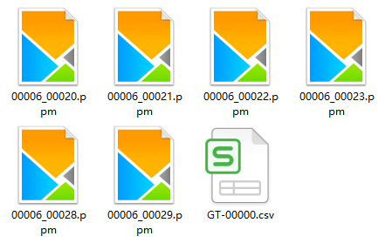
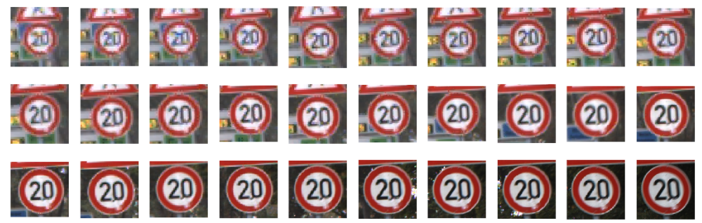
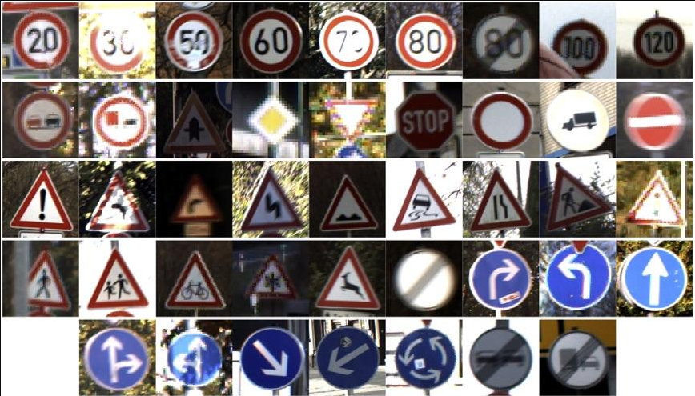
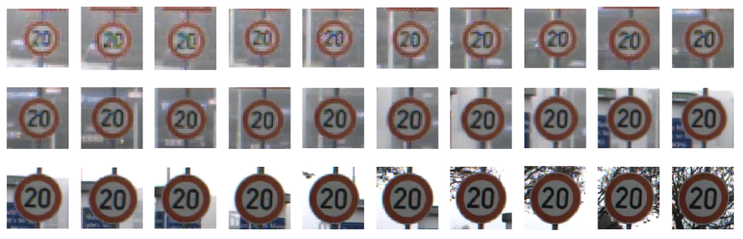
Dataset
German Traffic Sign Recognition Benchmark (GTSRB)
(url: https://benchmark.ini.rub.de/gtsrb_dataset.html)
43 classes

Slide 6
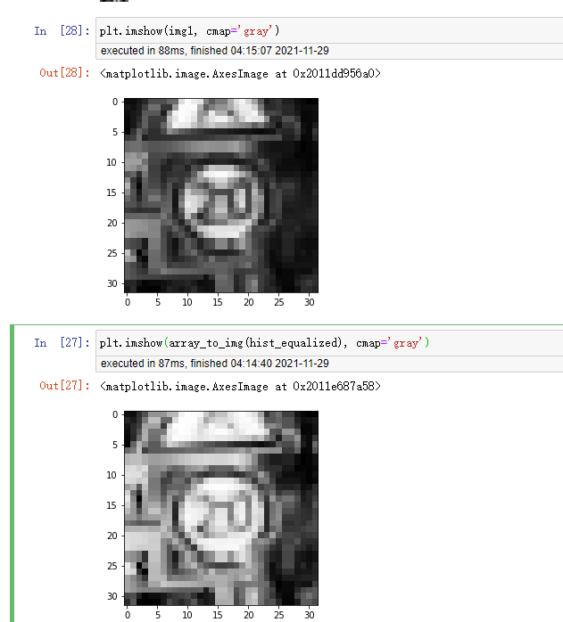

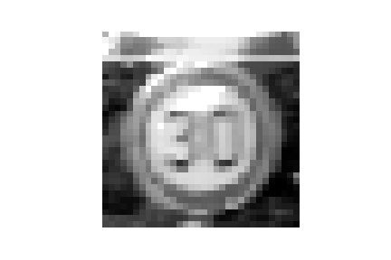
Pre-processing
1.Loading data
2.Resizing
3.Grayscaling
4.Normalization
5.Histogram equalization
Histogram equalization
Grayscale

Slide 7
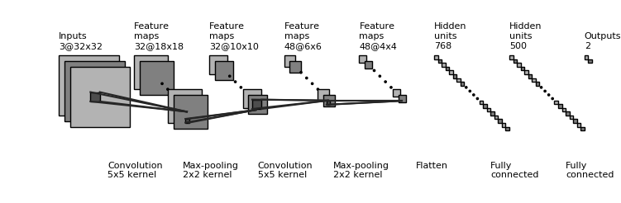
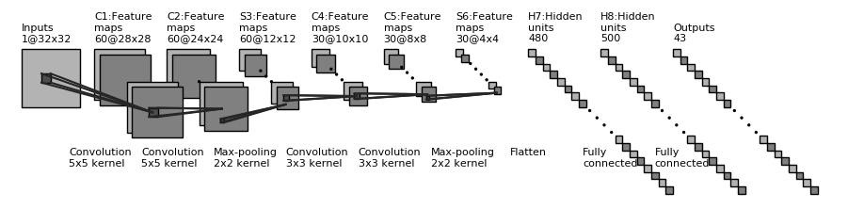
Structure of the Algorithm
LeNet-5
Our Enhanced
LeNet-5

Slide 8
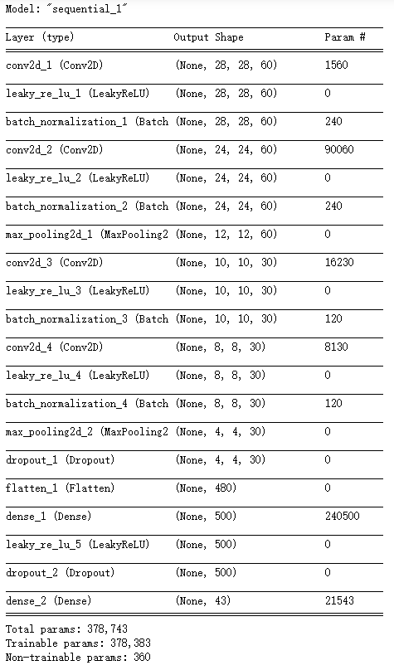
Structure of the Algorithm

Slide 9
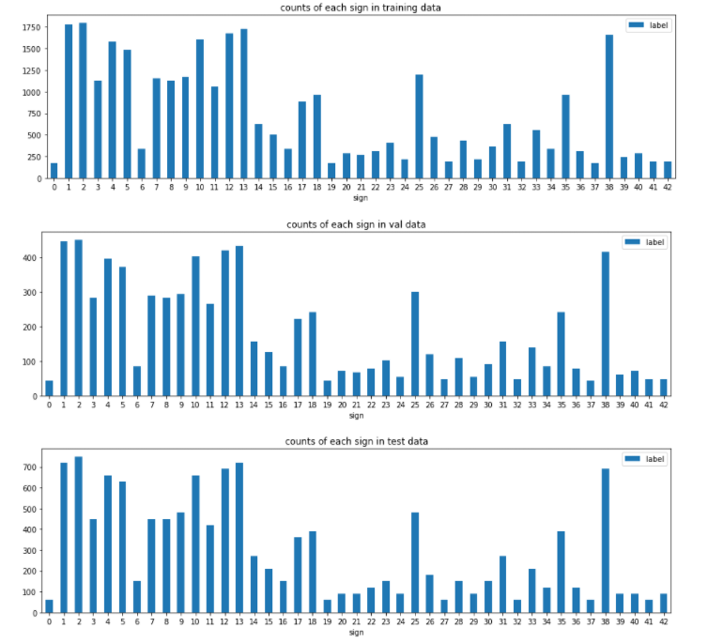
Trian
Split the dataset
Original Train: 39209
Trian: Validation=4:1
Test: 12630

Slide 10
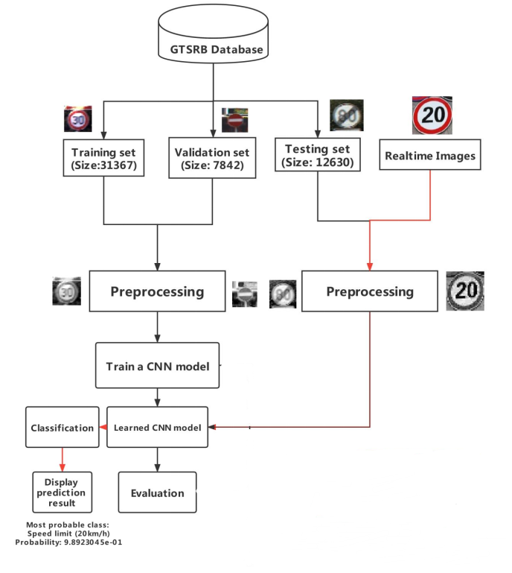
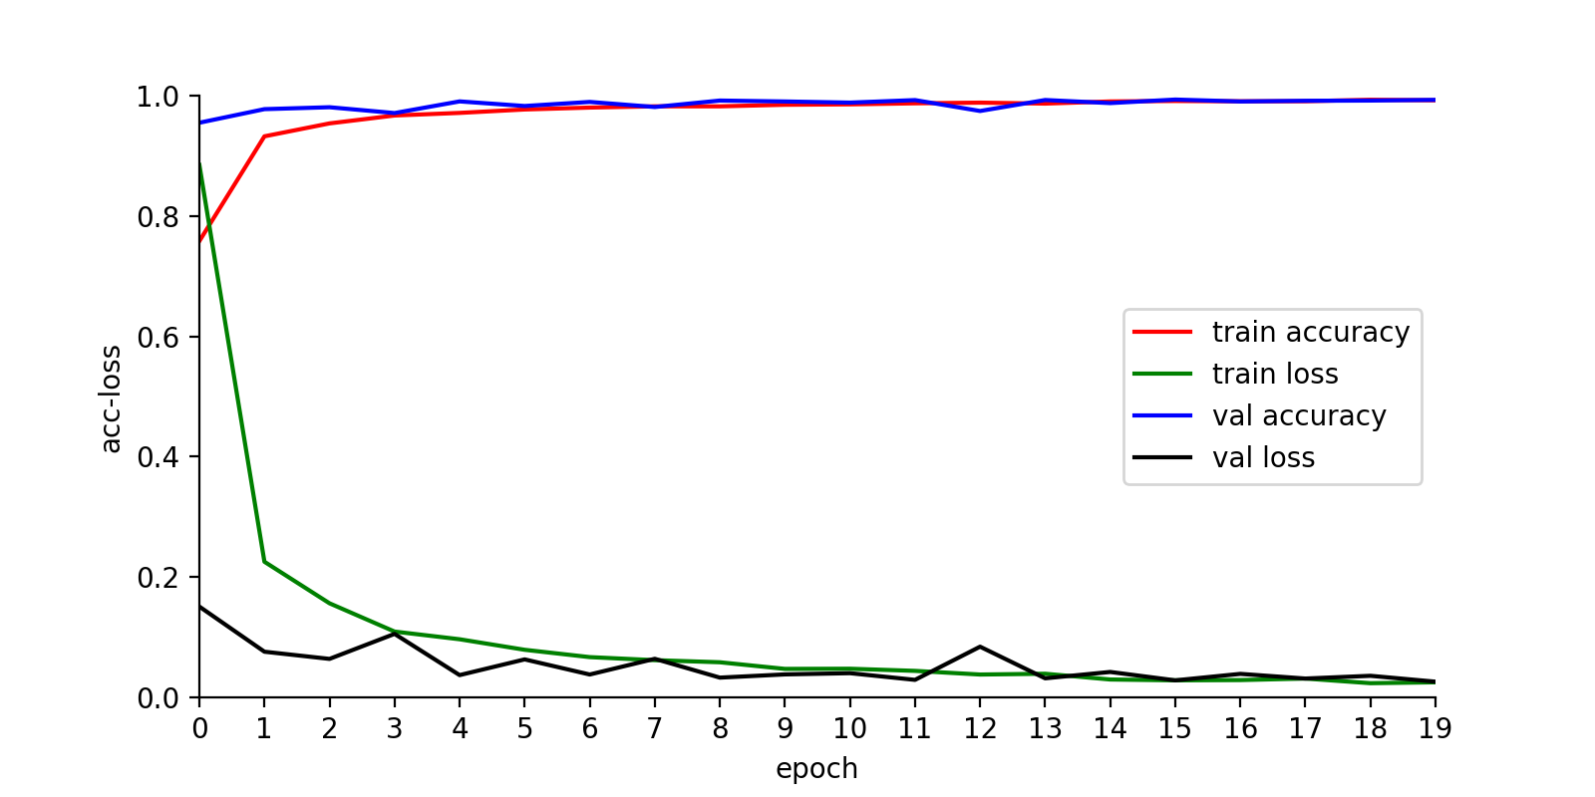
Train
loss:0.1474821766200685
acc:0.9755344390869141

Slide 11
Thanks

