Slide 1

MajicBus

Slide 2
Project Roles
Product Owner: James McDonnell
Scrum Master: Ashley Wong
Developers:
Brooke Mitchell
Bronson Bouchard
Charlotte Bergman

Slide 3
Progress of Sprint
Collectively:
Set up development required software (Visual Studio, Git, Sql Server Management Studio, Android Studio
James:
Set up Git repository
Set up staging build environment
Set up Microsoft Sql Server Database
Bronson:
Set up local Git repository
Created GPS Tracking Android App
Imported Google Maps API and implemented activity

Slide 4
Progress of Sprint
Brooke:
Set up local git repository
Created administrative backend
Ashley:
Set up local git repository
Prototyped use of google maps api
Prototyped out look of statistics page
Charlotte
Set up local git repository
Created SMS relay android app

Slide 5
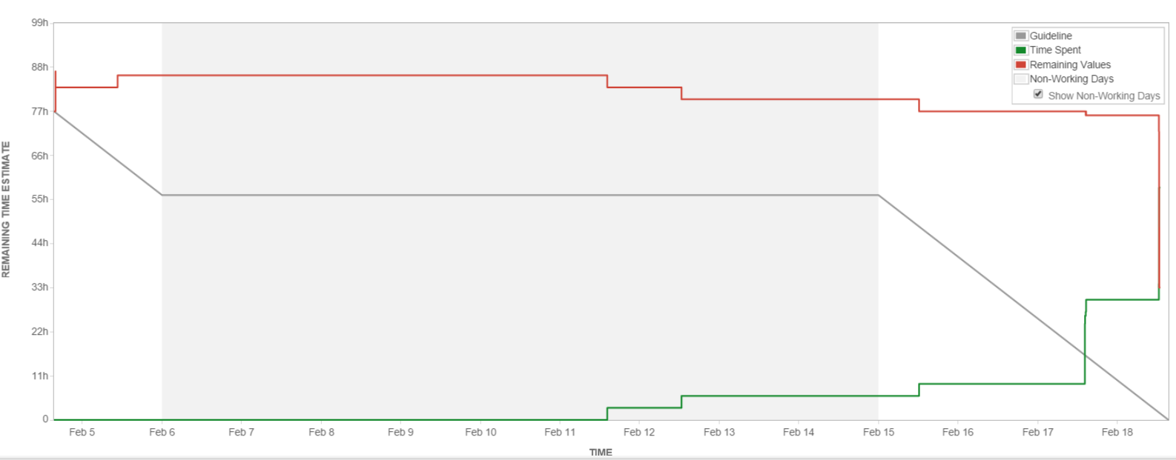
Burndown Chart

Slide 6
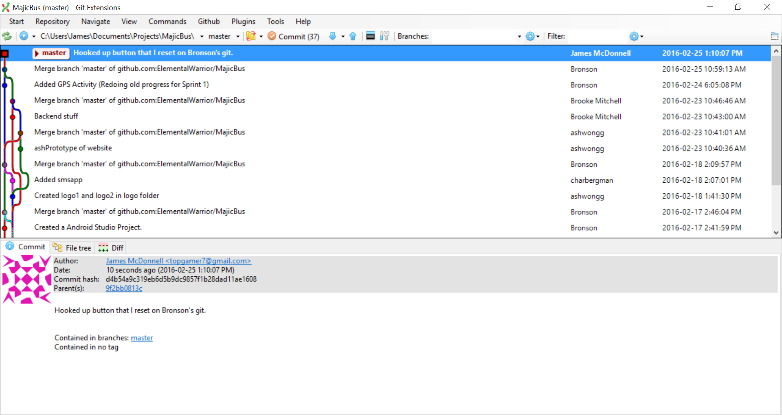
Progress!!

Slide 7
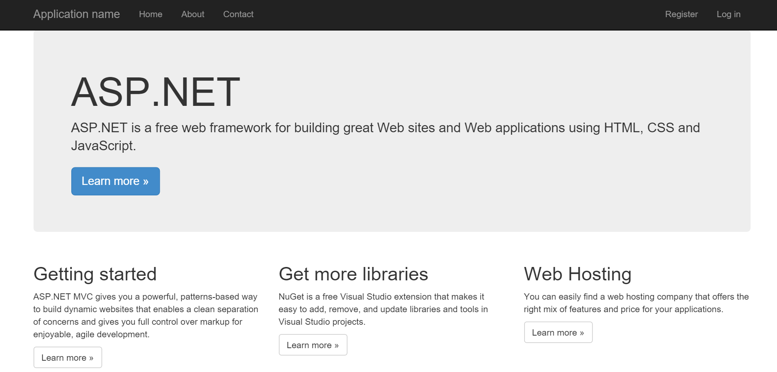
Admin Backend
http://majicbus.azurewebsites.net/

Slide 8
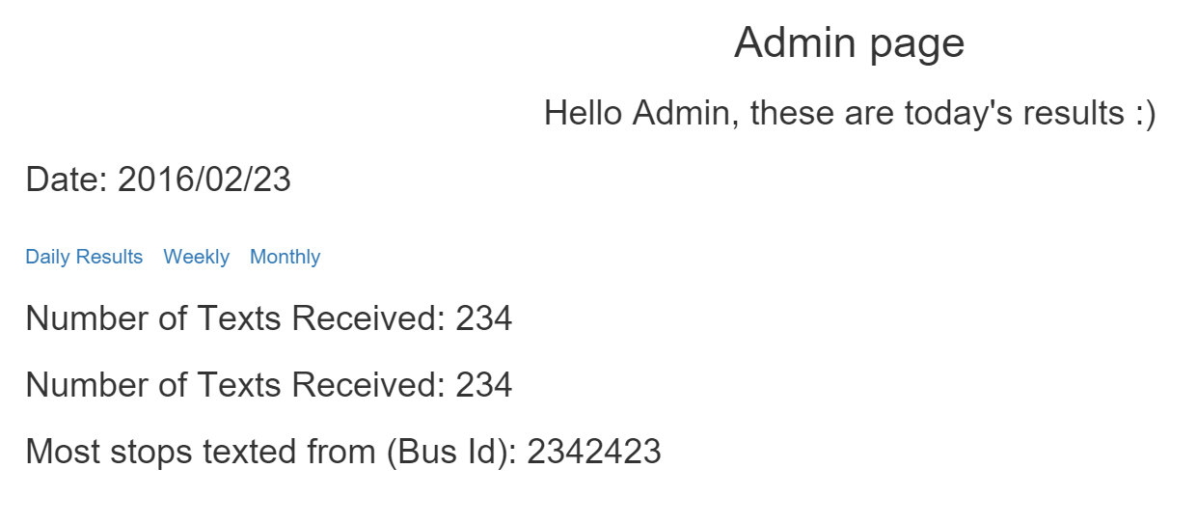
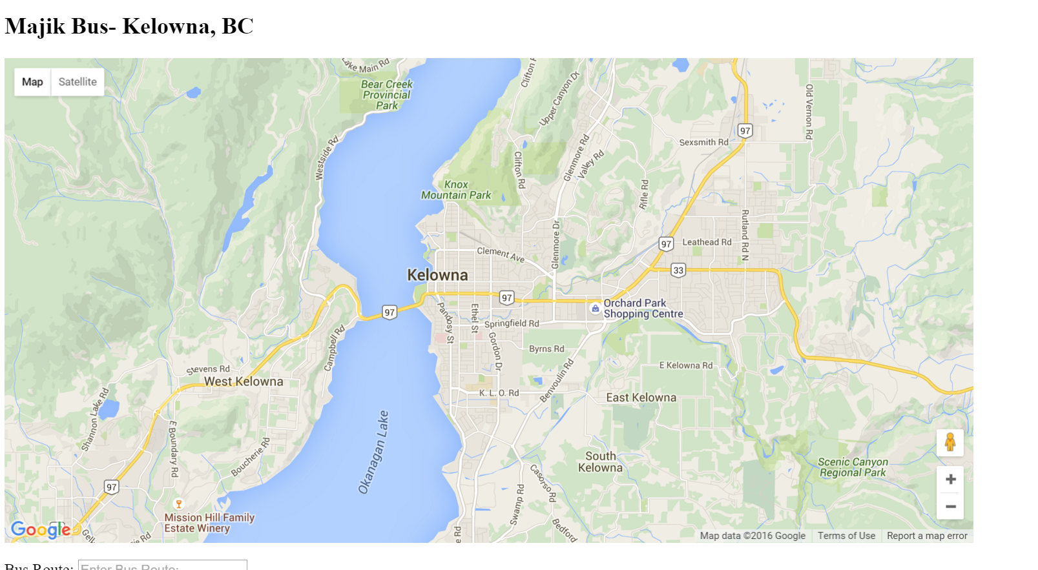
Map Prototypes
Admin Page
Map Page

Slide 9
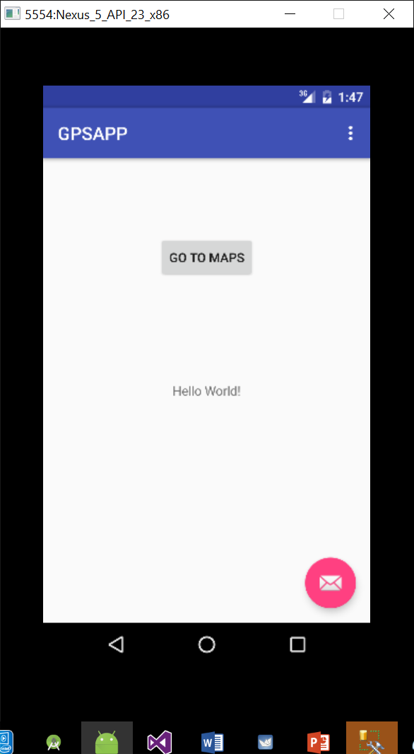
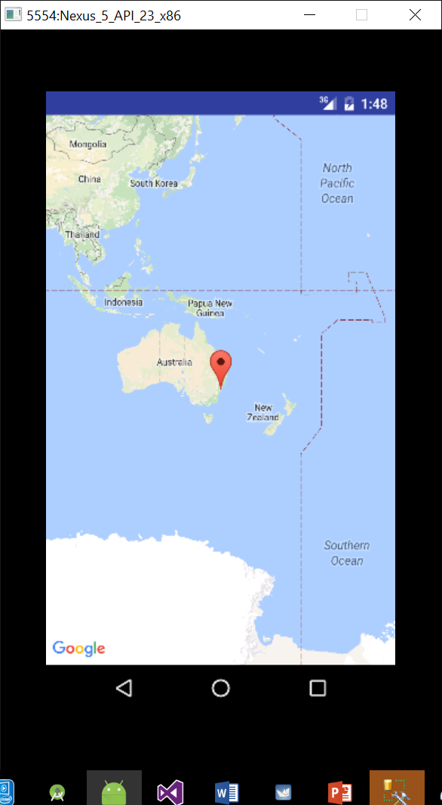
GPS Tracking App

Slide 10
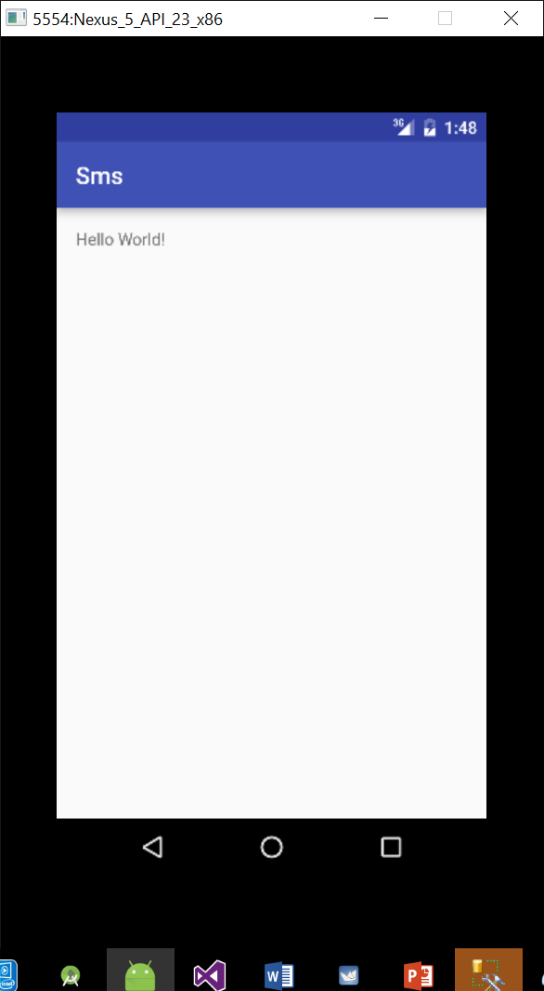
SMS App

Slide 11
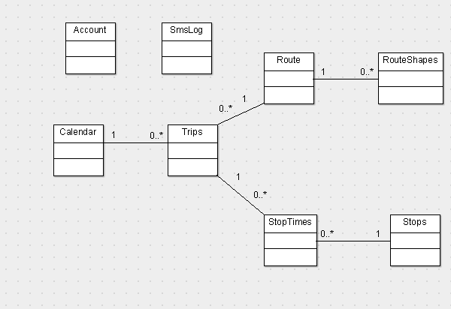
Framework Structure

Slide 12
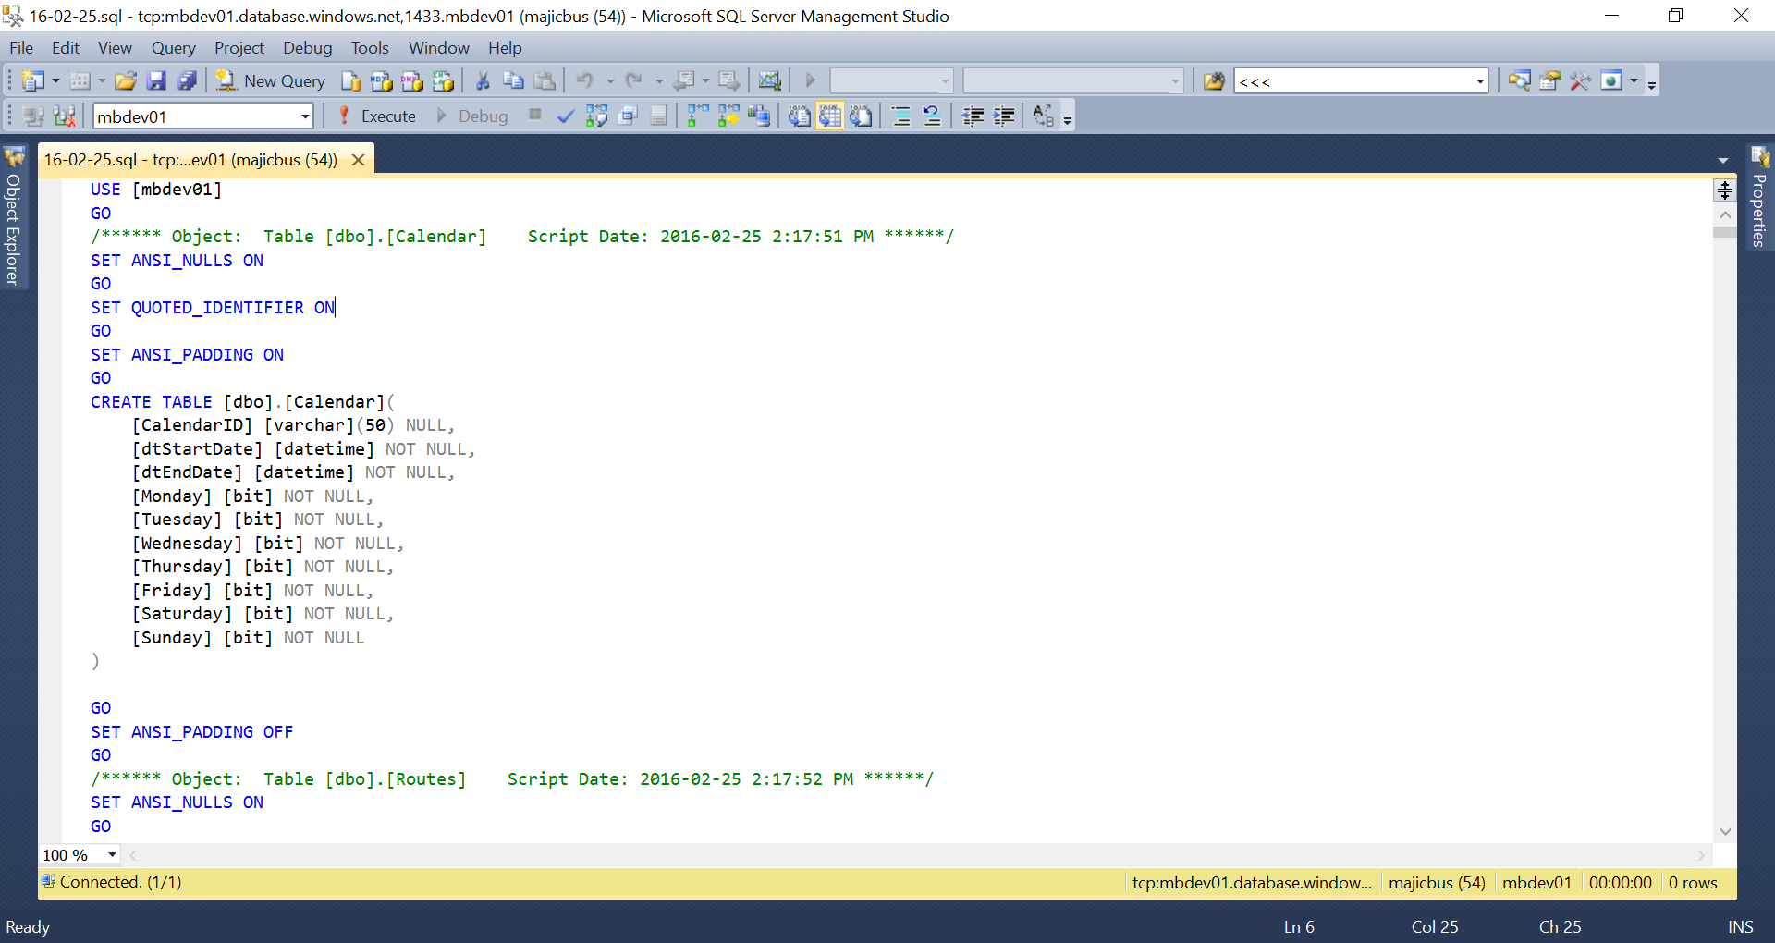
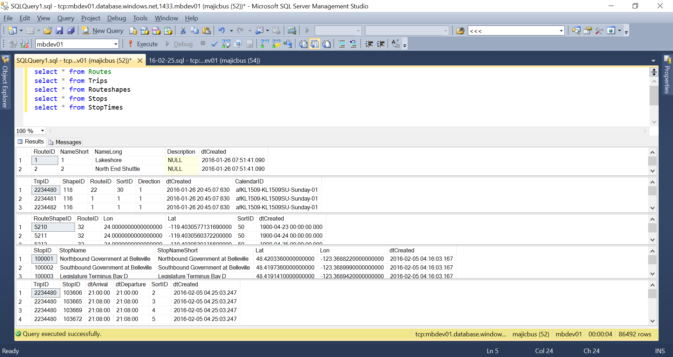
DB Backup

Slide 13
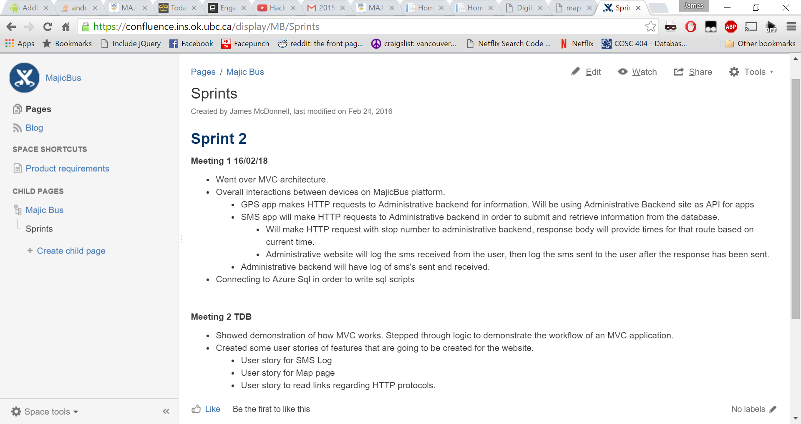
Confluence Sprint Planning Log

Slide 14
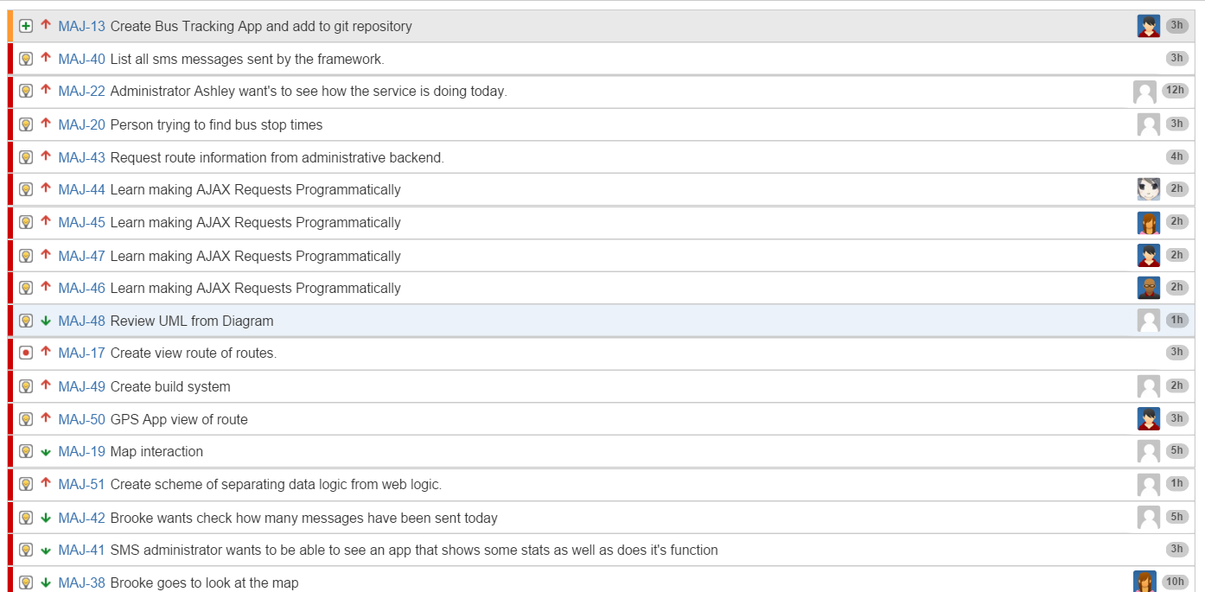
Sprint 2 Planning

