Slide 1
Events
And Event Propagation

Slide 2
What is an Event?
Events are how JavaScript and HTML interact.
They occur when either the user or browser manipulates the page.
The page loading is an event.
A user clicking a button is an event.
When a change is made in the HTML, we can create a response using JavaScript that runs and changes the website.

Slide 3
Useful Terms
Event Attribute – added into the html element to define event actions.
Event Handler – code (functions) that executes when an event occurs, either using an event attribute or using JavaScript methods.
Event Flow/ Event Propagation – the order in which events are triggered (event bubbling or event capture).
Notes:
If event flow doesn’t make much sense we will come back to it later

Slide 4
Different Events:
click
mousenter
mouseleave
mousedown
mouseup
mousemove
keydown
blur
focus
keyboard or mouse events
input event
Notes:
There are lots of different events that can be handled.
I’m going to just use the click event for all my examples to keep things simple.

Slide 5
CodePen

Slide 6
Event Attributes or Event Listeners?
A node can only have one handler added as an attribute
The addEventListener method used in JavaScript allows any number of handlers to be added to one node.
There is also another reason…

Slide 7
Event Propagation
1. Event capture – when an event occurs, the notification of this event is passed down through the elements to the target node where the event occurs.
2. Event target – notifies the node where the event took place.
3. Event bubbling – on next slide.

Slide 8
Event bubbling
After the target phase, the notice that the event has occurred passes up through all the ancestor elements of the target element, from bottom to top.
It is more noticeable that the other phases as the events on the ancestor elements will also occur.
Example order:
<button> → <div> → <body> → <html> → <document>

Slide 9
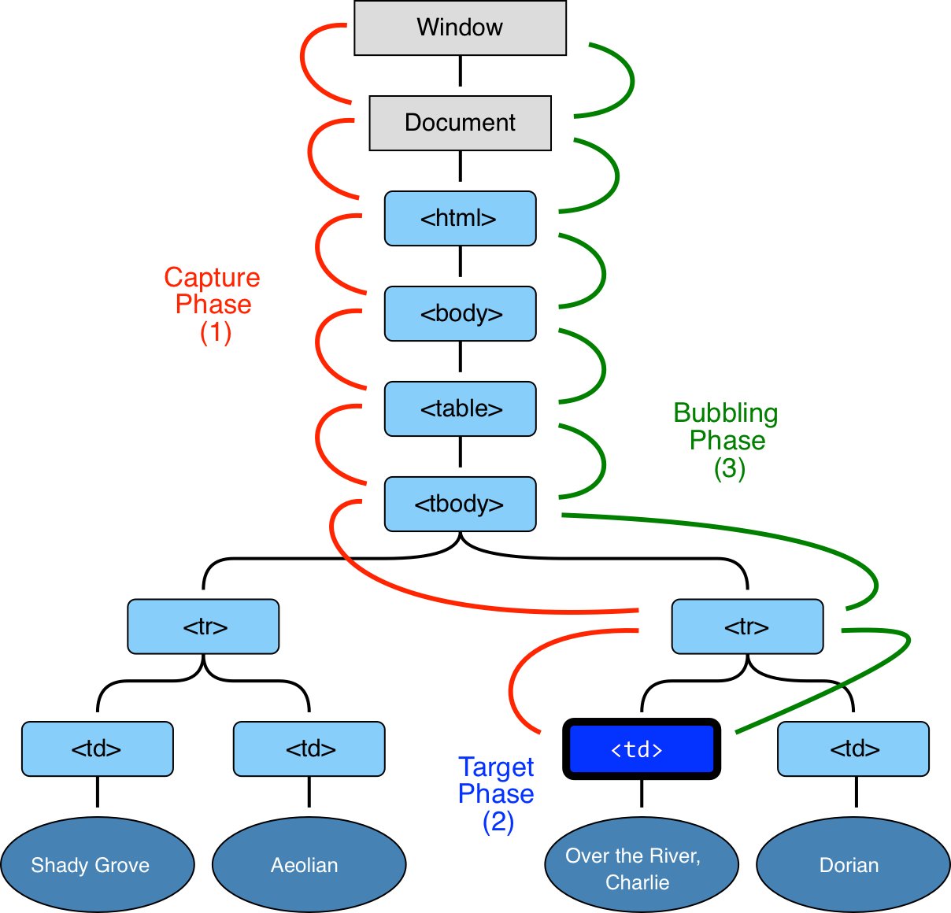

Slide 10
CodePen

Slide 11
Stopping Event Bubbling
event.stopPropagation() method
Stops the event travelling from the bottom to the top
The event.stopPropagation() method is placed inside the HTML event attribute.
Notes:
If you remember me saying earlier that there is another reason that putting event handlers in JavaScript rather than straight into the HTML - it is because of stopping event bubbling

Slide 12
CodePen

Slide 13
Food for Thought
Even though event capturing occurs as part of event propagation, it can also occur without event bubbling and cause the firing events beginning with the parent element and ending with the child element, even if a child element is clicked.
This is just not visible on current web browsers, but used to be the default way of propagating events, now event bubbling is.
Notes:
Check with Anna

Slide 14
Useful Resources
Quite interesting for the history of capturing vs bubbling but a bit confusing as it makes it seem like only one or the other occurs which isn’t true - https://medium.com/@vsvaibhav2016/event-bubbling-and-event-capturing-in-javascript-6ff38bec30e
Web Development Week 2 Resources.

