Slide 1
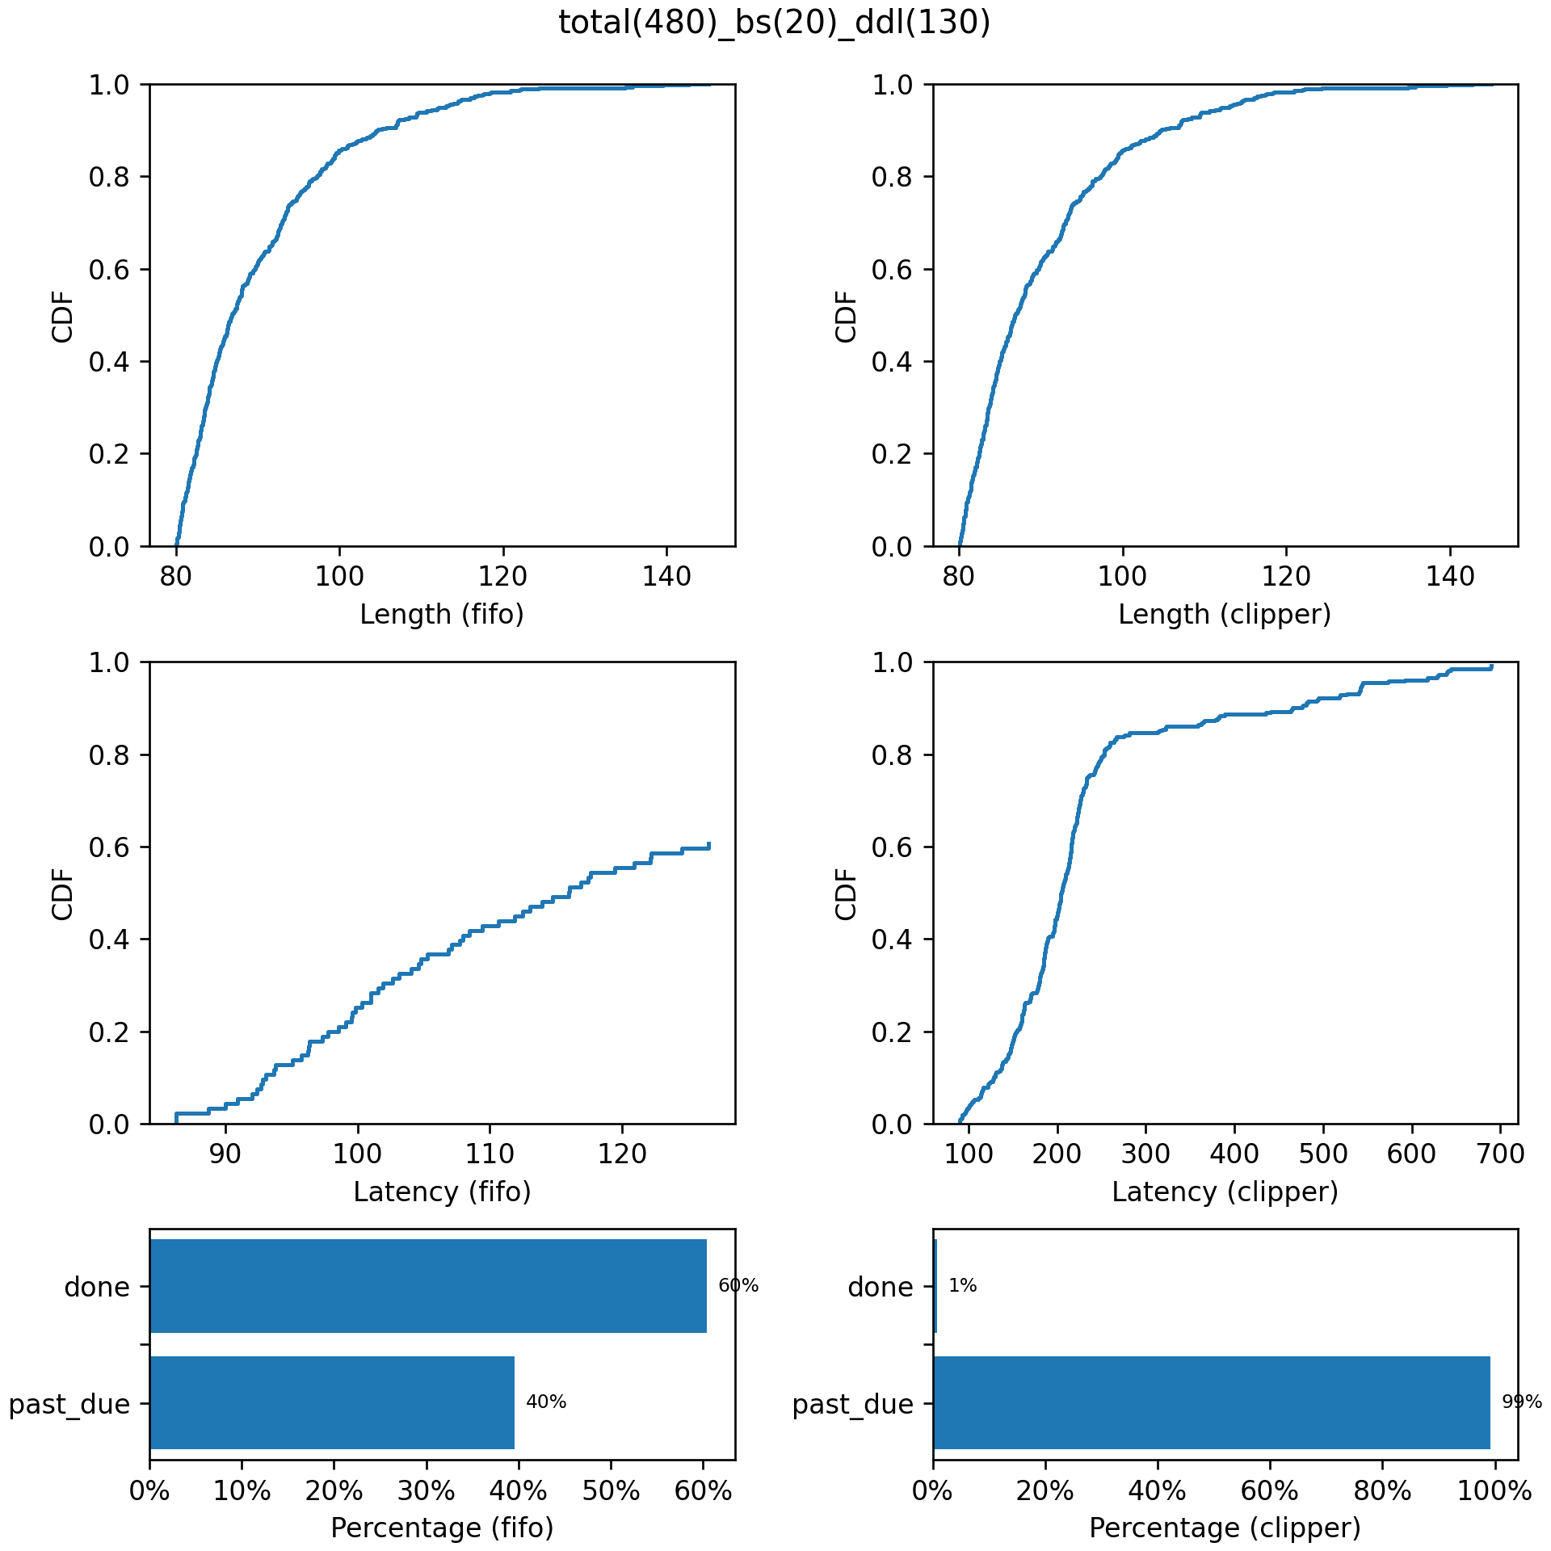
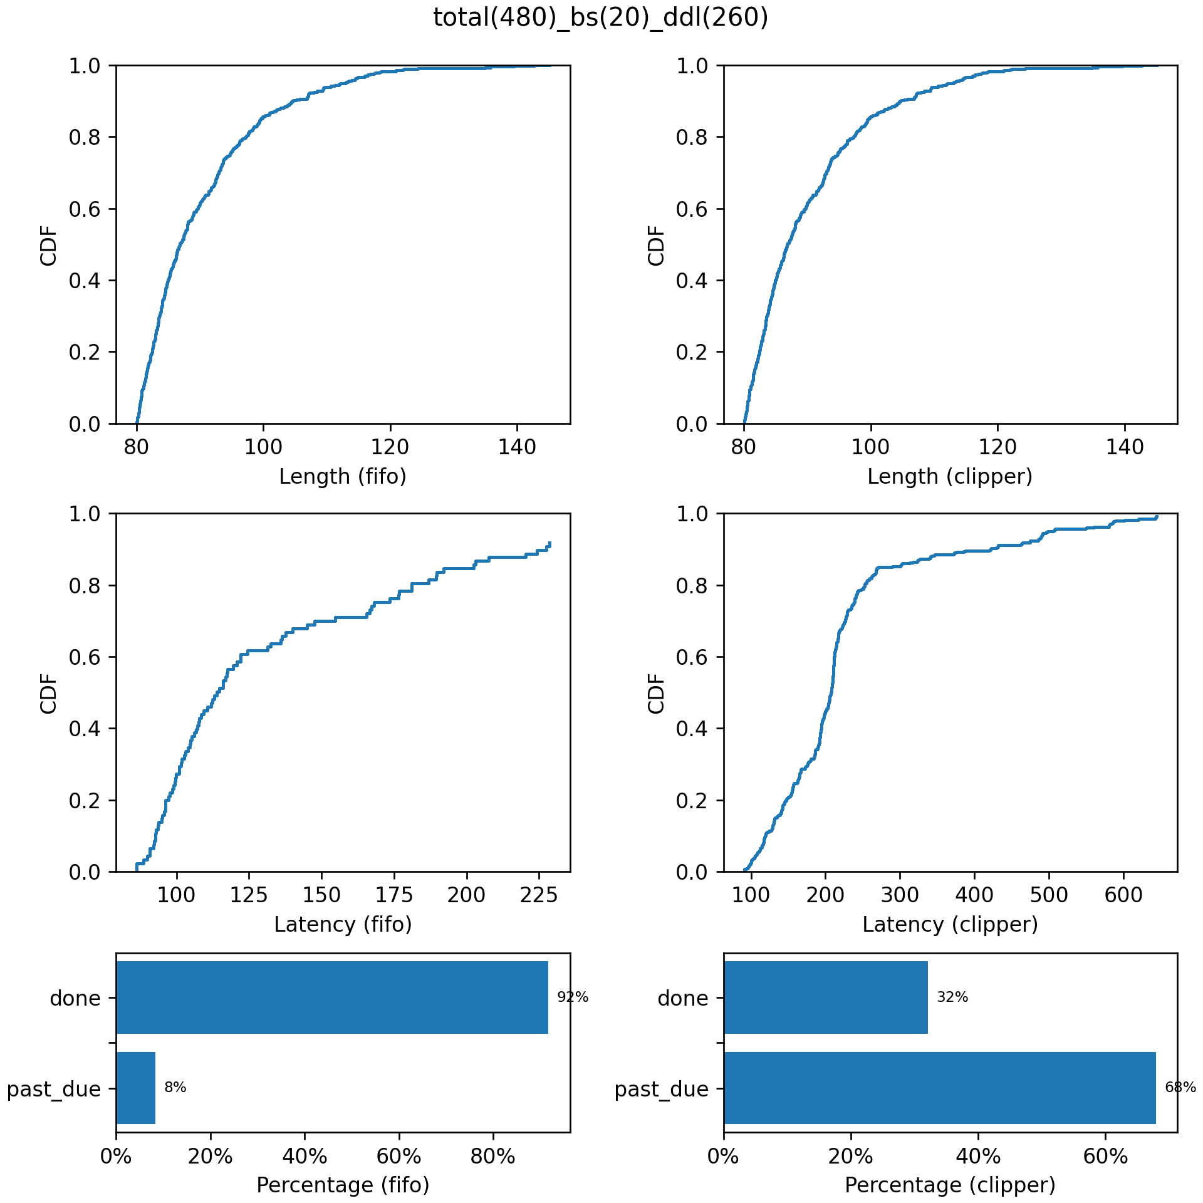
Average Length (100) Total jobs (480) Batch Size (20)
Deadline = 1x LengthP99
Deadline = 2x LengthP99

Slide 2
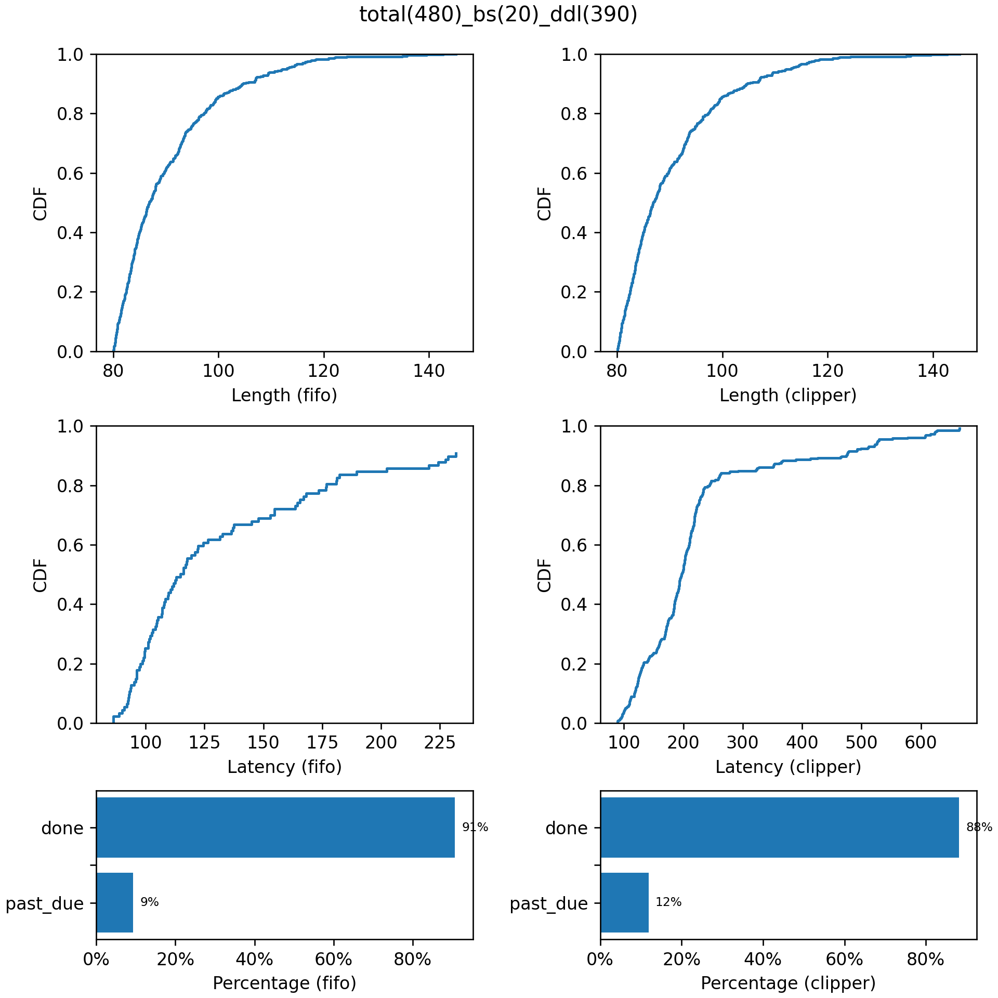
Average Length (100) Total jobs (480) Batch Size (20)
Deadline = 2x LengthP99
Deadline = 3x LengthP99

Slide 3
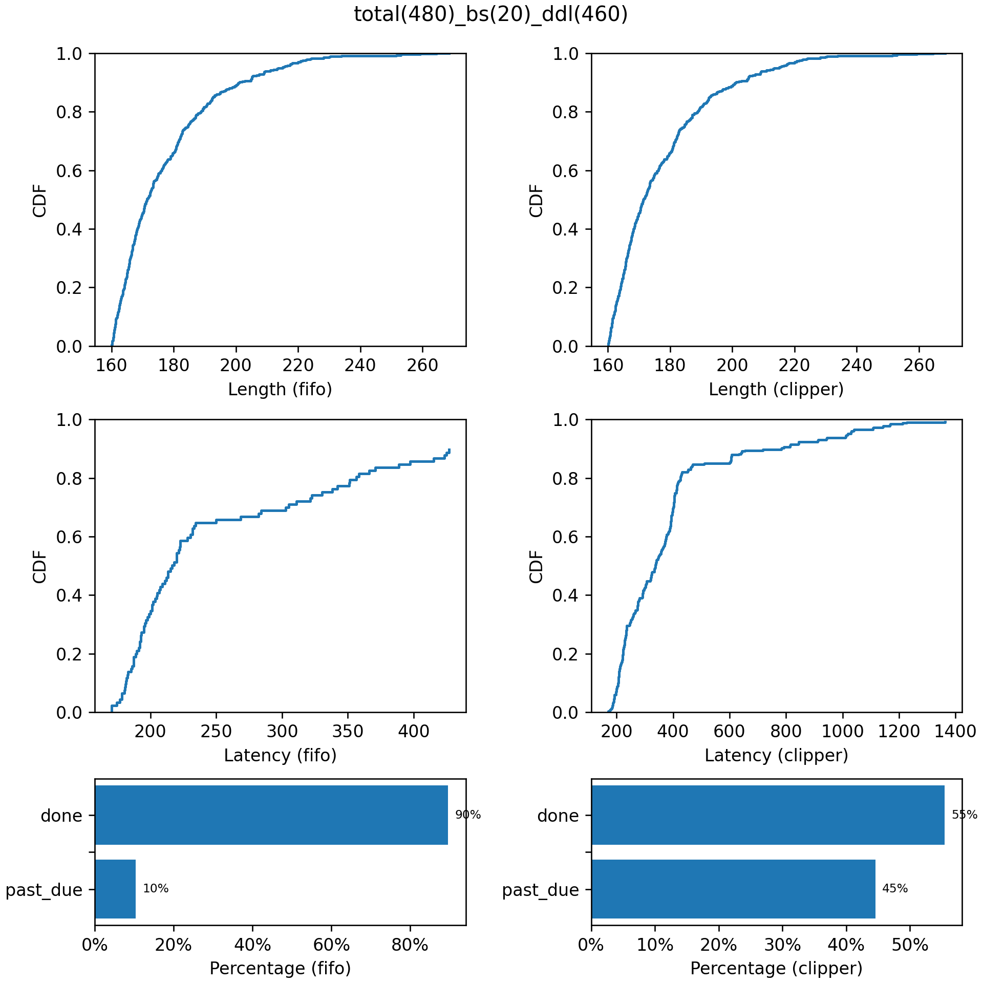
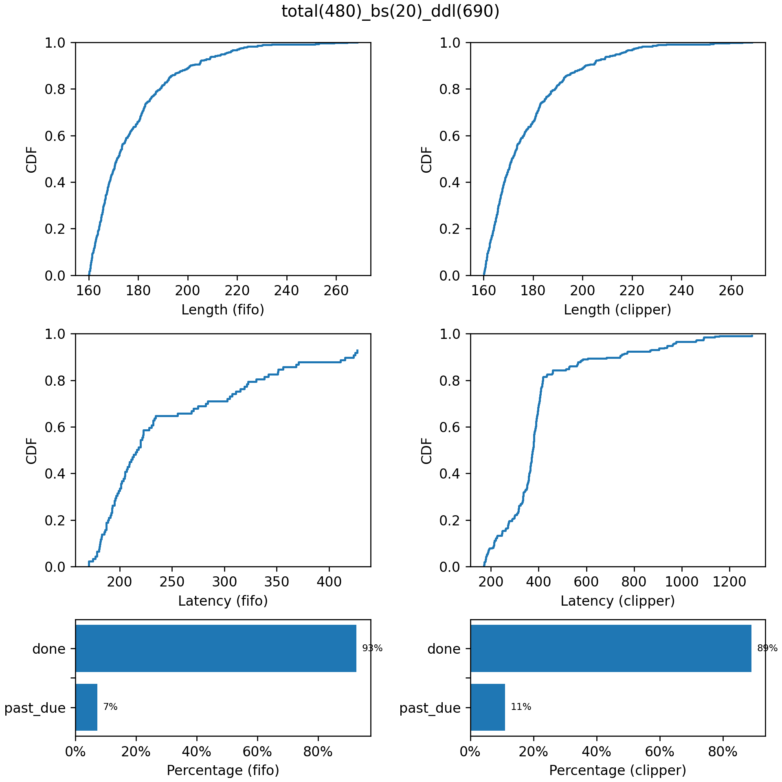
Average Length (200) Total jobs (480) Batch Size (20)
Deadline = 2x LengthP99
Deadline = 3x LengthP99

Slide 4
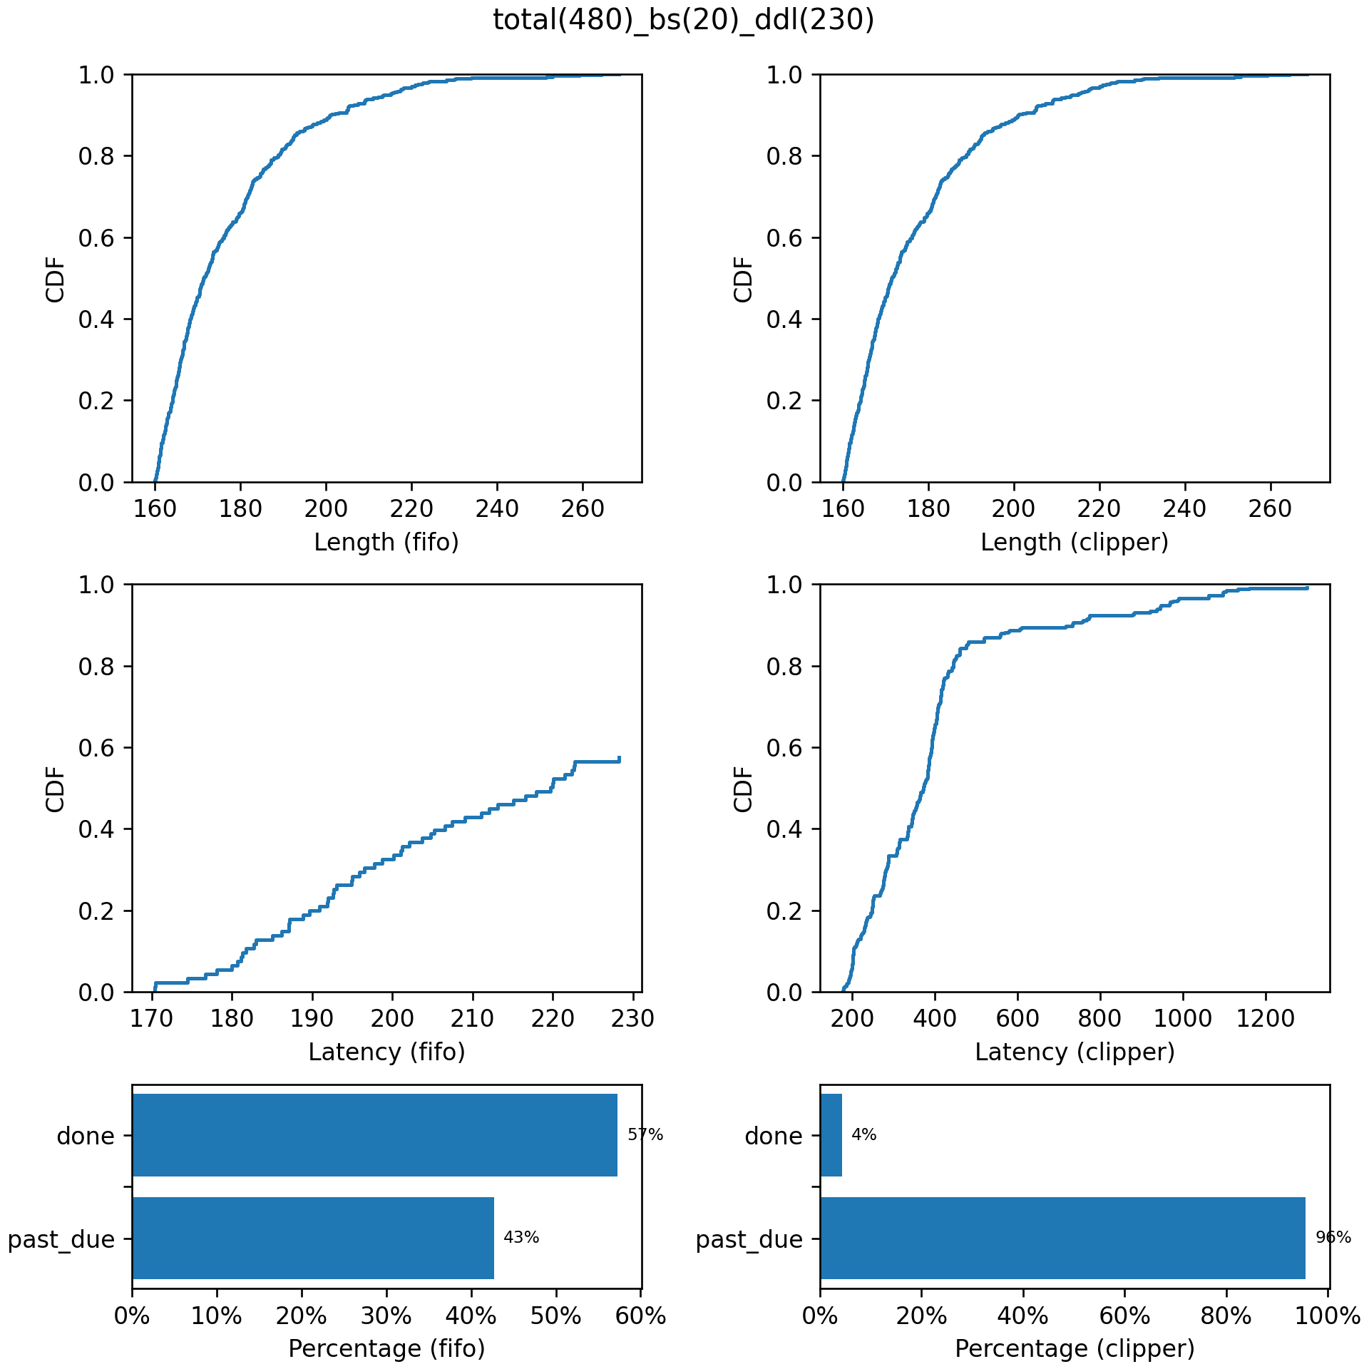
Average Length (200) Total jobs (480) Batch Size (20)
Deadline = 1x LengthP99
Deadline = 2x LengthP99

