Slide 1

TechGear Inc. Business Data Analysis
BDA Unit 6 Touchstone
ELENA PONOMAREVA
11/15/2025
Notes:
Hello, my name is Elena and today we discuss TechGear Inc case. Using the historical sales data, we build predictive models and, with prescriptive analytics, provide actionable insights on how to improve sales and marketing strategies to increase profitability and customer satisfaction.

Slide 2
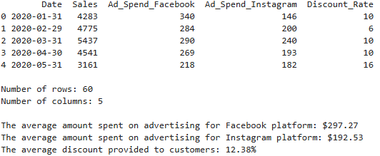
Data Exploration and Summary
Notes:
But before we begin our analysis, let’s review the historical sales data that we will use. The table represents data for the period from January 2020 to December 2024. The data includes the total number of sales for the month, the amount of money spent on advertising on each social media platform (Facebook and Instagram), and the discount rate applied to sales the month. Based on the average amounts we calculated, we see that the average Facebook ad spend is $297.27, while Instagram ad spend is lower at $192.53. Furthermore, the company offered an average discount of 12.38%.

Slide 3
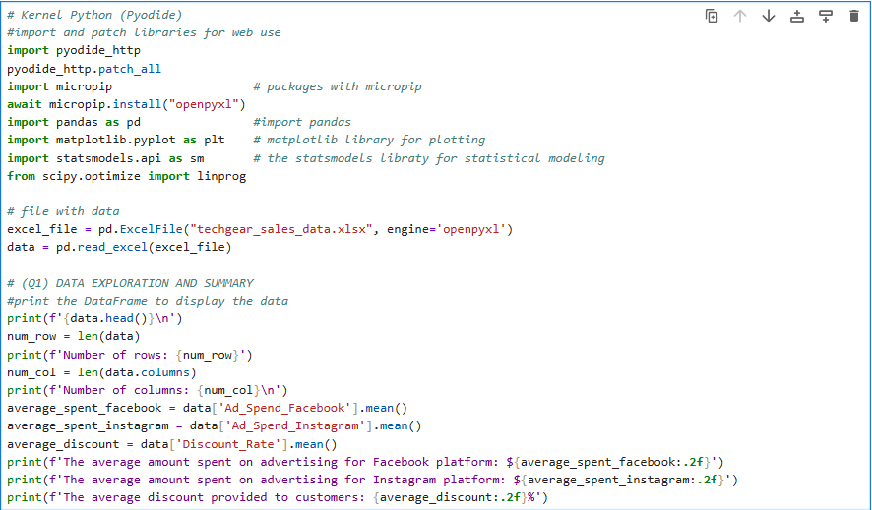
Python code snippets

Slide 4
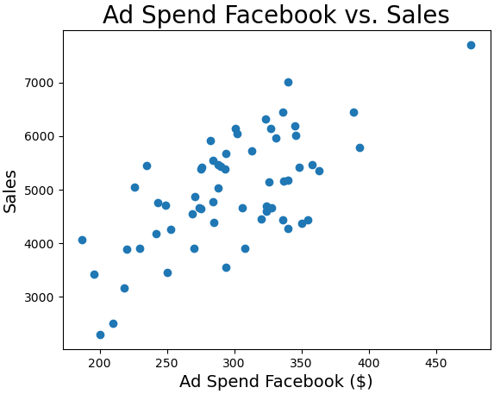
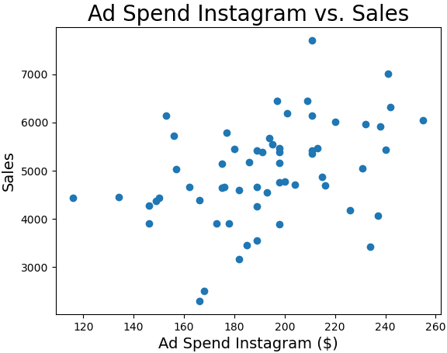
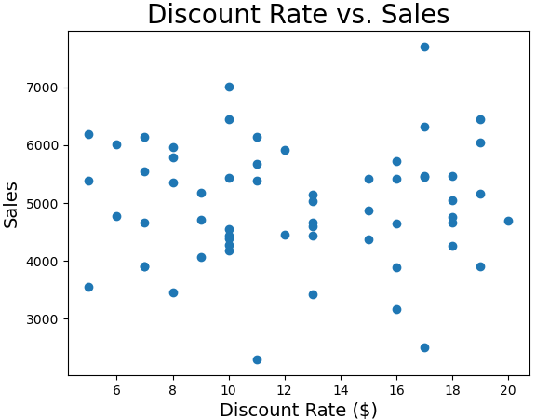
Visualizing Relationships
Notes:
Data visualization allows us to see patterns, relationship, and trends that may not be apparent from analyzing raw data alone. To visualize the relationship between sales and each of variable (Facebook ad spend, Instagram ad spend, Discount rate), we created three scatter plots. The first two scatter plots show that Facebook and Instagram ad spend, and Number of Sales have a positive linear relationship. The linear relationship of the plotted points indicates moderate spread, suggesting there is a medium or strong correlation, which typically means that as one variable increases, the other variable also tends to increase. The next steps are to calculate the correlation coefficient and conduct a regression analysis to demonstrate the strength of this relationship.
According to the “Discount Rate vs Sales” scatter plot, the relationship between the two variables is weakly correlated. The points are widely dispersed, making a linear trend difficult to detect visually.

Slide 5
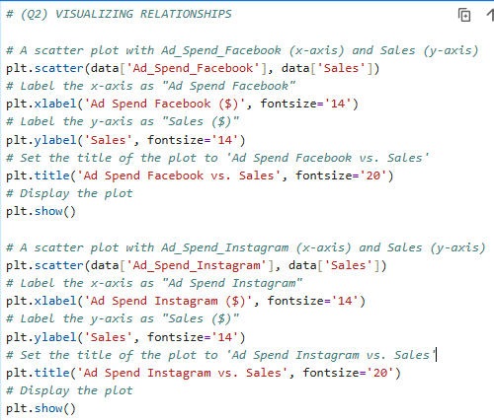
Python code snippets

Slide 6
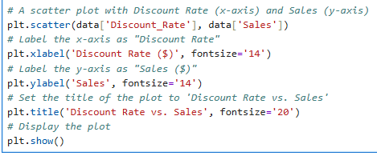
Python code snippets

Slide 7
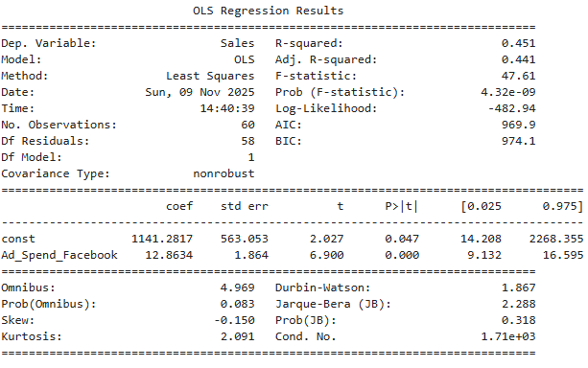
Simple Linear Regression
y = 1141.28 + 12.86 * x ,
where x – Facebook ad spend
y – Numer of Sales
Example:
Facebook ad spend is $300,
then y = 1141.28 + 12.86 * 300
y = 4999
Predicted Sales 4,999
Notes:
Now, we will run a regression analysis to find a simple linear regression that we can use to examine the relationship between two variables: Facebook ad spend and Sales. A Simple Linear Regression y = 1,141.28 + 12.86 * x, where x is independent variable, which in our case is the Facebook ad spend; y is dependent variable, which in our case is predicted number of sales; 1,141.28 is the y-intercept and 12.86 is the slope in this statistical model. We can use the model to predict the number of sales after a particular Facebook ad spend in a month. For example, if the company spends $300 per month on Facebook ads, the predicted number of sales would be y = 1,141.28 + 12.86 * 300 = 4,999. Overall, Facebook advertising spending is beneficial for the business. However, if we look at the coefficient of determination (R-squared) value, which measured the proportion of variance in the response variable explained by the explanatory variable, R-squared = 0.451. This suggests that the model provides a useful, moderate explanation of the variability in the data, but there is a still a large portion of variation that the current predictors do not capture.

Slide 8
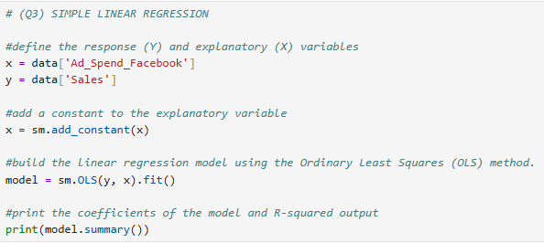
Python code snippets

Slide 9
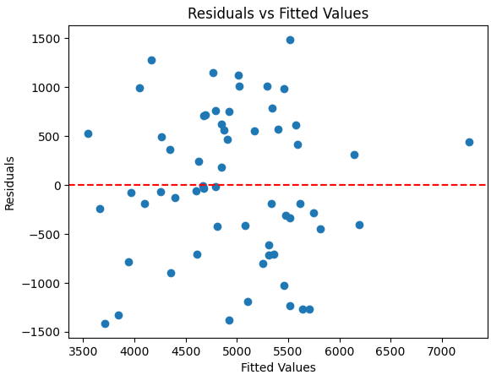
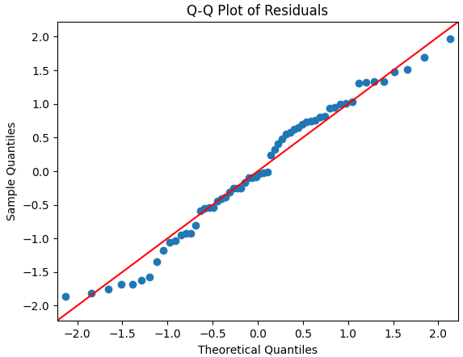
Assessing Model Fit
Notes:
Next, we will evaluate performance of the simple linear regression by analyzing residuals. On the slide we can see two plots. The plot on the left (Residuals vs Fitted Values) shows residuals from a linear relationship. The residuals are randomly scattered around the horizontal axis (zero lane), indicating that the simple linear regression model from the previous step is a good fit for the data. It also shows that the residuals have a consistent spread, which indicates that the model’s residuals are evenly distributed.
The plot on the right, Q-Q Plot of Residuals, help us to indicate if the model’s residuals are normally distributed. In practice, minor deviations are often acceptable, especially in large datasets. As we can see from the plot, we do not have significant deviations from the line. A few points near -1.5 a little bit far from the line might indicate outliers, which can affect normality, but overall pattern shows the residuals are likely normally distributed and small deviations are usually acceptable. This suggests that the assumption of normality for the residuals in the regression model is reasonably met, supporting the reliability of the model's predictions.

Slide 10
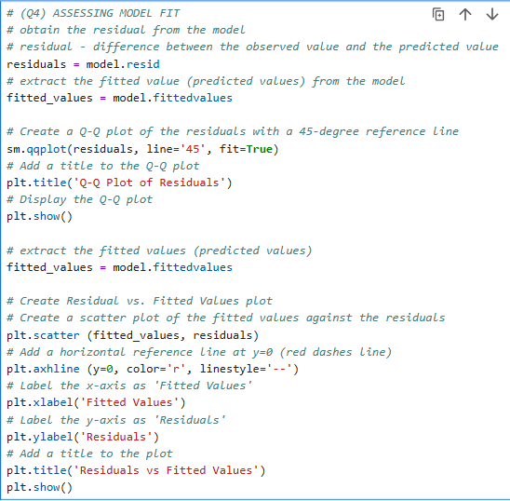
Python code snippets

Slide 11
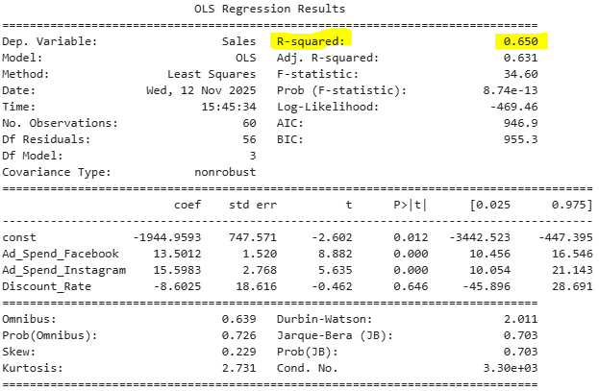
Multiple Linear Regression
Simple linear regression:
R-squared 0.451
Multiple linear regression:
R-squared 0.650
Multiple linear regression model:
$$y=−1944.96+13.50∗x_{1}+15.60∗x_{2}−8.60∗x_{3}$$
Notes:
Next step, we will explore multiple linear regression. While simple linear regression involves one predictor variable, multiple linear regression allows us to include multiple explanatory variables to better understand and predict the response variable. In our example, we used Facebook ad spend to predict the number of sales. Multiple linear regression allows you to use more than one explanatory variable, which means we will use Facebook ad spend, Instagram ad spend, and discount rate to predict sales. Examining the calculations for R-squared, we can observe, R-squared increases with the multiple regression model.
R-squared Simple linear regression – 0.451
R-squared Multiple linear regression – 0.650
This proves that including Instagram ad spend and discount rate improves the model’s predictive power.
Using the regression output, the multiple linear regression model that predicted number of sales is given by y = -1944.96 + 13.50 * x_1 + 15.60 * x_2 – 8.60 * x_3

Slide 12
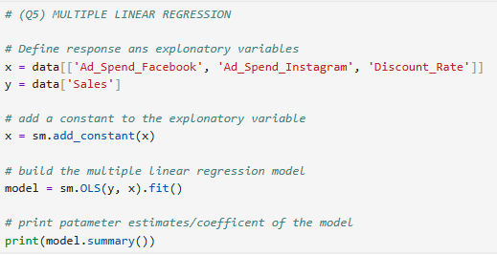
Python code snippets

Slide 13
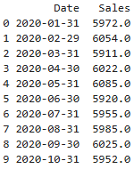

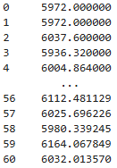
Forecasting
Actual Values
3-month moving average
An exponential smoothing
3-month moving average forecast for January 2025: 6059 Sales
An exponential smoothing forecast for January 2025: 6032 Sales
Notes:
In our analysis we will use two forecasting methods: “3-month moving average” and “An exponential smoothing”.
“3-month moving average” helps smooth out short-term fluctuations in data to see the overall pattern. In our example we decided to take 3-month window size. A table on the left shows the forecasted values based on the 3-month moving averages. And as we calculated that the 3-month moving average forecast for January 2025 equals 6059 Sales.
“An exponential smoothing” predicts future data points by giving more weight to recent data while still considering older data. In our calculations we use a smoothing parameter of 0.08. The column “An exponential smoothing” shows the forecasts for sales data. And as we calculated that an exponential smoothing forecast for January 2025 equals 6032 Sales.

Slide 14
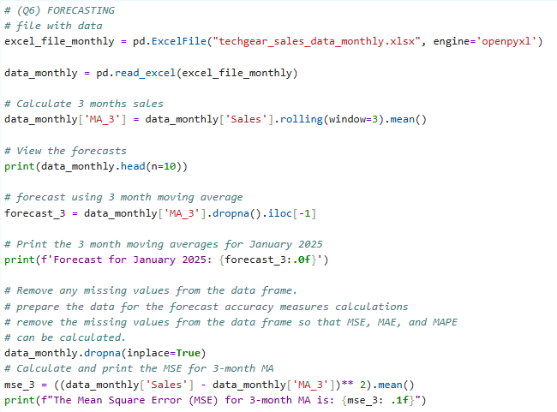
Python code snippets

Slide 15
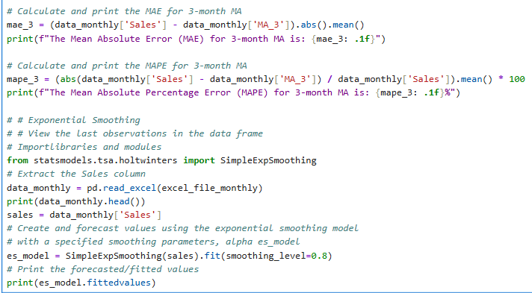
Python code snippets

Slide 16
Machine Learning Models
Lower RMSE values indicate better model performance!
Multiple linear Regression Model provides more
accurate predictions with lower error compared
to the Decision Tree model.
Notes:
In this step, we build a multiple linear regression model using 5-fold cross-validation to model the relationship between a target variable and a set of features. In our model, the target variable is sales, and the features are Facebook ad spend, Instagram ad spend, and discount rate. We calculated Root Mean Square Error (RMSE) to represent how far, on average, the model’s predictions are from the actual values.
RMSE value of 626 sales indicates the average deviation of the predicted sales from the actual sales, the model’s predictions are off by 626 sales. This level of accuracy might be acceptable depending on the company’s tolerance for prediction discrepancies.
After evaluating both the multiple linear regression model and the decision tree model using 5-fold cross validation, it is observed that the multiple linear regression model has an average RMSE of 626 points, while the decision tree model has an average RMSE of 911 points. This indicates that the multiple linear regression model provides more accurate predictions with lower error compared to the decision tree model for this particular data set. Therefore, we will recommend using the multiple linear regression model for predicting the target variable - Sales, as it demonstrates better performance in our case. However, the company needs to continue monitoring and potential model improvements are always advisable.

Slide 17
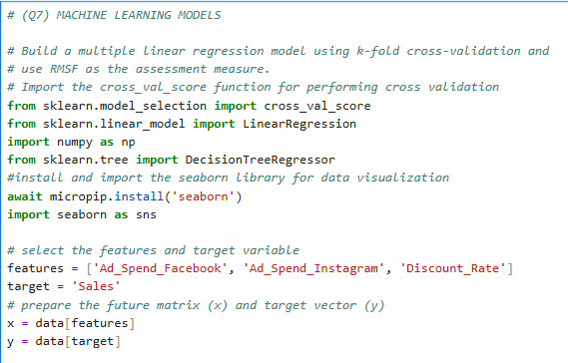
Python code snippets

Slide 18
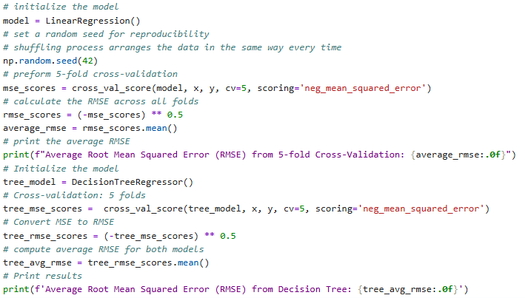
Python code snippets

Slide 19
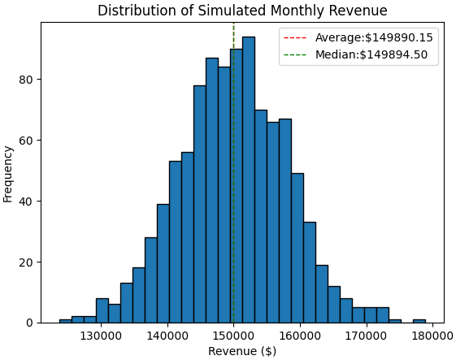
Monte Carlo Simulation
Estimated Average Monthly Revenue: $149,890.15
Median Monthly Revenue:
$149,894.50
Standard Deviation of Monthly Revenue: $8,165.60
Notes:
The best way to make accurate predictions of the future sales is to use Monte Carlo Simulation. This simulation will help to see a range of possible sales outcomes and understand the risks involved. We will construct the Montecarlo simulation based on the requirement below:
1. Examining sales data for the past 60 months we observed that daily sales can be vary between 2,299 and 7,702. And we can assume the daily sales follow a uniform distribution.
2. Use a random seed value of 42 so that the results will be reproducible.
3. Estimate the average and median monthly sales by running 1,000 simulations.
4. Number of days in a month – 30.
To summarize the results, we created a histogram “Distribution of Simulated Monthly Revenue”.
Estimated Average Monthly Revenue: $149,890.15. The average monthly revenue provides an estimate of what the typical monthly revenue might be, considering the variability in daily revenues due to different factors (holidays, market trends, etc.). This information is useful for budgeting, financial planning, and setting sales targets.
Median Monthly Revenue: $149,894.50. The median monthly revenue represents the point at which half of the simulated monthly revenues are below and half are above. The median gives more robust measures of the central tendency of the monthly revenue.
Both the average and monthly revenue help the company set realistic budgets and financial plans. The average helps in setting optimistic targets, while the median ensures that targets are realistic and not overly influenced by outliers.
The Standard Deviation of Monthly Revenue equals $8,165.60 represents the variability or dispersion in the simulated monthly revenues. This value provides insights into how much the monthly revenues are expected to fluctuate around the average monthly revenue. This is crucial for managing financial risks and ensuring that the business can sustain operations even during less profitable months. This information is essential for making informed decisions about inventory, staffing, and risk management, ultimately helping the business operate more efficiently and sustainably.
Understand and managing these risks and uncertainties through Monte Carlo simulations allows businesses to make more informed and strategic decisions.

Slide 20
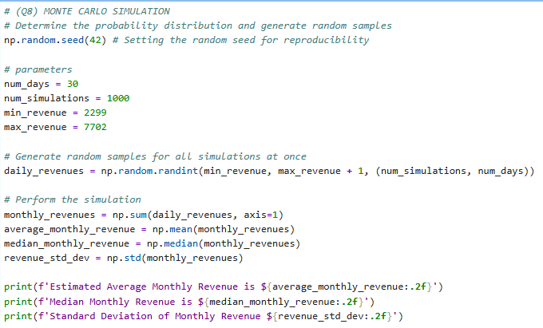
Python code snippets

Slide 21
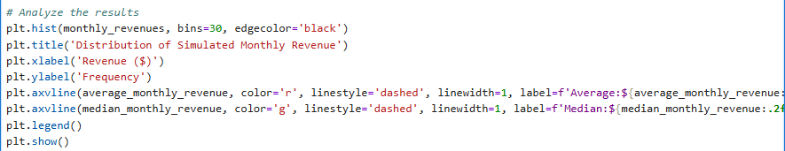
Python code snippets

Slide 22

Linear Programming
Notes:
The company has a fixed advertising budget of $10,000 per month, and we need to determine the optimal distribution of this budget between Facebook and Instagram advertising to achieve the maximum possible sales.
Other constraints:
Must spend at least $2,000 on Facebook advertising to maintain its presence on the platform.
Must spend a minimum of $1,000 and no more than $7,000 on Instagram advertising due to platform-specific constraints.
The amount spent on Instagram advertising should be at least 50% of the amount spent on Facebook advertising to ensure balanced marketing efforts.
Objectives:
1. Sales from Facebook: SF = 5F, where F is the Facebook ad spend
2. Sales from Instagram: SI = 5I, where F is the Instagram ad spend
The optimal budget allocation for Facebook - $6,666; for Instagram $3,333. Under these conditions the company can achieve maximum sales revenue of $43,333.

Slide 23
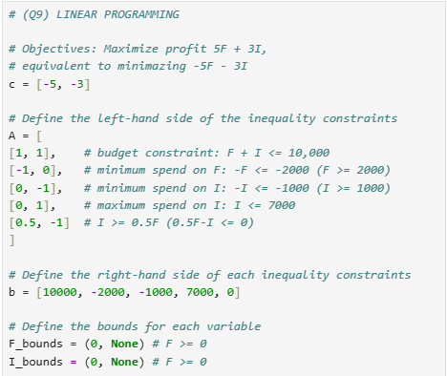
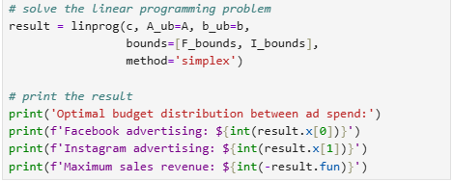
Python code snippets

