Slide 1

TechGear Inc. Business Data Analysis
BDA Unit 6 Touchstone
ELENA PONOMAREVA
11/11/2025
Notes:
Hello, my name is Elena and today we discuss TechGear Inc case. Using the historical sales data, we build predictive models and, with prescriptive analytics, provide actionable insights on how to improve sales and marketing strategies to increase profitability and customer satisfaction.

Slide 2
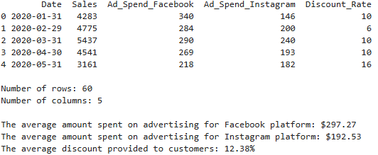
Data Exploration and Summary
Notes:
But before we begin our analysis, let’s review the historical sales data that we will use. The table represents data for the period from January 2020 to December 2024. The data includes the total number of sales for the month, the amount of money spent on advertising on each social media platform (Facebook and Instagram), and the discount rate applied to sales the month. Based on the average amounts we calculated, we see that the average Facebook ad spend is $297.27, while Instagram ad spend is lower at $192.53. Furthermore, the company offered an average discount of 12.38%.

Slide 3
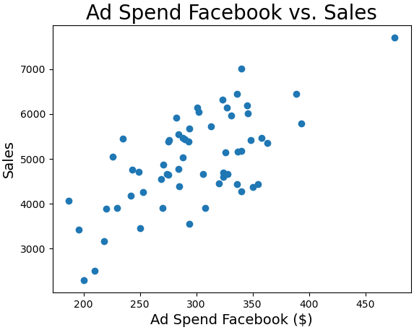
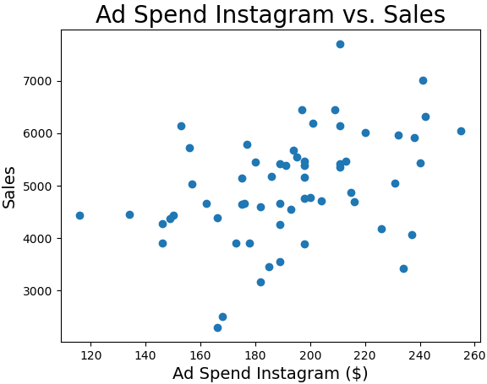
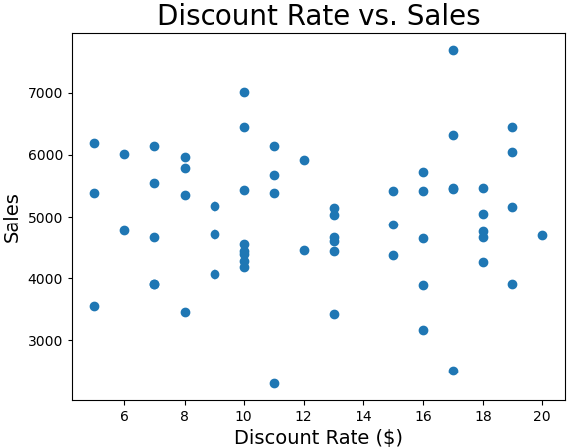
Visualizing Relationships
Notes:
Data visualization allows us to see patterns, relationship, and trends that may not be apparent from analyzing raw data alone. To visualize the relationship between sales and each of variable (Facebook ad spend, Instagram ad spend, Discount rate), we created three scatter plots. The first two scatter plots show that Facebook and Instagram ad spend and Number of Sales have a positive linear relationship. The linear relationship of the plotted points indicates moderate spread, suggesting there is a medium or strong correlation, which typically means that as one variable increases, the other variable also tends to increase. The next steps are to calculate the correlation coefficient and conduct a regression analysis to demonstrate the strength of this relationship.
According to the “Discount Rate vs Sales” scatter plot, the relationship between the two variables is weakly correlated. The points are widely dispersed, making a linear trend difficult to detect visually.

Slide 4
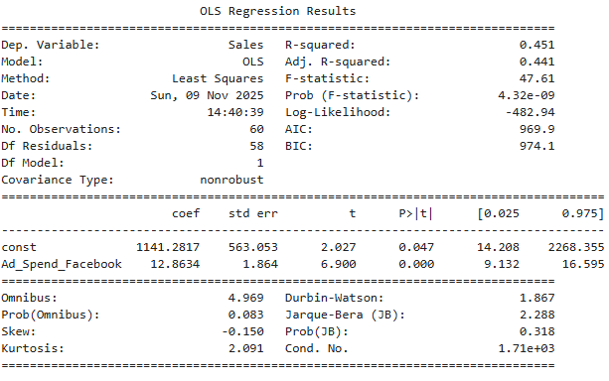
Simple Linear Regression
y = 1141.28 + 12.86 * x ,
where x – Facebook ad spend
y – Numer of Sales
Example:
Facebook ad spend is $300,
then y = 1141.28 + 12.86 * 300
y = 4999
Predicted Sales 4,999
Notes:
Now, we will run a regression analysis to find a simple linear regression that we can use to examine the relationship between two variables: Facebook ad spend and Sales. A Simple Linear Regression y = 1,141.28 + 12.86 * x, where x is independent variable, which in our case is the Facebook ad spend; y is dependent variable, which in our case is predicted number of sales; 1,141.28 is the y-intercept and 12.86 is the slope in this statistical model. We can use the model to predict the number of sales after a particular Facebook ad spend in a month. For example, if the company spends $300 per month on Facebook ads, the predicted number of sales would be y = 1,141.28 + 12.86 * 300 = 4,999. Overall, Facebook advertising spending is beneficial for the business. However, if we look at the coefficient of determination (R-squared) value, which measured the proportion of variance in the response variable explained by the explanatory variable, R-squared = 0.451. This suggests that the model provides a useful, moderate explanation of the variability in the data, but there is a still a large portion of variation that the current predictors do not capture.

Slide 5
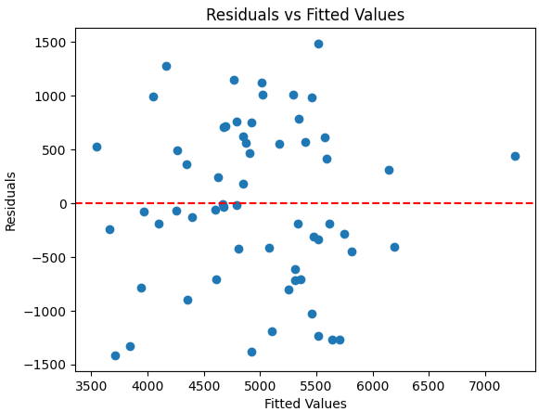
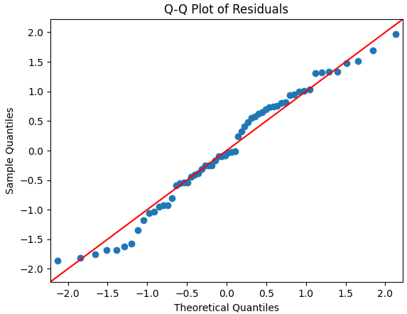
Assessing Model Fit
Notes:
Next, we will evaluate performance of the simple linear regression by analyzing residuals. On the slide we can see two plots. The plot on the left (Residuals vs Fitted Values) shows residuals from a linear relationship. The residuals are randomly scattered around the horizontal axis (zero lane), indicating that the simple linear regression model from the previous step is a good fit for the data. It also shows that the residuals have a consistent spread, which indicates that the model’s residuals are evenly distributed.
The plot on the right, Q-Q Plot of Residuals, help us to indicate if the model’s residuals are normally distributed. In practice, minor deviations are often acceptable, especially in large datasets. As we can see from the plot, we do not have significant deviations from the line. A few points near -1.5 a little bit far from the line might indicate outliers, which can affect normality, but overall pattern shows the residuals are likely normally distributed and small deviations are usually acceptable. This is suggests that the assumption of normality for the residuals in the regression model is reasonably met, supporting the reliability of the model's predictions.

Slide 6
Multiple Linear Regression (Question 5)
Notes:
Analysis Task:
Develop a multiple linear regression model using Facebook ad spend, Instagram ad spend, and discount rate to predict sales.
Compare this model’s performance to the simple linear regression model.
Slide Content:
Regression output and performance comparison.
Key insights about how these variables collectively influence sales.
Speaker Notes:
Interpret the coefficients of the multiple linear regression model.
Discuss how the model improves on the simple linear regression model.

Slide 7
Forecasting (Question 6)
Notes:
Analysis Task:
Construct both a 3-month moving average forecast and an exponential smoothing forecast for January 2025 (use a smoothing parameter of 0.80).
Choose the most reliable method based on TechGear’s preference for recent sales trends.
Slide Content:
Forecast results from both methods.
Recommendation of the most reliable method.
Speaker Notes:
Justify your choice of forecasting method.
Provide recommendations on how TechGear can use the forecast to optimize marketing strategies.

Slide 8
Machine Learning Models (Question 7)
Notes:
Analysis Task:
Build a multiple linear regression model using 5-fold cross-validation to predict future sales.
Build a decision tree model using 5-fold cross-validation to predict future sales.
Compare the performance of these models using RMSE and determine which one TechGear should select. Provide a reason for why TechGear should select the model you are suggesting.
Slide Content:
RMSE comparison and model selection.
Key insights from the best model.
Speaker Notes:
Explain why you selected the best model.
Interpret the RMSE and discuss its implications for decision-making.
Consider the $6,500 threshold and the potential range of actual sales.

Slide 9
Monte Carlo Simulation (Question 8)
Notes:
Analysis Task:
Estimate the average and median monthly sales by running 1,000 simulations.
Assume that daily sales follow a uniform distribution within the minimum and maximum sales values TechGear experienced over the last 60 months.
Use a random seed value of 42.
Interpret the standard deviation of the simulated monthly sales and explain its significance in understanding the variability of TechGear's sales.
Slide Content:
Histogram and summary statistics (average, median, and standard deviation).
Key insights on sales variability.
Speaker Notes:
Explain the significance of the average, median, and standard deviation.
Provide actionable insights for improving sales, budgeting, and operations based on the simulation.

Slide 10
Linear Programming (Question 9)
Notes:
Analysis Task:
Use linear programming to optimize TechGear’s monthly advertising budget allocation between Facebook and Instagram to maximize sales.
Ensure you meet all budget and constraint requirements.
Slide Content:
Optimal budget allocation and maximum sales result.
Speaker Notes:
Explain the optimal allocation between Facebook and Instagram advertising.
Describe the maximum achievable sales and how this allocation aligns with business goals.

