Slide 1
Super-Resolution with SRGAN
Perceptual Face Reconstruction using Adversarial Training
Olena Pinevych

Slide 2
Problem Statement
Single Image Super-Resolution (SISR) aims to reconstruct a high-resolution image from a low-resolution input.
Traditional interpolation methods (e.g., bicubic) fail to recover high-frequency details and produce over-smoothed results.
The objective of this project is to:
  Upscale facial images by ×4
  Preserve structural consistency
  Improve perceptual realism

Slide 3
Why GAN for Super-Resolution?
Pixel-wise losses (MSE) optimize for average reconstruction, which leads to blurry outputs.
GANs introduce adversarial learning:
Generator tries to produce realistic HR images
  Discriminator learns to distinguish real vs generated
  This pushes the model toward sharper and more natural textures.

Slide 4

Dataset Overview
For this project, we used the Human Faces dataset from Kaggle.
The dataset contains thousands of aligned facial images with diverse lighting conditions, skin tones, facial expressions, and backgrounds. The images are high-resolution and suitable for supervised super-resolution training.
The task setup is supervised:
High-resolution (HR) images serve as ground truth
Low-resolution (LR) images are generated artificially from HR images
This allows controlled training with exact pixel correspondence.

Slide 5
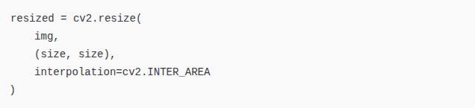
Data Preparation Pipeline
The original dataset contains only high-resolution images.
Low-resolution inputs are generated by downscaling HR images.
Preprocessing steps:
Load original HR images
Normalize pixel values to range [-1, 1]
Downscale HR images to generate LR images (×4 scale)
Store both HR and LR versions
This ensures perfect alignment between LR and HR pairs.
Example downscaling:

Slide 6
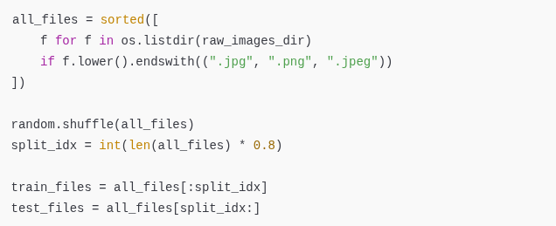
Train / Test Split
The dataset was split into training and testing sets using a random shuffle.
The split ratio:
  80% training data
  20% testing data
Random permutation was applied before splitting to ensure data diversity.
This ensures that:
The model does not see test images during training
Evaluation reflects generalization ability

Slide 7
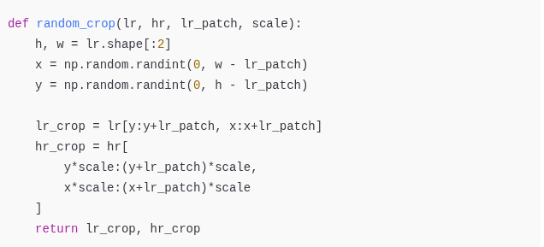
Patch-Based Sampling
Instead of training on full-resolution images, the model is trained on random patches.
Patch sizes:
  HR patch: 64×64
  LR patch: 16×16
  Scale factor: ×4
Random cropping is performed during training:
Advantages of patch-based training:
  Reduces GPU memory usage
  Increases training speed
  Provides more diverse local textures per epoch
  Improves convergence stability

Slide 8
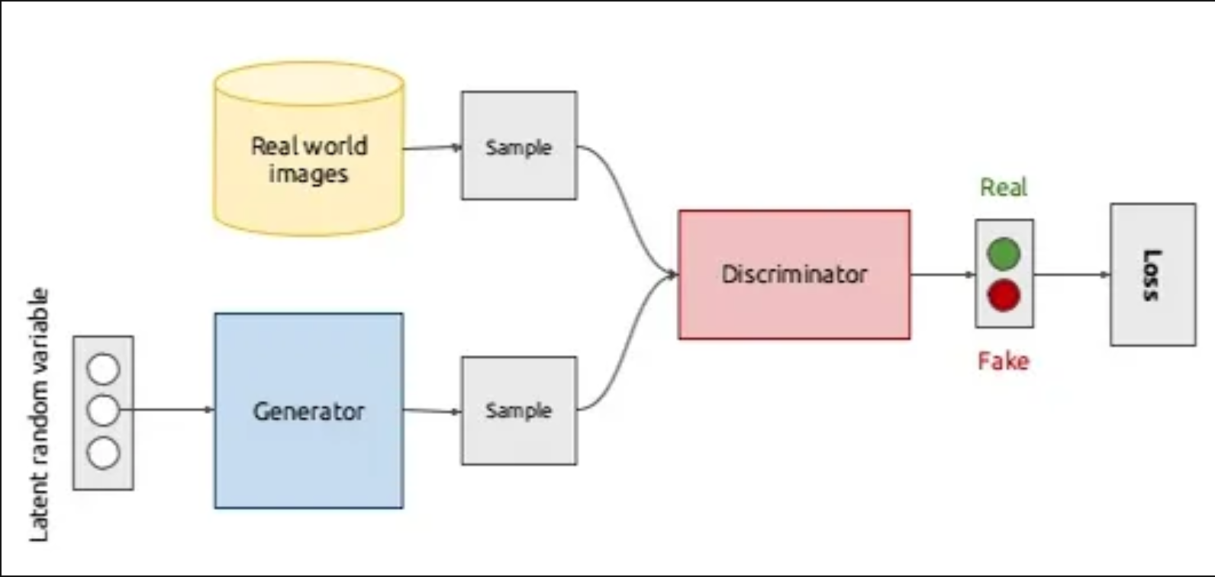
Overall Architecture
The system consists of:
  Generator (upsampling network)
  Discriminator (real/fake classifier)
  VGG19 (perceptual feature extractor)
During inference, only the generator is required.

Slide 9
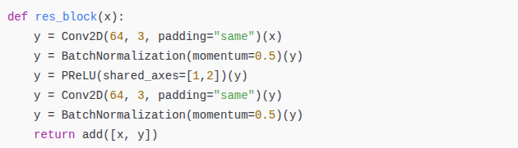
Generator Architecture
Core Residual Block
The generator follows the SRGAN design:
  Initial 9×9 convolution
  Residual blocks
  Skip connection
  Two upscaling blocks (×4 total scale)
  Final tanh activation
Residual learning improves gradient flow and stability.

Slide 10
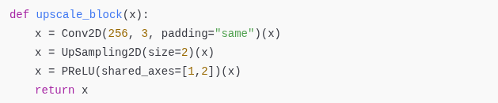
Upscaling Mechanism
Upscaling is performed using convolution + upsampling:
Two such blocks result in ×4 resolution increase.

Slide 11
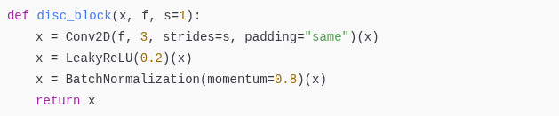
Discriminator
The discriminator is a CNN classifier trained to distinguish:
  Real HR images
  Generated SR images
It improves perceptual realism via adversarial feedback.

Slide 12
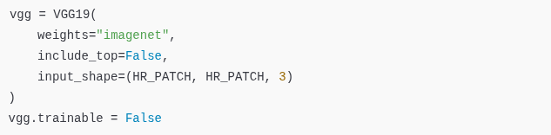
Why VGG Perceptual Loss?
Instead of comparing pixels directly, we compare deep features extracted by VGG19.
This encourages:
  Better structural similarity
  Sharper edges
  Realistic textures
Perceptual loss operates in feature space, not pixel space.

Slide 13
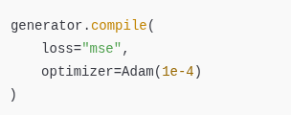
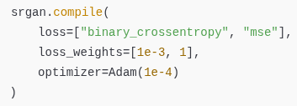
Two-Stage Training Strategy
Stage 1 — Generator Pretraining (MSE)
Ensures stable spatial reconstruction before adversarial training.
Stage 2 — Adversarial Fine-Tuning
Generator loss combines:
  Adversarial loss
  Perceptual (VGG) loss
This balances realism and structural fidelity.

Slide 14
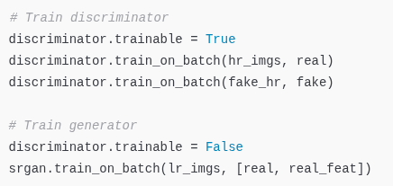
Training Loop Logic
GAN training alternates between:
  Train discriminator
  Freeze discriminator
  Train generator

Slide 15
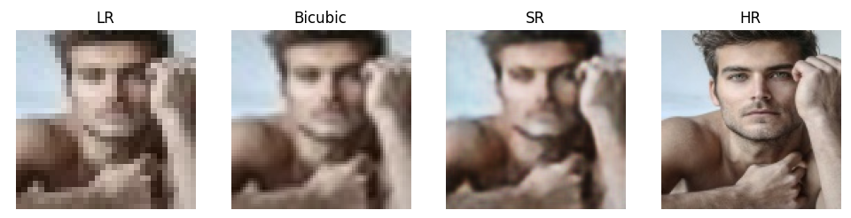
Results After Pretraining
Observations:
  Comparable to bicubic
  Structurally consistent
  Slight smoothing remains

Slide 16
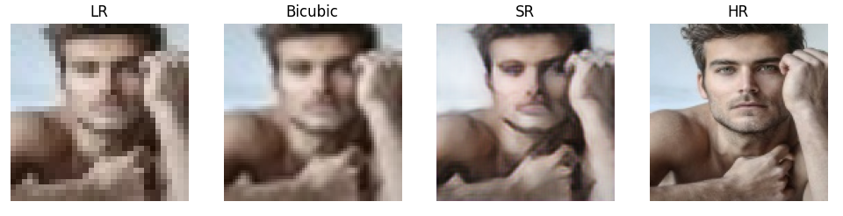
Results After GAN Fine-Tuning
Improvements:
  Sharper contours
  Better micro-textures
  Reduced over-smoothing

Slide 17
Improvements Over Previous Version
Compared to the initial course implementation:
  Added mandatory generator pretraining
  Stabilized GAN training
  Corrected Keras training graph logic
  Implemented patch-based training
  Added bicubic baseline comparison
  Improved reproducibility
The current implementation produces stable and consistent results.

