Slide 1

CREDIT ONE PROJECT

Slide 2
Contents
1. INTRODUCTION
2. TARGETS
3. DATA SCIENCE PROCESS FRAMEWORK
4. DATA SET INFORMATION
5. EXPLORATORY DATA ANALYSIS
6. NEW CRITERIA
7. MODELING
Client Status Next Month Model
Demographic Data Models
8. CONCLUSIONS AND PROPOSALS
9. LIMITS
10. RECOMMENDATIONS

Slide 3
CREDIT ONE
CREDIT ONE is an issuer of credit cards and credit scoring service company with over 10 years of experience and facilities in over 20 locations in Taiwan. CREDIT ONE works with most financial institutions in market.

Slide 4
Introduction
Due to Taiwan’s credit card crisis Credit One has seen an increase in the number of customers who have defaulted on loans they have secured from various partners
That is the reason why the company should modify the requirements of credit card and find solutions in order to avoid risk losing market share

Slide 5
Targets
New criteria
Credit limit
Debts solutions
Find a much better criteria to know if a customer should be approved or not
Understand how much credit to allow a client
Propose solutions to deal with not credible client's debts

Slide 6
Data science process framework
Obtaining and Preprocessing data
EDA using data mining methods
01
02
Modeling using machine learning methods
03
04
Data and libraries import
General reformatting
Duplicates and null values
Type reformatting
Univariate Analysis
Bivariate Analysis
Multivariate Analysis
Data selection and dividing
Models building
Choosing the best model

Slide 7
Data set information
2396 credit card holders information:
Amount of the given credit
Sex
Education
Marital status
Age
Amount of bill statement (for 6 months)
Amount of previous payment (for 6 months)
Client's behavior (default/not default)

Slide 8
EXPLORATORY DATA ANALYSIS

Slide 9
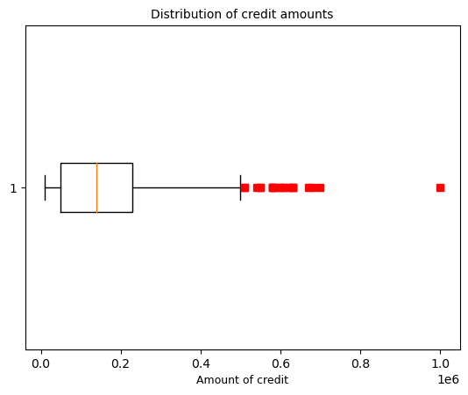
Amount of the given credit
The credit limit appear to be mostly between 50k and 230k.
The minimum credit limit is 10k, the maximum amount is 1M

Slide 10
Distribution of clients by sex
58%
46%
WOMEN
MEN

Slide 11
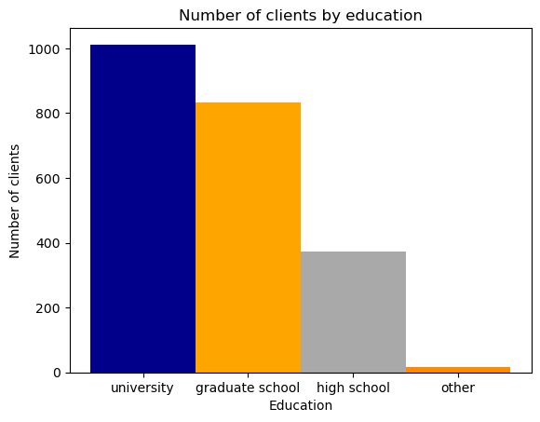
Education of clients
University – 45%
Graduate school - 38% High school - 16%
Other – 1%

Slide 12
Marital status
56%
SINGLE
43%
MARRIED
1%
DIVORCE AND OTHER

Slide 13
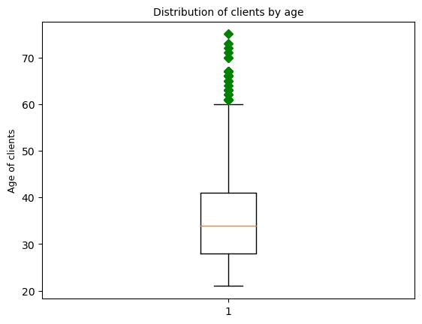
Age of clients
The clients are 21-60 years old. There are some older clients (outliers) up to 75 years old.
Average age – 35 years old
Median age – 34 years old
The clients between the ages of 28 and 41 get the biggest part of credit cards.

Slide 14
New criteria
To define the client next month status, we should compare the amount paid in a month with a 10% of a previous bill statement amount.
If the monthly payment is less than 10% of the debt accumulated in the previous month, the client should be considered as 'default'.

Slide 15
Comparison of results
21%
50%
Old criteria
New criteria
Defaulted clients
Defaulted clients
Not defaulted clients
Not defaulted clients

Slide 16

MODELING

Slide 17
Client Status Next Month Model
In order to solve a problem of the actual debts of defaulted clients and find out which part of debts could be restructured, which part needs to be blocked and which one should be sold, we have built a mathematical model to predict clients default payments.

Slide 18
Client Status Next Month Model
Response variable (Y) | Binary variable, default payment (default / not default)
Independent variable (X) | X1: Amount of the given credit, it includes both the individual consumer credit and his/her family (supplementary) credit; X2-X6: Amount of previous payment. X2 = amount paid in April, X3 = amount paid in May; . . .; X6 = amount paid in August; X7-X11: Amount of bill statement. X7 = amount of bill statement in April, X8 = amount of bill statement in May, . . . , X11 = amount of bill statement in August; X12-X15: Amount of spent money. X12 = amount of spent money in May, X13 = amount of spent money in June, . . . , X15 = amount of spent money in August.

Slide 19
Premodeling Processes
1
2
3
4
5
Data Scaling
Data Splitting
Data Smooting
Cross-Validation
Hyperparameters
tuning
Split data into training and test sets
Remove noise or irregularities from a dataset
Estimate the performance of the model
Transform all values of independant variable into new values that are easier to compare
Optimization of hyperparameters of the model using gridsearch & randomizedsearch functions

Slide 20
Model accuracy comparison
Classifier | Model Accuracy
Decision Tree Classifier | 88 %
Random Forest Classifier | 88 %
Gradient Boosting Classifier | 94 %
We did not notice a difference between Decision tree and Random Forest classifiers, Gradient Booster is the improved version with the best accuracy.

Slide 21
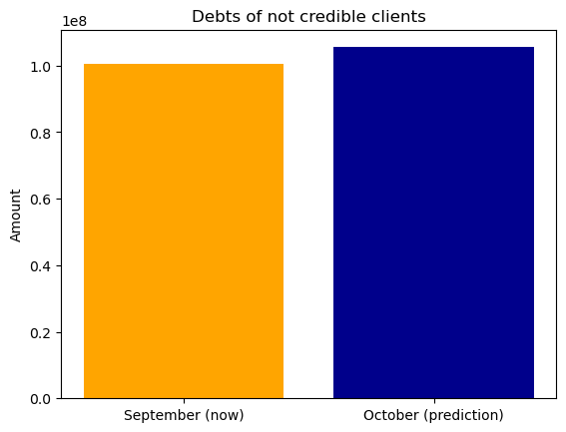
Debts of not credible clients
According to predictive model, next month Credit One risks losing more money than now

Slide 22
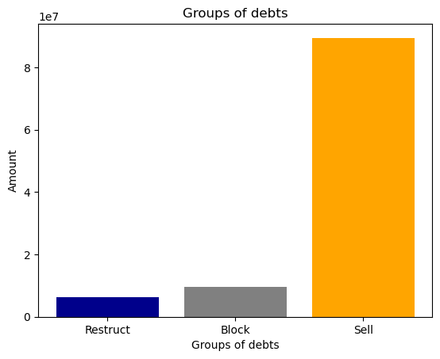
Business results
Restructuring
Blocking
Selling
Clients who are considered in September as 'not default' and in October as 'default
Clients whose payback time is less than 1 year and considered as 'default’ in September and October
Clients whose payback time is more than 1 year and considered as 'default’ in September and October
These are our assumptions for this project, but it is possible to modify them if necessary (for example, increase payback time or add another one indicator (for example, average delay time)

Slide 23
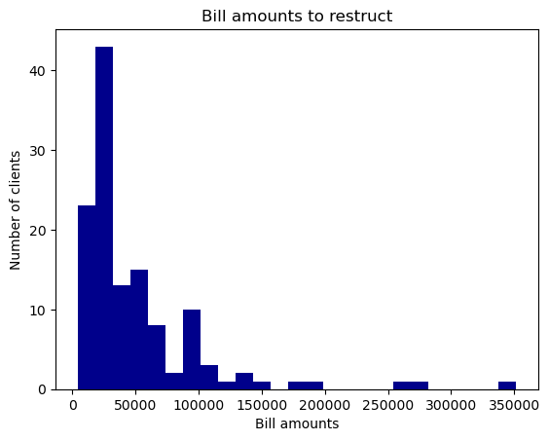
Debts to restruct
Reduce the payback time and establish a new one

Slide 24
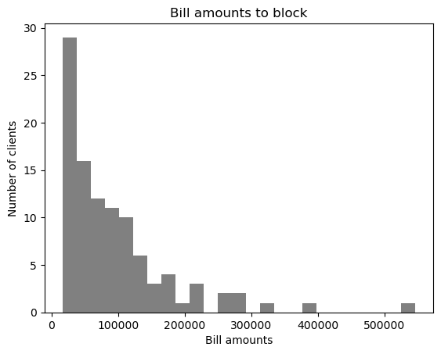
Debts to block
Block the credit line until the complete debt amount has been repaid

Slide 25
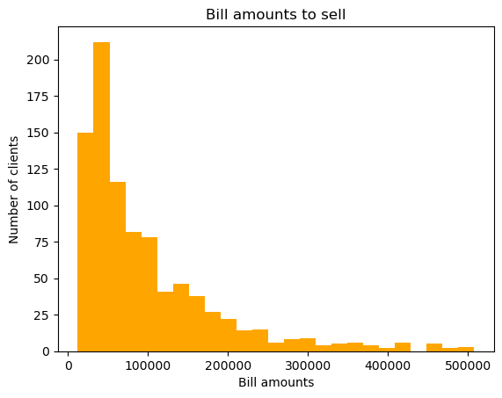
Debts to sell
Sell the debts to a third person (debt collectors)

Slide 26
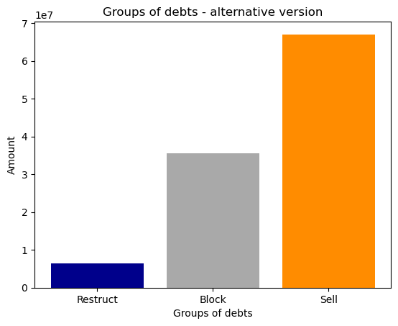
Alternative business results
Restructuring
Blocking
Selling
Clients who are considered in September as 'not default' and in October as 'default
Clients whose payback time is less than 2 years and considered as 'default’ in September and October
Clients whose payback time is more than 2 years and considered as 'default’ in September and October

Slide 27
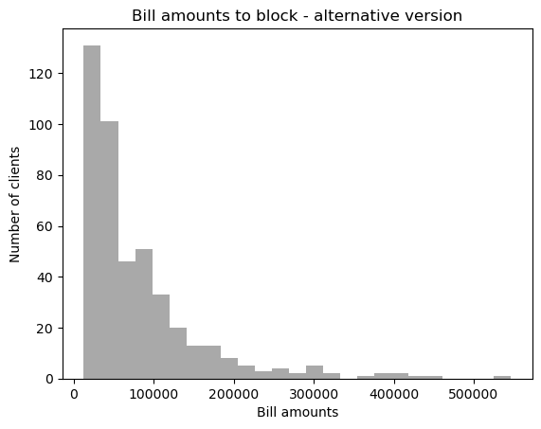
Debts to block
Block the credit line until the complete debt amount has been repaid

Slide 28
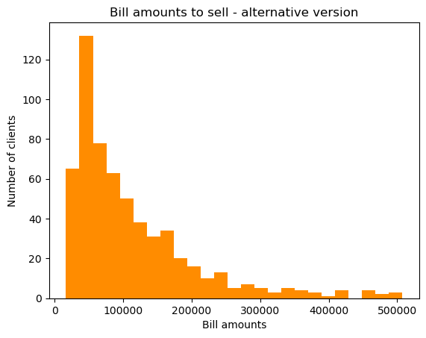
Debts to sell
Sell the debts to a third person (debt collectors)

Slide 29
Demographic Data Models
To improve future customer acquisition and not repeat the same mistakes (some approved customers ended up being defaulted), we have built another mathematical model that operates on the basis that we have only demographic variables.
For Credit One this is a new client, therefore we do not have his payment history.
This model is divided into the 2 submodels:
1st model will try to predict clients default payments;
2nd model will try to find out which credit segment should be assigned to a client.

Slide 30
Demographic Data Models
 | PREDICTION OF AMOUNT GIVEN | PREDICTION OF DEFAULT
Response variable (Y) | Integer variable ‘Amount of the given credit’ (data is splited into 7 groups) | Binary variable, client's status: not default/default
Independent variable (X) | X1 Age (years) X2 Gender (male; female). X3 Education (graduate school; university; high school; others) X4 Marital status (married; single; divorce; others) | X1 Age (years) X2 Gender (male; female). X3 Education (graduate school; university; high school; others) X4 Marital status (married; single; divorce; others)

Slide 31
66%
41%
Model accuracy
DEFAULT PREDICTION
MODEL
CREDIT GIVEN PREDICTION MODEL

Slide 32
Business results
Join
Default
Credit limit
STEP 1
STEP 2
STEP 3
Joining two models into one function
Predict client's status (default / not default)
Predict credit limit for credible client

Slide 33
Conclusions and proposals

Slide 34
Conclusions and proposals
The credit limit appear to be mostly between 50k and 230k. The minimum credit limit is 10k, the maximum amount is 1M.
The age distribution of clients follows the population pyramid, where the largest group is people between 28 and 40 years old and there are more women (58%) than men (46%).
More than half customers are single (56%), the next largest group are the clients with the status ‘married’ (43%).
Most of the clients have education ‘university’ (45%), on the second place are the clients with ‘graduate school’ education (38%).
The new criteria to define the client next month status is based on a comparison the monthly payment amount with a 10% of a previous bill statement amount.

Slide 35
Conclusions and proposals
The best classifier for Client status next month model is Gradient Boosting Classifier (93% accuracy).
On may propose the 3 solutions to deal with the not credible client's debts:
Debts restructuring. Reduce the payback time and establish a new one.
Credit blocking. Block the credit line until the complete debt amount has been repaid.
Debts selling. Sell the debts of the clients to the third person (debt collectors)
Using a function built by joining 2 models based only on demographic data we are able to identify clients who will be defaulted or not defaulted and after that we will know the credit limit for clients who have the right of admission.

Slide 36
Limits
We have client payment history only for 6 months
We don’t know interesting rate
We don’t know client’s assets, monthly incom
We cannot control customer spending habits
We removed outliers (clients who have credit limit > 600k and those who have a negative value in columns spent amount as well ) in order to increase a model accuracy.

Slide 37
Recomendations
To improve EDA and predictive models the following information is required:
Client’s payment history for 1 year or more
Interesting rate
Customer´s assets and monthly incom

Slide 38
Thanks!
Do you have any questions?
elena_bezmenova@gmail.com
+34 656 579 838

