Slide 1
Analysis of energy consumption
Presentation by
Elena Bonan

Slide 2
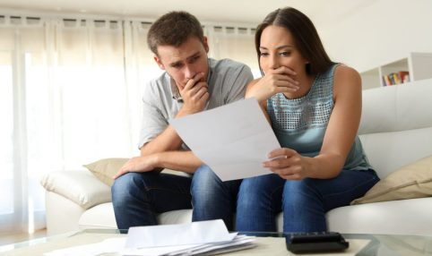
GOAL
Show the useful information
that the house-owner
can get from the
sub-metering devices

Slide 3
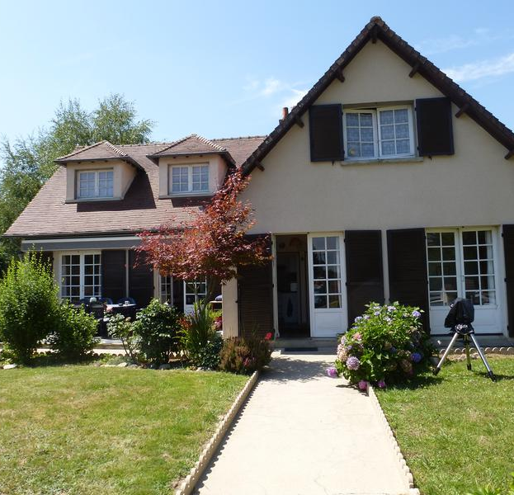
Our sample
A big house
(3 floors, 4/5 people)
in Nord of France
was monitored
from 2007-01-01
to 2010-11-26

Slide 4
The data we have examined
For every minute we know the active energy in
Sub-metering 1
( a dishwasher, an oven and a microwave )
Sub-metering 2
(a washing-machine, a tumble-drier,
a refrigerator and a light)
Sub metering 3
(a water-heater and an air-conditioner)
All the other devices
( sleeping rooms, living room, etc)

Slide 5
It is possible to study the energy by
Year
Month
Day
Hour/minute

Slide 6
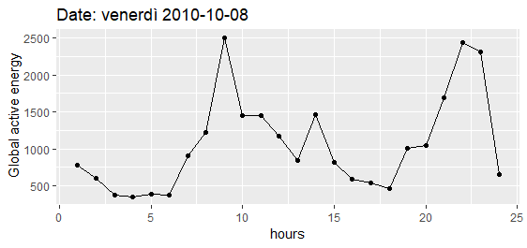
Energy consumption during the day
Wednesday 2010-10-08

Slide 7
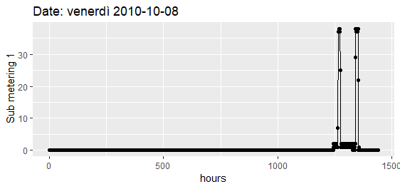
Sub-metering 1 ( a dishwasher, an oven and a microwave )
Wednesday 2010-10-08
8:20
16:40
23:59

Slide 8
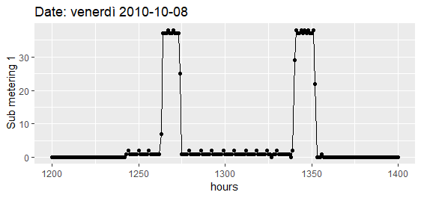
Zoom in sub-metering device 1
Dishwasher
Time: 1h & 53 min
Energy: 1kWh
Wednesday 2010-10-08
20:00
20:50
21:40
22:30
23:10

Slide 9
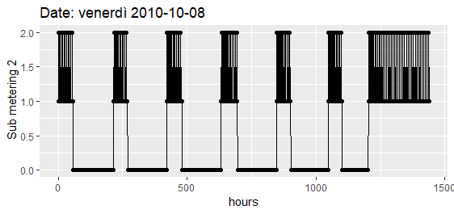
Sub-metering 2
Refrigerator
Stop: 2 h & 37 min
Work: 54 min 74 Wh
500 Wh per day
Alert!
Unexpected situation
Wednesday 2010-10-08
8:20
16:40
23:59

Slide 10
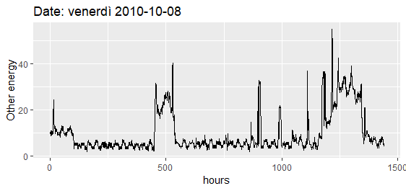
Other devices
Wednesday 2010-10-08
Peaks of energy
8:20
16:40
23:59

Slide 11
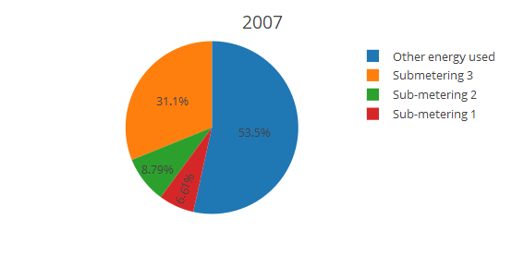
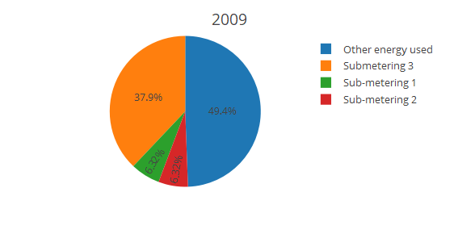

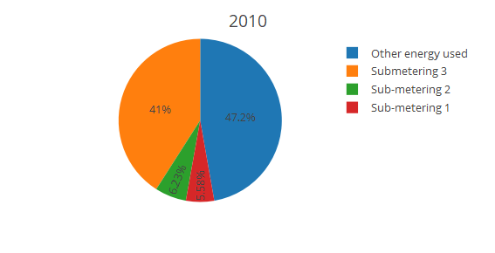
Energy consumption during the years
Global active power: 9376 kWh

Slide 12
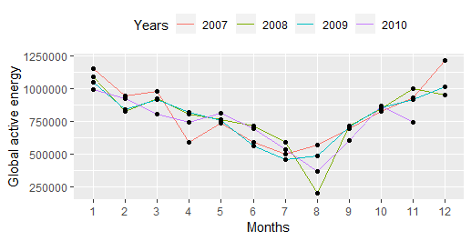
Energy consumption during the months

Slide 13
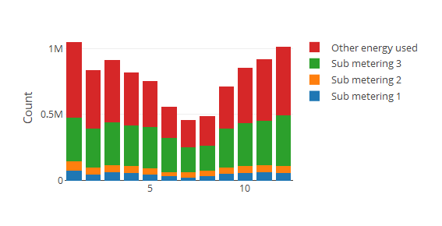
Where the energy is used

Slide 14
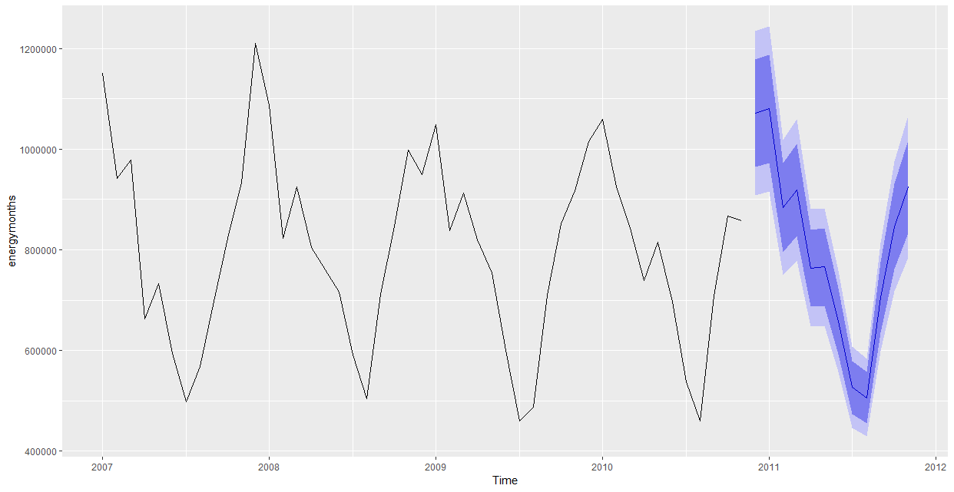
Forecast by month using Holt-Winter(M,N,M)

Slide 15

Predicted
active energy in
919 kWh
80%
March
828 kWh
1011 kWh
95%
779 kWh
1059 kWh

Slide 16
Summary
Control the behaviour of the of the electrical devices
Alert for anomal situations
Forecast the energy consumption
Recommendation: monitor the devices
where most of energy is consumed!

Slide 17
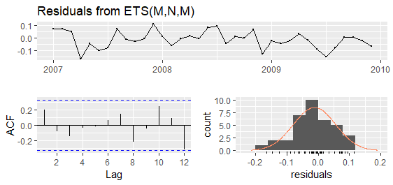
INFORMATION ABOUT THE MODEL
MAPE: TRAINING: 5.44 TESTING : 5.40
Residuals in the training test

