Slide 1
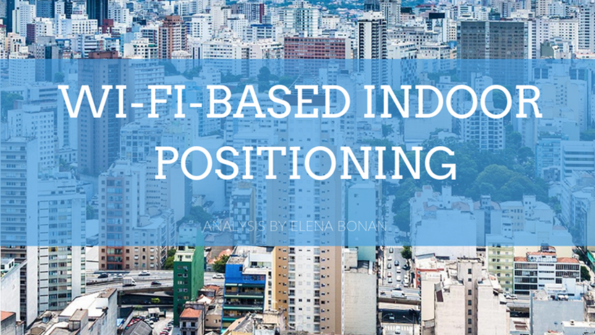

Slide 2
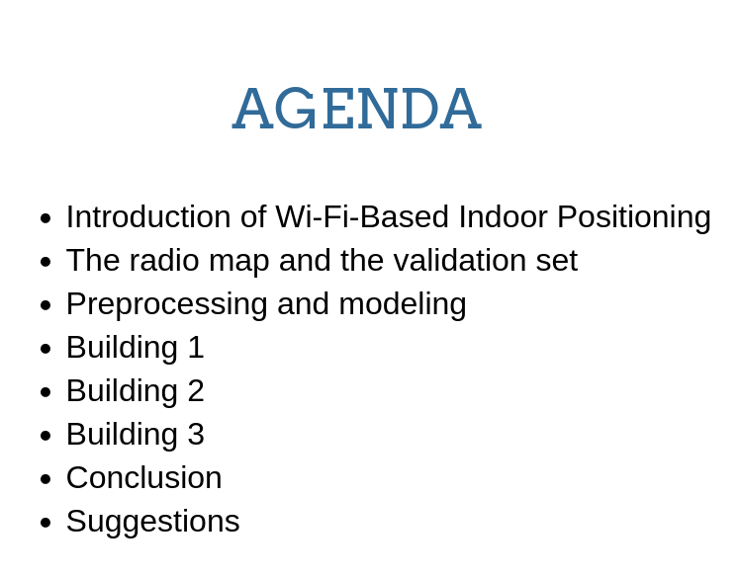
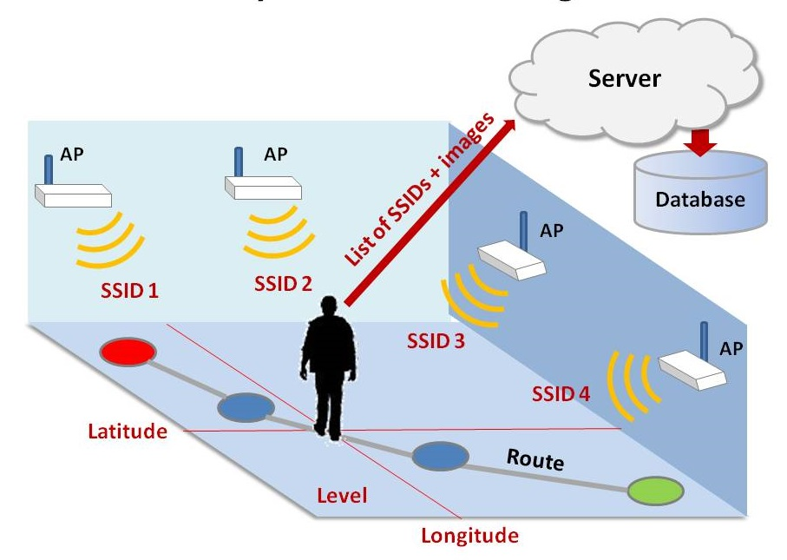

Slide 3
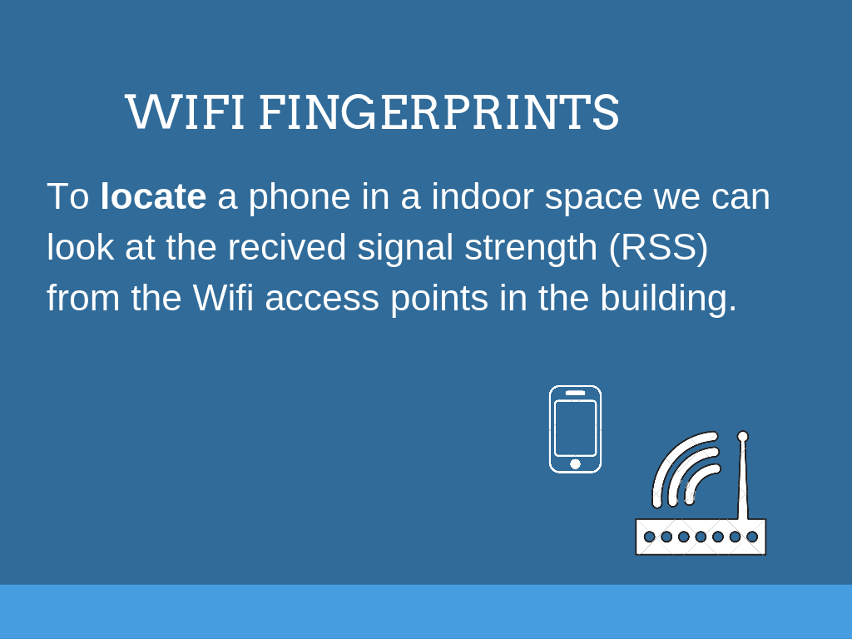

Slide 4
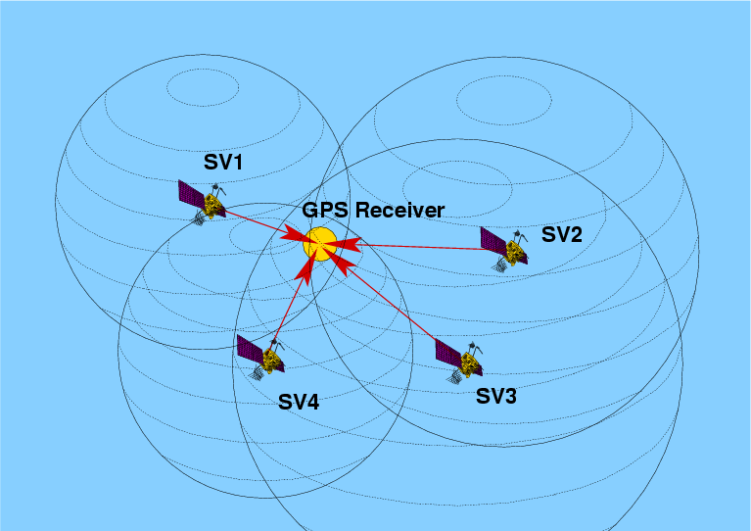
A DIFFICULT PROBLEM
Have an accurate propagation model for the signals of WAPS in a indoor real word enviroment is extremly difficult. We can not use an approach similar to GPS.
Location fingerprints techniques use empirical data to approximate a location.
Let us show what we did with the data of the University of Jaume I ….

Slide 5
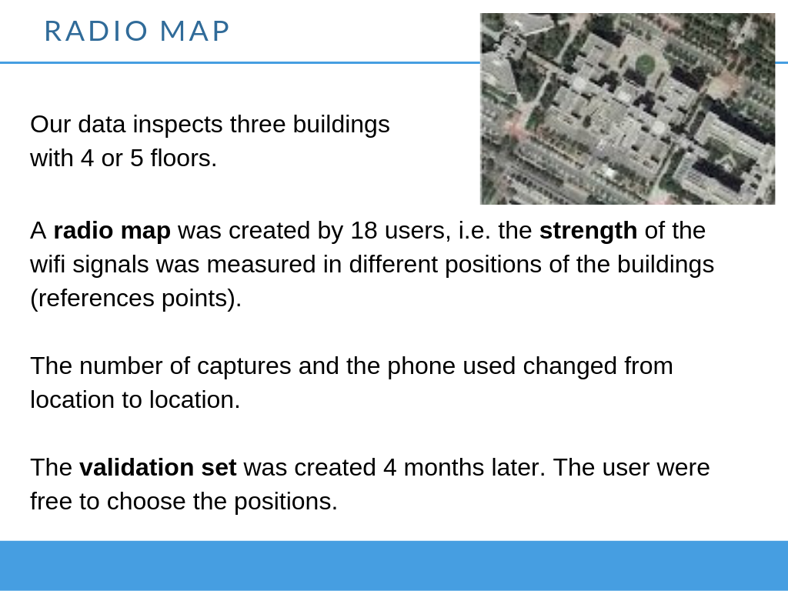

Slide 6
Eliminate WAPS with no signal
Eliminate duplicates
Eliminate the observations with strange signals
Locate the waps
Preprocessing:
Modeling:
PREDICT BUILDING
B1
Waps: 120
Istances: 5245
B2
Waps: 108
Istances: 4903
B3
Waps: 76
Istances:9076
FLOOR LONGITUDE LATITUDE
FLOOR LONGITUDE LATITUDE
FLOOR LONGITUDE LATITUDE

Slide 7
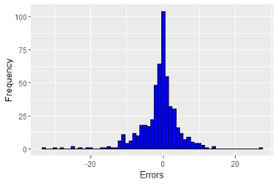
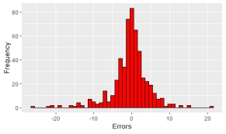
BUILDING 1
FLOOR
LONGITUDE
LATITUDE
Random forest
Mtry = 10
Knn
k = 4
Knn
k = 4
Accuracy | Kappa
97% | 98%
RMSE | R2 | MAE
5.66 | 96% | 3.55
RMSE | R2 | MAE
4.93 | 98% | 3.22
Real
 | 0 | 1 | 2 | 3
0 | 74 | 2 | 0 | 0
1 | 2 | 206 | 3 | 0
2 | 1 | 0 | 161 | 2
3 | 0 | 0 | 1 | 83
Predicted

Slide 8
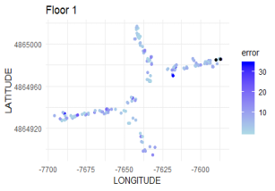
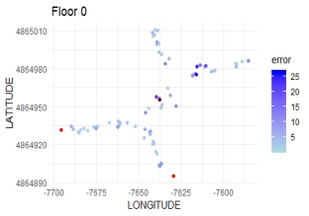
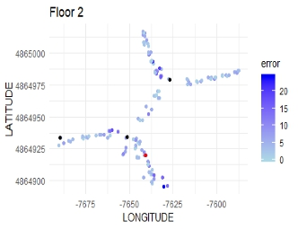
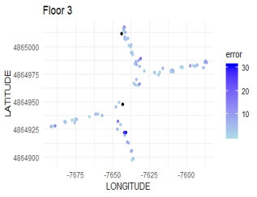
POSITION OF THE ERRORS
+1 floor
+2 floors
-1 floor

Slide 9
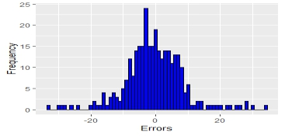
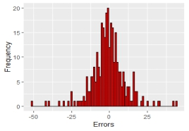
BUILDING 2
FLOOR
LONGITUDE
LATITUDE
Accurac
96%
SVM
Kernel = radial
Random forest
Mtry = 36
Random forest
mtry = 36
Accuracy Kappa
84% 78%
RMSE | R2 | MAE
9.09 | 96% | 6.57
RMSE | R2 | MAE
11.06 | 90% | 7.71
Real
 | 0 | 1 | 2 | 3
0 | 22 | 5 | 0 | 0
1 | 5 | 109 | 1 | 2
2 | 3 | 28 | 84 | 2
3 | 0 | 1 | 2 | 43
Predicted

Slide 10
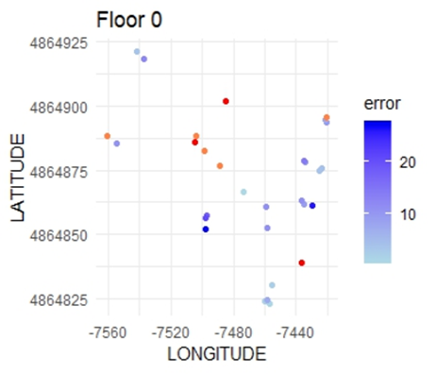
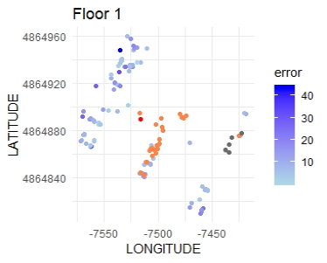
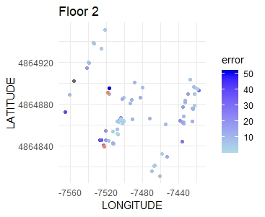
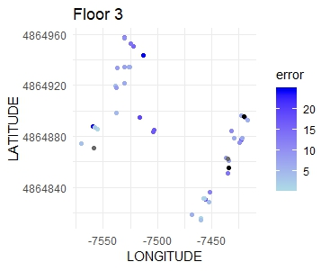
POSITION OF THE ERRORS
+1 floor
+2 floors
-1 floor
-2 floors

Slide 11
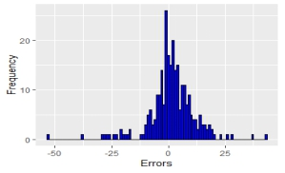
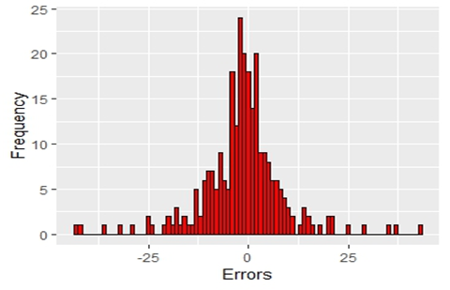
BUILDING 3
FLOOR
LONGITUDE
LATITUDE
Accurac
96%
Random forest
mtry = 8
Random forest
mtry = 25
KNN
k = 5
Accuracy Kappa
95% 93%
RMSE | R2 | MAE
10.23 | 90% | 6.86
RMSE | R2 | MAE
10.36 | 88% | 6.84
Real
Predicted
 | 0 | 1 | 2 | 3 | 4
0 | 21 | 0 | 0 | 0 | 0
1 | 3 | 110 | 1 | 0 | 1
2 | 0 | 1 | 51 | 0 | 0
3 | 0 | 0 | 2 | 39 | 5
4 | 0 | 0 | 0 | 1 | 32

Slide 12
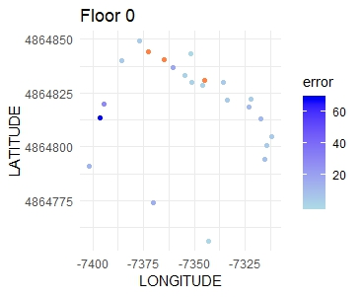
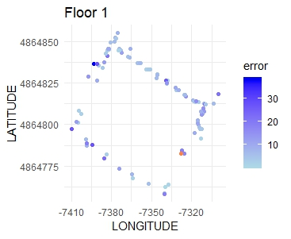
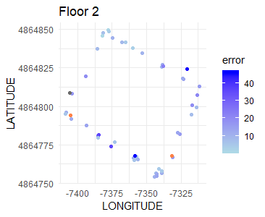
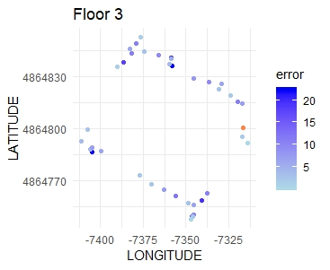
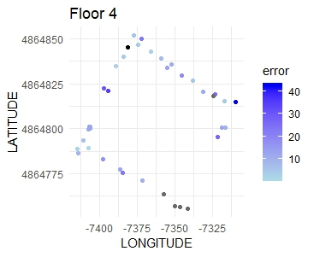
+1 floor
-1 floor
-3 floors

Slide 13
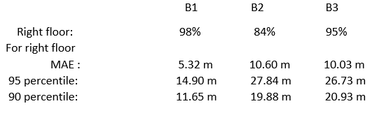
Recap of the results:
CONCLUSIONS:
For building 1 the model could help people to find the position. In the other two cases the errors are too high for a concreate application.
The errors we got are relate to: the shape of the bulding, the number and the distribution of observation in the training set, human errors and change in the enviroment.

Slide 14
How to improve the performance
Better radio map
Same number of observation per reference point
Same devices for every place. Possibly more then one
Declare the position and behaviour of the wifi- routers
More sophisticated machine learning algorithms
Cluster filtered knn
Fuzzy C-means clustering
Adaptive K-nearest point

