Slide 1
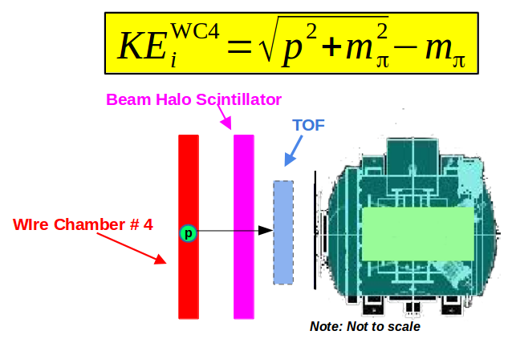
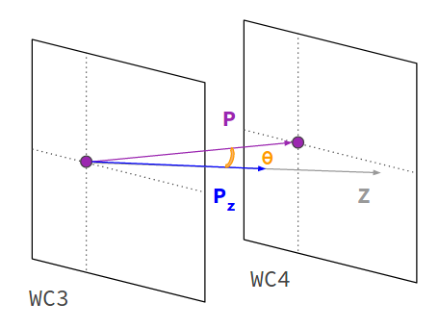
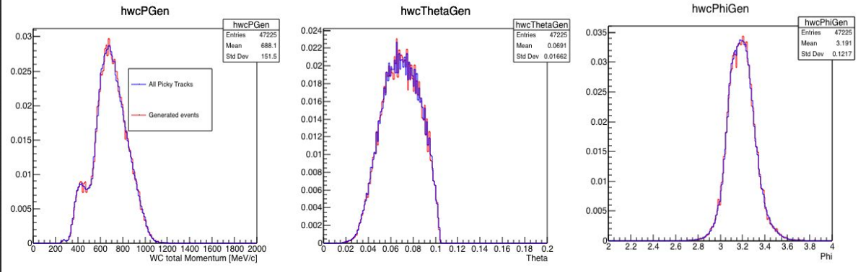

Slide 2
TPC Front Face

ΔY
Reconstructed Track

α
ΔX
Wire Chamber Track

