Slide 1
Before launching the quadrants :
Q1 : what do you want to call your IoT ?.
Q2 : what are the subsystems ?.
Q3 : what characteristics are relevant ?.
Q4 : what information items are involved in each subsystems (must be factored in when it comes to assessing a characteristics – 3rd dimension)

Slide 2
Before launching the quadrants :
Q0 : existing or new IoT ?.
Q1 : what do you want to call your IoT ?.
=> ventilator xyz
Q2 : what are the subsystems / services ?.
=> Srv1 : Breath sync / Srv2 : Pressure Measurement / Srv3 : Position Logging
Q3 : what characteristics are relevant ?.
=> Ch-Srv1 : availability , integrity , confidentiality , authentication , human/trust
Q4 : what information items (comes from sensors S1 , S2 , S3) are involved in each subsystem/service (must be factored in when it comes to assessing a characteristics – 3rd dimension)
II1-Srv1 : breathing frequency , II2-Srv1 : end-expiratory pressure , II3-Srv1 : position logging.

Slide 3
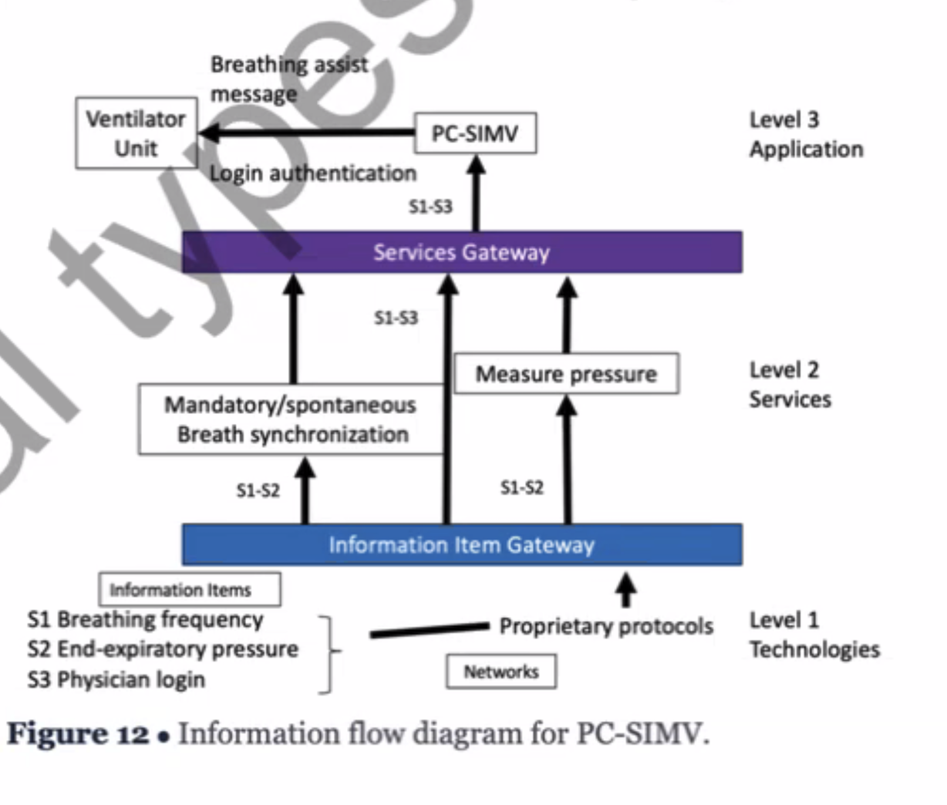
S1 : (S1P)processing / (S1T) transmission / (S1S) storage / (S1I) in-use ( by the user )
S2 :
S3 :
20 things that need to be dealt :
Give name for subsystem output
Add to Q4 a list/tree for services and characteristics and information items
Move PDF in Q4 to AI/Chatbot area in Q2.
* Top : service
* Bottom : description / requirement.
Interactive interface that will prompt me for inserting JSON input for a new system or edit an existing one.

Slide 4
Product description
Json
cubies
Fill out the table
I Subsystems
II properties
I – Assurance Risks
II Characteristics
Confidentiality
Transmission
T
Availability
Storage
Processing
In Use
Integrity
S
P
I
Authentication
Human/Trust
T
S
P
I
T
S
P
I
T
S
P
I
technology
policy and practice
training, education, and awareness
Technology measures
1
1
Training and Education Awareness measures
2
3
4
5
Policy and practice measures
2
3
4
5
1
2
3
4
5
Technology measures
Policy and practice measures
Training and Education Awareness measures

