Slide 1
IEEE SMC 2026 · Oral Presentation
Semantic-Aware Task Offloading with
Joint Source–Channel Coding in
Mobile Edge Computing
A MAPPO + Deep-Learning JSCC framework for bandwidth-efficient, low-latency offloading
Yihui Yan · Bo Xiao
MoE Engineering Research Center for Software/Hardware Co-Design Technology and Application
School of Software Engineering, East China Normal University, Shanghai, China

Slide 2
1
MOTIVATION
The Transmission Bottleneck in MEC
MEC offloads heavy computation from resource-limited User Equipment (UE) to nearby edge servers.
Raw-bit pipeline vs. Semantic pipeline
But large payloads — images, video, high-dimensional sensor data — make uplink delay and energy overwhelm any remote-compute saving.
Conventional (a²=0)
Raw data → full volume d
Conventional separate source–channel coding hits a cliff-edge failure when the wireless channel fluctuates.
▼
Large uplink → high delay & energy
Our angle — Deep-learning JSCC
Semantic JSCC (a²=1)
Semantic features → α · d (α≈0.3)
A learned encoder extracts a low-dimensional semantic representation and maps it directly to channel symbols.
▼
Far smaller bandwidth ratio at equal task quality; graceful degradation instead of a cliff effect.
Small uplink → low delay & energy
MAPPO-JSCC · IEEE SMC 2026
2

Slide 3
2
RESEARCH GAP & CONTRIBUTIONS
What We Add
Gap: Prior semantic-MEC work treats the neural encoder as a free resource — its on-UE compute footprint and its coupling with offloading decisions remain underexplored.
1
2
3
System & Fidelity Model
Dec-POMDP + MAPPO-JSCC
Extensive Evaluation
Multi-user MEC with JSCC support. Each task triggers a two-tier UE decision, and a semantic-fidelity function is calibrated from PSNR-vs-SNR measurements of a pre-trained model.
We cast joint offloading and coding-mode selection as a Dec-POMDP and propose MAPPO-JSCC, a multi-agent PPO algorithm that coordinates both decisions.
Across user counts and bandwidths, MAPPO-JSCC cuts total system cost versus RL baselines and fixed heuristics — the advantage amplifying under bandwidth scarcity.
MAPPO-JSCC · IEEE SMC 2026
3

Slide 4
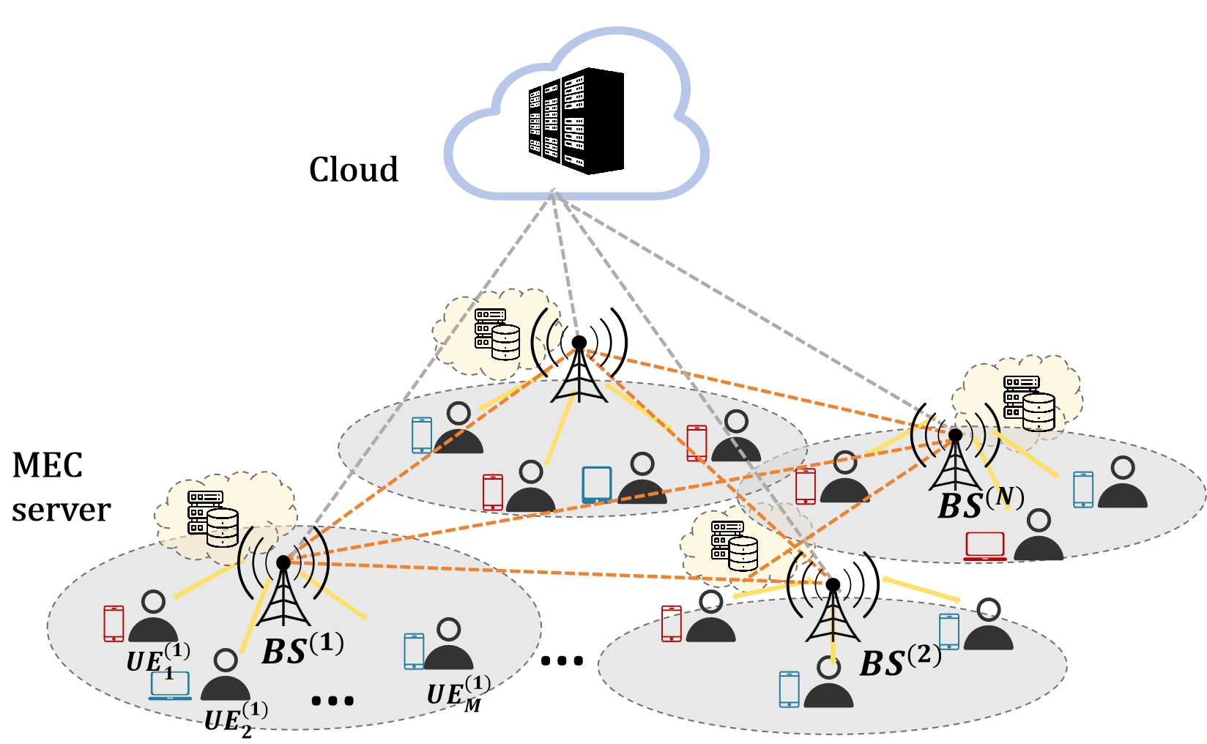
3
SYSTEM MODEL
User–Edge–Cloud Collaboration
N mobile UEs, M edge servers and a remote cloud provide K service types over discrete time slots.
Each arriving task (workload w, data size d) triggers a two-tier decision at the UE.
Tier 1 — Offloading target a¹
local · edge · cloud { 0, 1, 2 }
Tier 2 — Communication mode a²
separate coding (0) · semantic JSCC (1)
active only when offloading (a¹ ≠ 0)
Semantic-aware MEC (SA-MEC): N UEs, M edge servers, one cloud.
MAPPO-JSCC · IEEE SMC 2026
4

Slide 5
4
JSCC MODEL
Semantic Communication, Overhead & Fidelity
Encoder & effective volume
End-to-end learned codec
z = f_{ϕ}(x) α = l / n ∈ (0, 1]
Source
x
→
Encoder
fφ (UE)
→
Decoder
gψ (ES)
d′ = α · d (semantic) d (conventional)
On-UE encoding overhead (ignored by prior work)
Channel y = h·z + n · frozen after pre-training, reused as a black-box codec
t_{enc} = C_{enc} / f_{u} E_{enc} = κ f_{u}² C_{enc}
Per-inference JSCC cost, added only in semantic mode.
α ≈ 0.3
R² > 0.97
Semantic fidelity → distortion
S(γ) = S_{max} / ( 1 + exp[ −η_{s}(γ − γ₀) ] )
q = 1 − S(γ)
channel uses per source symbol
logistic fidelity fit quality
Logistic fit R² > 0.97 — smooth, cliff-free degradation as SNR drops.
MAPPO-JSCC · IEEE SMC 2026
5

Slide 6
5
PROBLEM FORMULATION
Cost Model & Dec-POMDP
Scalar per-task cost (delay, energy, distortion each normalized to [0,1])
C_{i} = ω_{T} t̄_{i} + ω_{E} Ē_{i} + ω_{q} q_{i} r_{i} = − C_{i}
Delay & energy per offloading action a¹
Formulated as a Dec-POMDP
LOCAL
t = w / f_{u} , E = κ f_{u}² w
Global state: all UEs' channels & tasks, cache states, and the server-load vector Λ.
EDGE
t = d′/R + (w / f_{s}) φ + (1 − c) δ_{cache}
Local obs. oᵢ: per-ES gains/loads, best-server SNR, one-hot service, task demand & size, cache-hit flags (|oᵢ| = 3M+K+3).
CLOUD
t = d′/R + w / f_{c} + δ_{cloud}
Objective: min E[ Σ_{t} Σ_{i} C_{i}(t) ]
LOAD
Λ(t+1) = μ Λ(t) + Σ w_{i}
Stochastic channels + coupled multi-agent actions ⇒ intractable ⇒ learning-based solver.
Edge adds congestion φ = 1+ρ and cache-miss delay; server load couples decisions across slots.
MAPPO-JSCC · IEEE SMC 2026
6

Slide 7
6
PROPOSED METHOD
MAPPO-JSCC: Learning the Joint Policy
(i) Pre-trained JSCC codec
Algorithm · training loop
Trained offline end-to-end, then frozen and reused as a black-box codec.
1
Pre-train & freeze JSCC (fφ, gψ); deploy across UE / ES / cloud.
fφ deployed on every UE; gψ on every edge server and the cloud.
2
Init shared actor πθ and centralized critic Vφ (orthogonal init).
Policy invokes it by cost only — no retraining of the codec.
3
Each step: agents sample actions; apply fφ on semantic-mode tasks and use the calibrated fidelity.
(ii) MAPPO under CTDE
4
Execute joint action; collect rewards & next state into buffer B.
Shared actor π(a|o) → softmax over joint actions (decentralized execution).
5
Compute GAE advantages over the trajectory.
Centralized critic V(s) used only at training time.
GAE advantages; PPO clipped surrogate + annealed entropy bonus.
6
PPO epochs: update θ (actor loss) and φ (critic loss) from mini-batches.
Nonzero γ captures load coupling across slots.
MAPPO-JSCC · IEEE SMC 2026
7

Slide 8
7
EXPERIMENTAL SETUP
Parameters & Baselines
Key simulation parameters
Baselines
UEs N | 15 | Edge servers M | 3
Services K | 12 | Cache cap. C | 4
Area L | 200 m | Bandwidth B | 5 MHz
UE freq fᵤ | 0.8 GHz | ES freq fₛ | 10 GHz
Cloud f_c | 50 GHz | Tx power pₜ | 0.5 W
Band. ratio α | 0.3 | Enc. cost | 1.5×10⁸
Discount γ | 0.95 | GAE λ | 0.95
PPO clip ε | 0.2 | Episodes | 2000
MAPPO-Raw
Same MAPPO, restricted to 3 conventional-coding actions.
DQN
Independent Deep Q-Network with all 5 admissible actions.
Heuristic
SNR-threshold policy: separate>18 dB, JSCC>10 dB, else local.
Greedy
Always offload to best-channel ES with conventional coding.
Random
Uniformly random offloading & coding-mode selection.
Local-Only
All tasks computed locally on the UE.
JSCC codec pre-trained on CIFAR-10 under AWGN at α = 0.3.
MAPPO-JSCC · IEEE SMC 2026
8

Slide 9
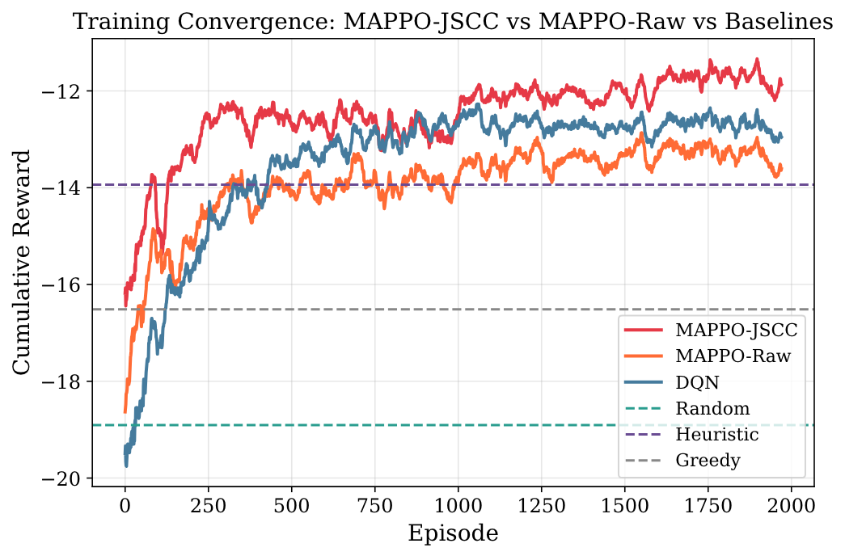
8
RESULTS · CONVERGENCE
Training Convergence of RL Methods
MAPPO-JSCC converges to the highest cumulative reward of all methods.
Gap over MAPPO-Raw = the tangible JSCC benefit: joint coding modes exploit graceful degradation where separate coding hits the cliff.
Both MAPPO variants beat DQN, which cannot account for the temporal impact of offloading on future server load.
Cumulative reward vs. episode (2000 episodes).
MAPPO-JSCC · IEEE SMC 2026
9

Slide 10
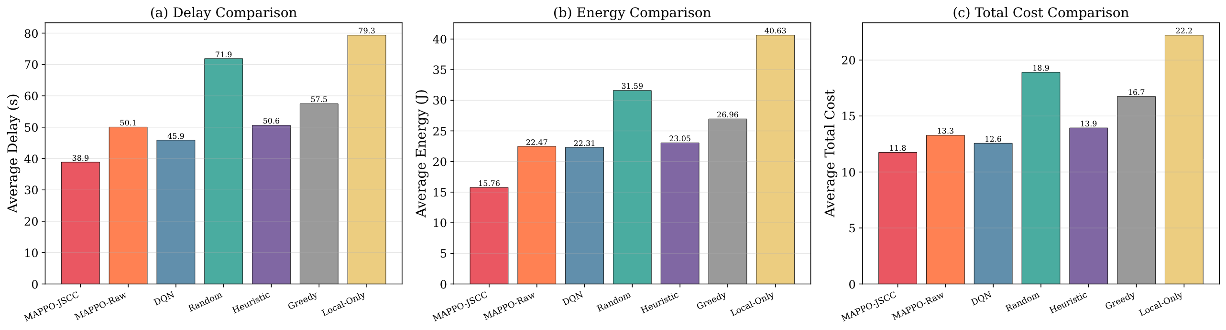
9
RESULTS · OVERALL
Overall Performance Comparison
Delay, energy and total cost across all seven methods (N = 15, B = 5 MHz).
11.77
−13.2%
−25.7%
−47.0%
lowest total cost
cost vs. MAPPO-Raw
delay vs. MAPPO-Raw
cost vs. Local-Only
MAPPO-JSCC · IEEE SMC 2026
10

Slide 11
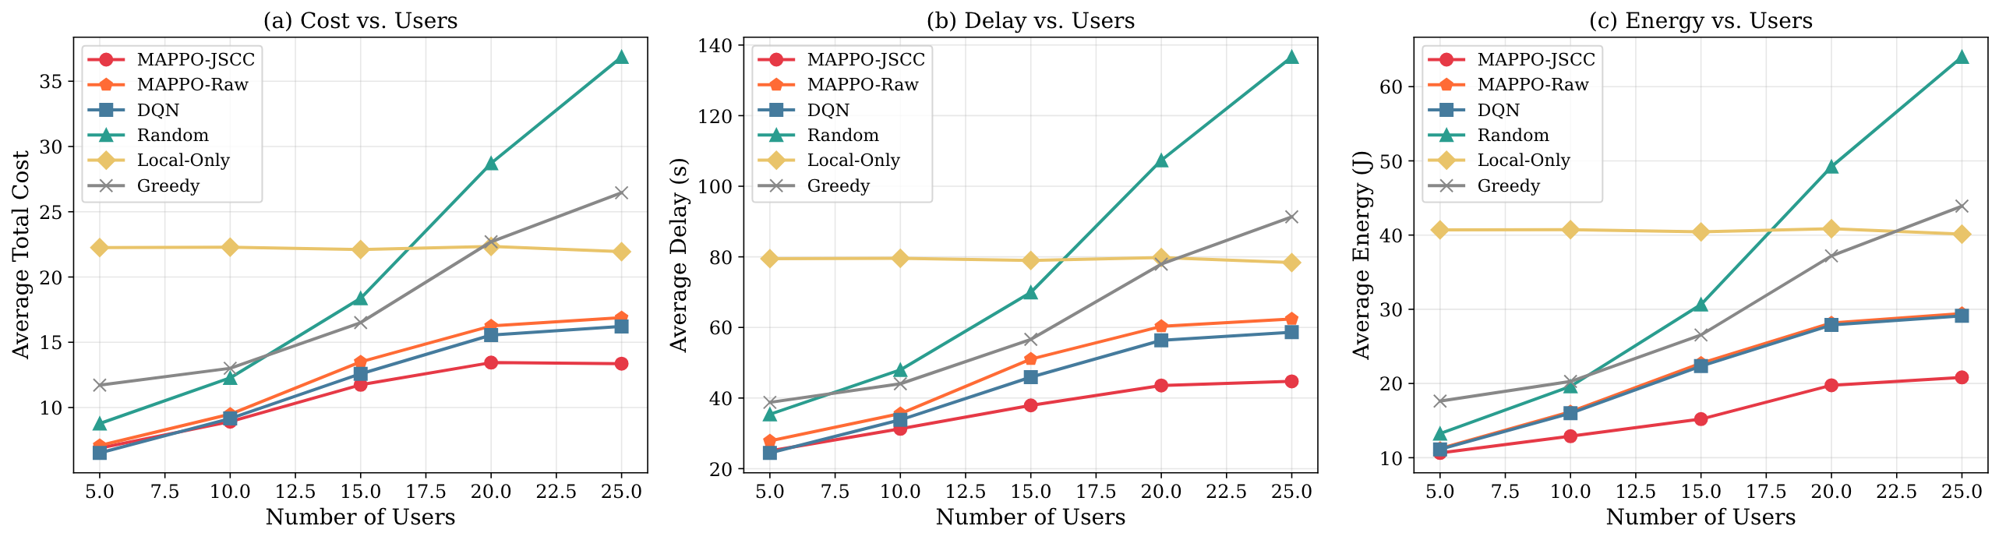
10
RESULTS · SCALABILITY
Impact of the Number of Users
Cost, delay and energy as the number of UEs grows from 5 to 25.
More users ⇒ smaller per-user bandwidth ⇒ offloading-based methods are penalized.
13.66
−62.9%
The JSCC advantage grows with N: semantic compression matters most when bandwidth is scarce.
MAPPO-JSCC cost @ N=25
cost vs. Greedy @ N=25
MAPPO-JSCC · IEEE SMC 2026
11

Slide 12
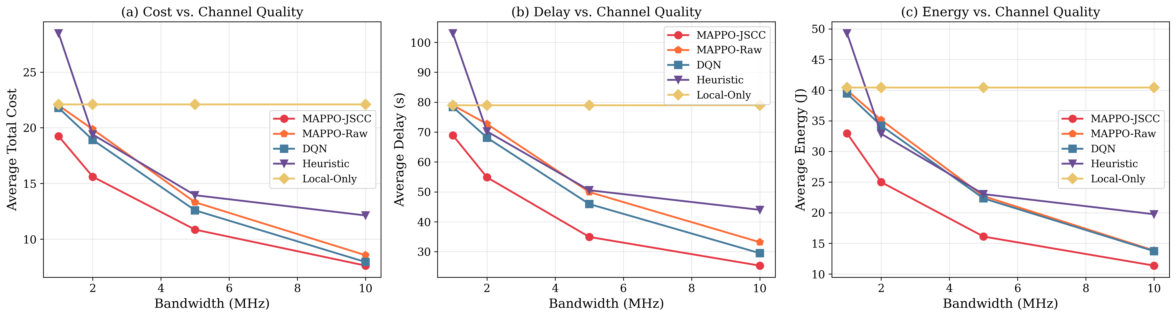
11
RESULTS · BANDWIDTH
Impact of System Bandwidth
Cost, delay and energy as system bandwidth varies.
At B = 1 MHz MAPPO-JSCC scores 19.10 — 13.5% below MAPPO-Raw and 77.9% below Greedy.
−13.5%
−77.9%
As bandwidth grows the MAPPO variants converge: abundant bandwidth removes the transmission bottleneck.
cost vs. Raw @ 1 MHz
cost vs. Greedy @ 1 MHz
MAPPO-JSCC · IEEE SMC 2026
12

Slide 13
CONCLUSION
Semantics make offloading cheaper
A JSCC-enabled multi-user offloading system that maps source data directly to channel symbols for bandwidth-efficient edge/cloud offloading.
Headline results
−13.2%
Each UE jointly optimizes offloading destination and coding mode via a two-tier decision on local channel and task state.
total cost vs. separate-coding MAPPO
up to −47.0%
cost vs. fixed baselines
MAPPO minimizes total UE cost while accounting for the on-UE encoder overhead prior work ignored.
amplified
gains under bandwidth scarcity
Thank you · Questions welcome
Yihui Yan · Bo Xiao — East China Normal University, Shanghai, China

