Slide 1
LOSS RATIO PREDICTIONS FOR AUTO INSURANCE COMPANY
Team 4:
Elena
Billy
Jay
Loren

Slide 2

The key idea is to create a predictive model that gives an advantage for an auto insurance company to predict loss ratio of policies. This advantage will give an insurance company opportunity to make decision of premium rates based on the overall risk of a portfolio.

Slide 3

The key problem is that 50% of all policies can be mispriced by more or less than 10%.

Slide 4

DATASET
The model will be built on a database of historical 400k input samples of auto insurance policies which have 69 features
Most of features are categorical
Testing dataset of 330 testing portfolios
Each portfolio consists of 1000 to 5000 policies
Testing dataset does not have loss amount, loss ratio, claim count, freq., and severity
The target will be natural logarithm of the loss ratio of portfolio
The problem which we will face during this project is that our dataset is imbalanced, and we might have outliers.

Slide 5
STEPS
Exploratory Data Analysis
Data Preprocessing
Creating Portfolios of Training Dataset
Building a Machine Learning Model
Model Evaluation & Optimization
Predictions

Slide 6
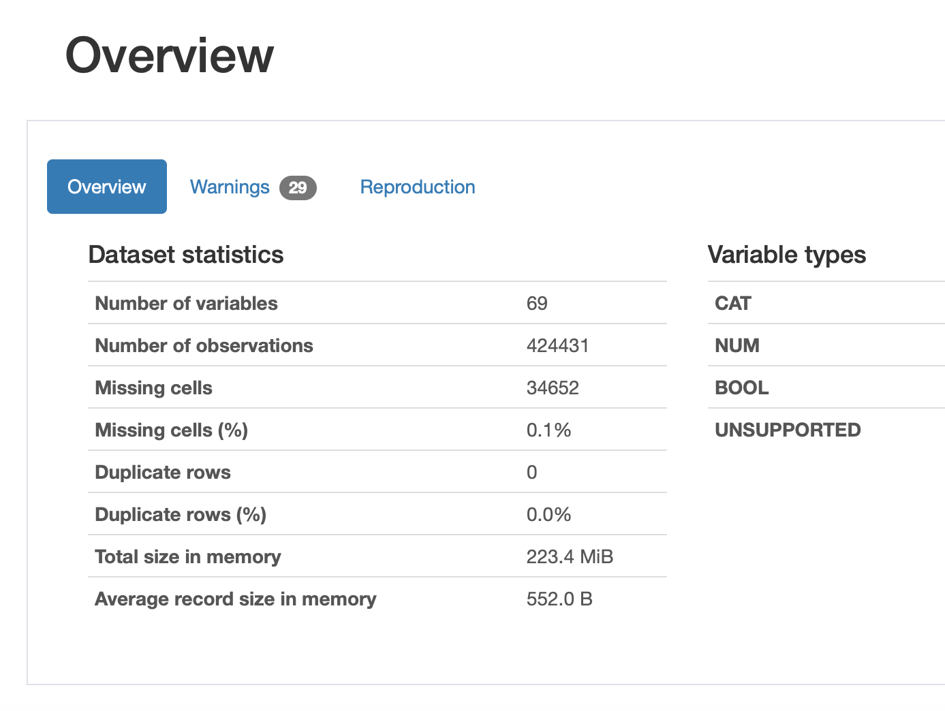
Exploratory data analysis
Understanding the data using pandas-profiling

Slide 7

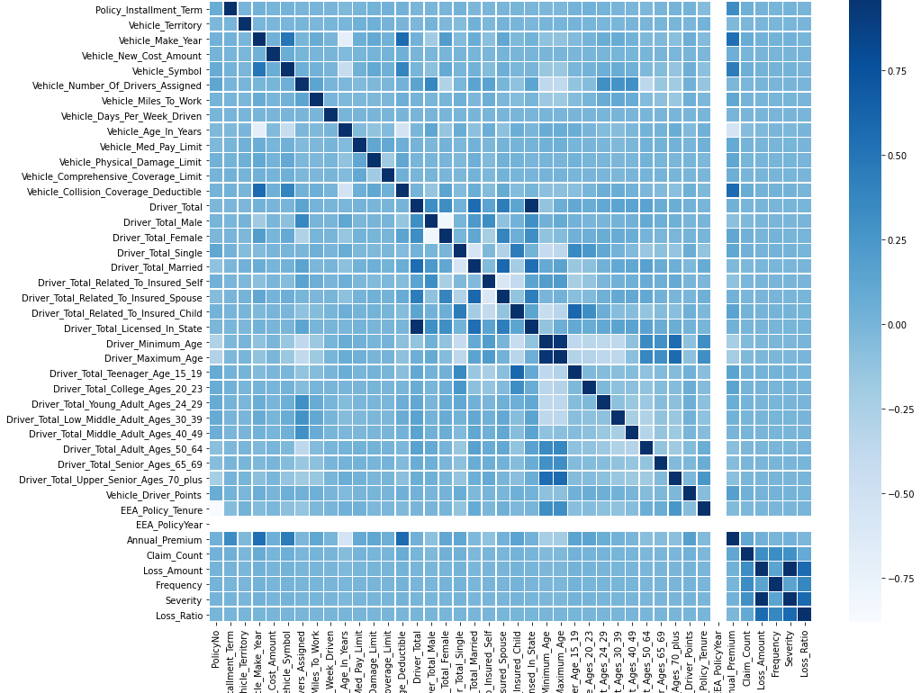
Correlation Matrix

Slide 8
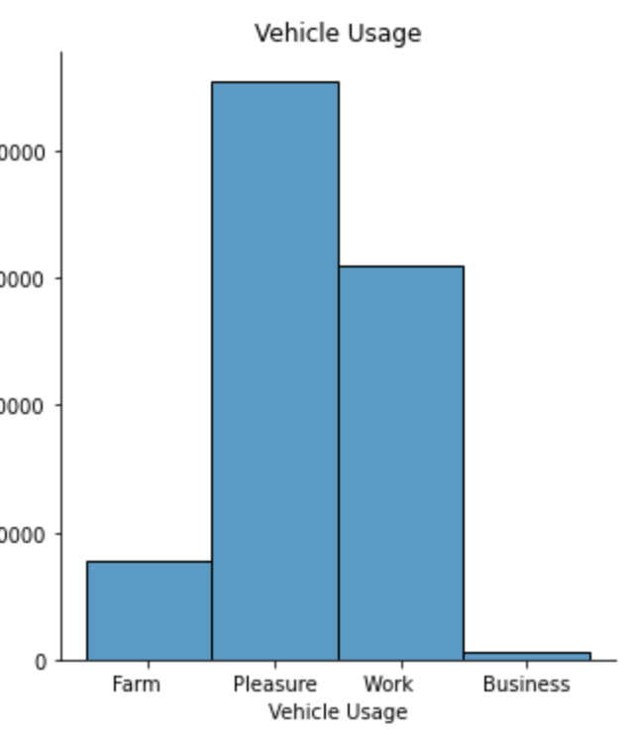
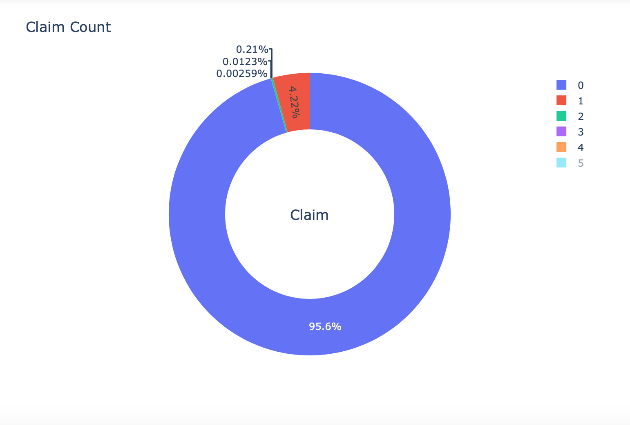
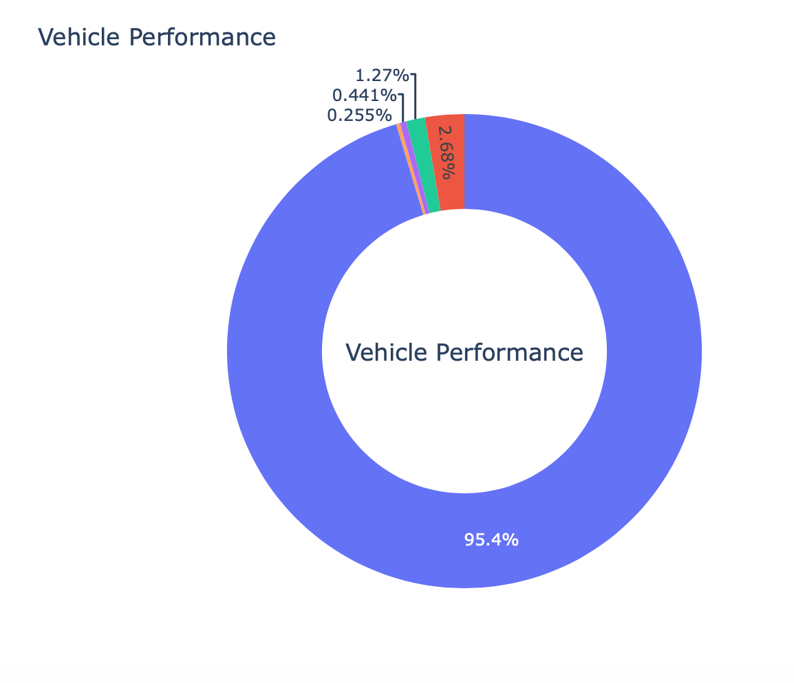
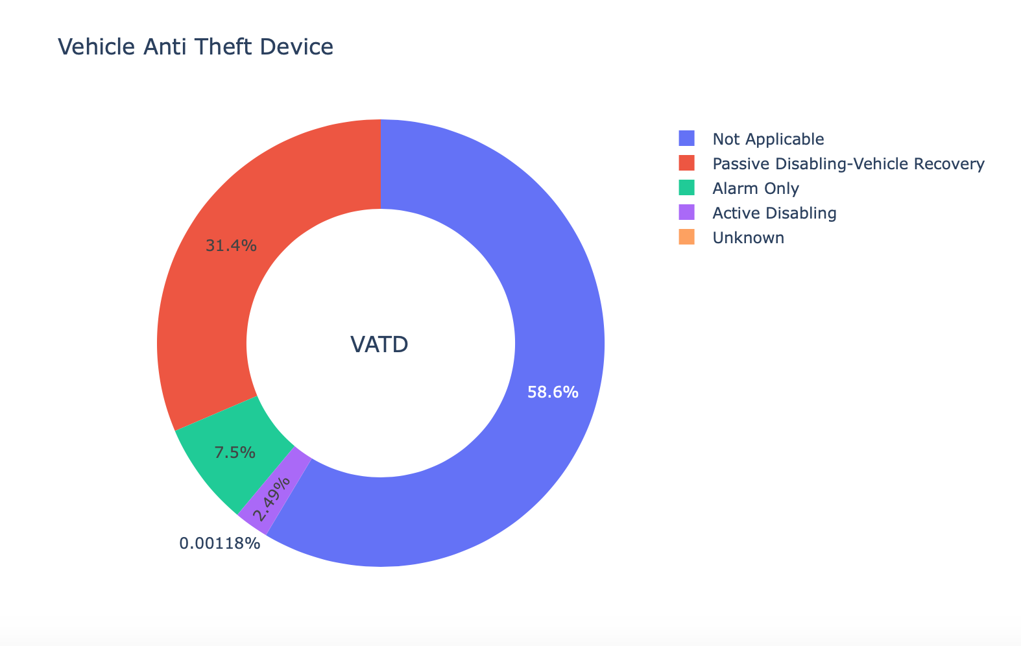
Understanding categorical variables

Slide 9
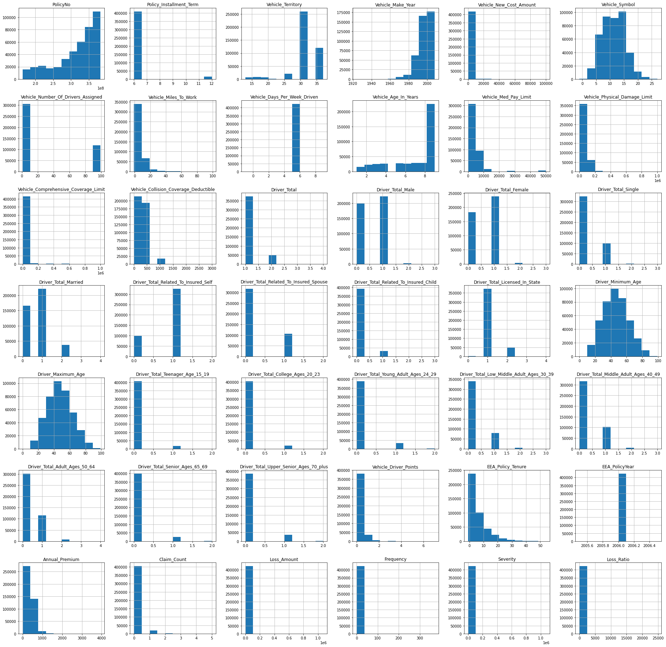
Understanding the distribution of numerical variables

Slide 10
DATA PREPROCESSING
Select
Features
Check
Missing values
Create
Dummy variables

Slide 11
Creating portfolios of training dataset
Create portfolios of training data where each portfolio will have from 1000 to 5000 policies, and percentage of losses
For each training portfolio engineered a set of features that summarizes the data in that portfolio

Slide 12
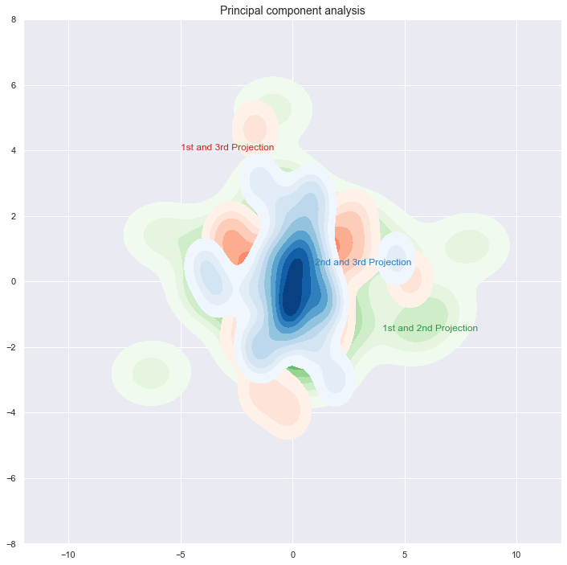
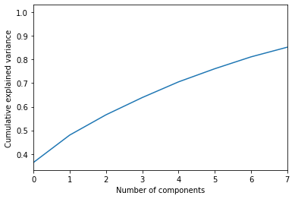
Building a machine learning model
Principal component analysis (PCA)

Slide 13
Modeling techniques
Linear Regression
Ridge Regression
Decision Tree
XGBoost
Random Forest
KNN

Slide 14
MODEL EVALUATION AND OPTIMIZATION
Splitting training portfolios intro training and holdout sets
Calculate Root Mean Squared Error (RMSE) and Mean Absolute Error (MAE)
Predict loss amount on the testing portfolios
Calculate Natural Logarithm

Slide 15
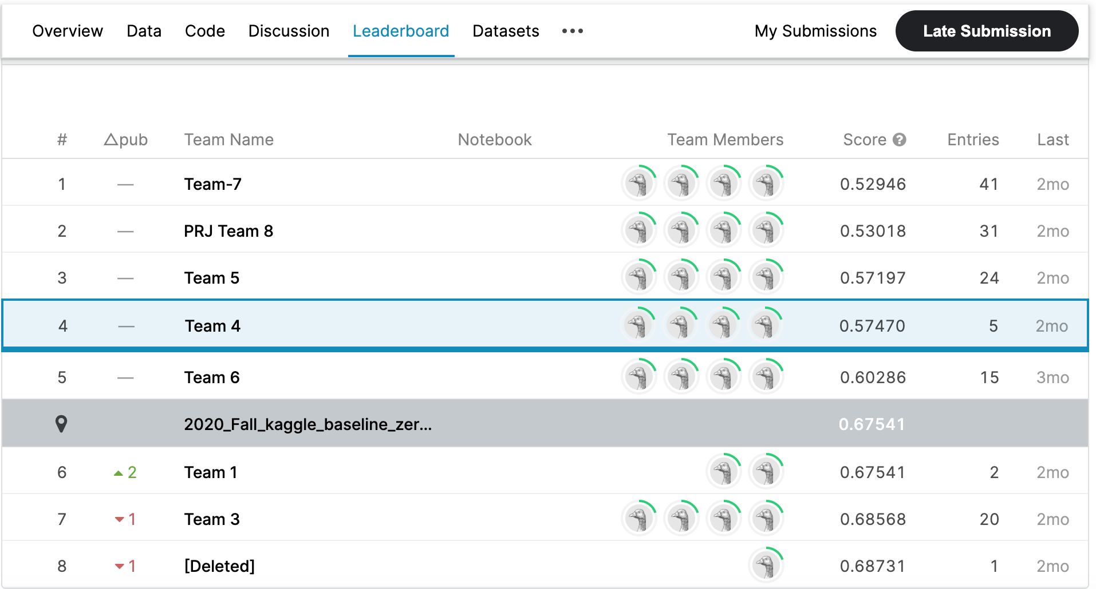
Predictions/results

