Slide 1
Arrays
Theorieles
Structs

Slide 2
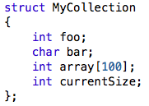
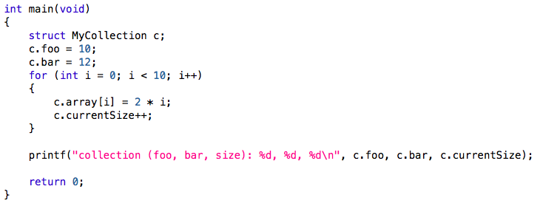
Structs
Probleem?
Notes:
currentSize is niet geïnitialiseerd

Slide 3
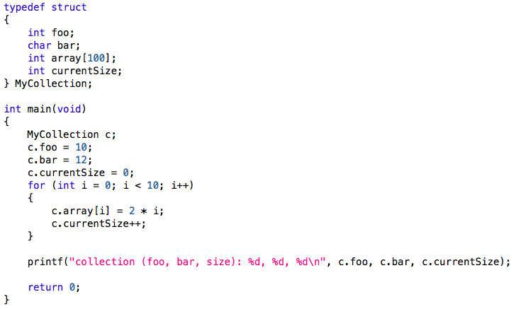
Structs
typedef
bug opgelost
Notes:
currentSize is niet geïnitialiseerd

Slide 4
Struct and pointer
struct name
{
int a;
float b;
};
int main()
{
struct name *ptr,p;
ptr=&p; /* Referencing pointer to memory address of p */
.........
(*ptr).a is same as ptr->a
(*ptr).b is same as ptr->b

