Slide 1
Analysis of the potential locations for consumer business in Moscow, Russia.
Elena ngouth
17 july 2019

Slide 2
Introduction
Introduction
Search for the most profitable locations to open a new business in Moscow,Russia. Where to open a pharmacy or a convinient shop? Where passability and competitive environment are the most profitable? Moscow metro serves an average of 10 million passengers a day. Thus there are certain places what customers passes every day. Using foursquare data we will find out the best places for new customer business startup. This analysis will be interesting for retail business stakeholders.

Slide 3
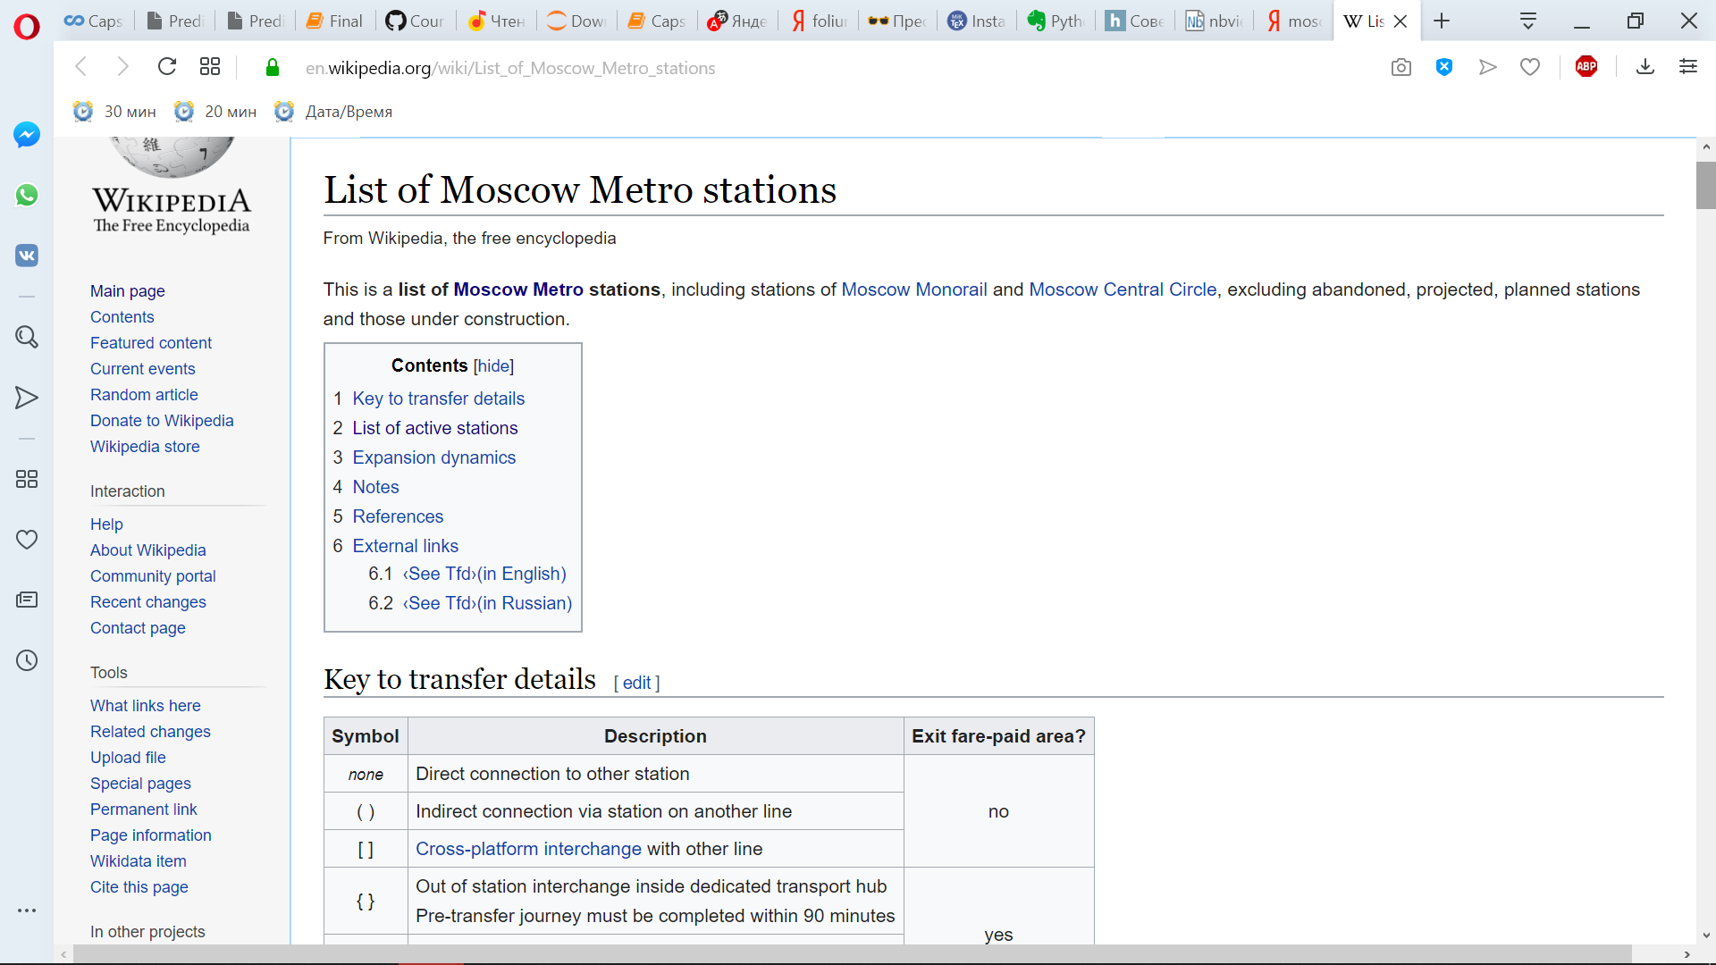
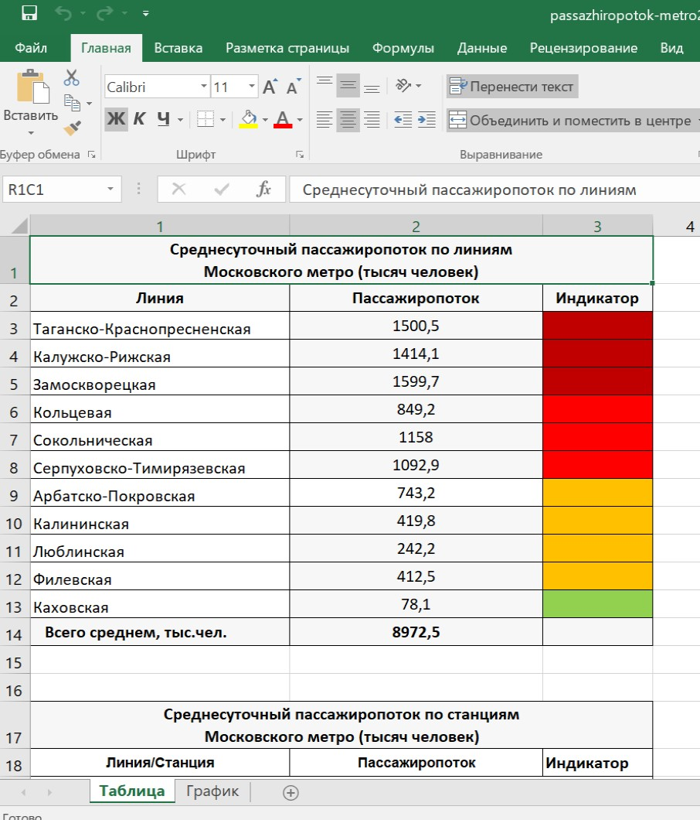
Data
Moscow subway stations list with coordinates from wikipedia. https://en.wikipedia.org/wiki/List_of_Moscow_Metro_stations#List_of_active_stations
Passenger traffic data.
Foursquare data about existing venues near Moscow subway stations.
Subway station coordinates will be downloaded, correlated with passenger traffic data. Then existing venues will be analysed. Clasterisation will be provided for subway station using its nearby venues.

Slide 4
Methodology
Moscow subway passenger traffic is an average 10 million passengers a day. Accordingly, metro stations are points of attraction in the city. To determine the most effective places for retail business, take the location of metro stations and retail facilities within 200 meters from the stations. This is the distance that passengers can go without significant loss of time to buy the necessary goods.
The technique is suitable for all types of retail. In this analysis, we will give an example for pharmacies.
The first step is to download the list of metro stations and its coordinates. It will be taken from the Wikipedia page. Add to the list of stations data on passenger traffic.
We will draw a map of Moscow and the metro stations on it.
With Foursquare we will find all the objects within 200 meters from the stations. For this analysis, we choose only pharmacies.
Let's define a list of stations where there are no pharmacies.
We will cluster (using k-means clustering) stations without pharmacies according to two parameters: passenger traffic and the number of objects nearby.
We will make significant conclusions for business on the results of clustering.

Slide 5
Downloaded data
 | Line | Station | Station_Ru | Transfer | Opened | Elevation | Type | Coordinates | Latitude | Longitude | StationID | Traffic
0 | #1 Sokolnicheskaya line | Bulvar Rokossovskogo | Бульвар Рокоссовского | <> | 1990-08-01 | −8 m | column, triple-span | 55°48′53″N 37°44′03″E﻿ / ﻿55.8148°N 37.7342°E﻿... | 55.8148 | 37.7342 | Bulvar Rokossovskogo Line #1 | 445
1 | #1 Sokolnicheskaya line | Cherkizovskaya | Черкизовская | {} | 1990-08-01 | −9 m | single-vault, shallow | 55°48′14″N 37°44′41″E﻿ / ﻿55.8038°N 37.7448°E﻿... | 55.8038 | 37.7448 | Cherkizovskaya Line #1 | 94676
2 | #1 Sokolnicheskaya line | Preobrazhenskaya Ploshchad | Преображенская площадь |  | 1965-12-31 | −8 m | column, triple-span | 55°47′47″N 37°42′54″E﻿ / ﻿55.7963°N 37.7151°E﻿... | 55.7963 | 37.7151 | Preobrazhenskaya Ploshchad Line #1 | 70553

Slide 6
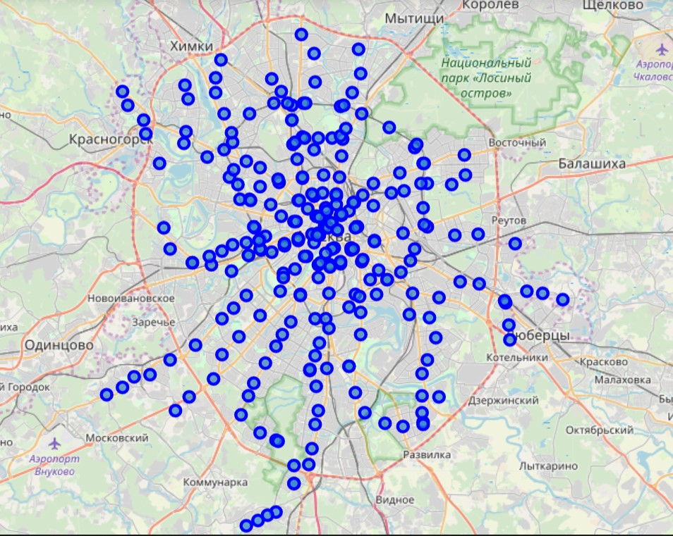
Moscow map

Slide 7
Foursquare
 | StationID | Station | Station Latitude | Station Longitude | Venue | Venue Latitude | Venue Longitude | Venue Category
0 | Bulvar Rokossovskogo Line #1 | Bulvar Rokossovskogo | 55.8148 | 37.7342 | Ветеринарная Аптека Ветлек | 55.813464 | 37.735036 | Pet Store
1 | Bulvar Rokossovskogo Line #1 | Bulvar Rokossovskogo | 55.8148 | 37.7342 | Фо & Ролл | 55.815955 | 37.736421 | Vietnamese Restaurant
2 | Bulvar Rokossovskogo Line #1 | Bulvar Rokossovskogo | 55.8148 | 37.7342 | Подружка | 55.814523 | 37.736781 | Cosmetics Shop
3 | Bulvar Rokossovskogo Line #1 | Bulvar Rokossovskogo | 55.8148 | 37.7342 | Галерея Богородское | 55.813944 | 37.734298 | Art Gallery
4 | Bulvar Rokossovskogo Line #1 | Bulvar Rokossovskogo | 55.8148 | 37.7342 | Бургер Кинг | 55.814026 | 37.733659 | Burger Joint

Slide 8
Traffic and venues count
 | Line | Station | Opened | Latitude | Longitude | StationID | Traffic | Venues count
0 | #5 Koltsevaya line | Komsomolskaya | 1952-01-30 | 55.7748 | 37.6549 | Komsomolskaya Line #5 | 187078 | 5.0
1 | #7 Tagansko-Krasnopresnenskaya line | Vykhino | 1966-12-31 | 55.7156 | 37.8181 | Vykhino Line #7 | 176629 | 5.0
2 | #1 Sokolnicheskaya line | Yugo-Zapadnaya | 1963-12-30 | 55.6637 | 37.4833 | Yugo-Zapadnaya Line #1 | 128629 | 33.0
3 | #2 Zamoskvoretskaya line | Rechnoy Vokzal | 1964-12-31 | 55.8549 | 37.4761 | Rechnoy Vokzal Line #2 | 121187 | 26.0
4 | #7 Tagansko-Krasnopresnenskaya line | Tekstilshchiki | 1966-12-31 | 55.7088 | 37.7316 | Tekstilshchiki Line #7 | 118849 | 14.0

Slide 9
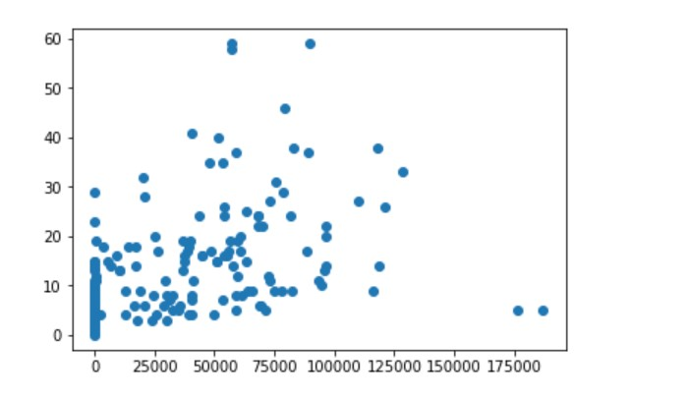
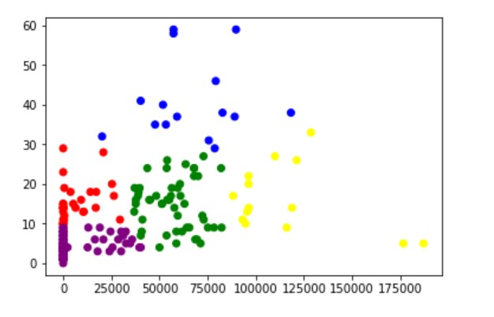
Clustering

Slide 10
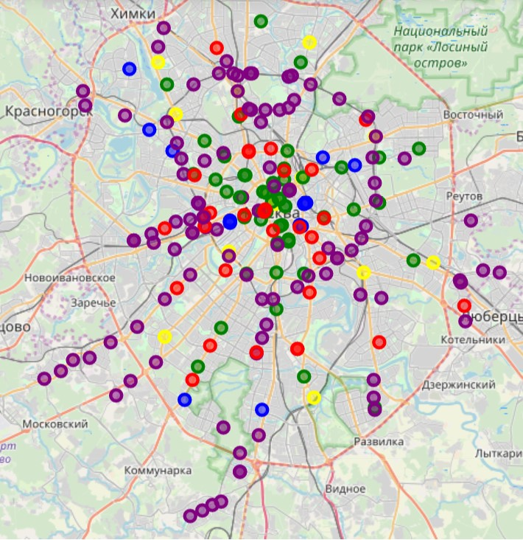
Moscow map after clustering

Slide 11
Clusters
Cluster | Latitude | Longitude | Traffic | Venues count | Color | Num of Stations
0 | 55.736329 | 37.611042 | 6385 | 15.2 | red | 31
1 | 55.749507 | 37.592380 | 66693 | 41 | blue | 15
2 | 55.754302 | 37.626042 | 57192 | 14 | green | 50
3 | 55.762086 | 37.623393 | 115645 | 16 | yellow | 14
4 | 55.733924 | 37.592076 | 4877 | 4.4 | purple | 105

Slide 12
Cluster 3
Line | Station | Traffic | Venues count | Cluster
#5 Koltsevaya line | Komsomolskaya | 187078 | 5.0 | 3
#7 Tagansko-Krasnopresnenskaya line | Vykhino | 176629 | 5.0 | 3
#1 Sokolnicheskaya line | Yugo-Zapadnaya | 128629 | 33.0 | 3
#2 Zamoskvoretskaya line | Rechnoy Vokzal | 121187 | 26.0 | 3
#7 Tagansko-Krasnopresnenskaya line | Tekstilshchiki | 118849 | 14.0 | 3
#9 Serpukhovsko-Timiryazevskaya line | Petrovsko-Razumovskaya | 116079 | 9.0 | 3
#7 Tagansko-Krasnopresnenskaya line | Pushkinskaya | 109983 | 27.0 | 3
#2 Zamoskvoretskaya line | Tsaritsyno | 96381 | 14.0 | 3
#3 Arbatsko-Pokrovskaya line | Ploshchad Revolyutsii | 96283 | 20.0 | 3
#2 Zamoskvoretskaya line | Teatralnaya | 96283 | 22.0 | 3
#1 Sokolnicheskaya line | Sportivnaya | 95552 | 13.0 | 3
#1 Sokolnicheskaya line | Cherkizovskaya | 94676 | 10.0 | 3
#2 Zamoskvoretskaya line | Voykovskaya | 93165 | 11.0 | 3
#6 Kaluzhsko-Rizhskaya line | Babushkinskaya | 88258 | 17.0 | 3

Slide 13
Cluster 1
Line | Station | Traffic | Venues count | Cluster
#9 Serpukhovsko-Timiryazevskaya line | Prazhskaya | 118271 | 38.0 | 1
#5 Koltsevaya line | Kiyevskaya | 89742 | 59.0 | 1
#7 Tagansko-Krasnopresnenskaya line | Shchukinskaya | 89055 | 37.0 | 1
#7 Tagansko-Krasnopresnenskaya line | Skhodnenskaya | 82748 | 38.0 | 1
#6 Kaluzhsko-Rizhskaya line | Tyoply Stan | 79216 | 46.0 | 1
#5 Koltsevaya line | Kurskaya | 78695 | 29.0 | 1
#7 Tagansko-Krasnopresnenskaya line | Oktyabrskoye Polye | 75603 | 31.0 | 1
#1 Sokolnicheskaya line | Sokolniki | 59133 | 37.0 | 1
#3 Arbatsko-Pokrovskaya line | Kiyevskaya | 57294 | 59.0 | 1
#4 Filyovskaya line | Kiyevskaya | 57294 | 58.0 | 1
#5 Koltsevaya line | Taganskaya | 53339 | 35.0 | 1
#3 Arbatsko-Pokrovskaya line | Semyonovskaya | 51828 | 40.0 | 1
#10 Lyublinsko-Dmitrovskaya line | Chkalovskaya | 47733 | 35.0 | 1
#8 Kalininskaya line | Marksistskaya | 40243 | 41.0 | 1
#3 Arbatsko-Pokrovskaya line | Kurskaya | 20209 | 32.0 | 1

Slide 14
Discussion
The above analysis shows that despite the significant number of venues located near the metro, there is an uneven distribution and, as a result, opportunities for development. Moscow metro is developing rapidly, in 2018-2019 25 new stations were opened. Also, not for all previously opened stations passenger traffic data is available . But even in such conditions we found more than 30 points suitable for opening a pharmacy. Further, this list should be analyzed in terms of availability of retail space and other non-associated factors in order to find suitable real property.

Slide 15
Conclusion
Purpose of this analysis was to determine efficient locations for retail pharmacy business. The list of locations with significant passenger traffic without competitive environment was provided.

