Slide 1
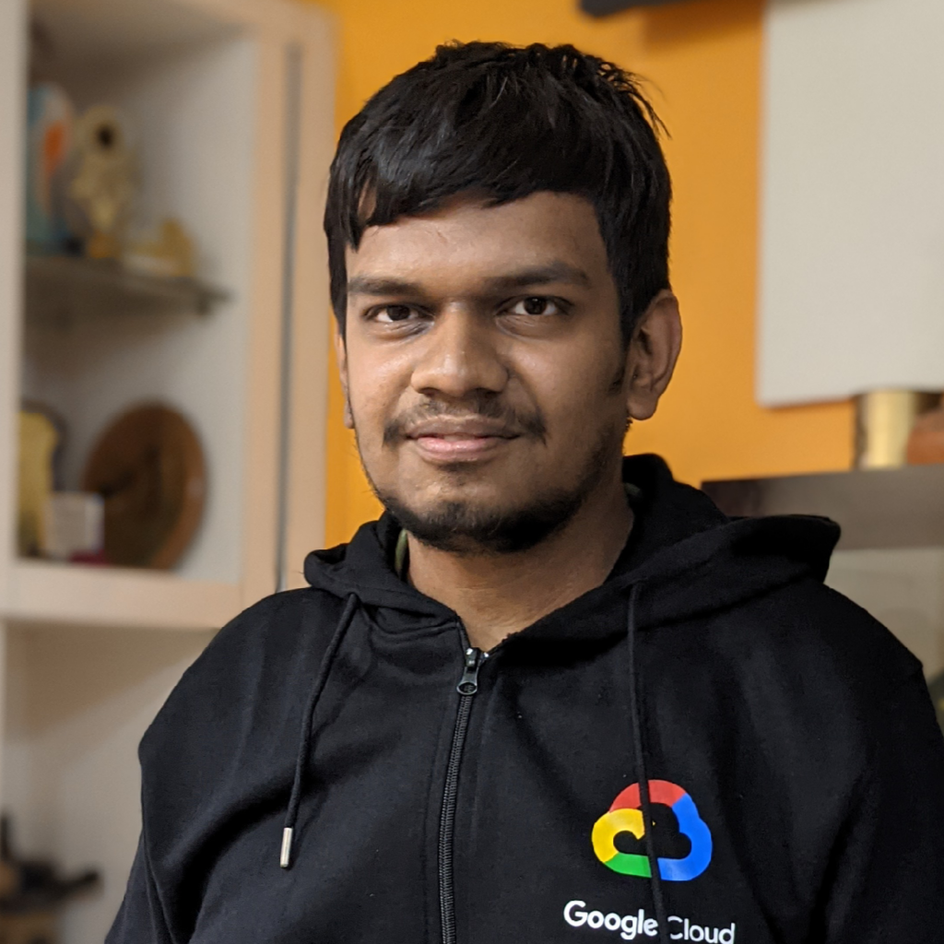

Introduction to Reinforcement Learning
Antariksh Pratham
9 to 10 am IST, 21st August, 2021
User Group Pune
https://www.meetup.com/Tensorflow-User-Group-Pune

