Slide 1
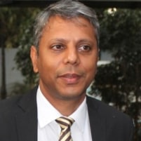

Time Series Forecasting:
An Introduction.
Srinivas Chillara
Managing Partner and Principal Consultant, SwanSpeed Consulting.
9 to 10 am IST, 17th July 2021
User Group Pune
https://www.meetup.com/Tensorflow-User-Group-Pune

