Slide 1
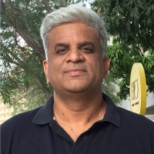

Algorithmic Trading using
Machine-Deep Learning.
Manish Okhade
Practice Manager, Wipro, Pune.
9 to 10 am IST, 19th June 2021
User Group Pune
https://www.meetup.com/Tensorflow-User-Group-Pune

