Slide 1
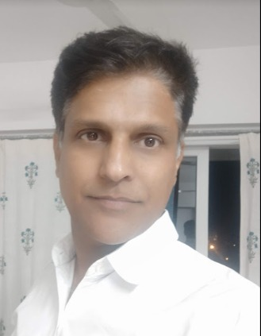

A visual exploration of Basic Math behind Multi-Variate Gaussian.
Anand Khandekar
Chief Architect, iPing Data Labs LLP.
9 to 10 am IST, 15th May 2021
User Group Pune
https://www.meetup.com/Tensorflow-User-Group-Pune

