Slide 1
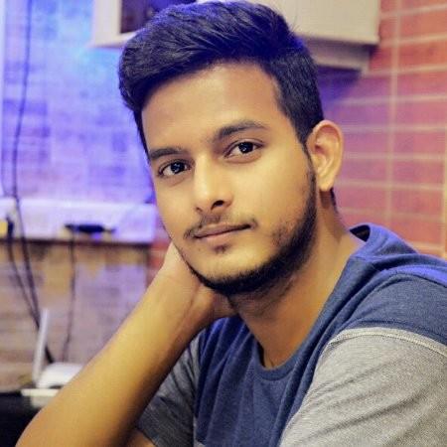

Text Generation from Knowledge Graphs
Rajat Paliwal
9 to 10 am IST, 17th September, 2021
User Group Pune
https://www.meetup.com/Tensorflow-User-Group-Pune

