Slide 1
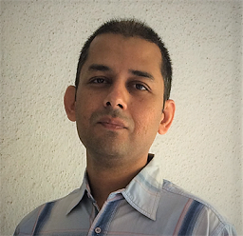

Addressing Data Scarcity In Your AI Journey
Nilesh Raghuvanshi
Principal Engineer, Siemens Digital Industry Software.
9 to 10 am IST, 17th April, 2021
User Group Pune
https://www.meetup.com/Tensorflow-User-Group-Pune

