Slide 1
A1-level
Lesson-18 – negative adjective prefixes

Slide 2
Contents
Vocabulary
Speaking;
Homework

Slide 3
vocabulary

Slide 4
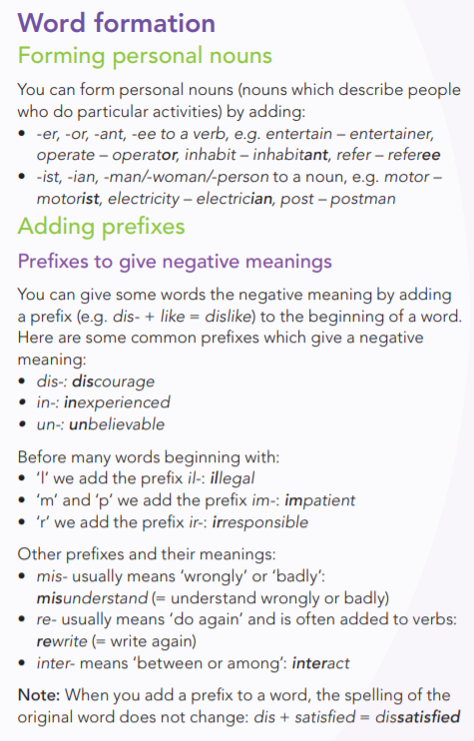
vocabulary

Slide 5
Speaking ☺
A company asks you to recommend a computer and work station configuration
for their sales team. Decide what to recommend. Use the office floor plan below to prepare the computer and work station configuration. Think about these things:
1 There are six people in the sales team.
2 Five people are out of the office four days of the week.
3 One person is in the office all the time - the team admin assistant.
4 Employees need a network connection (wired and wireless).
5 Employees print, scan and copy.
6 Company and client data must be stored on a separate device and backed
up regularly.

Slide 6
homework
Exercises contains in a folder with this presentation

