Slide 1
Suggestions for pubs in Wisconsin
XiaoFeng Wang

Slide 2
Summary of Analysis

Slide 3
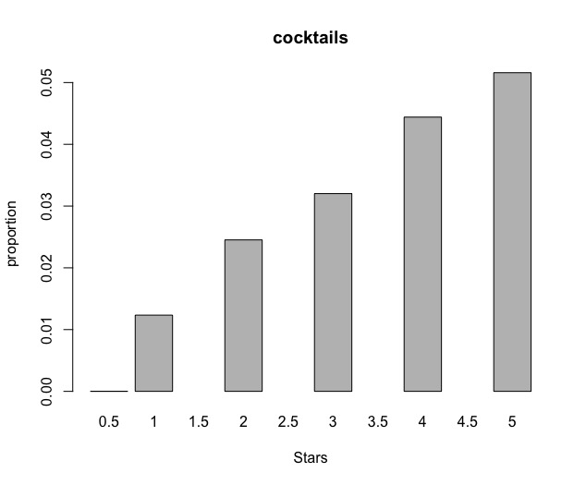
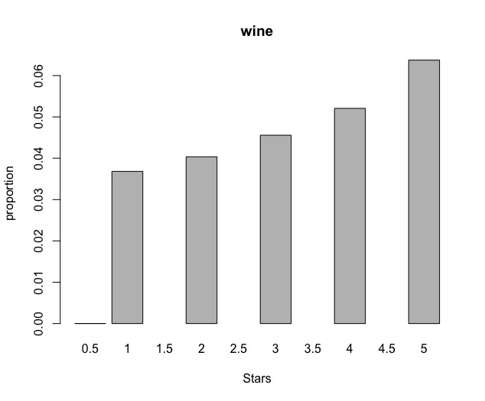
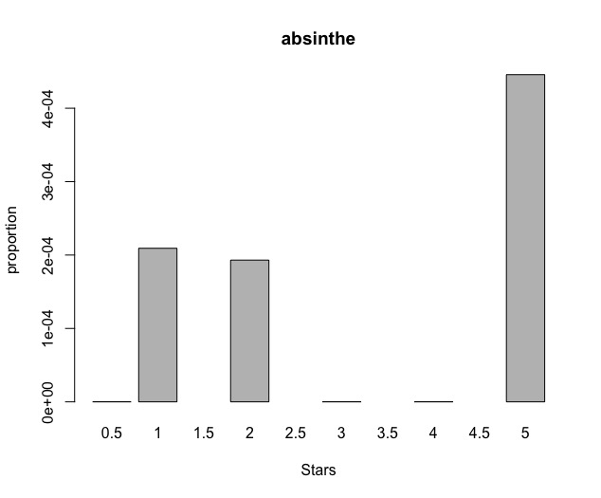
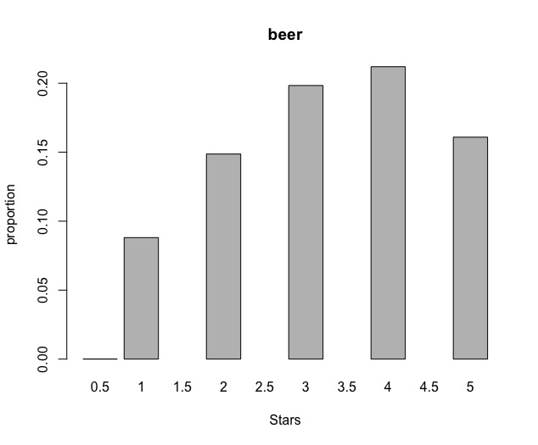
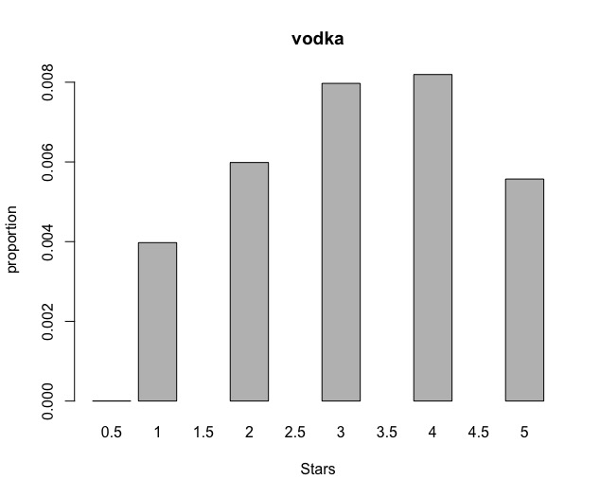
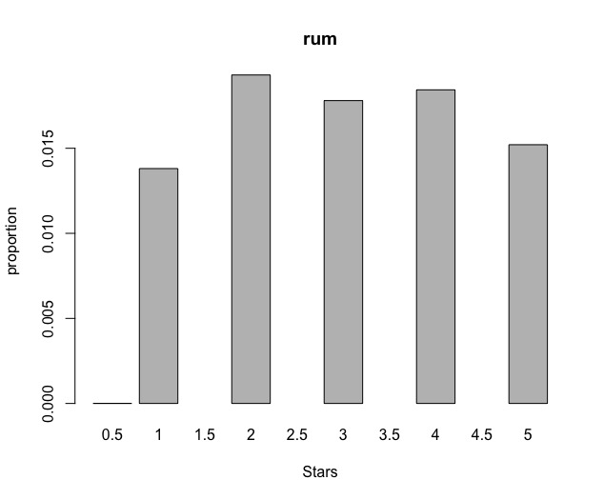
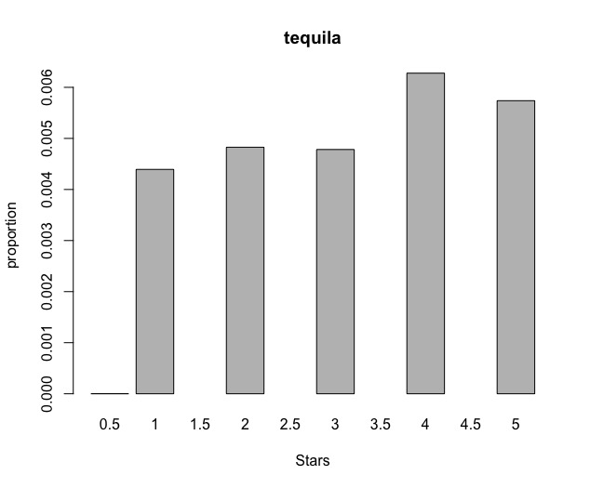
Explanatory Data Analysis
Definitly good For Business
Carefully use
A good start
No big difference

Slide 4
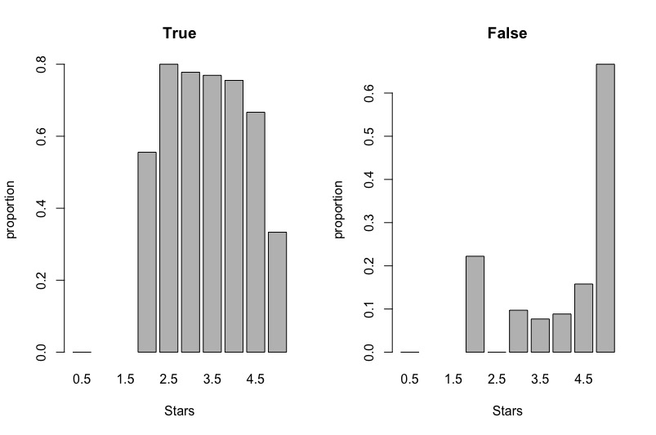
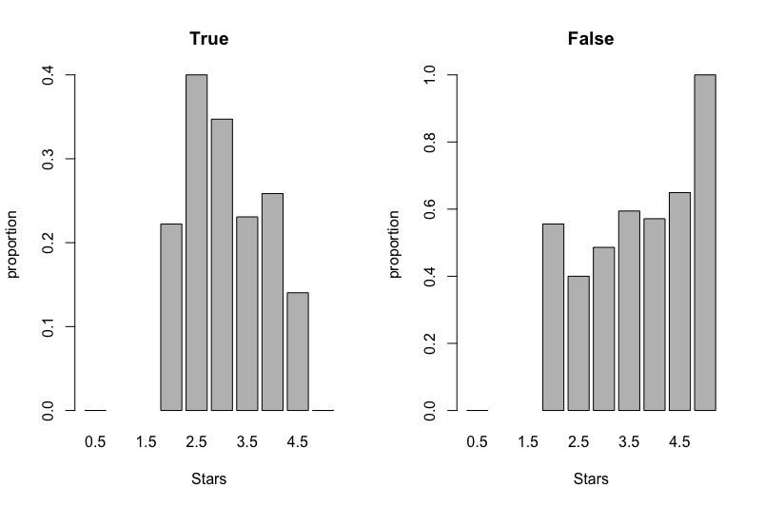
Explanatory Data Analysis

Slide 5
Modelling and diagnostic
Model is build using linear regression which is a widely used method for data analysis.
The output is ratings of pubs
Predictors are review_count, opening hours for each day of a week, the percentage of positive reviews, and attributes of a business such as whether it has TV, whether it offers delivery, when it is good for meal.
Our model can explain 67.86% of the variation of ratings.
ANOVA analysis is conducted to find those predictors that have significant influence on ratings.

Slide 6
Modelling and diagnostic
Conclusions:
influence | postive | negative
Variable names | The percentage of positive sentiment reviews Good for meal at late night Business Parking at valet Divey and trendy ambience Extend opening hour on Monday | Having TV Offering delivery Business Parking area at lot Accerpting credit card Reservation requirement No wifi or paid wifi Extendng opening hour on Saturday

Slide 7
Action Plan

