Slide 1
QIYAS AI HACKATHON #2 · EXECUTIVE TAKEAWAY
Addis Ababa
Ride Demand
Forecasting
THE INPUT GRID
10
24
12
months of trips
hours × day
Addis zones
A dependable, zone-hour forecast for 1–14 November 2025.
Result: 4,032 forecasts with uncertainty intervals, a local app, and reproducible analysis.
Name
Abraham Gebeyehu
Bethelhem Legesse
Eden Kibret
Eleni Andualem
Feven Abebe
Surafel Solomon
Student ID
qiyas-2026-004484
qiyas-2026-000286
qiyas-2026-000721
qiyas-2026-000054
qiyas-2026-003641
qiyas-2026-007128
Team teamdev · Qiyas / IADE AI Training Program, Addis Ababa University

Slide 2
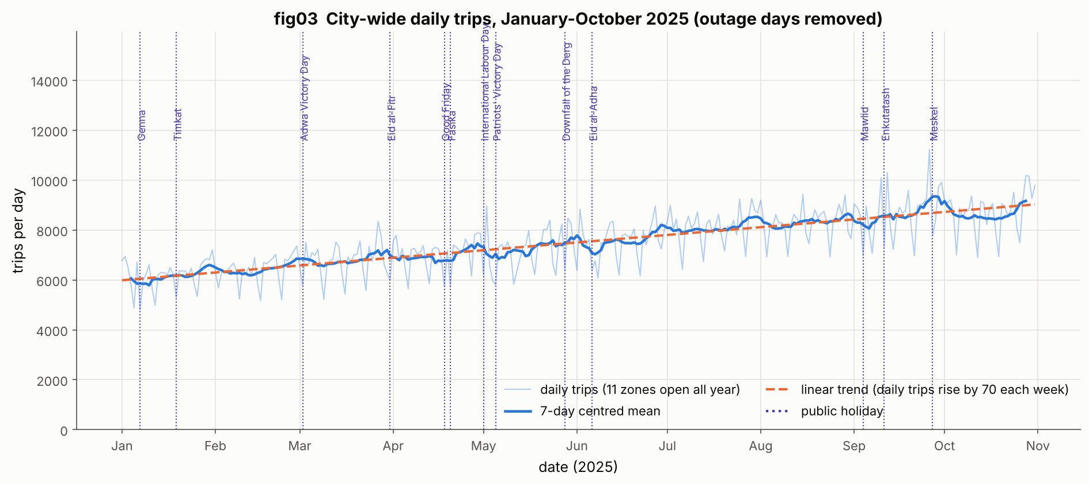
THE PROBLEM · OBJECTIVES
Demand moves faster than the plan.
THE DECISION WINDOW
Ride demand changes by zone, hour, weather, and events. Operators need a dependable view before drivers and fares must move.
12
zones × 24 hours × 14 days
Objective 1: forecast hourly trips for 12 Addis Ababa zones.
Objective 2: predict the 1–14 November 2025 horizon without future leakage.
Objective 3: turn forecast quality into staffing, fare, and monitoring decisions.
One common forecast frame for the city.
FIG03 · DEMAND GREW ~40% JAN–OCT

Slide 3
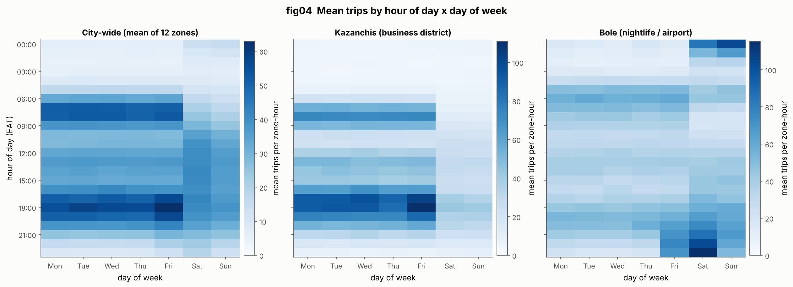
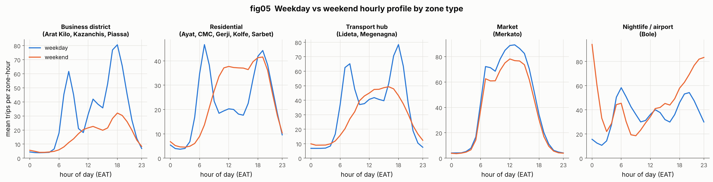
FORECASTING FRAME
DATA SOURCES · FORECASTING FRAME
Three inputs. One hourly forecasting grid.
10
12
months history
zones
All sources are joined on zone and time before features are created.
FIG04 · HOUR × WEEKDAY PATTERN
Trips: 10 months of synthetic hackathon ride records across 12 zones.
Weather: hourly observations used to explain demand changes.
Events: a city calendar capturing football and other demand shocks.
FIG05 · DAILY PROFILE BY ZONE TYPE
Target: zone-hour trip demand for 1–14 November 2025.

Slide 4
DATA CLEANING · INTEGRATION
Repair the inputs before asking the model to learn.
QUALITY GATE
We documented and fixed 28 data problems across the raw exports.
28
Converted Fahrenheit weather values and handled −9999 rain sentinels.
Investigated 125 export spikes instead of silently dropping them.
Standardized inconsistent event rows and joined the sources by zone-hour.
documented problems
Cleaning is part of the evidence, not hidden preprocessing.
Outcome: one clean, auditable analytical spine for training and forecast generation.

Slide 5
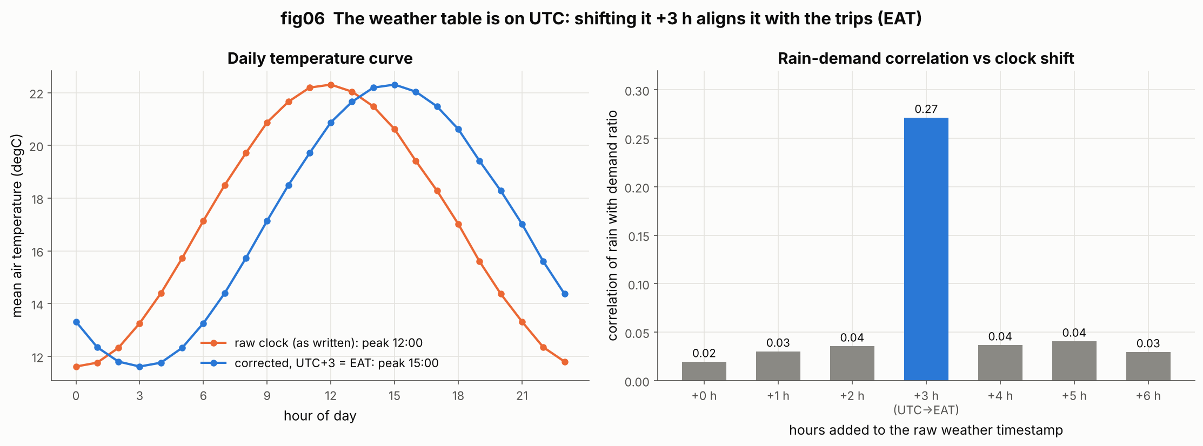
SIGNAL AFTER ALIGNMENT
THE BREAKTHROUGH · UTC → EAT
+3h
The weather clock was wrong.
Fixing it changed the signal.
UTC weather shifted into EAT.
WHY IT MATTERS
Rain lifts demand up to 64%, except Merkato, where it falls 42%.
Football demand reaches 1.8× before and 2.3× after the match.
Weather arrived in UTC. Trips were recorded in East Africa Time. Shifting weather by +3 hours aligned cause and response in the same zone-hour.
Measured effect. Rain correlation moved from 0.02 to 0.27 after the correction.
Modeling rule. Chronological validation and forecast-time features prevented future information from leaking into training.
FIG06 · CLOCK PROOF: RAIN SIGNAL PEAKS AT +3 H

Slide 6
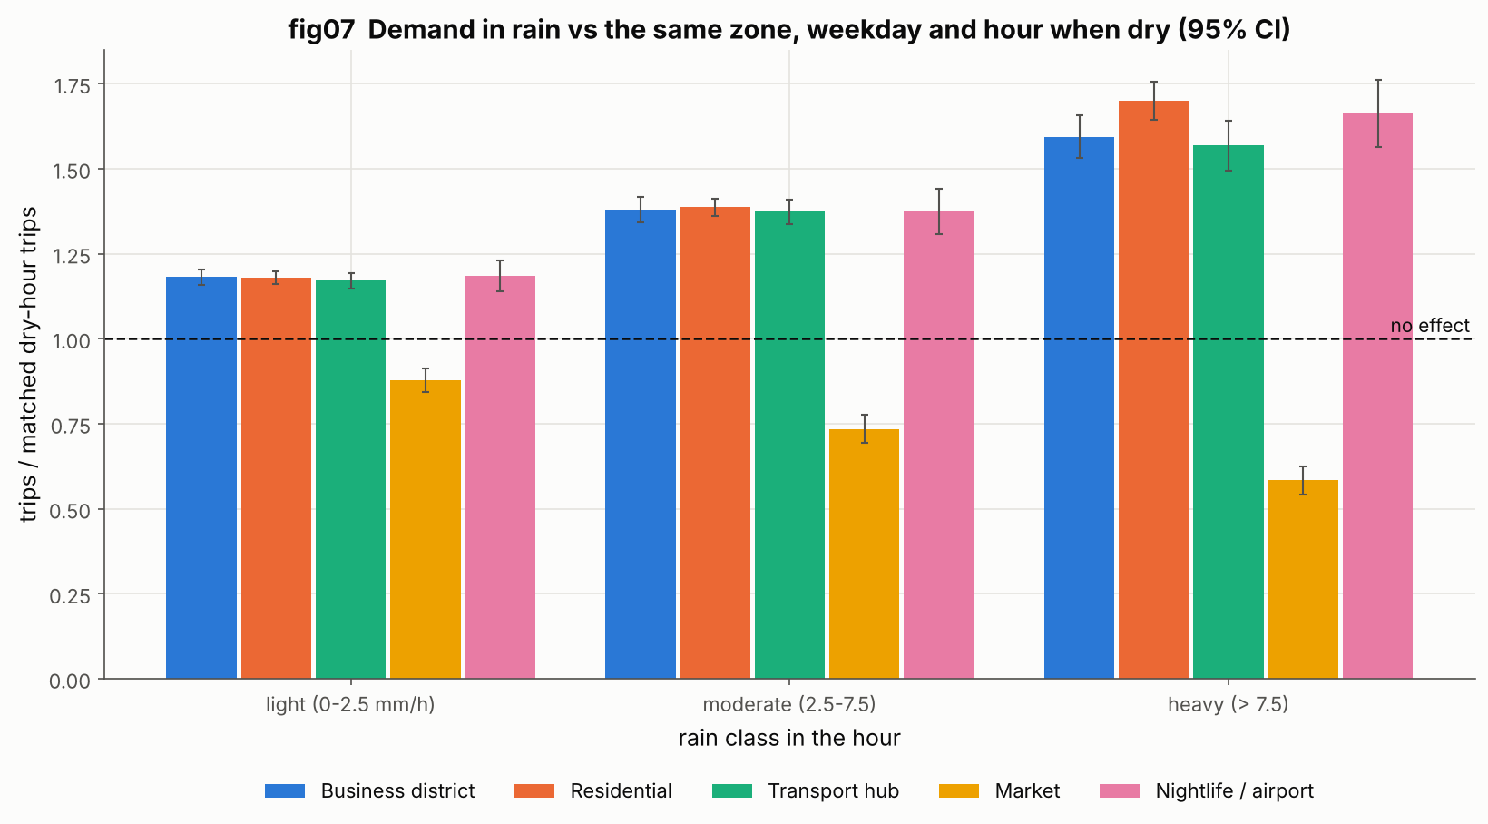
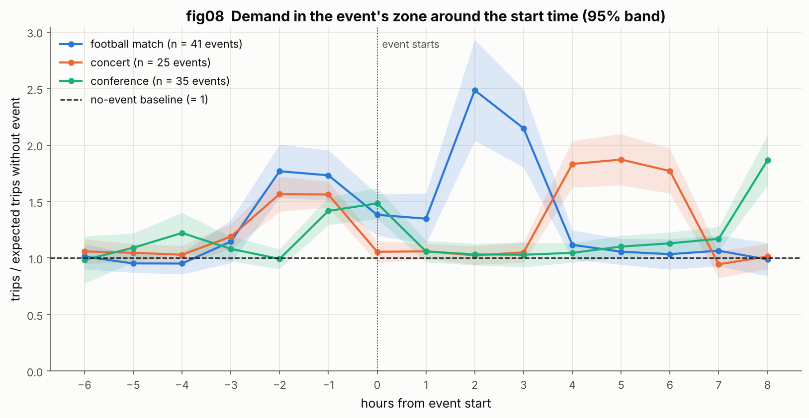
SIGNAL BOARD
FEATURE ENGINEERING · DEMAND SIGNALS
Features explain when demand moves.
64%
2.3×
rain lift
post-match demand
The model sees context, not just a historical average.
FIG07 · RAIN EFFECT BY ZONE TYPE
36 forecast-time features combine calendar structure, zone identity, weather, events, and recent demand context.
Rain lifts demand up to 64% in most zones, while open-air Merkato falls 42%—a reminder that signals are local.
Football demand reaches 1.8× before kick-off and 2.3× after the final whistle.
FIG08 · FOOTBALL EVENT STUDY

Slide 7
Model family | Role | Type | Outcome
Mean predictor | Baseline | Naive | RMSE 27.53
Moving average | Baseline | Naive | RMSE 14.55
Seasonal naive | Baseline | Naive | RMSE 9.94
Ridge regression | Classical | Linear | RMSE 12.99
ARIMA per zone | Classical | Statistical | RMSE 10.41
Random forest · gradient boosting | Tree | Ensemble | RMSE 8.79 · 8.63
HistGradientBoosting | Tree | Ensemble | RMSE 8.20
Final tuned LightGBM | Winner | Boosted tree | RMSE 8.09 · MAE 5.60
MODEL LANDSCAPE
LightGBM was the final choice.
19% better.
Poisson objective · 36 forecast-time features
Selection: compare simple baselines, classical models, and tree ensembles under chronological evaluation.

Slide 8
ABLATION RMSE CHANGE
−0.88
weather only
EVALUATION · ABLATION
−0.35
The gain held under rolling-origin validation.
events only
−1.16
Validation, 18–31 Oct: RMSE 8.09 and MAE 5.60.
Rolling origin: RMSE 8.68 ± 0.80 across five 14-day folds.
Baseline: seasonal naive RMSE 9.94, so the final model improves 19%.
weather + events
Both together lower RMSE by 11.7%; weather by 8.9%; events by 3.5%.

Slide 9
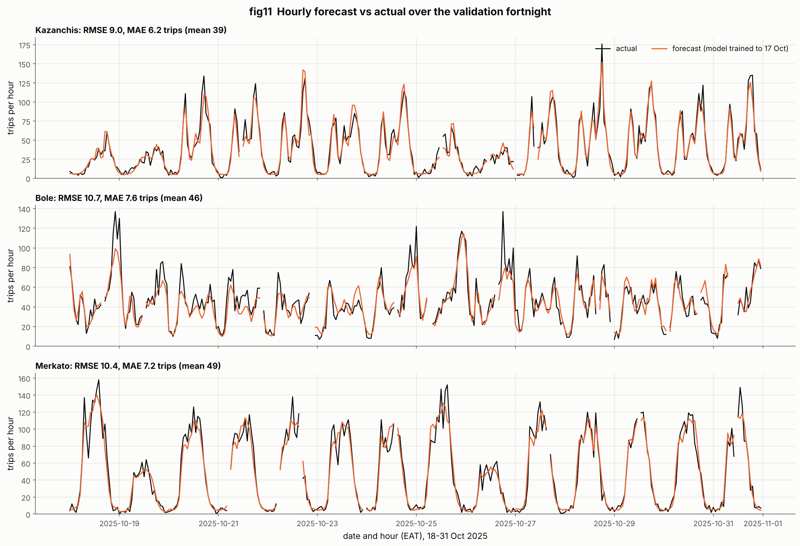
DELIVERY SNAPSHOT
FROM FORECAST TO ACTION
Forecasts become staffing and fare decisions.
4,032
79.8%
forecasts
80% interval coverage
89.6%
90% interval coverage
A decision surface for operations—not just a model score.
Local web app. One command (python app/app.py) opens a live zone map with forecasts by zone and hour.
Operational outputs. Plan driver coverage, anticipate rain and event peaks, and monitor exceptions before demand moves.
Uncertainty is visible. Every forecast includes prediction intervals rather than a single point estimate.
FIG11 · FORECAST VS ACTUAL, 18–31 OCT

Slide 10
FINAL DESTINATION
Built to run again, not just once.
WHAT SUCCESS LOOKS LIKE
Dependable forecasts
for 12 Addis zones.
Deliverables: 12 figures, 14 analysis tasks, 4,032 forecasts, and a local web app with a live zone map.
Reproducibility: pinned requirements, relative paths, random_state 42, and documented data preparation.
Guardrails: chronological validation, no test leakage, and explicit checks for the 28 data problems.
Synthetic hackathon data, handled transparently. A clear path from raw exports to staffing, fares, and monitoring.

