Slide 1

Customer Segmentation Analysis Author : Ntokou Eleni Stakeholders : Marketing Team

Slide 2
Scope
Marketing team wants to create more loyal customers by targeting valuable groups through a marketing campaign about "Breakfast" cuisine.
Segment existing customers based on their frequency and order amount.
Propose some actions based on customer segments.

Slide 3
Dataset
Assumptions
customers in smaller cities of Greece
include all types of orders
last date of orders: 31st January
121.943 customers
534.270 orders
period: 1st January – 31st January

Slide 4
RFM Analysis
RFM stands for recency, frequency and monetary value and it is a common data driver customer behavioral segmentation technique.
recency measures the time since the last purchase
frequency measures how often the customer makes an order
monetary measures the amount of money the customer spends on ordering
Result: an RFM score on a scale of 5. Based upon this score, customer segments are being created

Slide 5
Results
5 segments of customers:
Soulmates ideal customers (RFM scoring > 4.5)
Lovers almost as good as Soulmates, but need more care (RFM scoring > 4)
Flirting customers with potential growth (RFM scoring > 3)
Friends extra work needs to be done (RFM scoring > 1.6)
About to dump you effort to win them back, probably bad customer experience

Slide 6
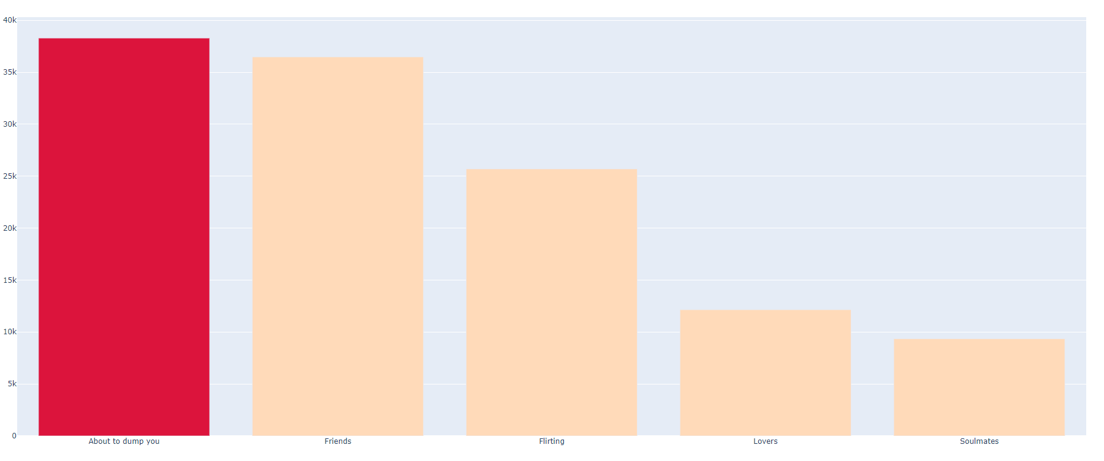
Results

Slide 7
Results
Segments | Counts | Percentages (%)
About to dump you | 38.289 | 31%
Friends | 36.473 | 30%
Flirting | 25.691 | 21%
Lovers | 12.142 | 10%
Soulmates | 9.348 | 8%

Slide 8
Key Suggestions
Soulmates: Customers who have already prove their loyalty. Introduce them to Breakfast cuisine through an e-mail notification
Lovers: Offer benefits (rubies) from most rated Breakfast dinners
Flirting: Consider free delivery charges from e-food Breakfast dinners
Friends: Create premium offers or consider incentives based on a price thresholds.
About to dump you: Maximum effort to win this segment back. Use promo codes to make breakfast offers more appealing. The key here is to create better user experience.

Slide 9
A/B Testing
Determine which of the previous suggestions will test
Create two possible variants of the suggestion (with and without the suggestion)
Measure the results (track customers who used the suggestions and their behavior after)
Determine testing period
Run test and monitor results
Repeat A/B Testing for the rest of the suggestions

