Slide 1


Streamify Time-Series Anomaly Detection Methods
Mining of Massive Datasets
Anestis Ampatzidis
Zoi Katsantoni
Eleni Trachanidou

Slide 2
dATASET
We used 4 different domains
1
2
3
4
YAHOO
SensorScope
GHL
Genesis

Slide 3
dATASET
We used 4 different domains
1
Normalities | Domains
1 | YAHOO
2 | YAHOO + SensorScope
3 | YAHOO + SensorScope + GHL
4 | YAHOO + SensorScope + GHL + Genesis
YAHOO
2
SensorScope
3
GHL
4
Genesis

Slide 4
NON-STREAMING Anomaly detection
Isolation Forest
Autoencoder
Metrics | Normality 1 | Normality 2 | Normality 3 | Normality 4
Recall | 0.8000 | 0.0055 | 0.3538 | 0.0089
Precision | 0.0952 | 0.0231 | 0.2056 | 0.0049
F1-Score | 0.1702 | 0.0089 | 0.2601 | 0.0063
ROC-AUC | 0.8772 | 0.4718 | 0.6565 | 0.4789
Runtime (minutes) | 0.0077 | 0.0519 | 0.4124 | 0.3579
Metrics | Normality 1 | Normality 2 | Normality 3 | Normality 4
Recall | 0.6000 | 0.1824 | 0.2894 | 0.8072
Precision | 0.3529 | 0.1921 | 0.1814 | 0.1379
F1-Score | 0.4444 | 0.1871 | 0.2230 | 0.2356
ROC-AUC | 0.9937 | 0.5319 | 0.8639 | 0.8818
Runtime (minutes) | 0.1289 | 0.2714 | 1.5101 | 2.8094

Slide 5
SAND - STREAMING Anomaly detection
Metrics | Normality 1 | Normality 2 | Normality 3 | Normality 4
Recall | 1.0000 | 0.7032 | 0.0031 | 0.0035
Precision | 0.0334 | 0.2347 | 0.0031 | 0.0017
F1-Score | 0.0647 | 0.3520 | 0.0031 | 0.0023
ROC-AUC | 0.9135 | 0.5459 | 0.4866 | 0.4718
Runtime (minutes) | 0.0088 | 0.1962 | 2.5002 | 2.6962

Slide 6
Variant 1
Naïve Streaming Variant
Batch size:
500 (Normality 1)
5000 (Normalities 2, 3, 4)

Slide 7
STREAMING Anomaly detection
Variant 1
Isolation Forest
Autoencoder
Metrics | Normality 1 | Normality 2 | Normality 3 | Normality 4
Recall | 0.9000 | 0.1047 | 0.1025 | 0.1084
Precision | 0.0592 | 0.2459 | 0.2184 | 0.1554
F1-Score | 0.1111 | 0.1469 | 0.1395 | 0.1277
ROC-AUC | 0.9072 | 0.5095 | 0.5458 | 0.5459
Runtime (minutes) | 0.0548 | 0.5470 | 0.5715 | 0.6472
Metrics | Normality 1 | Normality 2 | Normality 3 | Normality 4
Recall | 0.8000 | 0.3043 | 0.2978 | 0.3009
Precision | 0.1951 | 0.4252 | 0.2846 | 0.2375
F1-Score | 0.3137 | 0.3547 | 0.2910 | 0.2655
ROC-AUC | 0.9764 | 0.5880 | 0.9221 | 0.8863
Runtime (minutes) | 0.2699 | 1.0334 | 4.6188 | 5.7203

Slide 8
Variant 2
Batching with history
Batch size:
500 (Normality 1)
5000 (Normalities 2, 3, 4)

Slide 9
Variant 2 – batching with history
Variant 2
Isolation Forest
Autoencoder
Metrics | Normality 1 | Normality 2 | Normality 3 | Normality 4
Recall | 0.4000 | 0.2274 | 0.2226 | 0.2282
Precision | 0.3636 | 0.3147 | 0.3002 | 0.1105
F1-Score | 0.3810 | 0.2640 | 0.2556 | 0.1489
ROC-AUC | 0.6979 | 0.5477 | 0.6035 | 0.5883
Runtime (minutes) | 0.11 | 0.40 | 2.02 | 2.40
Metrics | Normality 1 | Normality 2 | Normality 3 | Normality 4
Recall | 0.8000 | 0.3171 | 0.3103 | 0.3127
Precision | 0.1951 | 0.4479 | 0.3143 | 0.2589
F1-Score | 0.3137 | 0.3713 | 0.3123 | 0.2833
ROC-AUC | 0.9675 | 0.5002 | 0.9281 | 0.9041
Runtime (minutes) | 0.2341 | 0.4498 | 3.4156 | 3.9614

Slide 10
FINal results – ROC AUC
 | Static |  | Variant 1 |  | Variant 2 |  | SAND
 | Isolation Forest | Autoencoder | Isolation Forest | Autoencoder | Isolation Forest | Autoencoder
Normality 1 | 0.8772 | 0.9937 | 0.9072 | 0.9764 | 0.6979 | 0.9675 | 0.9135
Normality 2 | 0.4718 | 0.5319 | 0.5095 | 0.5880 | 0.5477 | 0.5002 | 0.5459
Normality 3 | 0.6565 | 0.8639 | 0.5458 | 0.9221 | 0.5883 | 0.9281 | 0.4866
Normality 4 | 0.4789 | 0.8818 | 0.5459 | 0.5459 | 0.5883 | 0.9041 | 0.4718

Slide 11
FINal results – F1 SCORE
 | Static |  | Variant 1 |  | Variant 2 |  | SAND
 | Isolation Forest | Autoencoder | Isolation Forest | Autoencoder | Isolation Forest | Autoencoder
Normality 1 | 0.1702 | 0.4444 | 0.1111 | 0.3137 | 0.3810 | 0.3137 | 0.0647
Normality 2 | 0.0089 | 0.1871 | 0.1469 | 0.3547 | 0.2640 | 0.3713 | 0.3520
Normality 3 | 0.2601 | 0.2230 | 0.1395 | 0.2910 | 0.2556 | 0.3123 | 0.0031
Normality 4 | 0.0063 | 0.2356 | 0.1277 | 0.2655 | 0.1489 | 0.2833 | 0.0023

Slide 12
FINal results – RUNTIMES
 | Static |  | Variant 1 |  | Variant 2 |  | SAND
 | Isolation Forest | Autoencoder | Isolation Forest | Autoencoder | Isolation Forest | Autoencoder
Normality 1 | 0.0077 | 0.1289 | 0.0548 | 0.2699 | 0.11 | 0.2341 | 0.0088
Normality 2 | 0.0519 | 0.2714 | 0.5470 | 1.0334 | 0.40 | 0.4498 | 0.1962
Normality 3 | 0.4124 | 1.5101 | 0.5715 | 4.6188 | 2.02 | 3.4156 | 2.5002
Normality 4 | 0.3579 | 2.8094 | 0.6472 | 5.7203 | 2.40 | 3.9614 | 2.6962

Slide 13
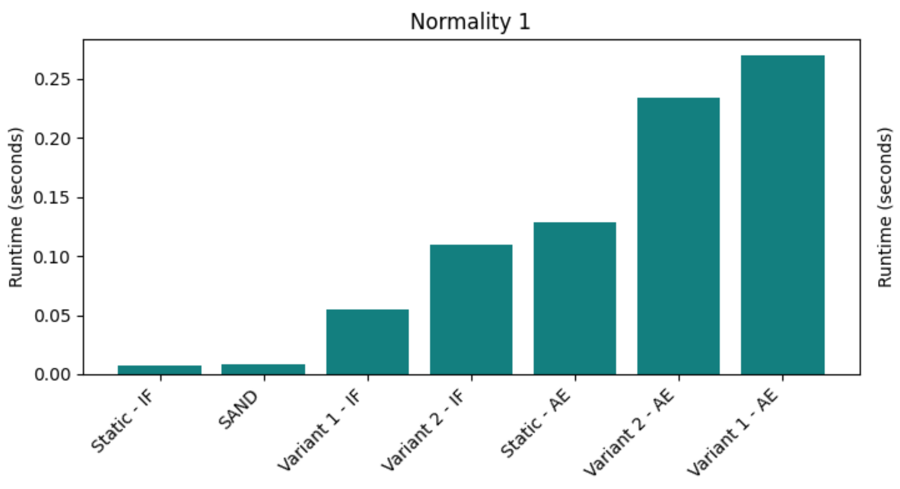
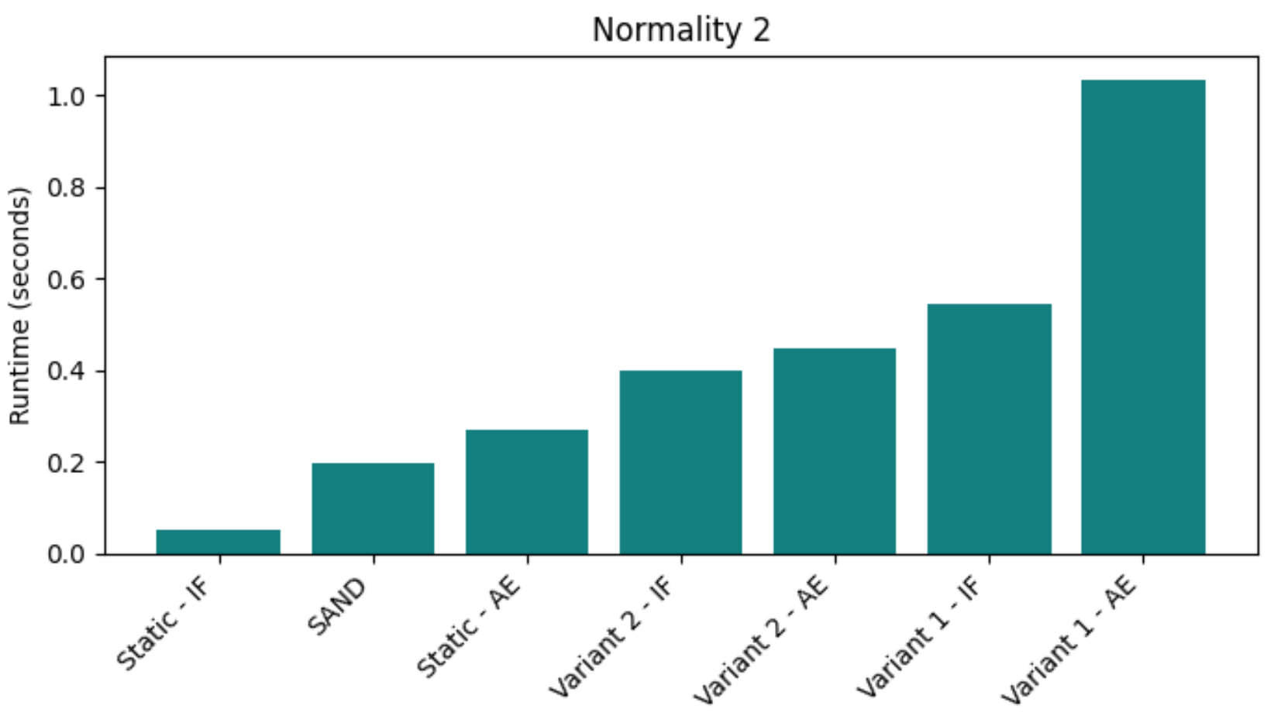
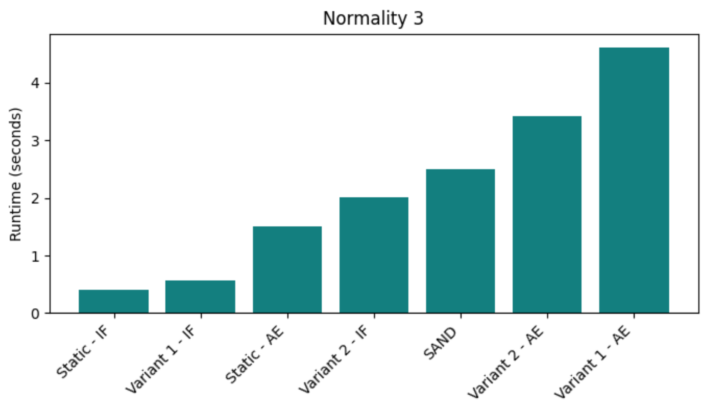
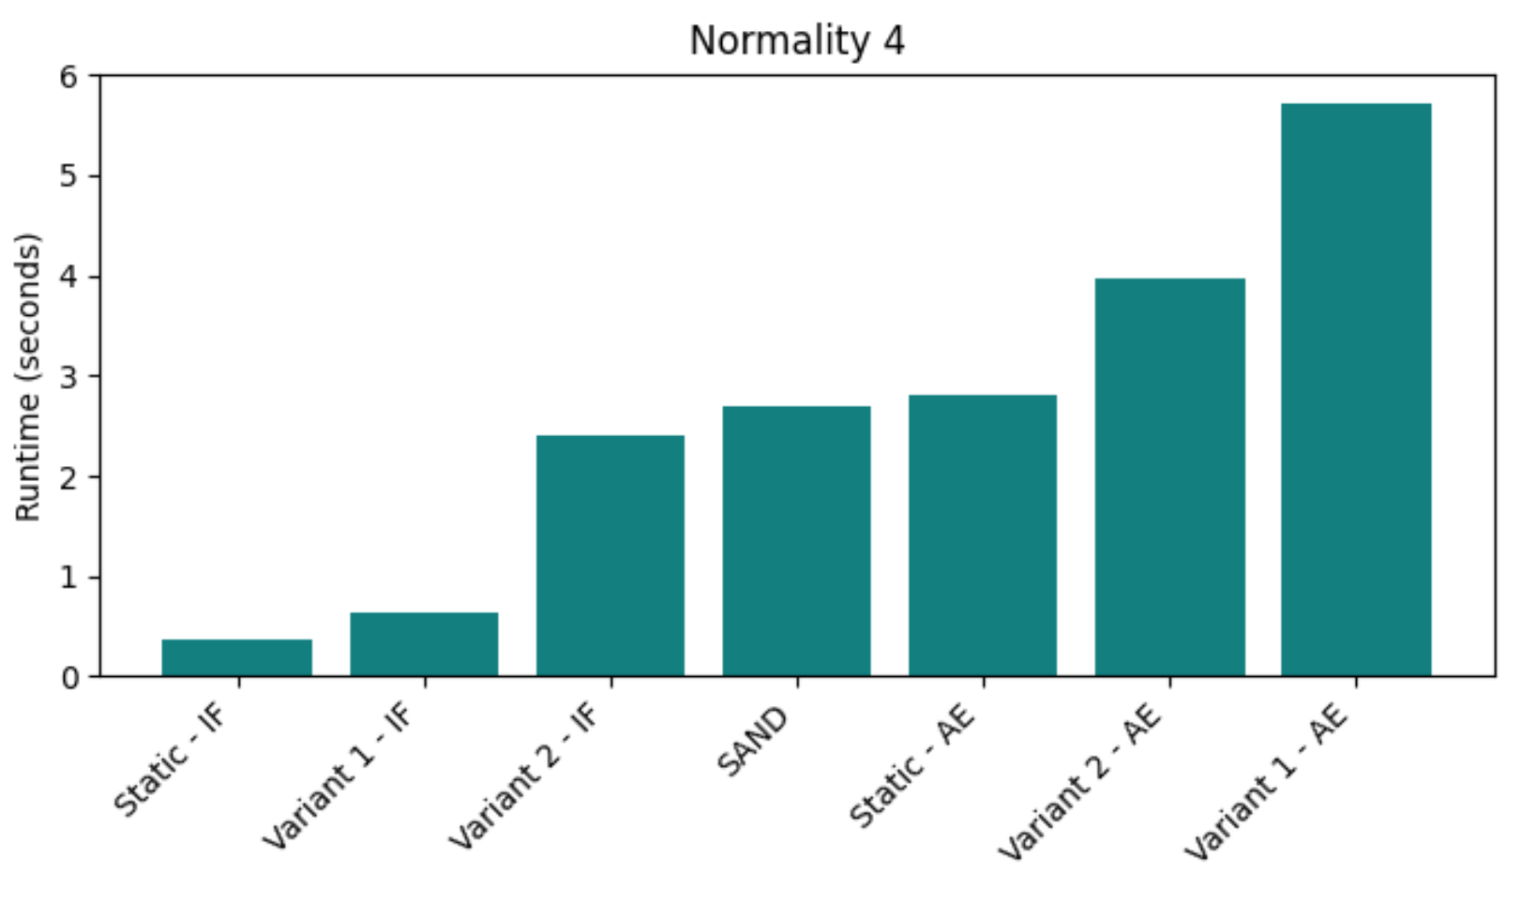
FINal results – RUNTIMES

Slide 14
Thank you!
Any questions?

