Slide 1


Web datamining & semantics
Adèle MONTOYA, Paul RUNAVOT, Eleonor KIOULOU

Slide 2

OBJECTIFS
Design a movie application that follows the Linked Data principles
Do a little software development, using Semantic Web programming frameworks
Setup and interact with an RDF database
Exploit multiple sources of heterogeneous data
Develop an application to create, query and validate calendar events.

Slide 3
PART 1 : Modeling the ontologie

Slide 4
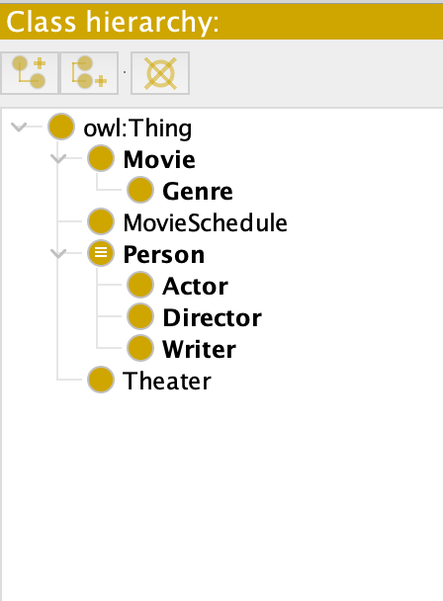
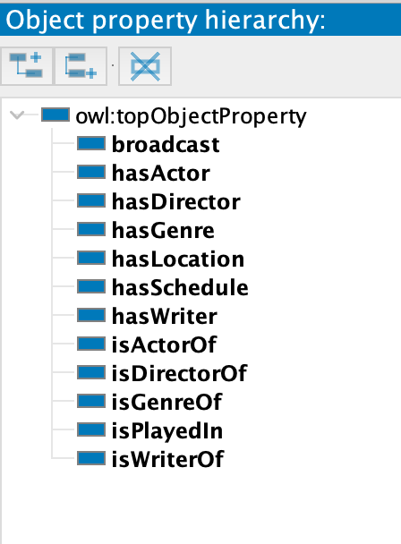
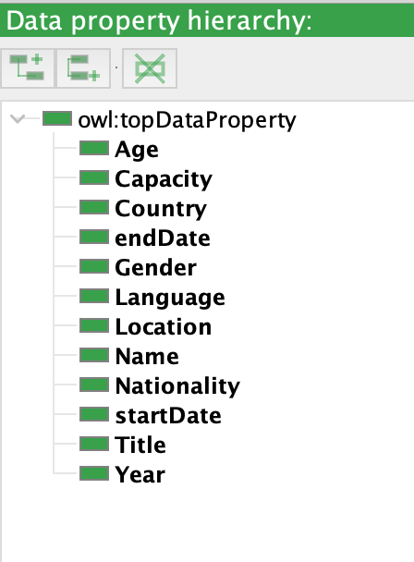
Classes
PART 1 : Modeling the ontologie
Object properties
Data properties

Slide 5
PART 2 : Populating the ontology

Slide 6
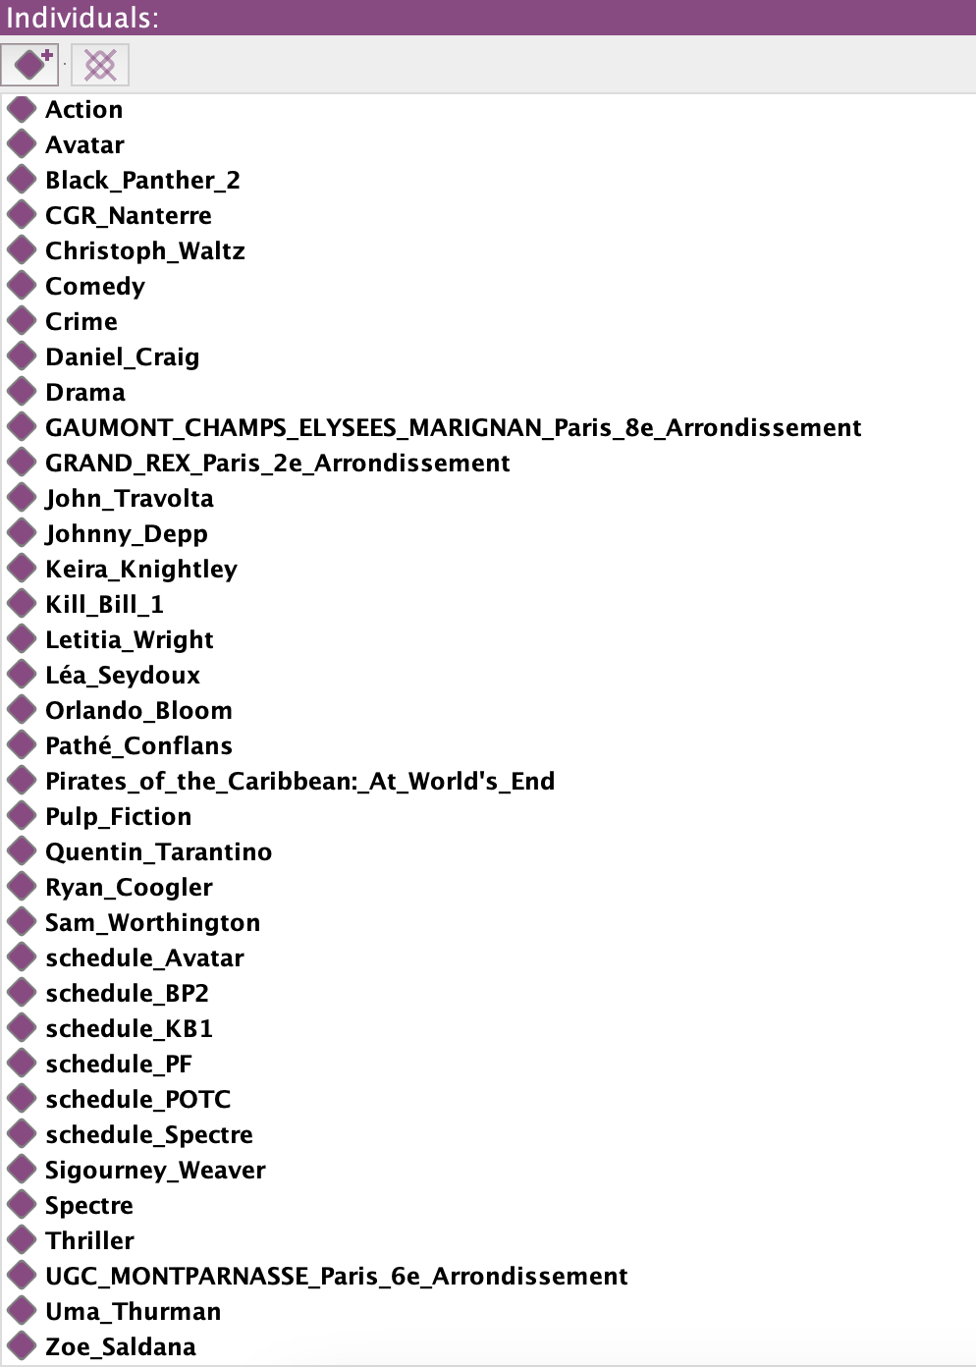
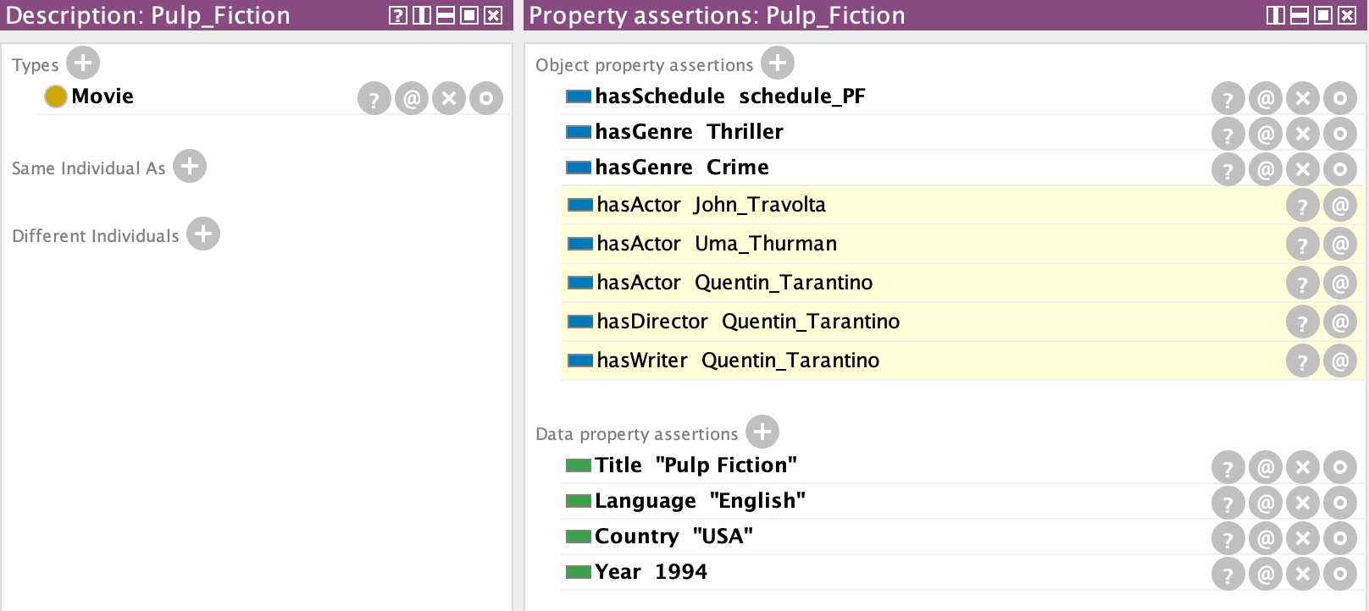
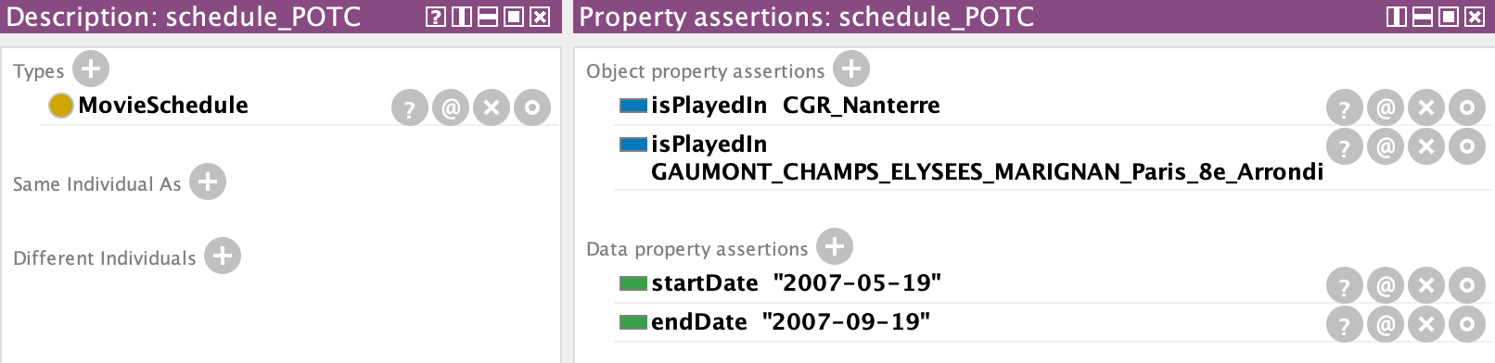
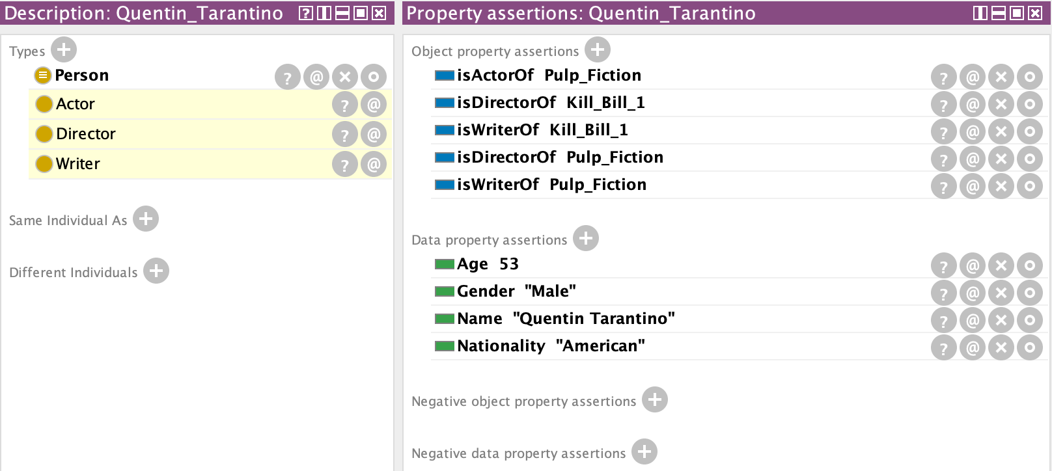
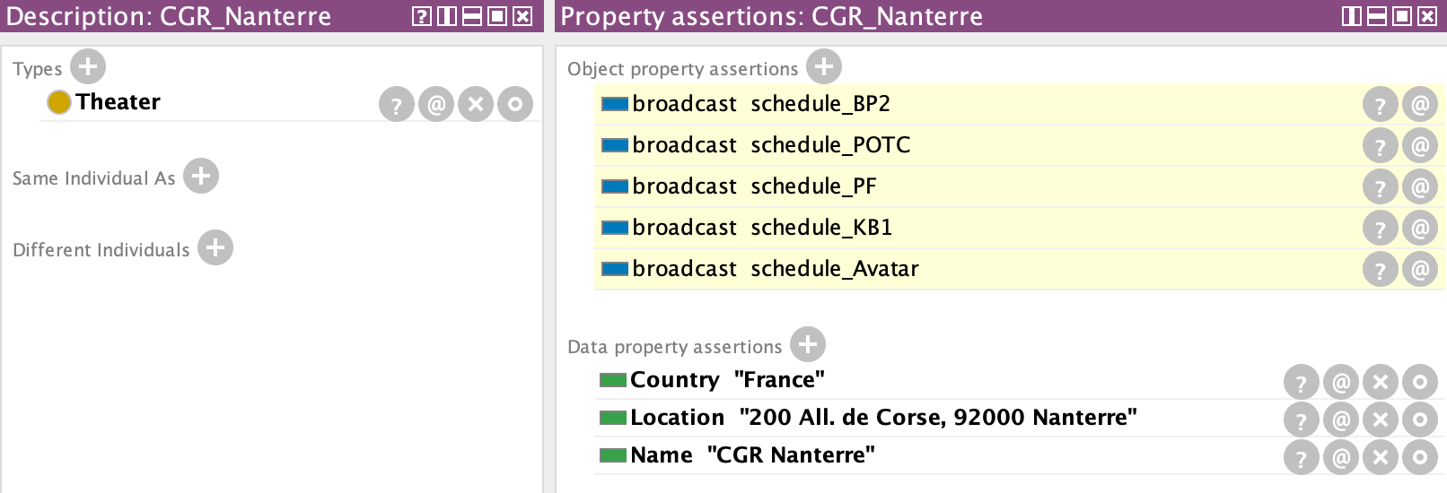
Examples

Slide 7
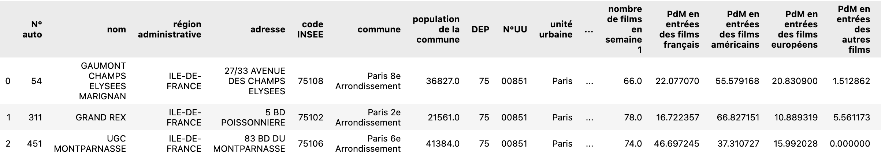
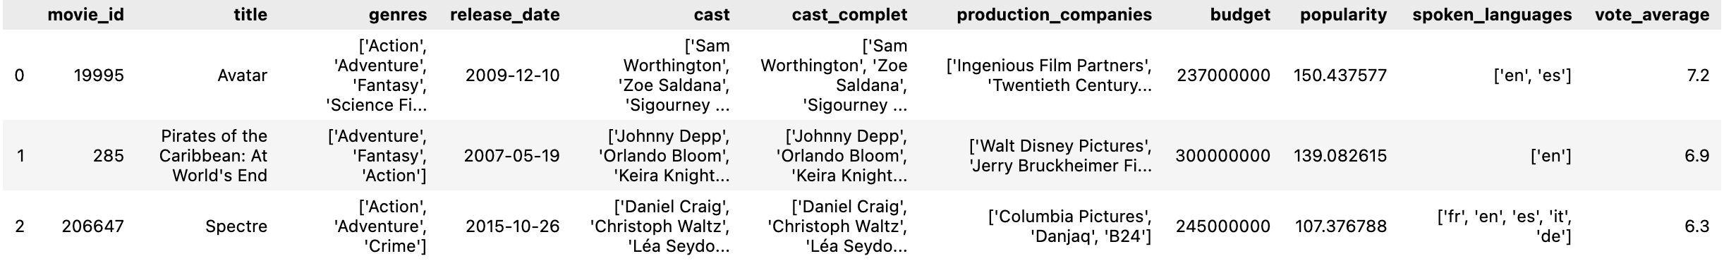
Generate an RDF file with individuals
Dataset about the theater in France used for the class “THEATER”
Dataset about some movies and their actors used for the classes :
“MOVIE”, ”PERSON” and “MOVIESCHEDULE”

Slide 8
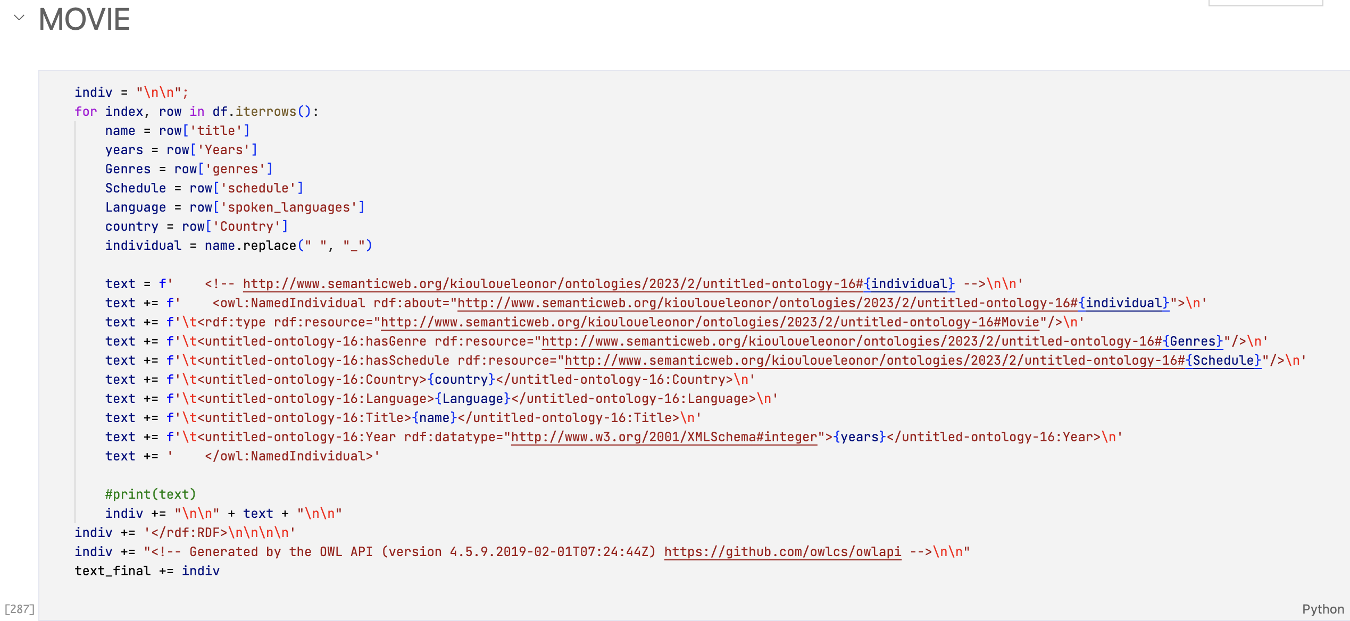
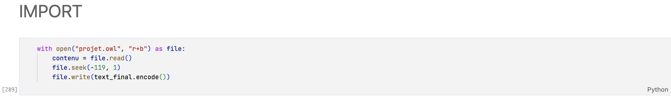
Inserting into a text and then inserting it into the .owl file

Slide 9
PART 3 : Querying the ontology

Slide 10
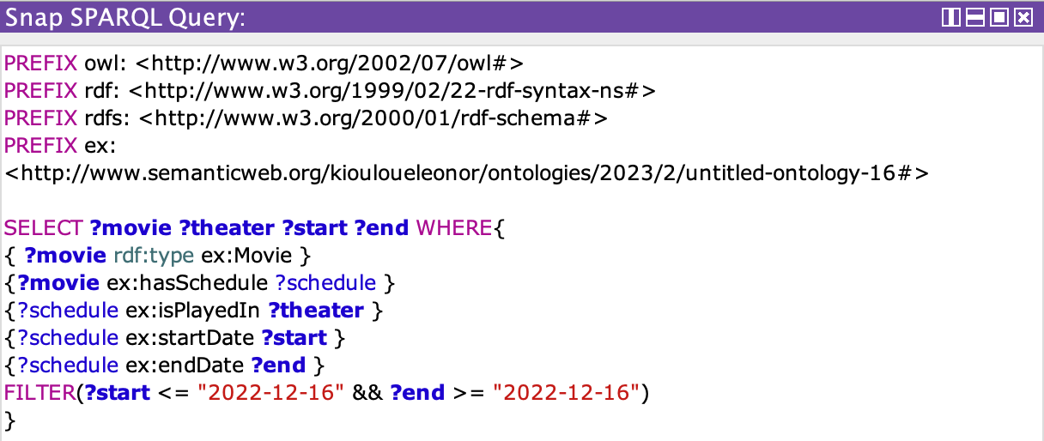
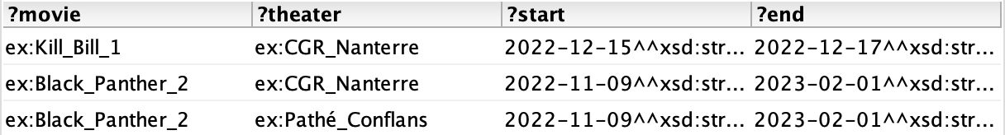
Example 1
List of movies that are played in theater for a specific day and where and until when

Slide 11
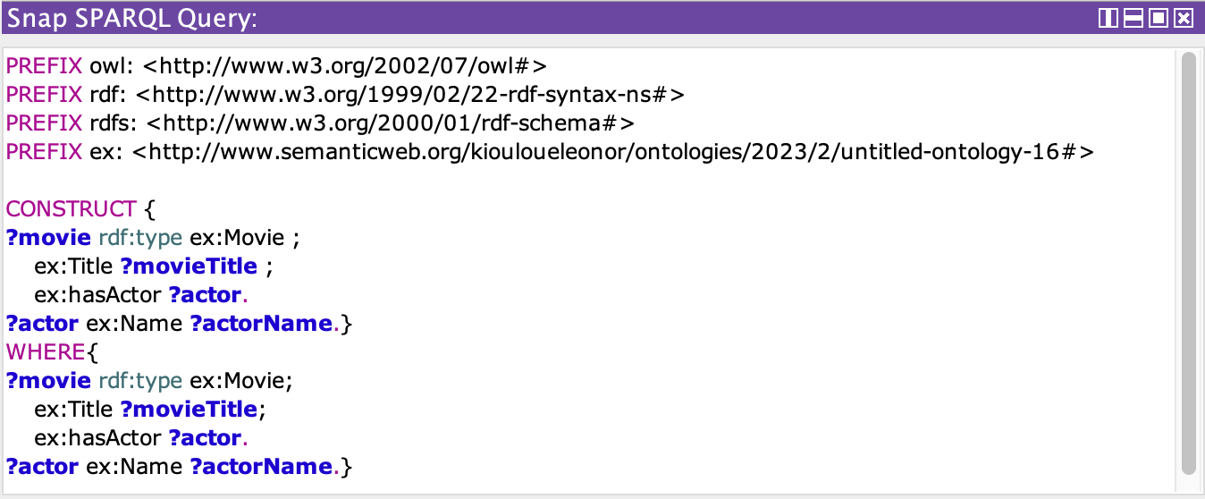
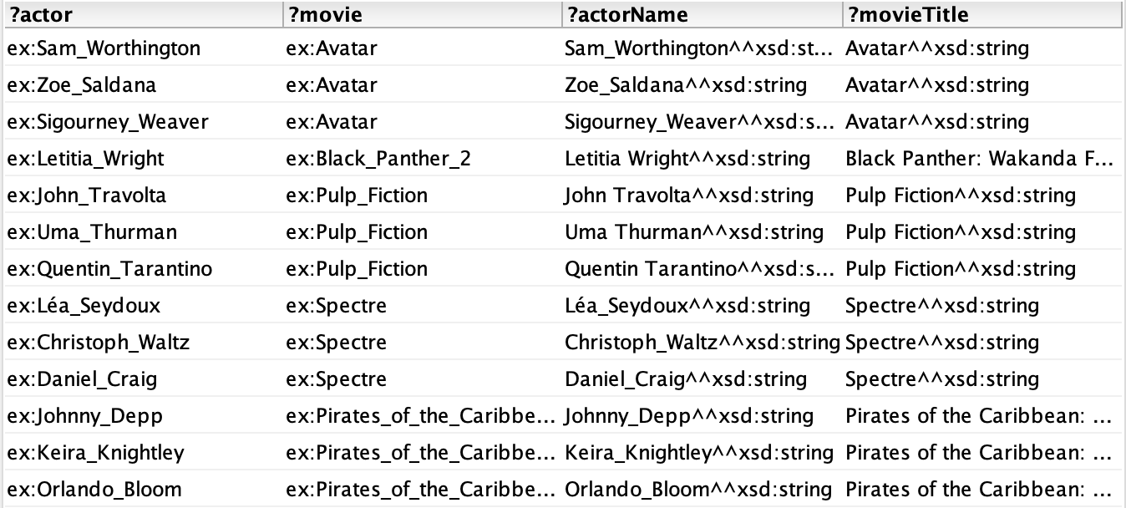
Example 2
A query that contains a CONSTRUCT query form
This query builds an RDF graph to represent movies and actors and establishes relationships between them using specific properties defined in the user-specified ontology

Slide 12
PART 4 :Manipulating the ontology using Jena

