Slide 1
UL FRI
Overview and Early Activities
First step : Describe the current state of digitalization in European schools.
Mainly collected data from : European Commission. 2nd survey of schools: Ict in education. Objective 1: Bench-mark progress in ict in schools. 2019.
We followed are methodology approach from our proposal and added a few findings on limitations and programming skill.

Slide 2
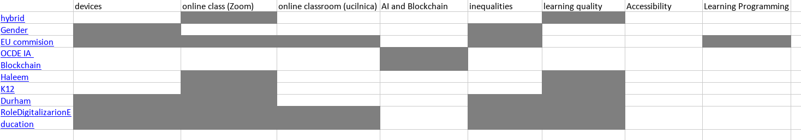
UL FRI
Progress and next step
Current achievements : We collected data on the current state of digitalization in EU schools.
Challenged encountered : many figures, sorting and extracting relevant figures
Next month focus : Link our collected data to others studies to show whether the digitalisation of education is going towards SDG4 and SDG 10.
Reserch methodology :

