Slide 1




A developer amongst (data) journalists
Éléonore Mayola
@EleonoreMayola
github.com/eleonore9
Elle-est-au-nord.com
PyCon Sweden 2018 | @EleonoreMayola

Slide 2

Background | Making new pythonistas | Building a stories pipeline | Mutual lessons learned
Web developer + Data scientist
digital agency, early startup, consultancy
Python, Clojure
jplusplus.org
elle-est-au-nord.com
PyCon Sweden 2018 | @EleonoreMayola

Slide 3
Background | Making new pythonistas | Building a stories pipeline | Mutual lessons learned
Journalism Plus Plus (J++)
jplusplus.org
team of data journalism specialists
Paris
Stockholm
Berlin
Porto
PyCon Sweden 2018 | @EleonoreMayola

Slide 4
Background | Making new pythonistas | Building a stories pipeline | Mutual lessons learned
Data journalism
Identifying / investigating stories
web scraping, APIs, data analysis
Presenting / telling stories
web app, interactive data visualisation
PyCon Sweden 2018 | @EleonoreMayola

Slide 5

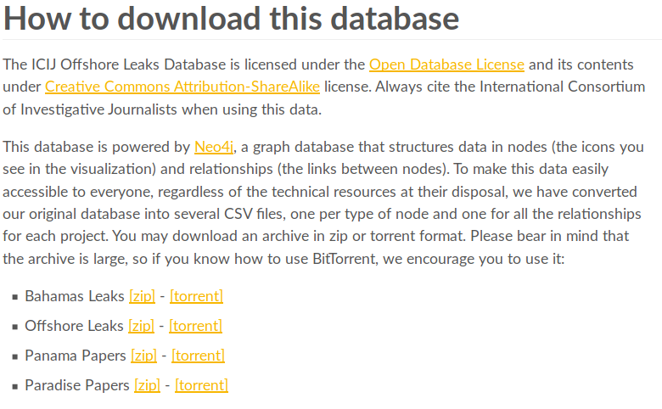

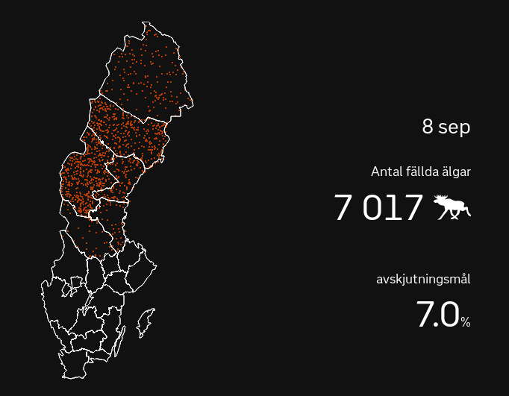
Background | Making new pythonistas | Building a stories pipeline | Mutual lessons learned
ICIJ – The Panama Papers
offshoreleaks.icij.org
The Washington Post
washingtonpost.com/graphics/politics/trump-claims-database
SVT
svt.se/special/algjakten-i-siffror
PyCon Sweden 2018 | @EleonoreMayola

Slide 6
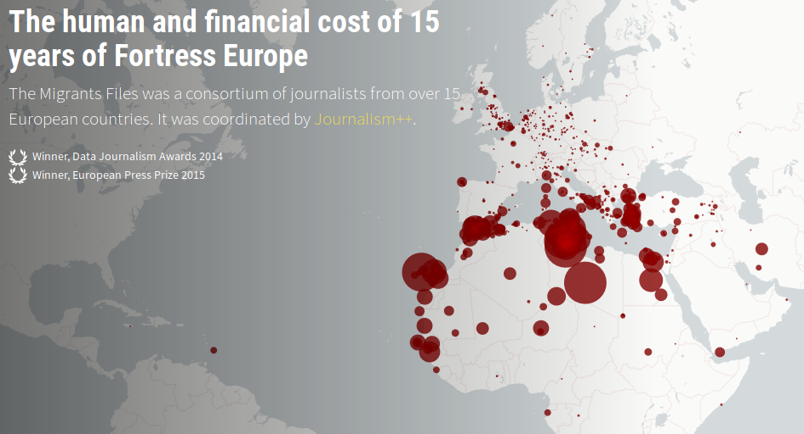
Background | Making new pythonistas | Building a stories pipeline | Mutual lessons learned
Journalism Plus Plus (J++)
The migrants files – themigrantsfiles.com
PyCon Sweden 2018 | @EleonoreMayola

Slide 7
Background | Making new pythonistas | Building a stories pipeline | Mutual lessons learned
Journalism Plus Plus (J++)
Stockholm office
Programming for journalists – Python course
Newsworthy – automated story finding
Clients projects – web applications, data analysis
Local/global news stories – research, analysis, viz
PyCon Sweden 2018 | @EleonoreMayola

Slide 8
Background | Making new pythonistas | Building a stories pipeline | Mutual lessons learned
What I’m NOT going to talk about:
Being a newsroom developer
How to become a data journalist (although I’m happy to chat about it)
What I’m going to talk about:
My experience at J++ (teaching Python to journalists, working on internal/client projects)
My takeaways from that experience
PyCon Sweden 2018 | @EleonoreMayola

Slide 9
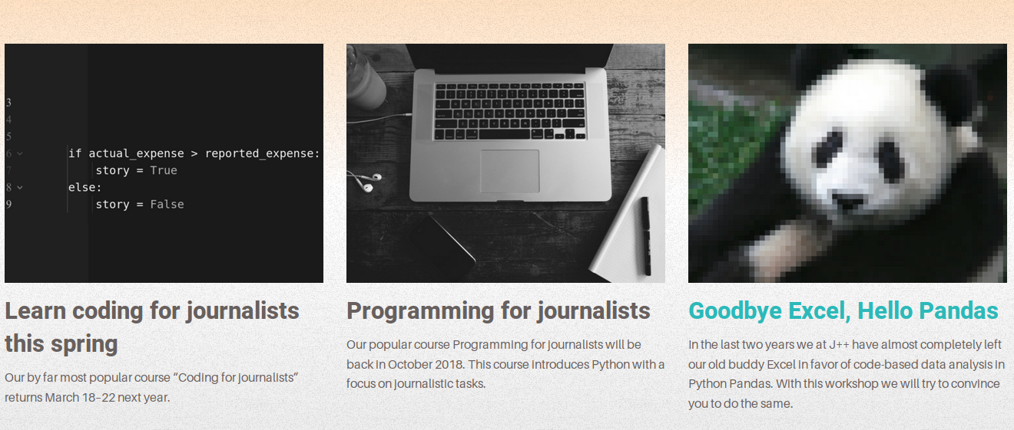

Background | Making new pythonistas | Building a stories pipeline | Mutual lessons learned
Programming for journalists – Python course
jplusplus.org/en/academy
X sessions already run → programme set but adapted to each class
PyCon Sweden 2018 | @EleonoreMayola

Slide 10
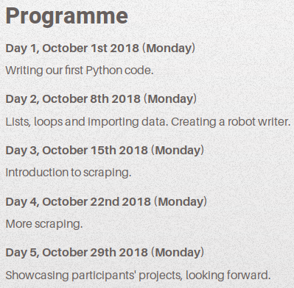

Background | Making new pythonistas | Building a stories pipeline | Mutual lessons learned
Classroom teaching
CLI basics
Python basic data structures
if statements, for loops
Work with Python libraries, APIs, reading/writing files
Support
Slack group (24/7)
Applied to journalism
Generating texts
Web scraping
Gather tweets
Course project
jplusplus.org/en/academy/programming-for-journalists
Slide Leo Wallentin
PyCon Sweden 2018 | @EleonoreMayola

Slide 11
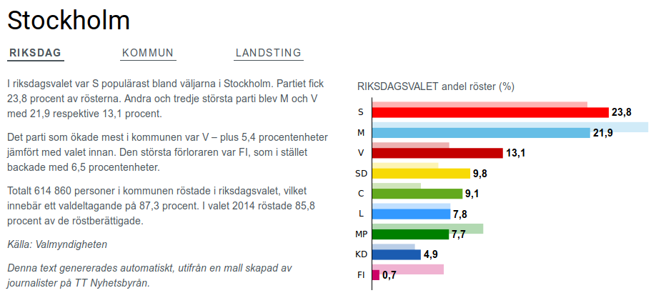
Background | Making new pythonistas | Building a stories pipeline | Mutual lessons learned
sverigesradio.se/sida/artikel.aspx?programid=4657&artikel=7037094
It’s so exciting!
Keeping things simple and practical → implement what they learn
We’ve actually made new members of the Python community
Teaching new skills → impact on their career
We’re having a (indirect) positive impact on society
PyCon Sweden 2018 | @EleonoreMayola

Slide 12
Background | Making new pythonistas | Building a stories pipeline | Mutual lessons learned
It’s also challenging
Adapting to the different students coding levels
  - remove things if they need more time
  - give more to more advanced students
There are so many tools, notions, libraries
  - don’t overwhelm them
  - develop a follow-up course
Get them to interact with other data journalists and other members of the Python community
Alumni network? Local meetup groups?
PyCon Sweden 2018 | @EleonoreMayola

Slide 13
Background | Making new pythonistas | Building a stories pipeline | Mutual lessons learned
Datasets
(employement, crime...)
Newsworthy – automated story finding
Node.js, Amazon Web Services
Internal project based on a statistical model
Feeds on local or European level databases
Generates JSON format data + graph images
Query data to write news stories
Identify story worthy
Generate data
JSON
IMG
Generate story
News story
HTML page with graph
PyCon Sweden 2018 | @EleonoreMayola

Slide 14
Background | Making new pythonistas | Building a stories pipeline | Mutual lessons learned
Data
(API, CSVs...)
Gather and
transform data
Clients projects – web applications, data analysis
Node.js or Python, Postgres, AWS
Use clients data and/or open data
Feed a database + add data upon updates
Query data for applications or analysis
DB
DB
Merge data sources
Merged DBs
usage
app/analysis
PyCon Sweden 2018 | @EleonoreMayola

Slide 15
Background | Making new pythonistas | Building a stories pipeline | Mutual lessons learned
Aim
Data pipeline - fully automated and reusable
Current state
- data pipeline – not fully automated, differs / projects
- for each project -
PyCon Sweden 2018 | @EleonoreMayola

Slide 16
Background | Making new pythonistas | Building a stories pipeline | Mutual lessons learned
Plans and ideas to test
- lambda functions and serverless architecture
- independent monitoring and alerting system
PyCon Sweden 2018 | @EleonoreMayola

Slide 17
Background | Making new pythonistas | Building a stories pipeline | Mutual lessons learned
Local/global news stories – research, analysis, viz
Example: EDJNET - OneDegreeWarmer
Investigating climate data
Part of a European network of journalists
First story (09/2018): temperatures in European cities
Communication, coordination, data analysis/modelling, text generation, web application
PyCon Sweden 2018 | @EleonoreMayola

Slide 18
Background | Making new pythonistas | Building a stories pipeline | Mutual lessons learned
OneDegreeWarmer - URL
Screenshot of the app
Methodology
PyCon Sweden 2018 | @EleonoreMayola

Slide 19
Background | Making new pythonistas | Building a stories pipeline | Mutual lessons learned
OneDegreeWarmer -story spread
Screenshots of news publications
PyCon Sweden 2018 | @EleonoreMayola

Slide 20
Background | Making new pythonistas | Building a stories pipeline | Mutual lessons learned
OneDegreeWarmer – bump on the road
Screenshot statement
PyCon Sweden 2018 | @EleonoreMayola

Slide 21
Background | Making new pythonistas | Building a stories pipeline | Mutual lessons learned
<TITLE>
Skills involved
Curiosity, general/domain knowledge
Communication (document)
Flexibility (new techs, ideas…)
Deliver: be simple and practicle (cf Zen of Python :))
PyCon Sweden 2018 | @EleonoreMayola

Slide 22
Background | Making new pythonistas | Building a stories pipeline | Mutual lessons learned
Methodology and processes
Tools
Slack (communication with Sthlm-Porto, Sthlm only, projects specific, ideas/cool stuffs)
Trello (general planning, projects features)
Google docs
Processes
Weekly planning meeting
Monthly update meeting Sthlm-Porto
Meetings project specific within networks (EDJNET)
PyCon Sweden 2018 | @EleonoreMayola

Slide 23
Background | Making new pythonistas | Building a stories pipeline | Mutual lessons learned
Think your interactions w/ “non-technical” colleagues
Take on n00bs
Think about how coding can help other professions
=> tricky balance between giving enough info, but not too much
PyCon Sweden 2018 | @EleonoreMayola

Slide 24
Background | Making new pythonistas | Building a stories pipeline | Mutual lessons learned
Think about your next “career move”
Tech work != tech organisation
PyCon Sweden 2018 | @EleonoreMayola

Slide 25

Resources
http://datajournalismhandbook.org/1.0/en/
@EleonoreMayola
github.com/eleonore9
Elle-est-au-nord.com
jpluplus.org
PyCon Sweden 2018 | @EleonoreMayola

