Slide 1




A developer amongst (data) journalists
Éléonore Mayola
@EleonoreMayola
github.com/eleonore9
Elle-est-au-nord.com
jpluplus.org
PyCon Sweden 2018 | @EleonoreMayola

Slide 2




Background | Making new pythonistas | Building a stories pipeline | Teaming up against climate change | Lessons learned
Web developer + Data scientist
digital agency, early startup, consultancy
Python, Clojure
Freelance work
Developer @ J++
PUG organiser
Coding mentor
PyCon Sweden 2018 | @EleonoreMayola

Slide 3
Background | Making new pythonistas | Building a stories pipeline | Teaming up against climate change | Lessons learned
Journalism Plus Plus (J++)
jplusplus.org
team of data journalism specialists
Paris
Cologne
Stockholm
Berlin
Amsterdam
Porto
PyCon Sweden 2018 | @EleonoreMayola

Slide 4
Background | Making new pythonistas | Building a stories pipeline | Teaming up against climate change | Lessons learned
Data journalism
Identifying / investigating stories
web scraping, APIs, data analysis
Presenting / telling stories
web app, interactive data visualisation
PyCon Sweden 2018 | @EleonoreMayola

Slide 5
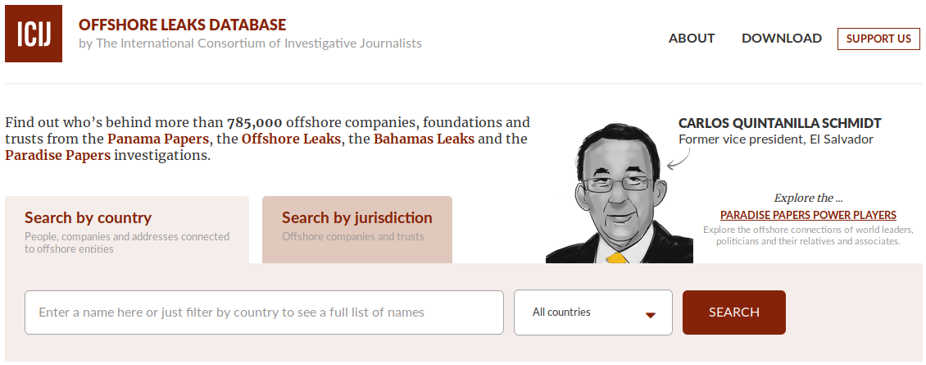
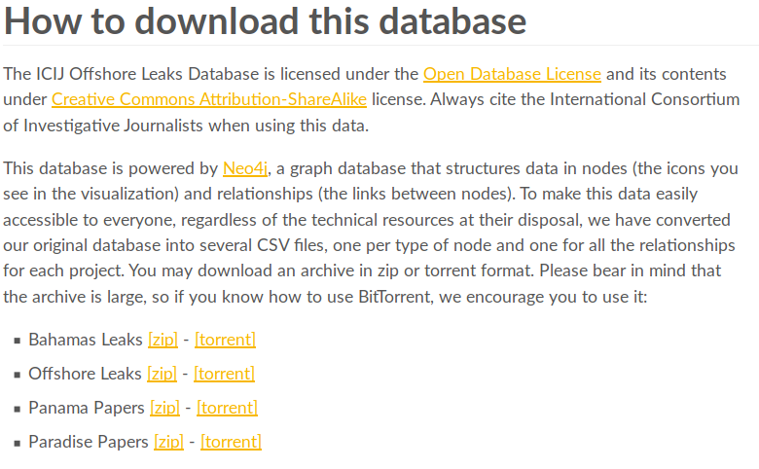

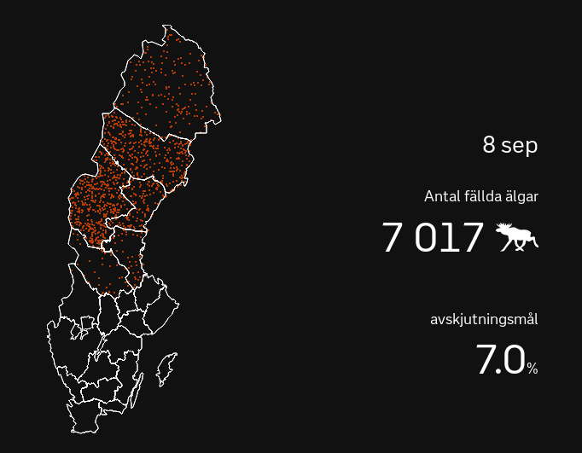
Background | Making new pythonistas | Building a stories pipeline | Teaming up against climate change | Lessons learned
ICIJ – The Panama Papers
offshoreleaks.icij.org
The Washington Post
washingtonpost.com/graphics/politics/trump-claims-database
SVT
svt.se/special/algjakten-i-siffror
PyCon Sweden 2018 | @EleonoreMayola

Slide 6
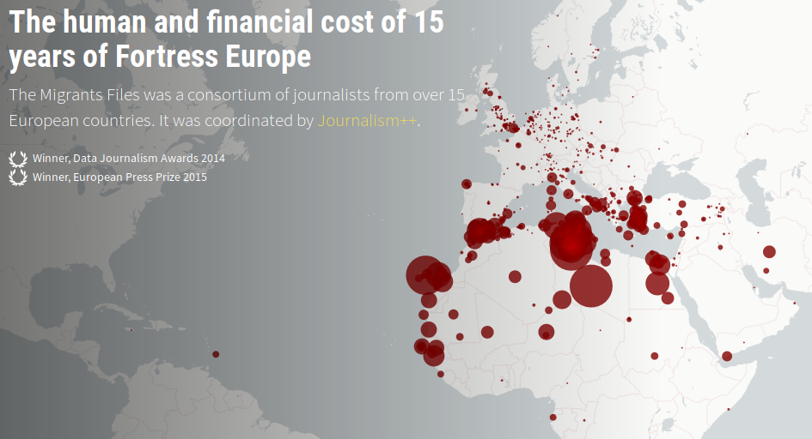
Background | Making new pythonistas | Building a stories pipeline | Teaming up against climate change | Lessons learned
Journalism Plus Plus (J++)
The migrants files – themigrantsfiles.com
PyCon Sweden 2018 | @EleonoreMayola

Slide 7
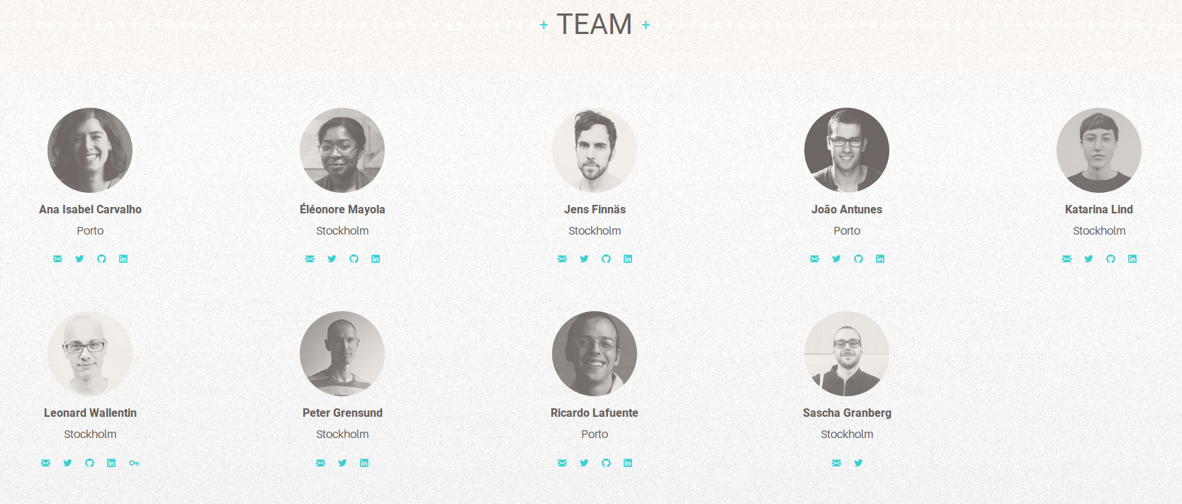
Background | Making new pythonistas | Building a stories pipeline | Teaming up against climate change | Lessons learned
Journalism Plus Plus (J++)
Stockholm and Porto offices
PyCon Sweden 2018 | @EleonoreMayola

Slide 8
Background | Making new pythonistas | Building a stories pipeline | Teaming up against climate change | Lessons learned
Journalism Plus Plus (J++)
Stockholm office
Programming for journalists – Python course
Newsworthy – automated story finding
Clients projects – web applications, data analysis
Local/global news stories – research, analysis, viz
PyCon Sweden 2018 | @EleonoreMayola

Slide 9
Background | Making new pythonistas | Building a stories pipeline | Teaming up against climate change | Lessons learned
What I’m NOT going to talk about:
Being a newsroom developer
How to become a data journalist (although I’m happy to chat about it)
What I’m going to talk about:
My experience at J++ (teaching Python to journalists, working on internal/client projects)
My takeaways from that experience
PyCon Sweden 2018 | @EleonoreMayola

Slide 10
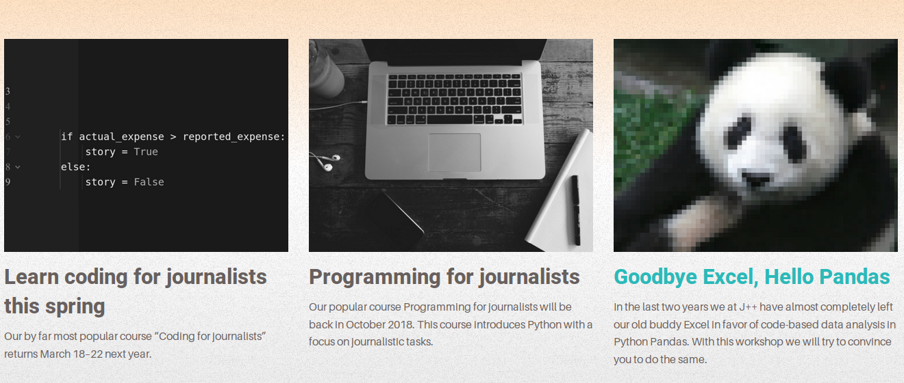

Background | Making new pythonistas | Building a stories pipeline | Teaming up against climate change | Lessons learned
Programming for journalists – Python course
jplusplus.org/en/academy
6 sessions already run → programme set but adapted to each class
PyCon Sweden 2018 | @EleonoreMayola

Slide 11
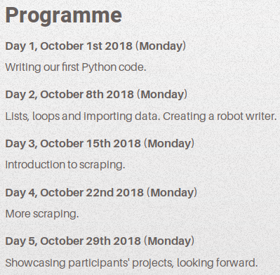
Background | Making new pythonistas | Building a stories pipeline | Teaming up against climate change | Lessons learned
Programming for journalists – Flexible scope
Classroom teaching
CLI basics
Python basic data structures
if statements, for loops
Work with Python libraries, APIs, reading/writing files
Support
Slack group (24/7)
Applied to journalism
Generating texts
Web scraping
Gather tweets
Course project
jplusplus.org/en/academy/programming-for-journalists
PyCon Sweden 2018 | @EleonoreMayola

Slide 12
Background | Making new pythonistas | Building a stories pipeline | Teaming up against climate change | Lessons learned
Programming for journalists – Flexible scope
Day | 2015/16 | 2017 | 2018
Day 1 | Variables, data types, conditionals, functions | Variables, data types, conditionals, functions | Variables, data types, conditionals
Day 2 | Lists, dicts, loops, more functions | Lists, dicts, loops, functions | Lists, dicts, loops
Day 3 | HTML basics, intro to web scraping, read/write files | HTML basics, intro to web scraping, read/write files | HTML basics, intro to web scraping, read/write files
Day 4 | Scrape data from a web page, save data in database | Scrape data from a web page | Scrape data from a web page
Day 5 | Demo git / Github | Demo git / Github How the web works, HTTP requests, Python tools | Demo git / Github
PyCon Sweden 2018 | @EleonoreMayola

Slide 13
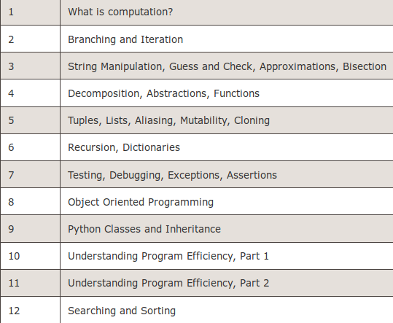
Background | Making new pythonistas | Building a stories pipeline | Teaming up against climate change | Lessons learned
Programming for journalists – Flexible scope
MIT | Intro to CS and Programming in Python
Udacity | Programming Foundations with Python
J++ | Python for Journalists
Day 1
Day 2
Day 3
Day 4
Day 5
Variables, data types, conditionals
Lists, dicts, loops
HTML basics, intro to web scraping, read/write files
Scrape data from a web page
Demo git / Github
Lesson 1
Lesson 2
Lesson 3
Lesson 4
Lesson 5
Intro and installation
Use functions, explore classes
OOP concepts, use 3rd party packages
Create classes
Personal project
PyCon Sweden 2018 | @EleonoreMayola

Slide 14
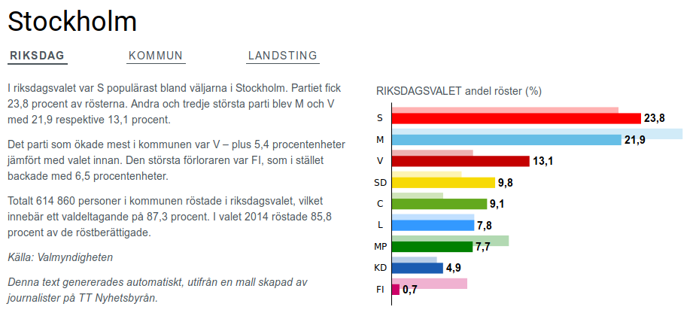
Background | Making new pythonistas | Building a stories pipeline | Teaming up against climate change | Lessons learned
Programming for journalists – Text robots
Read CSV file
Use election
results data
FOR loop
Go through
cities/regions
Use a dictionary
IF statement
Print statement
Write an article
About the results
sverigesradio.se/sida/artikel.aspx?programid=4657&artikel=7037094
PyCon Sweden 2018 | @EleonoreMayola

Slide 15

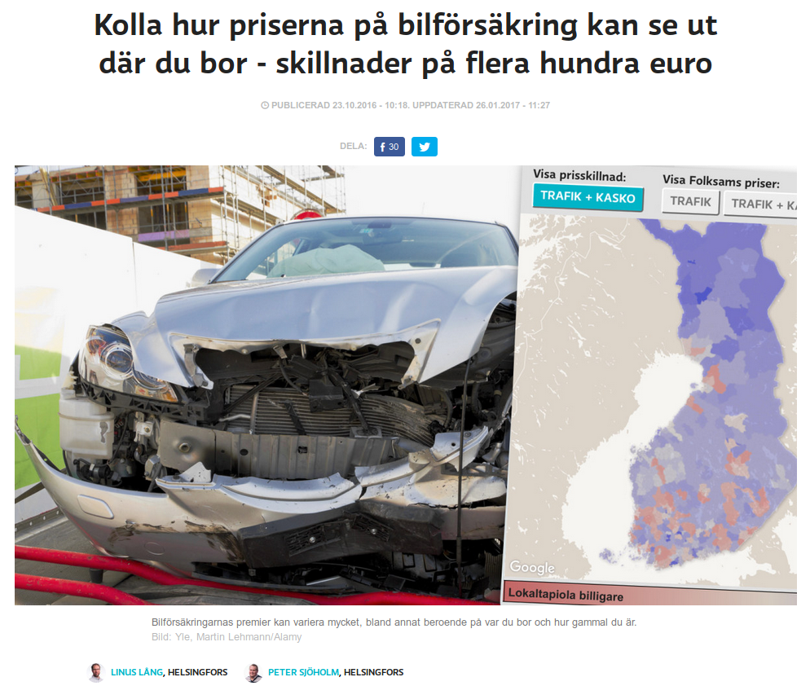
Background | Making new pythonistas | Building a stories pipeline | Teaming up against climate change | Lessons learned
Programming for journalists – Students projects
https://www.etc.se/inrikes/sds-toppnamn-i-kyrkovalet-kopte-nazistbocker-mitt-i-valrorelsen
https://svenska.yle.fi/artikel/2016/10/23/kolla-hur-priserna-pa-bilforsakring-kan-se-ut-dar-du-bor-skillnader-pa-flera
PyCon Sweden 2018 | @EleonoreMayola

Slide 16
Background | Making new pythonistas | Building a stories pipeline | Teaming up against climate change | Lessons learned
It’s so exciting!
Keeping things simple and practical
→ implement what they learn
We’ve actually made new members of the Python community
Teaching new skills
→ impact on their career
We’re having a (indirect) positive impact on society
PyCon Sweden 2018 | @EleonoreMayola

Slide 17
Background | Making new pythonistas | Building a stories pipeline | Teaming up against climate change | Lessons learned
It’s also challenging
Adapting to the different students coding levels
  - remove things if they need more time
  - give more to more advanced students
There are so many tools, notions, libraries
  - don’t overwhelm them
  - develop a follow-up course
Get them to interact with other data journalists and other members of the Python community
Alumni network? Local meetup groups?
PyCon Sweden 2018 | @EleonoreMayola

Slide 18
Background | Making new pythonistas | Building a stories pipeline | Teaming up against climate change | Lessons learned
Datasets
(employement, crime...)
Newsworthy – automated story finding
Node.js, Amazon Web Services
Internal project based on a statistical model
Feeds on local or European level databases
Generates JSON format data + graph images
Query data to write news stories
Identify story worthy
Generate data
JSON
IMG
Generate story
News story
HTML page with graph
PyCon Sweden 2018 | @EleonoreMayola

Slide 19
Background | Making new pythonistas | Building a stories pipeline | Teaming up against climate change | Lessons learned
Data
(API, CSVs...)
Gather and
transform data
Clients projects – web applications, data analysis
Node.js or Python, Postgres, AWS
Use clients data and/or open data
Feed a database + add data upon updates
Query data for applications or analysis
DB
DB
Merge data sources
Merged DBs
usage
app/analysis
PyCon Sweden 2018 | @EleonoreMayola

Slide 20
Background | Making new pythonistas | Building a stories pipeline | Teaming up against climate change | Lessons learned
Aim
Data pipeline fully automated and reusable
Include monitoring and alerting
Current state
Data pipeline – not fully automated, differs / projects
Code organised in a modular fashion
Research and design for a new pipeline
Identification of reusable bits
PyCon Sweden 2018 | @EleonoreMayola

Slide 21
Background | Making new pythonistas | Building a stories pipeline | Teaming up against climate change | Lessons learned
Plan and ideas [in progress]
Lambda functions and serverless architecture
→ Make use of the modular structure
Expand our use of AWS services
→ Quick set-up and for securely hosted services
Independent app for monitoring and alerting system
PyCon Sweden 2018 | @EleonoreMayola

Slide 22
Background | Making new pythonistas | Building a stories pipeline | Teaming up against climate change | Lessons learned
Local/global news stories – research, analysis, viz
Example: EDJNET - OneDegreeWarmer
Investigating climate data
Part of a European network of journalists
First story (09/2018): temperatures in European cities
Communication, coordination, data analysis/modelling, text generation, web application
PyCon Sweden 2018 | @EleonoreMayola

Slide 23

Background | Making new pythonistas | Building a stories pipeline | Teaming up against climate change | Lessons learned
European Data Journalism Network - EDJNet
europeandatajournalism.eu | @EdjNet
Consortium of data journalists throughout Europe
Independent platform for data-driven news on European affairs
Open source content in several languages
PyCon Sweden 2018 | @EleonoreMayola

Slide 24
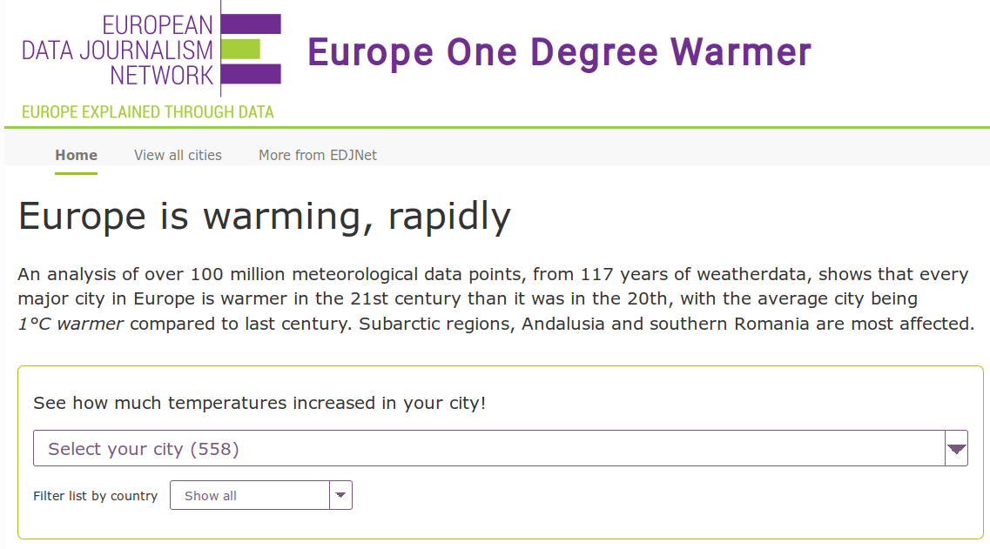
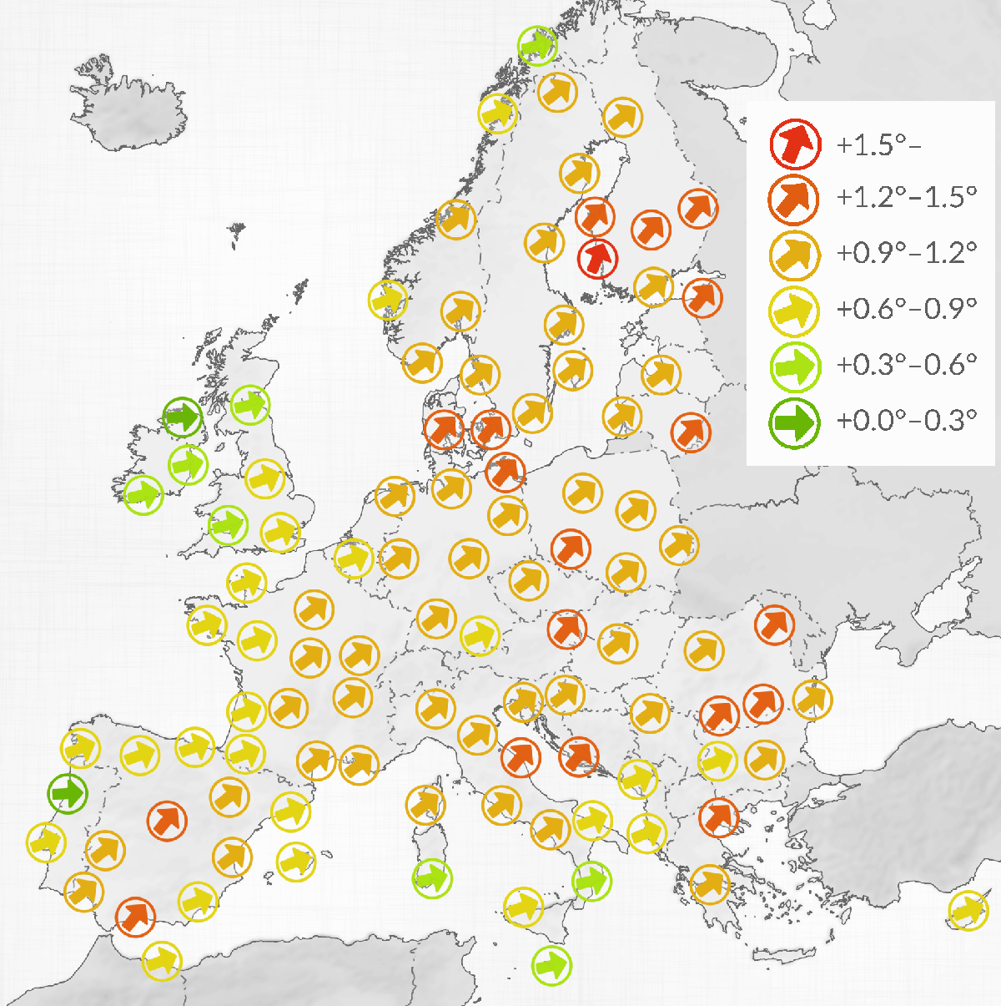
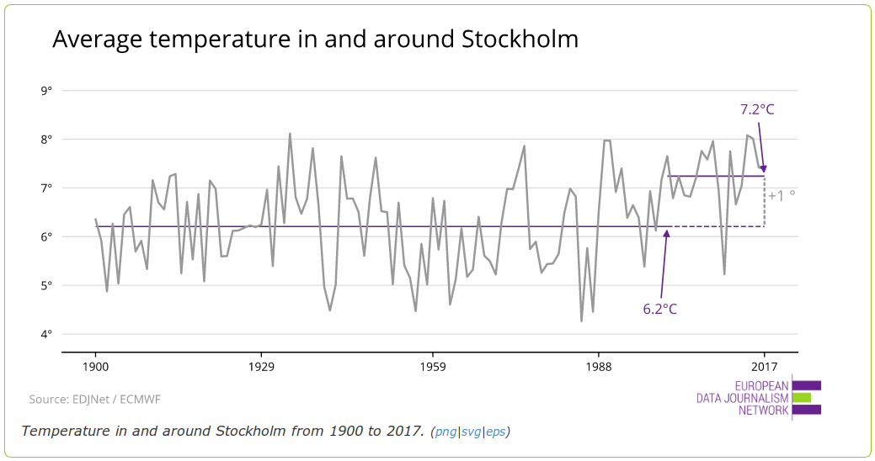
Background | Making new pythonistas | Building a stories pipeline | Teaming up against climate change | Lessons learned
OneDegreeWarmer
onedegreewarmer.eu
Analysis of temperaturess in 558 European cities from 1900 to 2017
Using 2 datasets from the European Centre for Medium-Range Weather Forecasts (ECMWF)
Analysis by ECMWF scientists to make up for weather stations change of location, cities expansion...
Highlight temperature increases and consequences (health, roads/rails traffic, students focus...)
PyCon Sweden 2018 | @EleonoreMayola

Slide 25
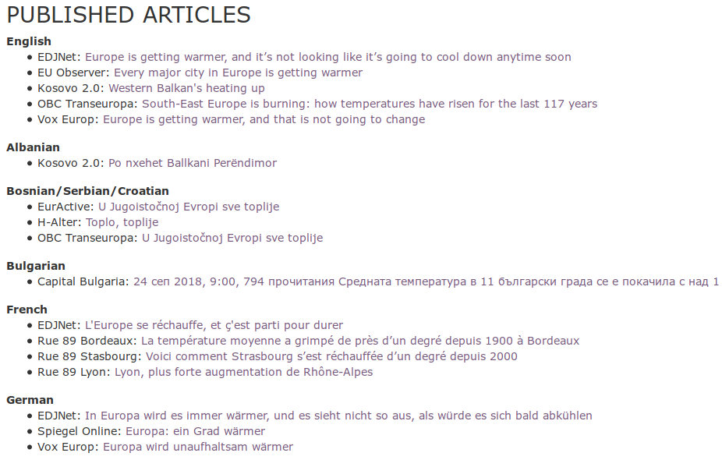
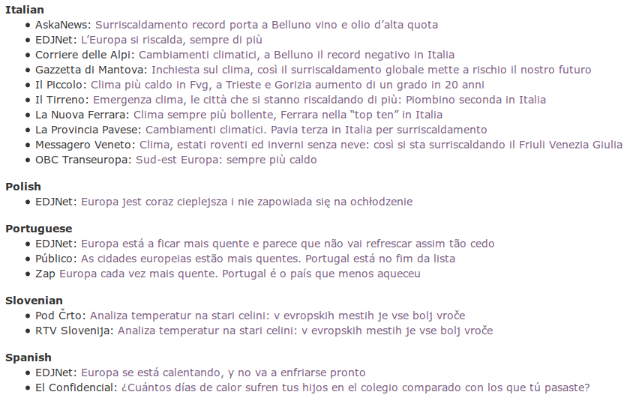
Background | Making new pythonistas | Building a stories pipeline | Teaming up against climate change | Lessons learned
OneDegreeWarmer – the story spread
PyCon Sweden 2018 | @EleonoreMayola

Slide 26
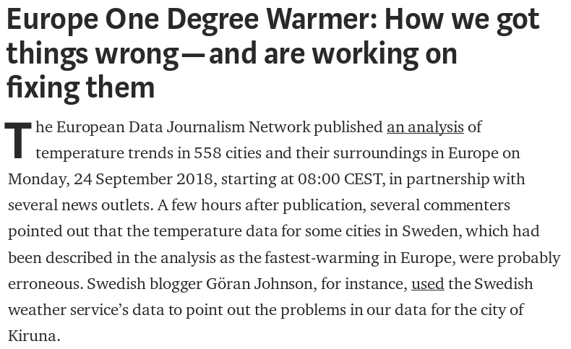
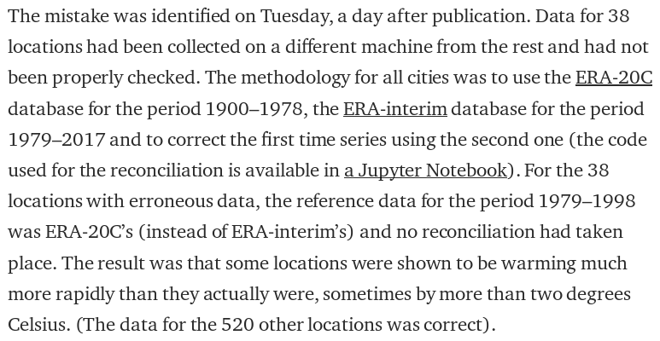
Background | Making new pythonistas | Building a stories pipeline | Teaming up against climate change | Lessons learned
OneDegreeWarmer – challenges
medium.com/european-data-journalism-network/europe-one-degree-warmer-how-we-got-things-wrong-and-are-working-on-fixing-them-67c9c892c13c
PyCon Sweden 2018 | @EleonoreMayola

Slide 27
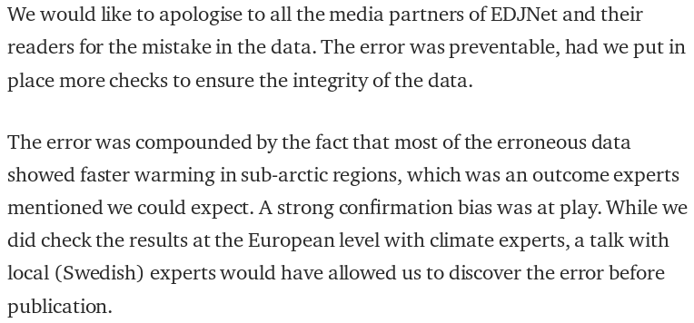
Background | Making new pythonistas | Building a stories pipeline | Teaming up against climate change | Lessons learned
OneDegreeWarmer – challenges
Technical challenges
→ automated checks (monitoring / alerting)
Human challenges
→ domain knowledge checks / feedbacks
Methology and data at https://gitlab.com/edjn/onedegwarmer-shared-data
PyCon Sweden 2018 | @EleonoreMayola

Slide 28
Background | Making new pythonistas | Building a stories pipeline | Teaming up against climate change | Lessons learned
Being a developer among (data) journalists
Skills involved
Curiosity, general/domain knowledge
Communication (document)
Flexibility (new techs, ideas…)
Deliver: be simple and practicle (cf Zen of Python :))
Data work: Python (scripting, Jupyter Notebook, Pandas, Matplotlib….), QGIS
Web work: JS (Node.js, React.js…), HTML, CSS
Other: SQL, version control (Git), AWS, APIs...
PyCon Sweden 2018 | @EleonoreMayola

Slide 29
Background | Making new pythonistas | Building a stories pipeline | Teaming up against climate change | Lessons learned
Methodology and processes
Tools
Slack (communication with Sthlm-Porto, Sthlm only, projects specific, ideas/cool stuffs)
Trello (general planning, projects features)
Google docs
Processes
Weekly planning meeting
Monthly update meeting Sthlm-Porto
Meetings project specific within networks (EDJNET)
PyCon Sweden 2018 | @EleonoreMayola

Slide 30
Background | Making new pythonistas | Building a stories pipeline | Teaming up against climate change | Lessons learned
(Workplace) interactions
Think your interactions with “non-technical” people
→ Take on non-experienced coders
→ Help non-coders eager to automate their work
→ Be proactive on helping other professionals
Balance between giving enough info, but not too much
Favour knowledge exchange (code, domain knowkedge)
PyCon Sweden 2018 | @EleonoreMayola

Slide 31
Background | Making new pythonistas | Building a stories pipeline | Teaming up against climate change | Lessons learned
Work opportunities
Tech work != tech organisations
Widen your perspectives
Widen your network(s)
Widen your job search
Science, art, education, travel, media...
PyCon Sweden 2018 | @EleonoreMayola

Slide 32

Resources
https://github.com/Eleonore9/-pyconse18
http://datajournalismhandbook.org/1.0/en/
@EleonoreMayola
github.com/eleonore9
Elle-est-au-nord.com
jpluplus.org
PyCon Sweden 2018 | @EleonoreMayola

