Slide 1
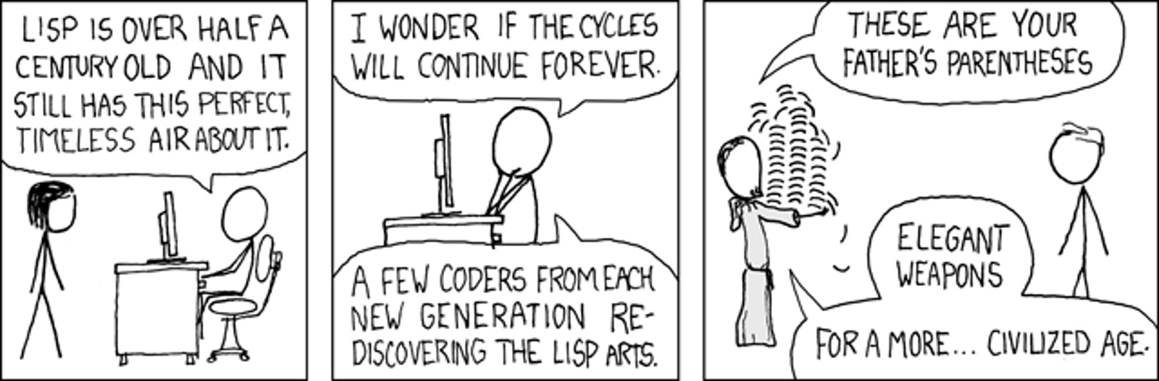



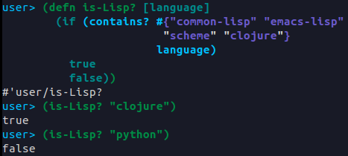


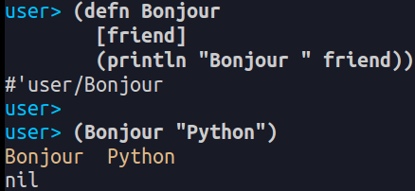


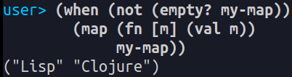
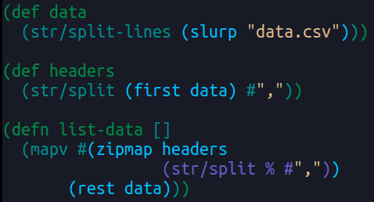
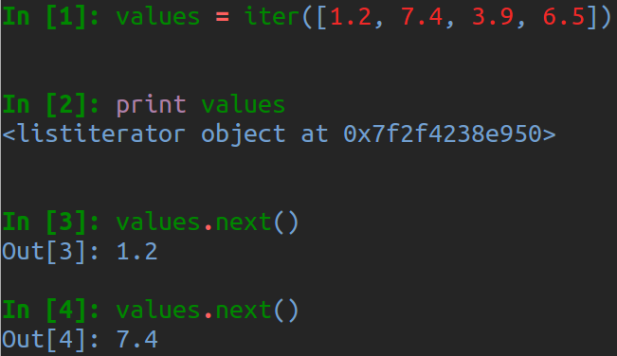
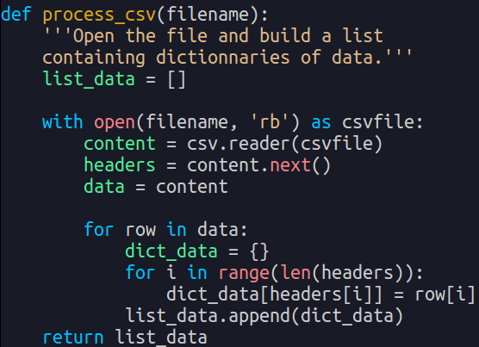

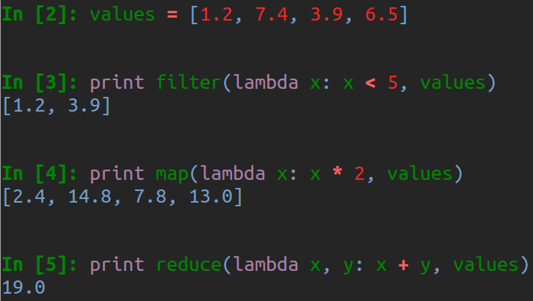
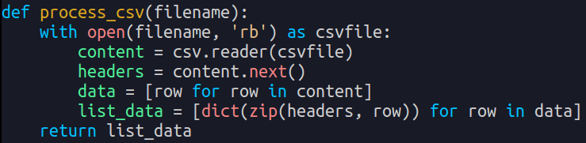
FROM PYTHON TO CLOJURE
A newbie's tale by Eleonore Mayola
Eléonore Mayola, PhD - @EleonoreMayola
Junior data scientist @MastodonC, Co-organiser @PyLadiesLondon
The Fellowship of the Lisp
~$ Tools
User=> (install Leiningen)
Standard tool to create/run a Clojure project + nREPL (Read-eval-print loop)
User=> (Clojure-friendly IDE)
Emacs, Light Table, Eclipse, Vim, Cursive, NightCode...
User=> (use Paredit)
Have you heard about Lisp? Its name derives from "LISt Processing" and it's one of the earliest programming language.
Clojure is a Lisp
Lisp
Common Lisp
Fast, powerful and expressive
Emacs Lisp
Clojure
Code-as-data approach
1958
Scheme
2007
Macro system
xkcd #297
Clojure runs on the JVM
Clojure is hosted on the Java Virtual Machine (JVM). It relies on the JVM for core features and can use Java libraries.
Clojure programs are compiled to Java bytecode by the Clojure compiler and executed by the JVM
Basic syntax
(operator operand1 operand2)
To Lisp' nested lists (S-expressions) it adds vectors, maps and sets
Keeps parentheses balanced for your sanity!
ordered
List:
Vector:
un-ordered
Map:
xkcd #859
Set:
The Two Paradigms
~$ Learning Clojure
User=> (Books)
→ Clojure for the brave and true, D Higginbotham
→ Practical Clojure, L VanderHart and S Sierra
→ Clojure programming, C Emerick, B Carper and C Grand
→ The Joy of Clojure, M Fogus and C Houser
User=> (First steps)
4clojure, Clojure/ClojureScript Koans, Clojure katas
User=> (Community)
Coding dojos, Meetups and conferences are beginners friendly. Also ClojureBridge!
What's all this fuss about functional programming? Where should you start?
Imperative vs functional
The imperative paradigm describes computation in terms of statements that change a program state.
Example: Python
The functional paradigm treats computation as the evaluation of mathematical functions and avoids changing-state and mutable data.
Example: Clojure
Clojure is functional
To avoid mutable state Clojure provides immutable data structures, first-class functions and emphasizes recursive iteration over side-effect based looping.
Immutable lists, vectors, sets and maps
First-class functions
Looping without side-effects
→ Easy way to avoid mutating state
→ Adding to or removing from the a collection means creating a copy with the changes
→ anonymous functions: fn
→ associated to a variable: def, defn
→ map, reduce, loop/recur, doseq
The Return of the Python
~$ Code examples
Clojure:
Python:
Can we use functional programming features while writing Python?
Python functional style
Tuple: immutable data structure
Iterators and generators
List / Dict comprehension:
Anonymous function lambda
associated with filter(), map(), reduce()
More classic
Modules and functions
→ Functional programming forces to break down a problem into small bits.
→ Using small functions that each perform one task.
→ This also makes it easier to write and read programs
→ It is possible in Python to write such small functions inside of modules when needed
More functional

