Slide 1


inspiring data viz projects
Éléonore
@EleonoreMayola
github.com/Eleonore9/inspiring-data-viz

Slide 2
Éléonore
@EleonoreMayola
2 days of conference
A mix of
advices
tips
opinions
rants
projects showcased
areas: art, science, business, fun
But most of all
a summary of the state of the art
a display of what’s possible
1 day of workshops
WebVR with A-frame
First contact with 3D and creating VR
→ broadens how you think about viz
→ creation of new types of viz
D3.js + React
(finally) get it :)
→ good and complete basics
→ useful to combine web + viz

Slide 3
Éléonore
@EleonoreMayola
1st floor
ground
floor
basement
EXPLORATORY DESIGN
Web apps + murals + bibliography
May 4th – October 6th 2018
Espace Fondation EDF
EXPLANATORY DESIGN
Physical displays + data cuisine
EXHIBITORY DESIGN
artsy visualisations

Slide 4
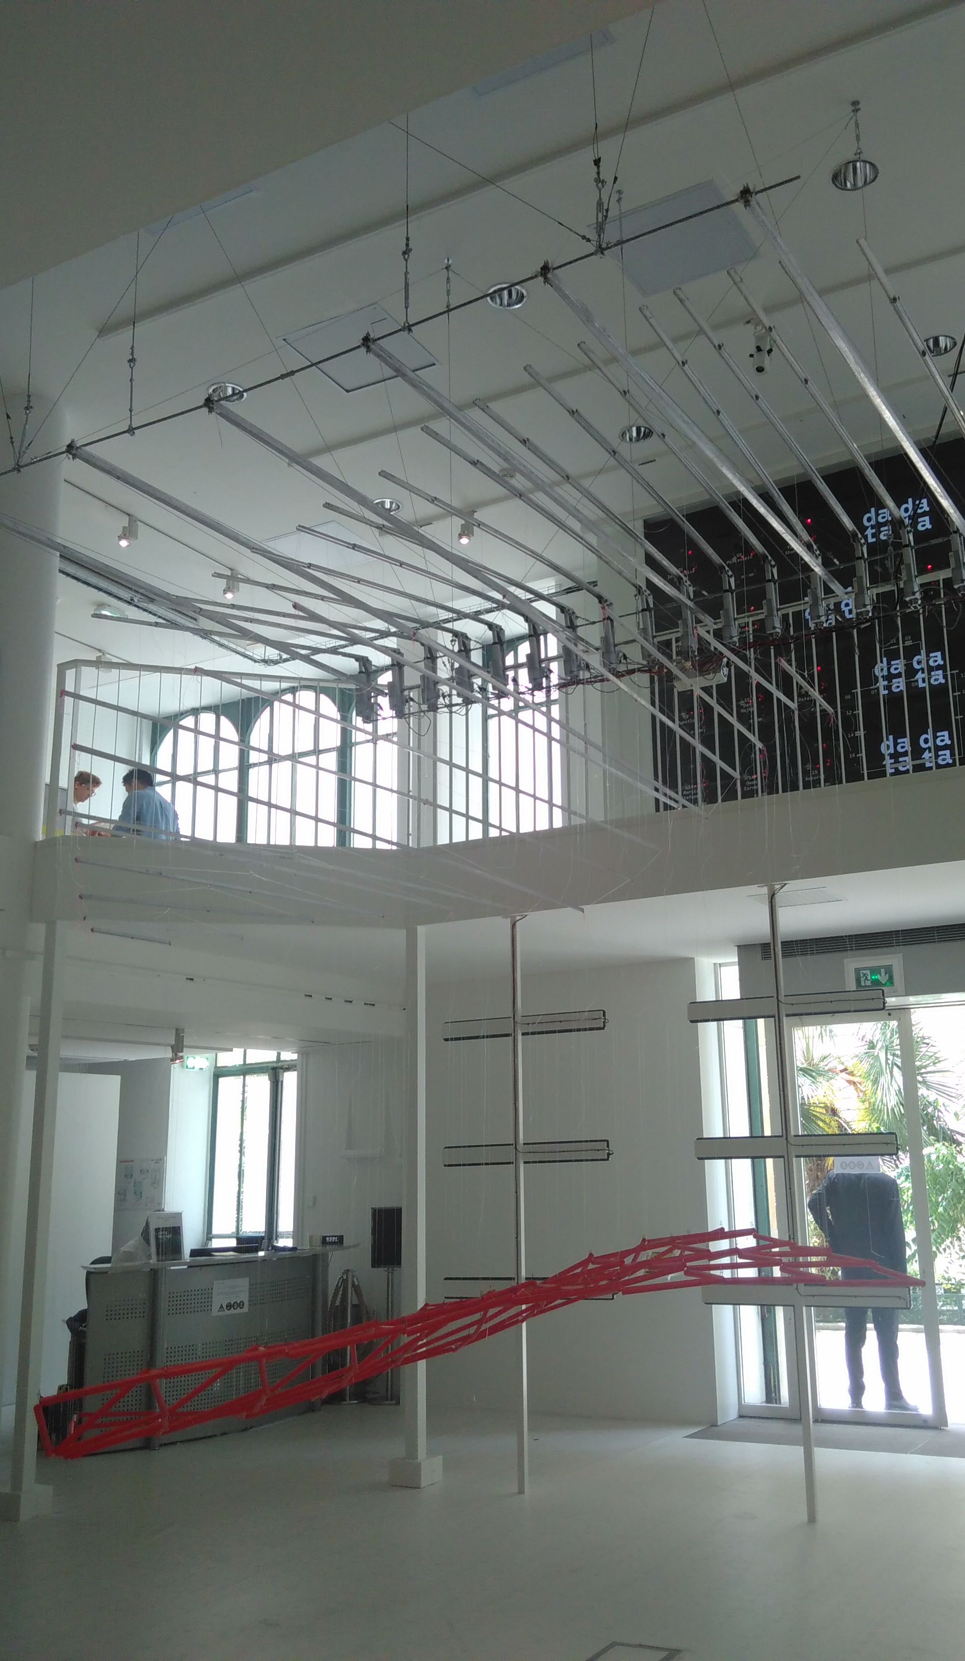
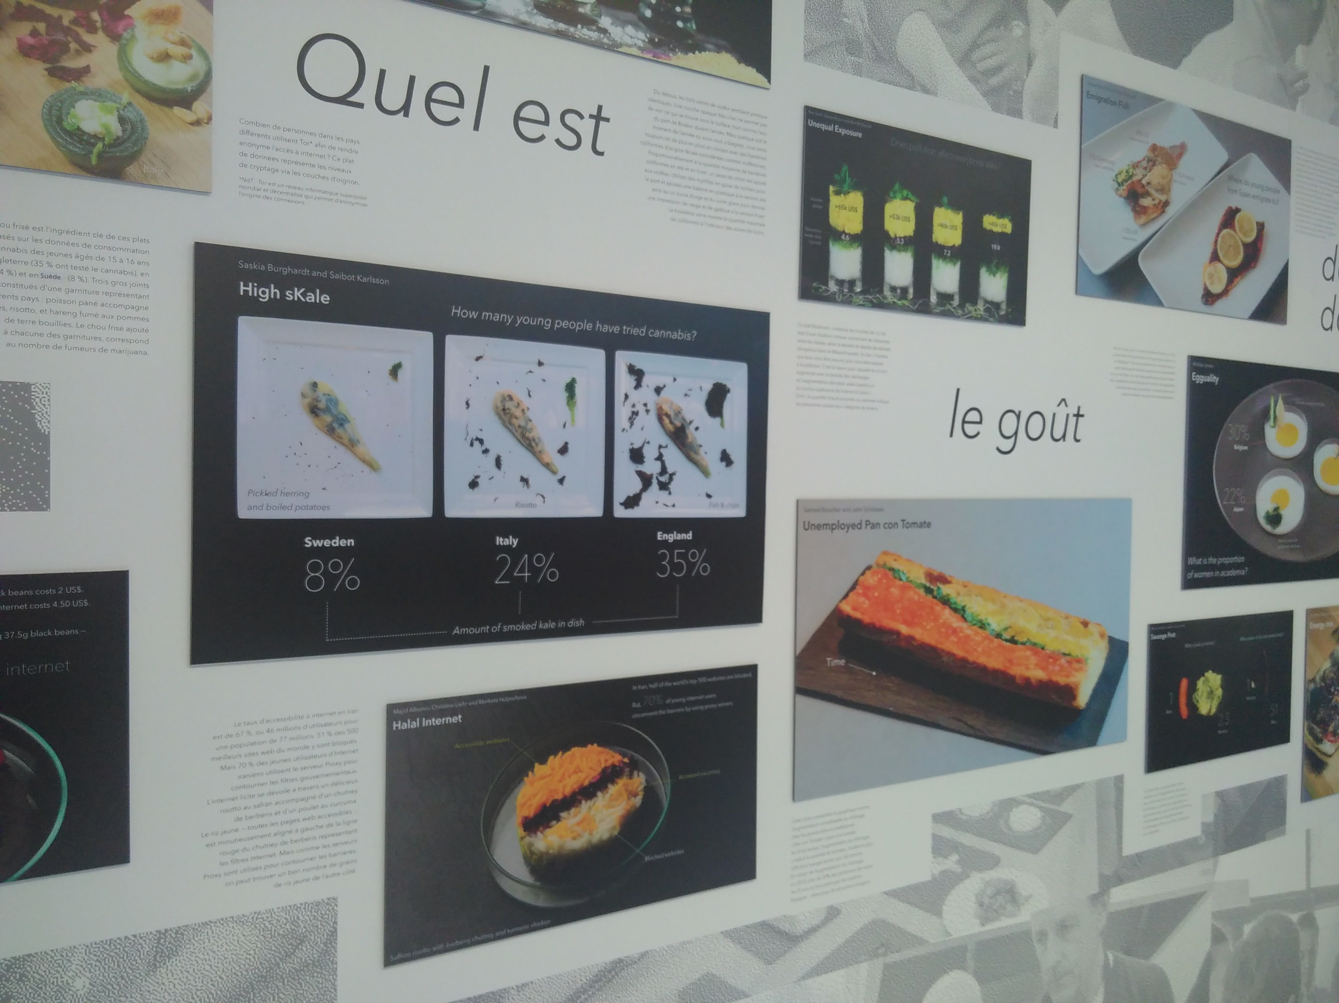
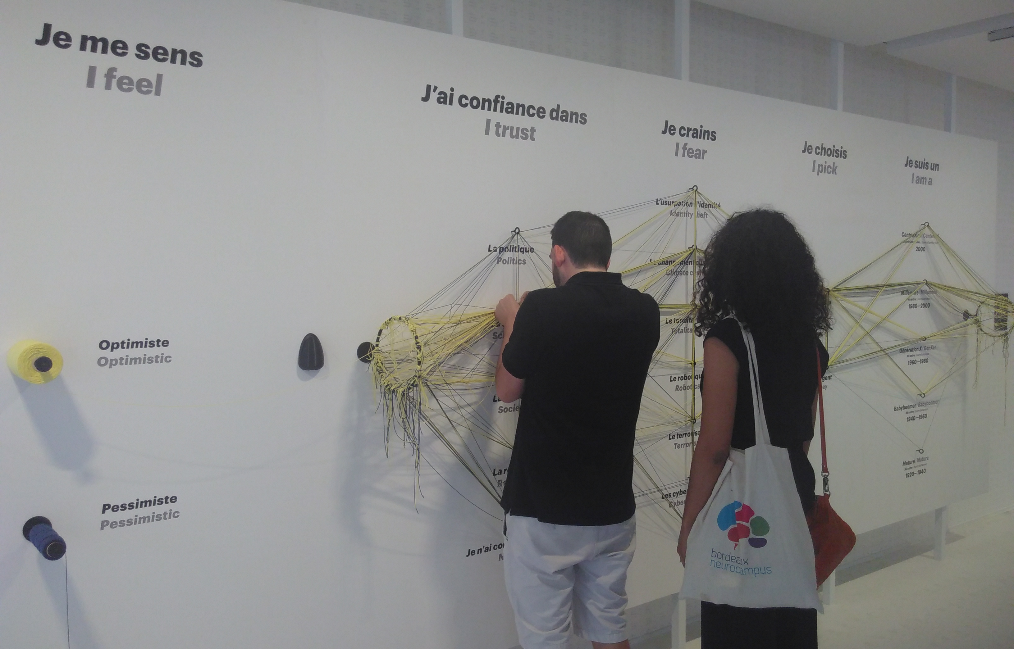

Slide 5
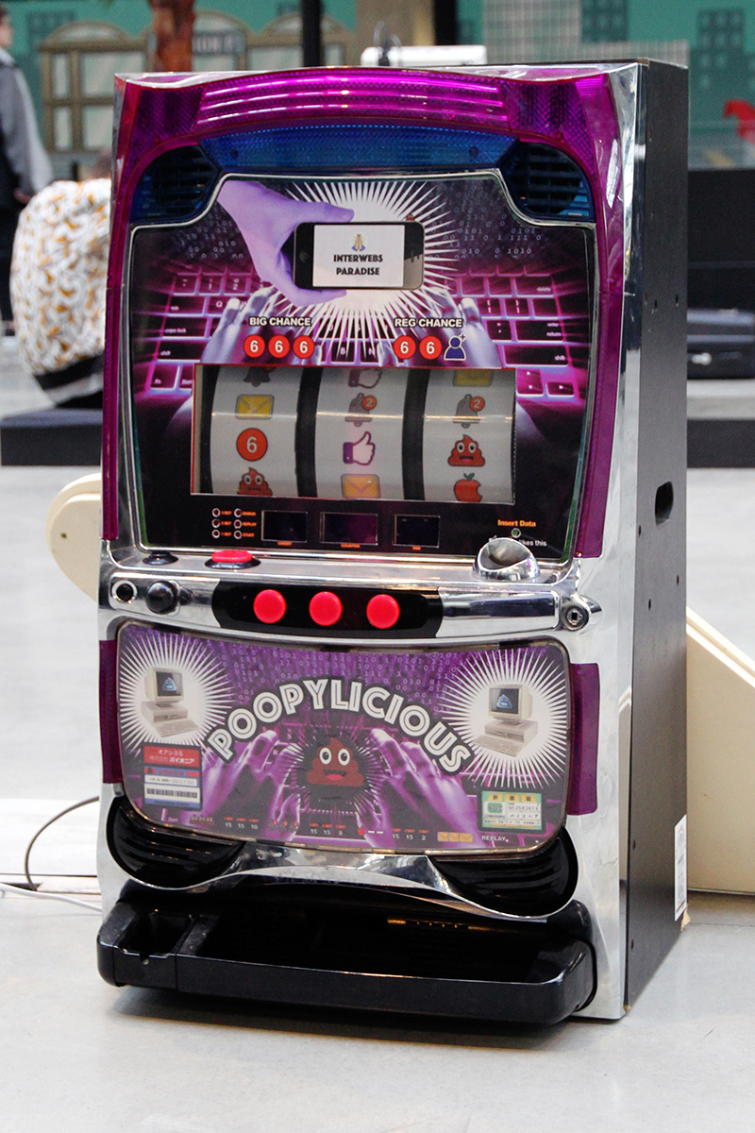
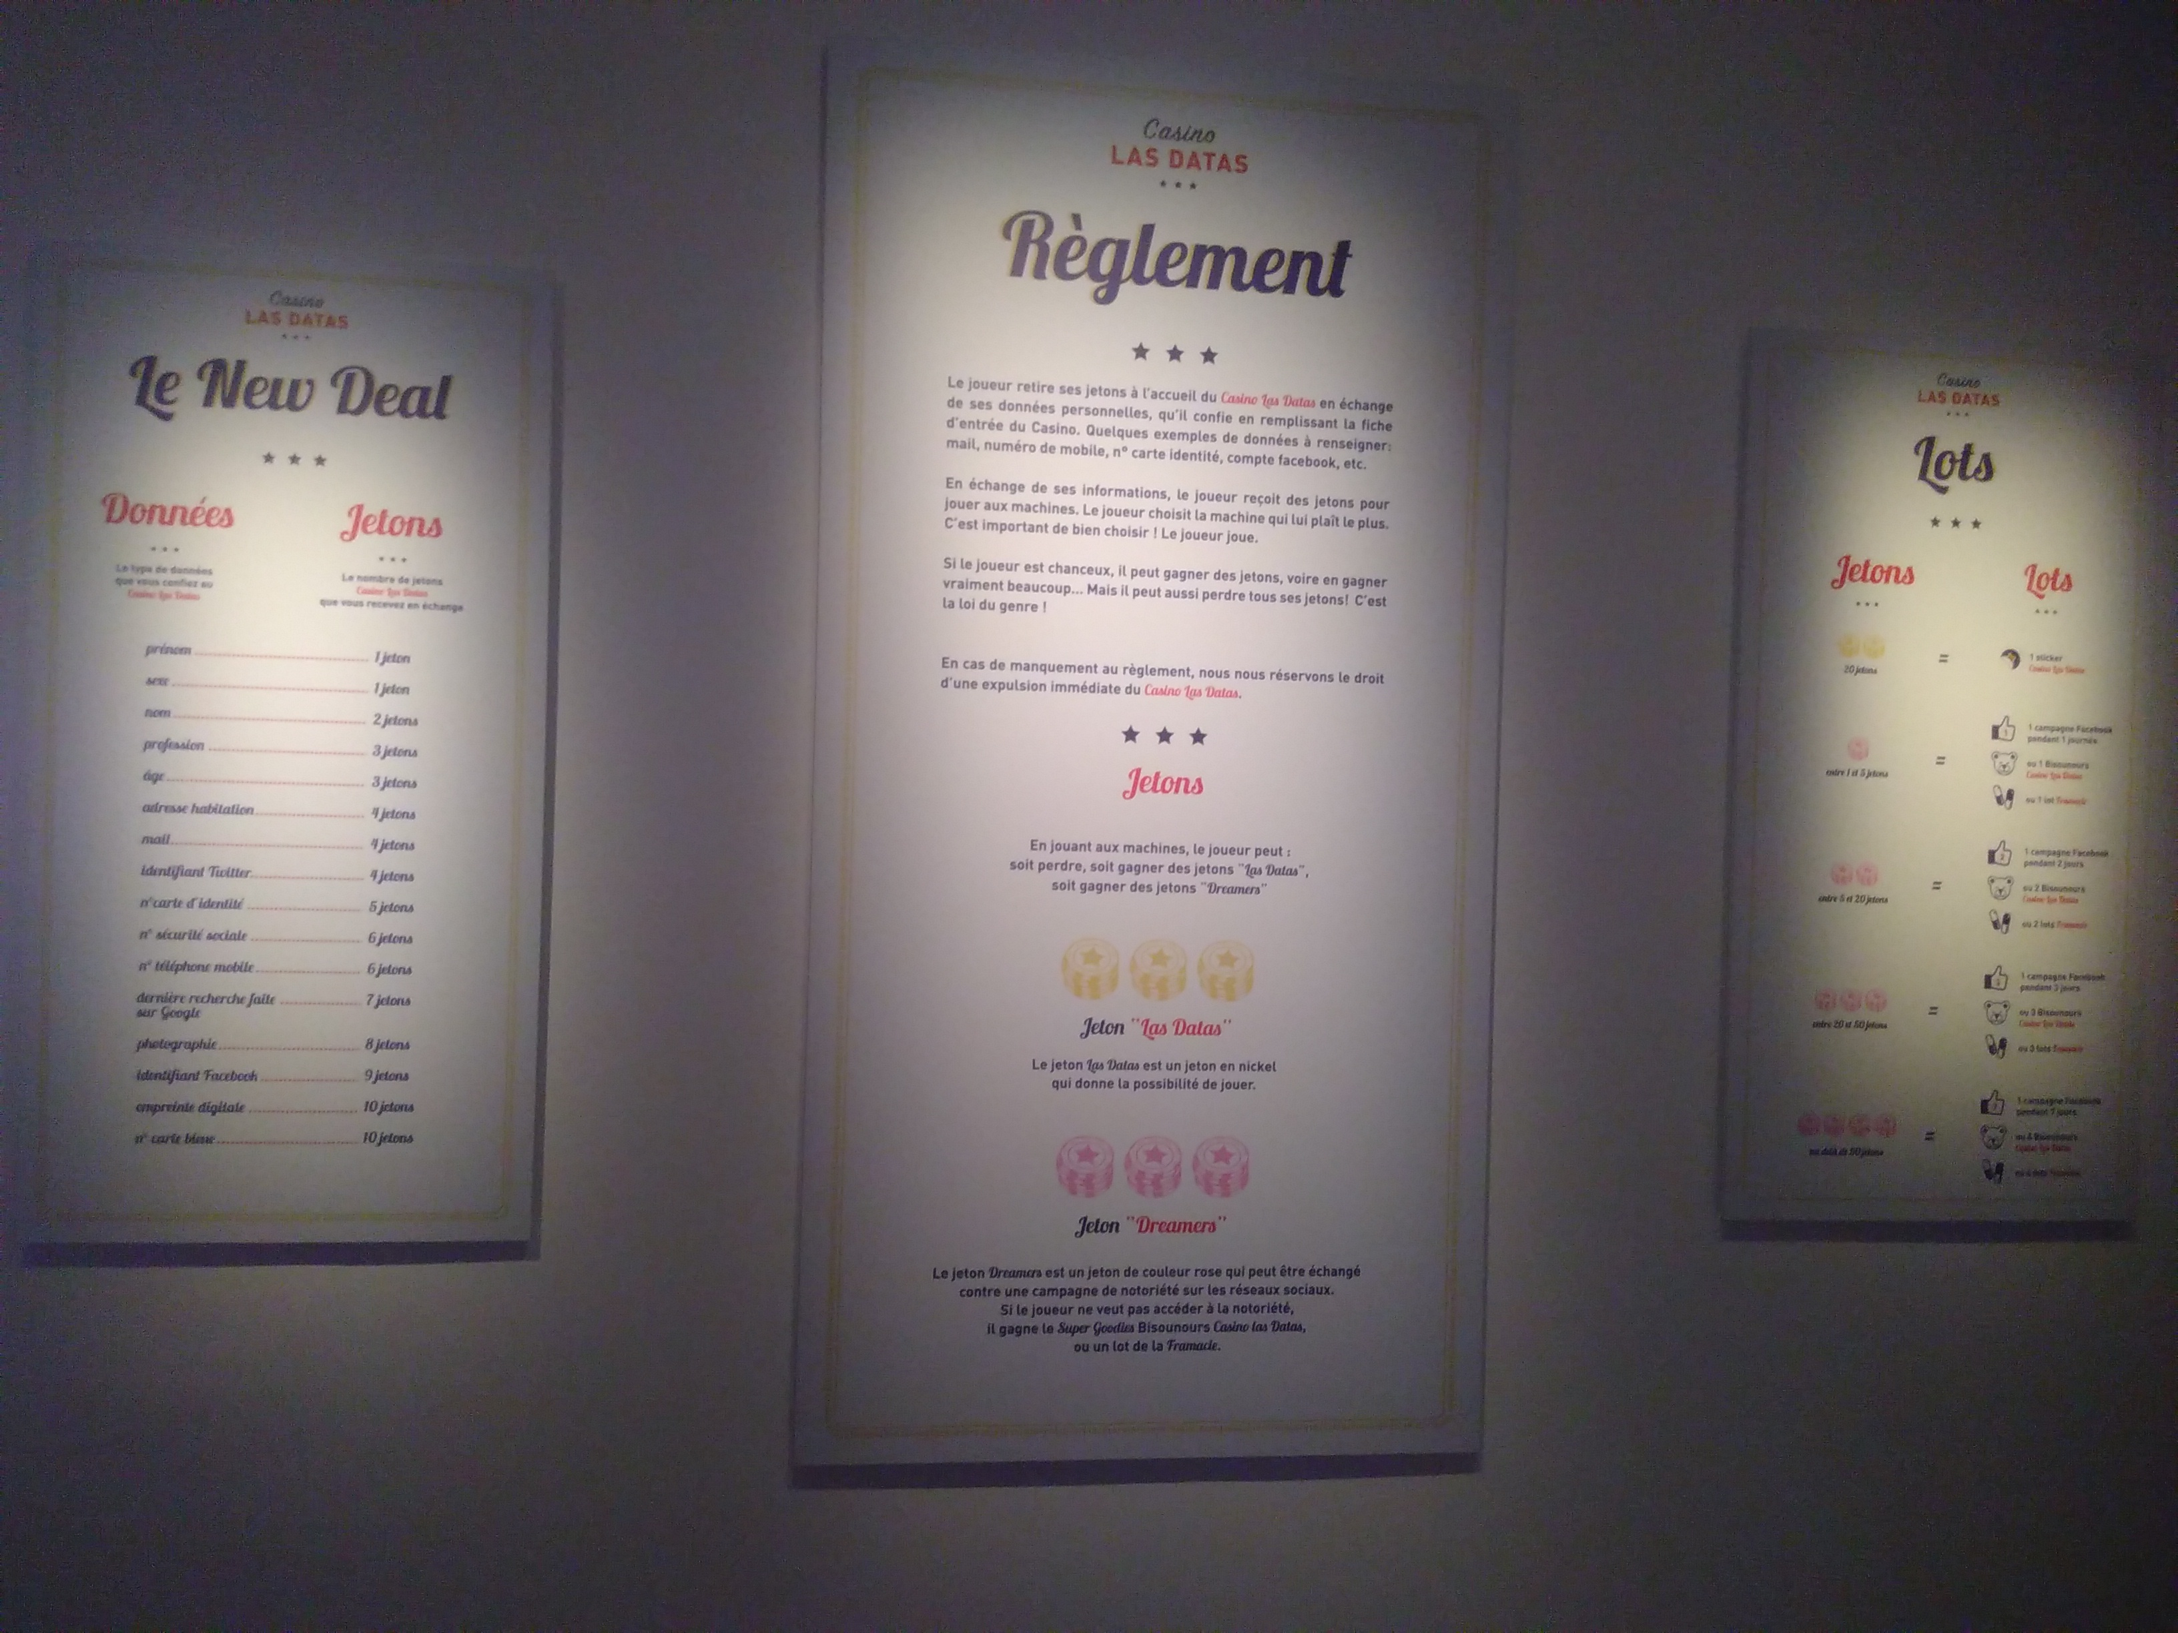
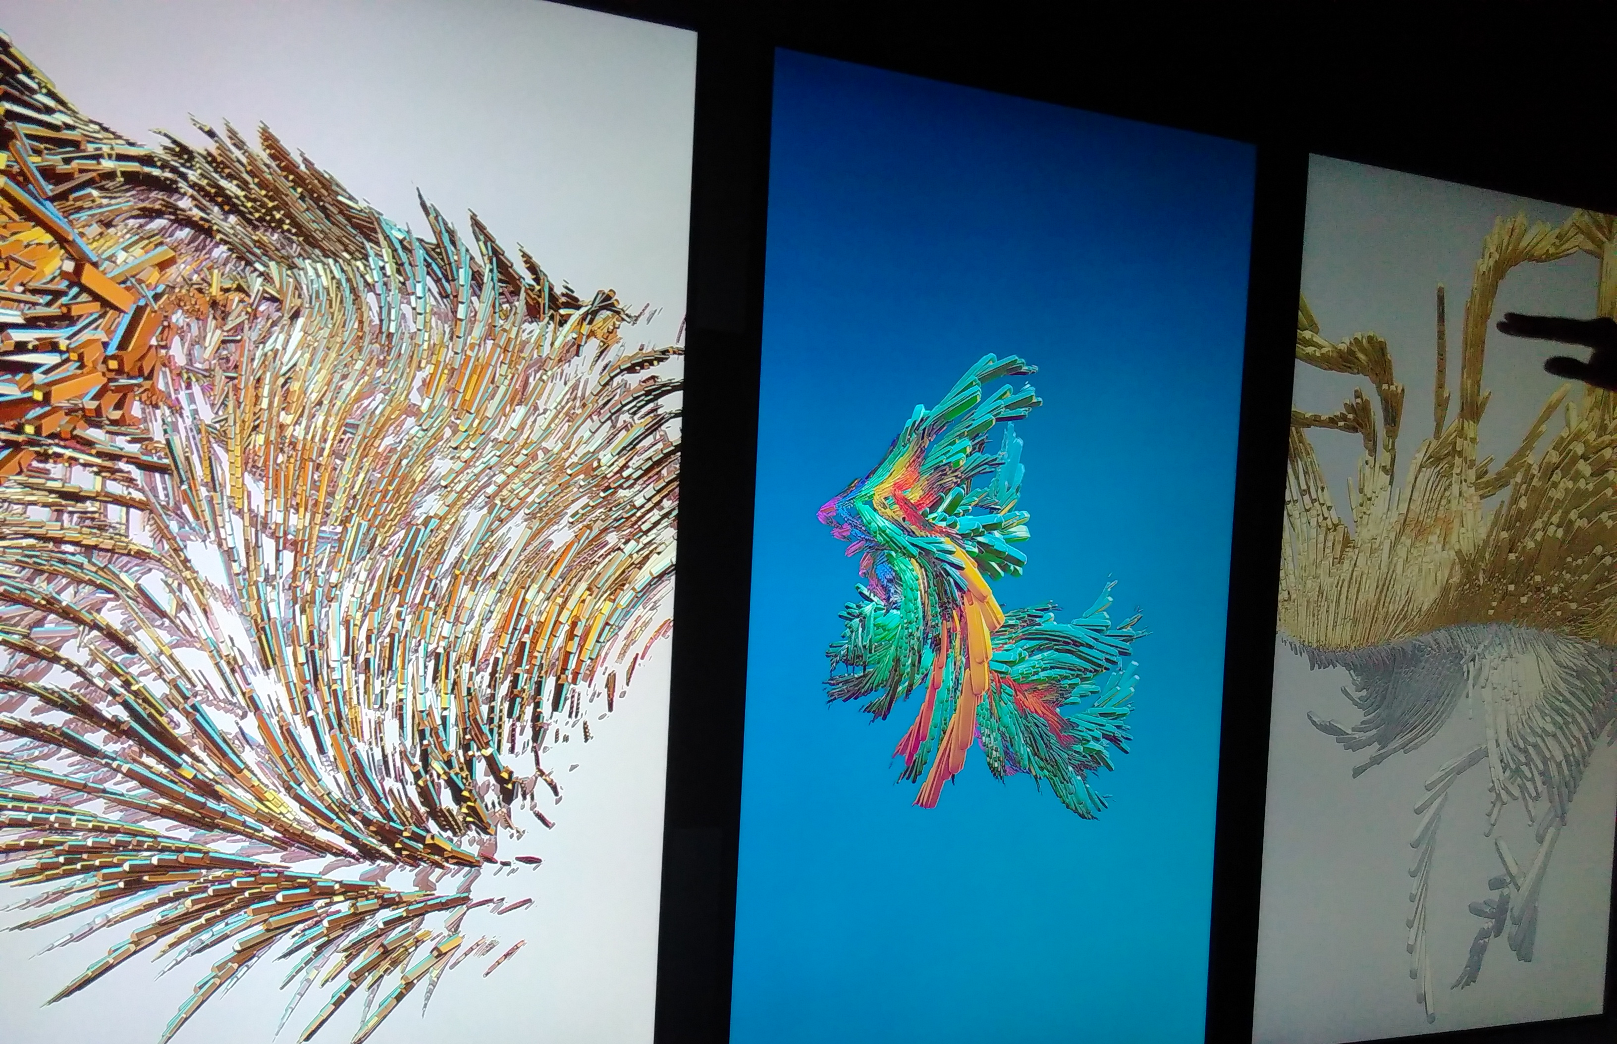

Slide 6
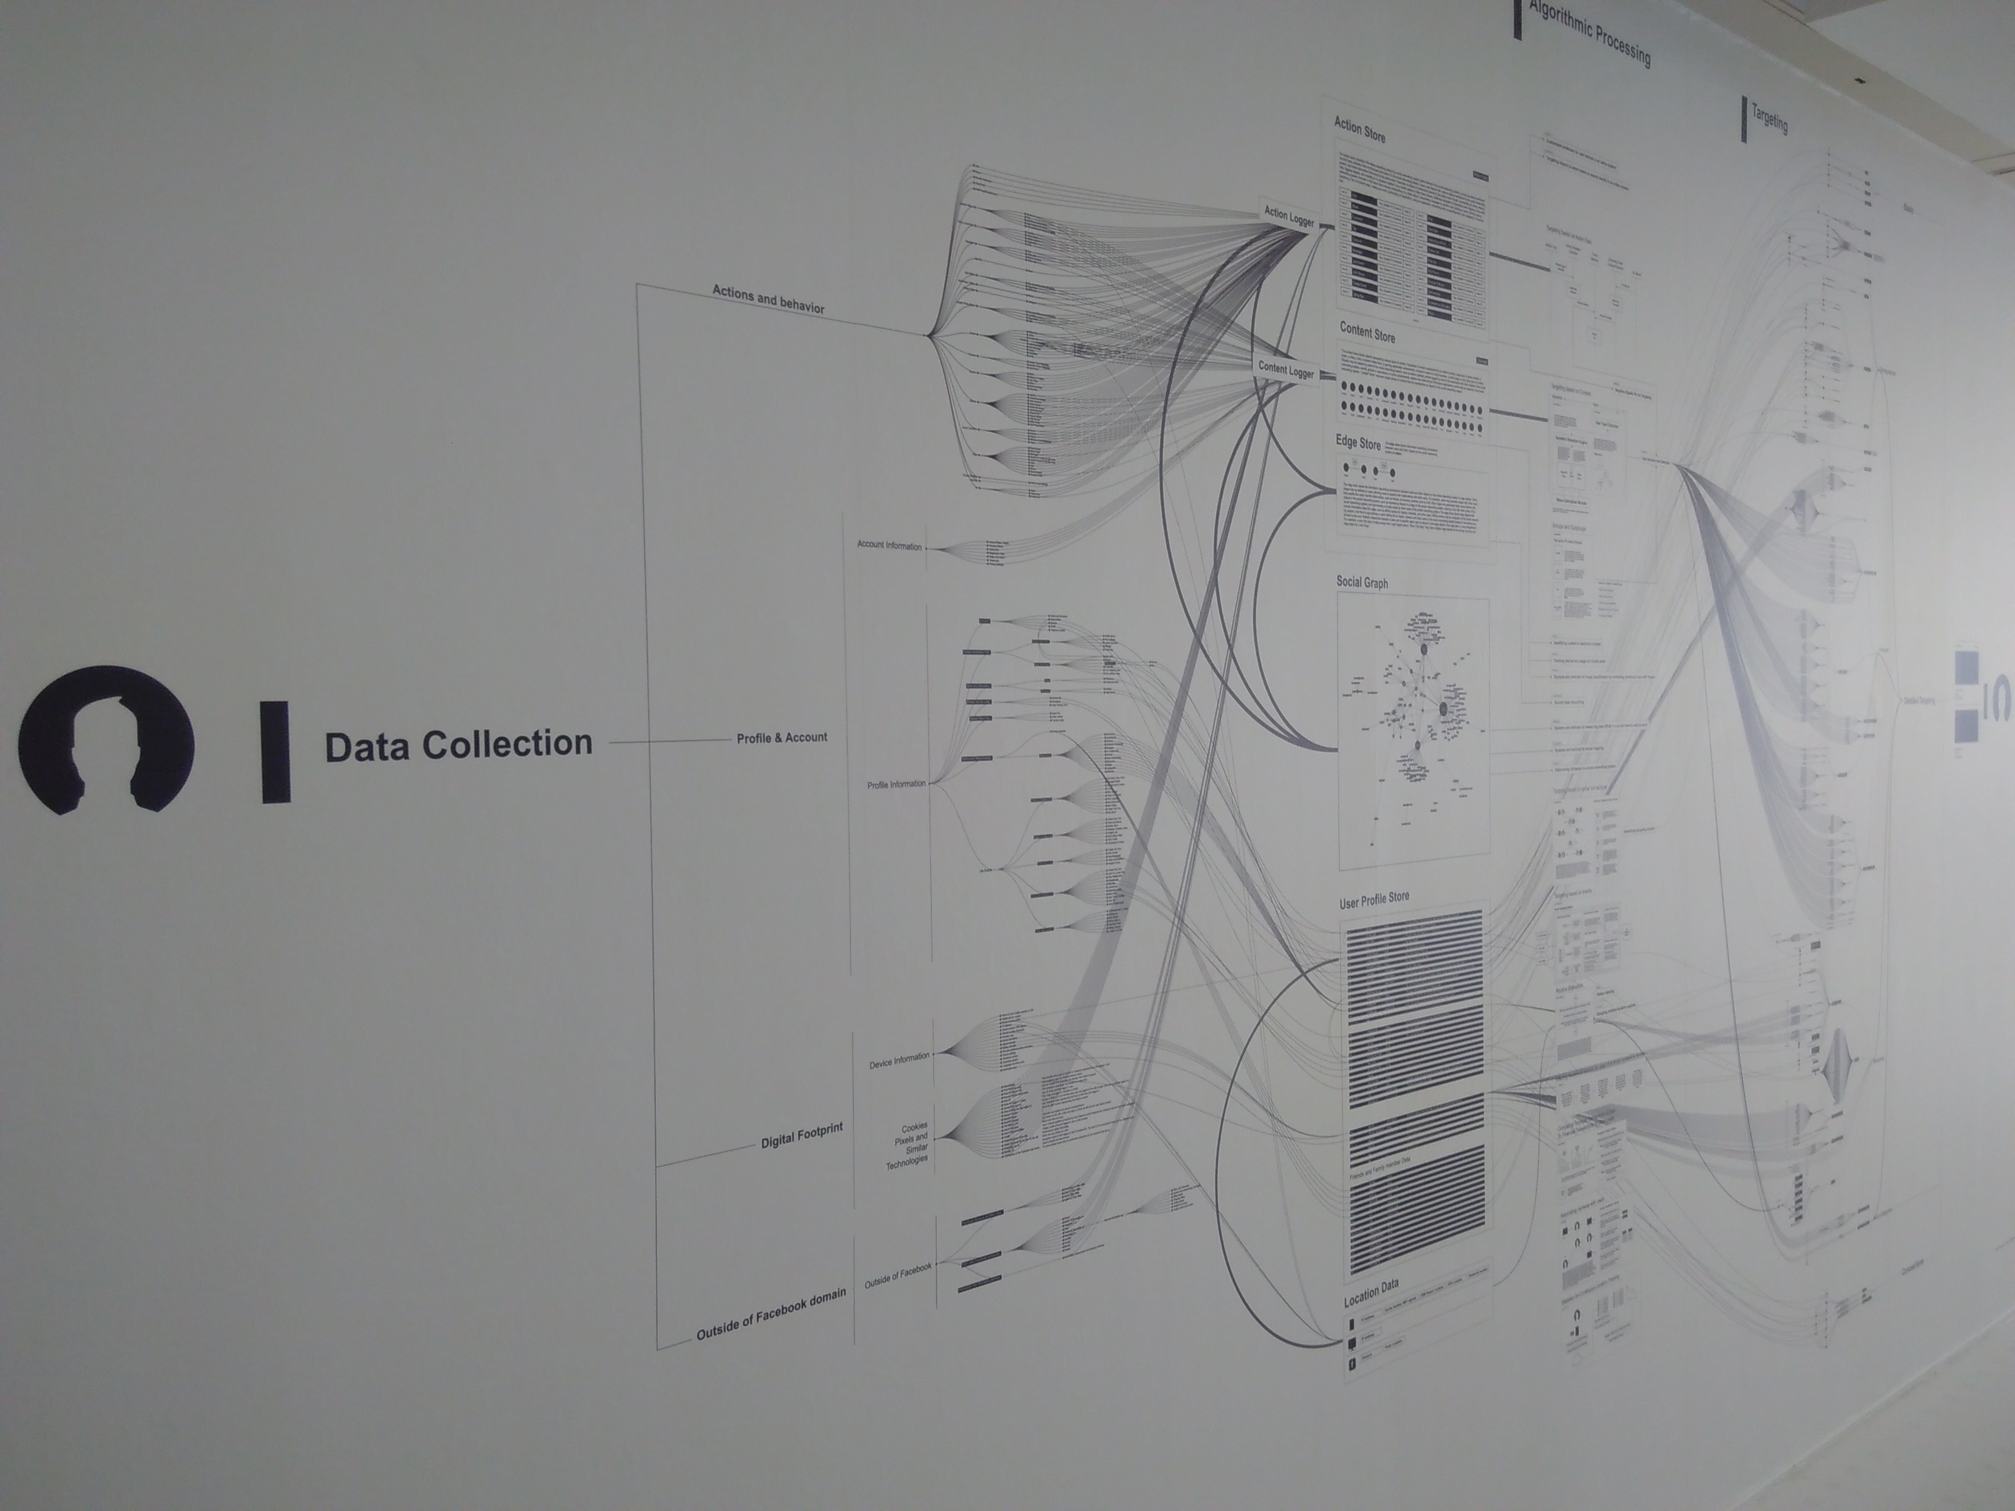

Slide 7
Éléonore
@EleonoreMayola
Explore an algorithm output
Experience social media data
Multiplicity
Network effect
/videos/multiplicity.mp4
/videos/network-effect.mp4
Explore a dataset
Gather opinion data
Galaxy of covers
Data strings
/videos/galaxy-of-covers.mp4
/videos/data-strings.mp4

Slide 8

Resources
* OpenVisConf 2018 http://www.openvisconf.com/
* A-frame http://aframe.io/
* D3.js + React https://github.com/mkfreeman/react-d3
* “1, 2, 3 DATA” https://fondation.edf.com/fr/expositions/1-2-3,
https://123data.paris/collection
* Multiplicity http://truth-and-beauty.net/projects/multiplicity
* Network effect http://networkeffect.io/
* data cuisine http://data-cuisine.net/
* Casino Las Datas http://casinolasdatas.com/
* Architecture of radio http://www.architectureofradio.com/
* Galaxy of covers https://lab.interactivethings.com/galaxy-of-covers/
* Treepedia http://senseable.mit.edu/treepedia/
* The Refugee Project http://www.therefugeeproject.org/
* The Iranian internet http://monoment.io/#/tiibfi/
* Data strings http://domesticstreamers.com/case-study/data-strings/
Éléonore
freelance developer + data scientist
github: Eleonore9
twitter: @EleonoreMayola
blog: eleonore9.github.io
website: elle-est-au-nord.com
github.com/Eleonore9/inspiring-data-viz

