Slide 1



Telling stories with data
Éléonore Mayola
@EleonoreMayola
Github.com/eleonore9

Slide 2

Who am I?
Web + Data
Python, Clojure, JS

Slide 3


Who is this talk for?
Anyone - all devs work with data
github.com/Eleonore9/pyconse17

Slide 4





Python data viz libraries
“10 Useful Python Data Visualization Libraries...”
Meanwhile in the land of Javascript
seaborn
ggplot
Pygal
Plotly
Folium
geoplotlib

Slide 5
What should we make of it?
Different libraries for different uses
Here: dataset → quick viz → tell someone a story

Slide 6
What’s Altair ?
Library: https://github.com/altair-viz/altair
BSD-3 License
Main contributers: Jake Vanderplas (@jakevdp) & Brian E Granger (@ellisonbg)

Slide 7
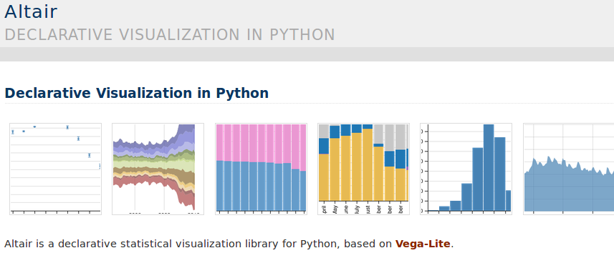
What’s different with Altair?
Doc: https://altair-viz.github.io/

Slide 8
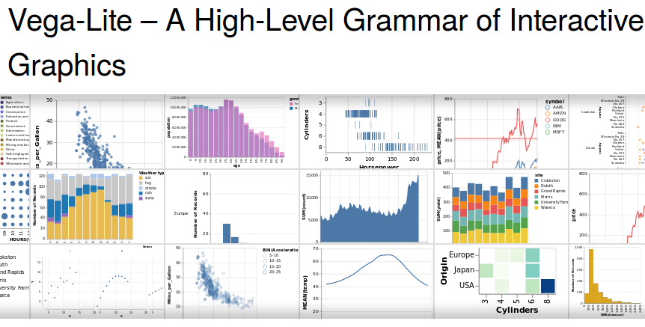
Wait, what’s Vega-Lite ?
Vega-Lite is a concise JSON syntax for supporting rapid generation of visualizations to support analysis.

Slide 9

So Altair is
Simple API built on top of Vega-Life
Aimed to produce beautiful visualizations with a minimal amount of code
Note: Still at an early stage (v1.2.0) → more docs and plots to come

Slide 10
Let’s have a closer look at Altair
Installation (Python 3)
$ pip install altair
$ pip install --upgrade notebook
$ jupyter nbextension install --sys-prefix --py vega
For Conda users:
$ conda install altair --channel conda-forge
Note: To render Vega-Lite in a notebook → extension IPython Vega needed

Slide 11
Let’s have a closer look at Altair
Installation (Python 2)
$ mkvirtualenv --python=/usr/bin/python3.4 altair
$ pip3 altair
$ pip3 install --upgrade notebook
$ jupyter nbextension install --sys-prefix --py vega
CLI output
To initialize this nbextension in the browser every time the notebook (or other app) loads:
jupyter nbextension enable vega --py --sysprefix

Slide 12
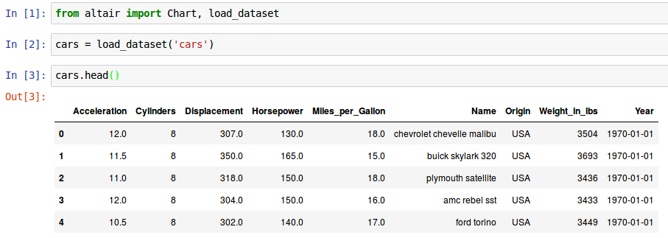
Let’s have a closer look at Altair
Doc example – import Altair, get dataset
$ jupyter nbextension enable vega --py --sys-prefix
$ jupyter notebook

Slide 13
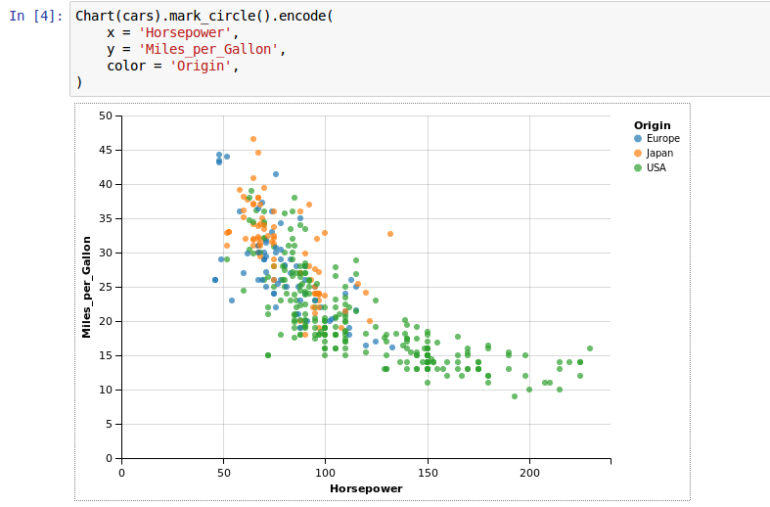
Let’s have a closer look at Altair
Doc example – create a plot

Slide 14
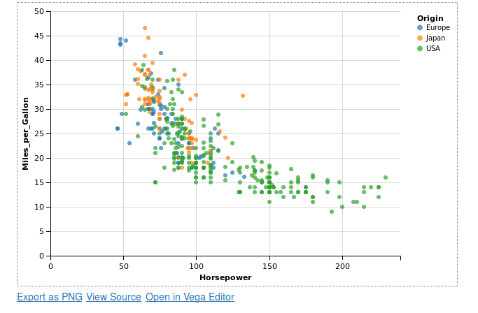
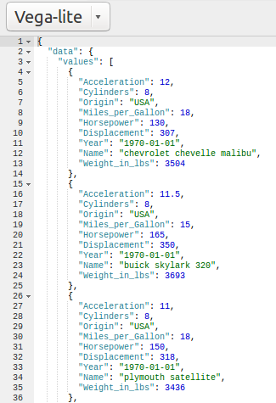

Let’s have a closer look at Altair
Doc example – more on the plot
Alternative:

Slide 15
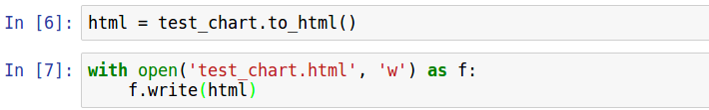
How to share the results?
Generate html

Slide 16
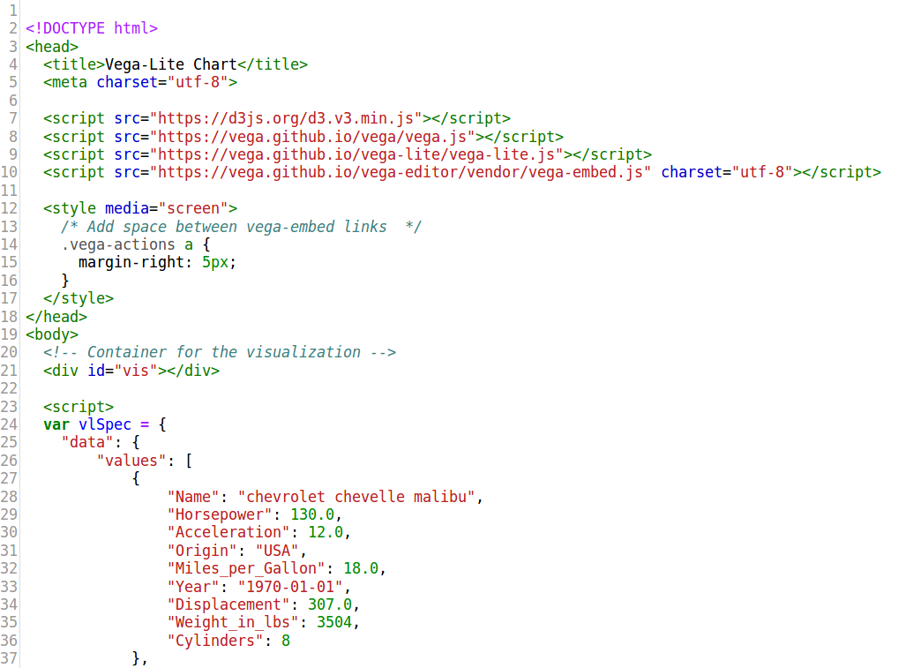
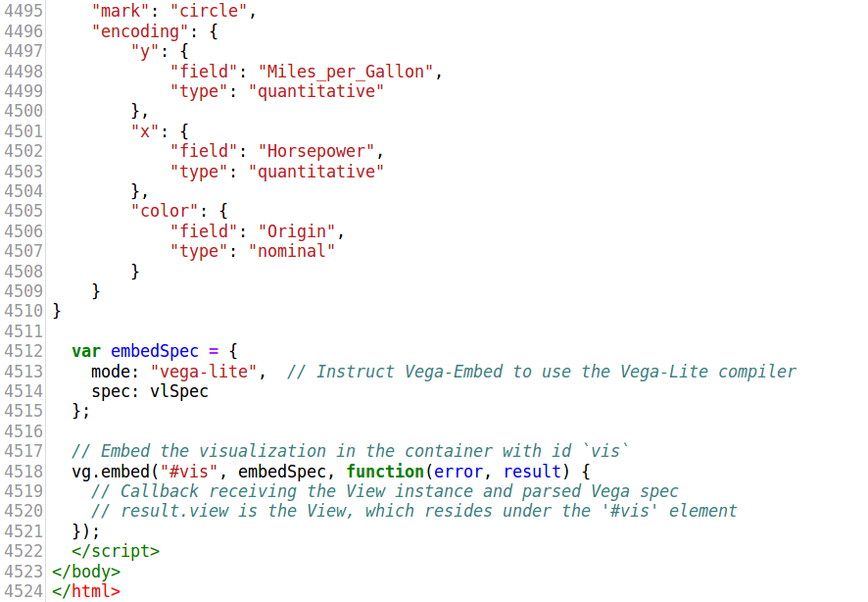
Note:
I ended up modifying the script slightly

Slide 17
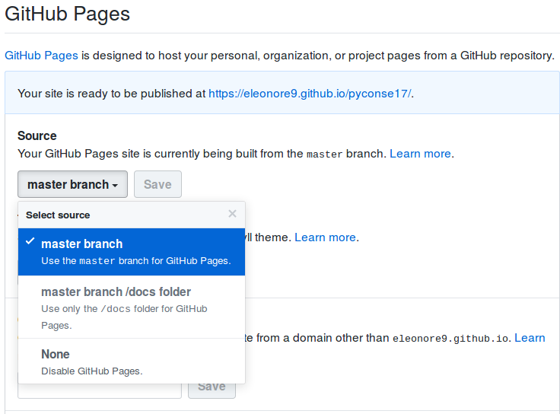
Produce shareable plots
Easy way → use Github pages
Note: rename your html file to “index.html”

Slide 18
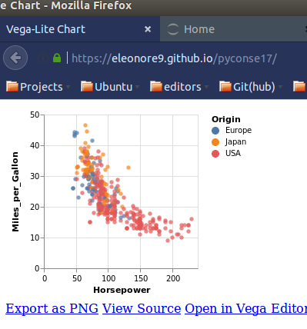
Produce shareable plots
Workflow
1. Explore dataset and create plot(s)
2. Commit changes and push to Github
3. Share the URL
https://<gh username>.github.io/<project name>

Slide 19
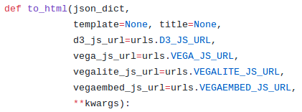

How to add to our page
Let’s look at Altair source code
to_html function
We can pass keyworded arguments

Slide 20
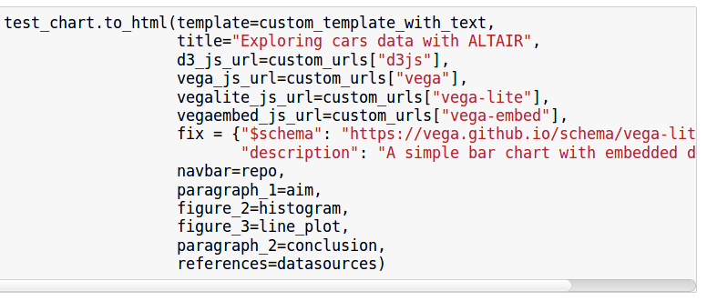
How to add to our page
Page wireframe
New function arguments
Navbar
Title
Paragraph
Visualisations
Paragraph
References

Slide 21
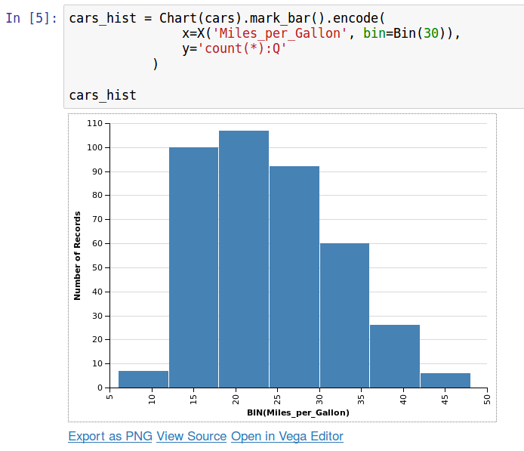
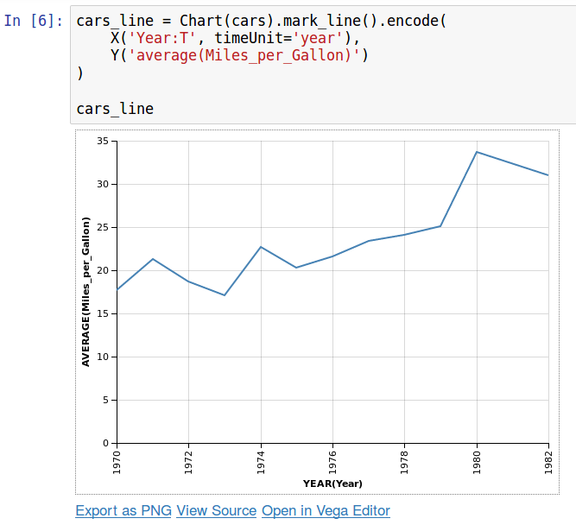

How to add to our page
Note: I converted extras Altair Chart objects to JSON

Slide 22

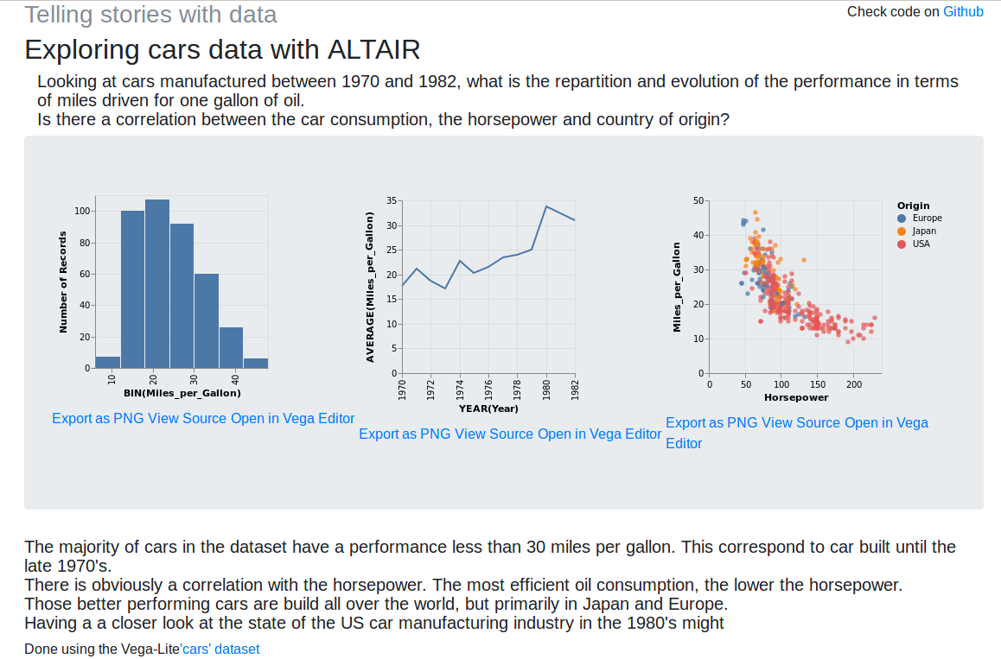
Tada
https://eleonore9.github.io/pyconse17/

Slide 23
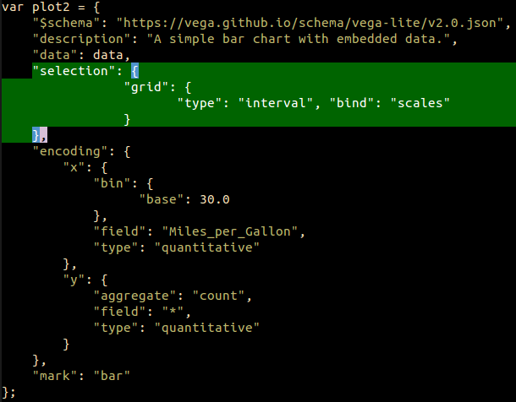
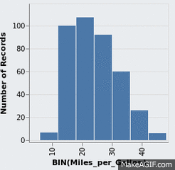
Let’s add interactivity
Plot zoom

Slide 24
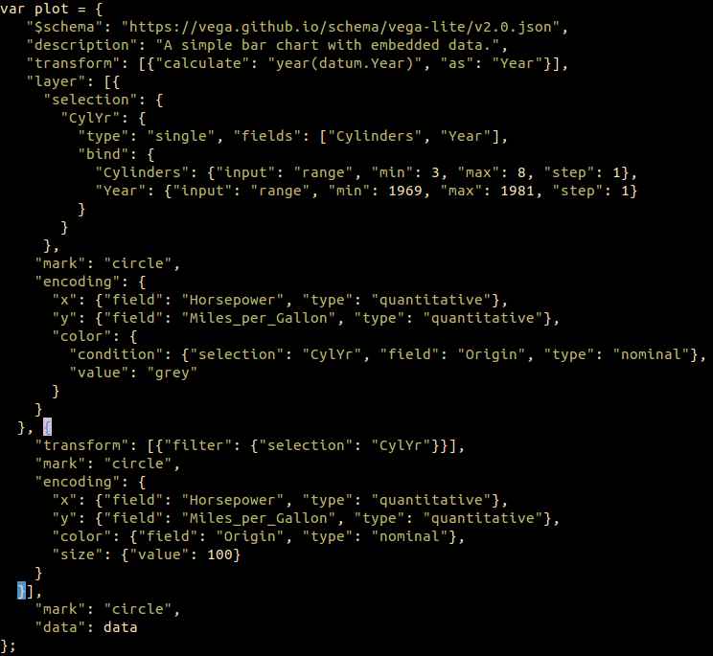
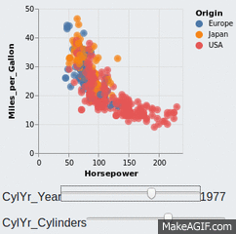
Let’s add interactivity
Query widgets

Slide 25
Let’s look back at the steps
(transformation)
(template)
Git
Dataset
Plots
Html file
Shareable URL
Chart()
to_html()
Github

Slide 26
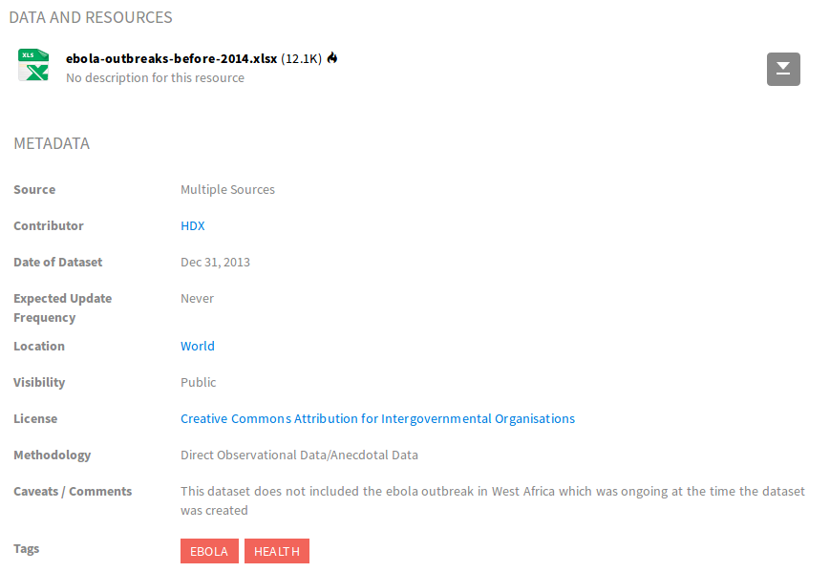

Looking at a dataset with Altair
Ebola outbreaks before 2014
Open platform for sharing humanitarian data, managed by the UN (OCHA)
Source: https://data.humdata.org/dataset/ebola-outbreaks-before-2014

Slide 27
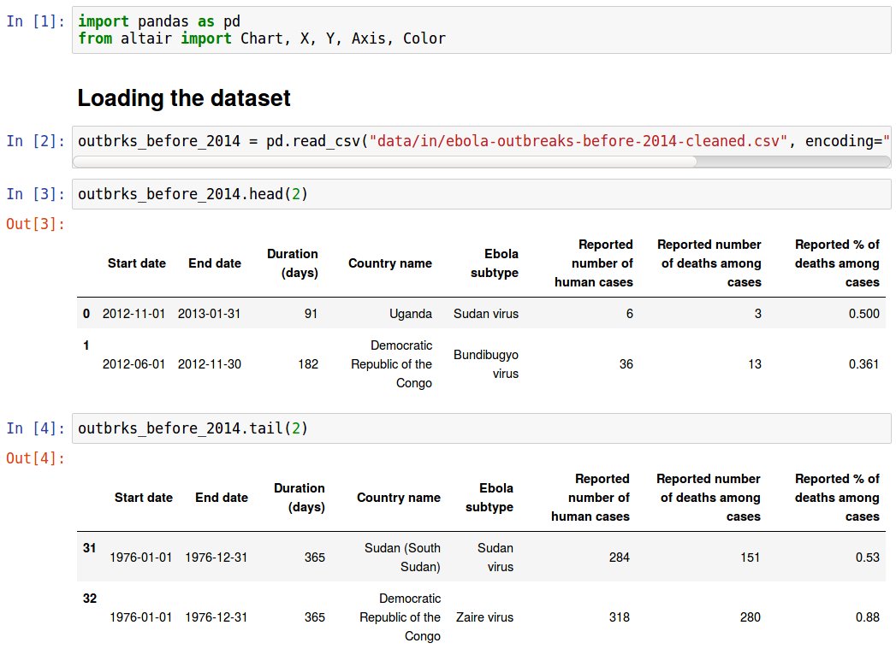
Looking at a dataset with Altair

Slide 28
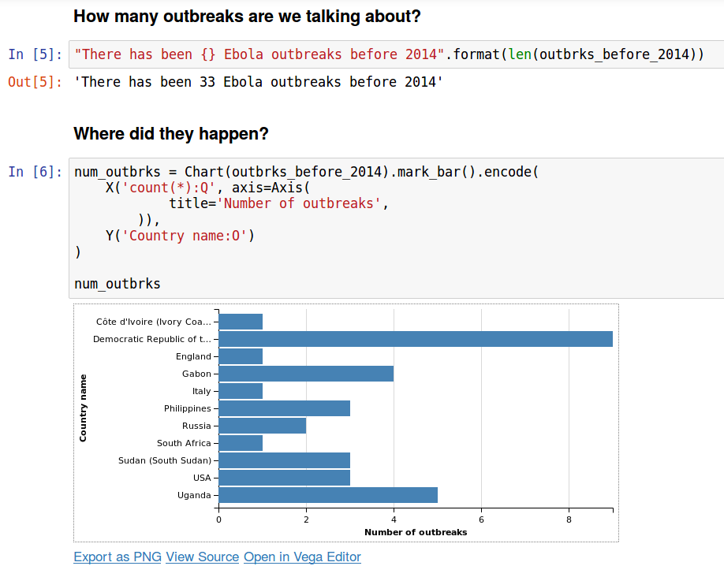
Example use of Altair

Slide 29
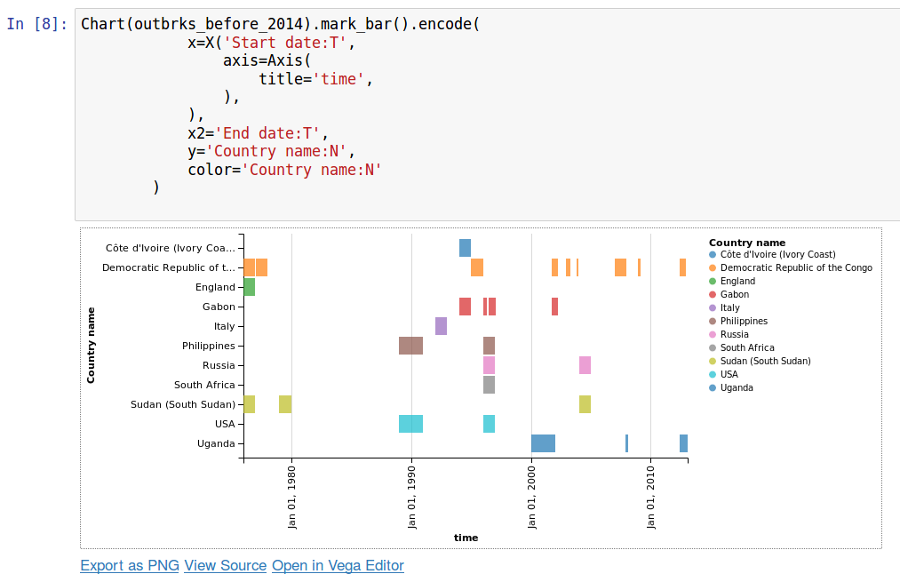
Example use of Altair

Slide 30
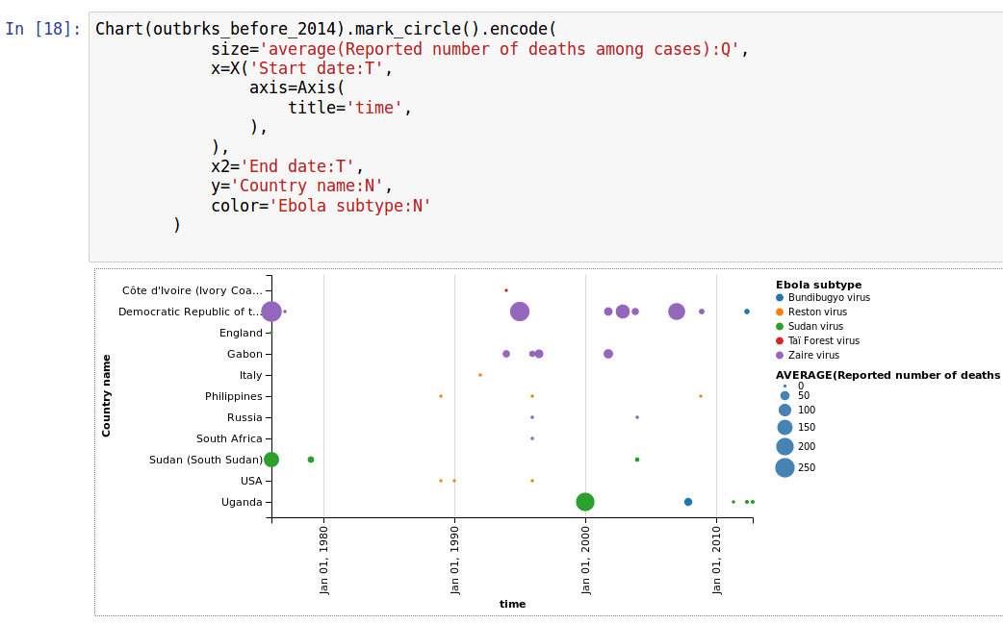
Example use of Altair

Slide 31
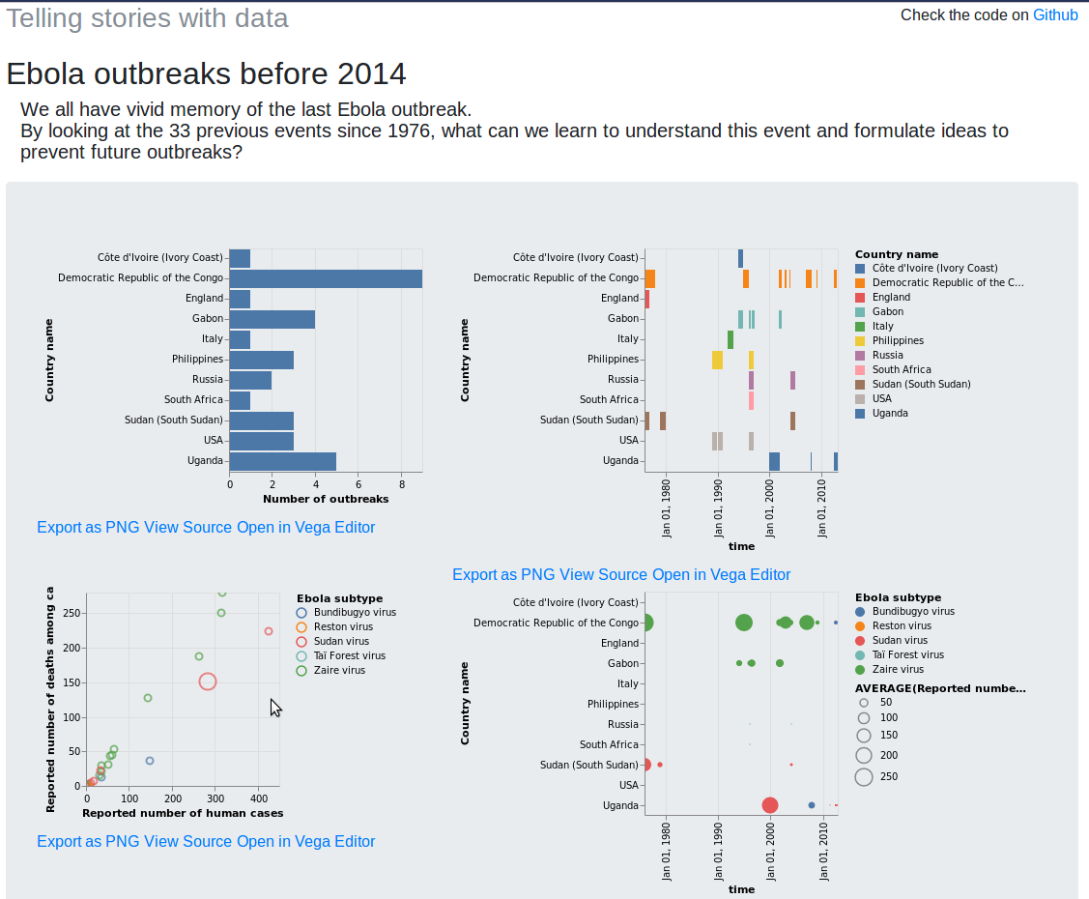
My shareable story
http://eleonore9.github.io/ebola_outbreaks/

Slide 32
Tips
Organise your repository: input datasets /notebooks / helpers / images or html outputs
Watch out for the next release supporting Vega-Lite 2.0

Slide 33
Pros & Cons
Pros: simple, work cooperatively (Github), reuse your code and html templates
Cons: no handling of geo data, depending on Github
Improvements: interactivity (next release)

Slide 34


Thank you
@EleonoreMayola
github.com/Eleonore9/pyconse17
Resources
Docs:
https://altair-viz.github.io/
https://altair-viz.github.io/documentation/displaying.html
https://vega.github.io/vega-lite/usage/embed.html
https://vega.github.io/vega-lite/examples/#interactive
https://vega.github.io/vega-lite/usage/applications.html
Data source:
https://data.humdata.org/
Blogposts:
https://blog.modeanalytics.com/python-data-visualization-libraries/
http://pbpython.com/altair-intro.html
Emojis: emojipedia.org

