Slide 1
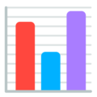



PYCON UK | Cardiff | Sept 2019
A tour of data viz in Python
Éléonore Mayola
@EleonoreMayola | github.com/eleonore9 | Elle-est-au-nord.com

Slide 2


overview
PYCON UK | Cardiff | Sept 2019
Different needs for different use cases
yourself
your colleagues
your manager
your clients
exploring a dataset
writing an internal report
writing a client report
writing a research article
@EleonoreMayola | github.com/eleonore9 | Elle-est-au-nord.com

Slide 3

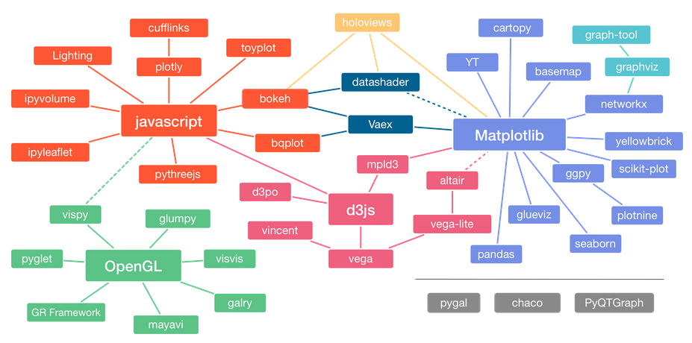
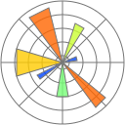


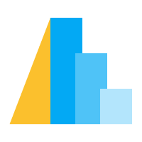
overview
PYCON UK | Cardiff | Sept 2019
Adaptation of Jake VanderPlas graphic about the Python visualization landscape, by Nicolas P. Rougier
Source: https://pyviz.org/overviews/index.html
@EleonoreMayola | github.com/eleonore9 | Elle-est-au-nord.com

Slide 4

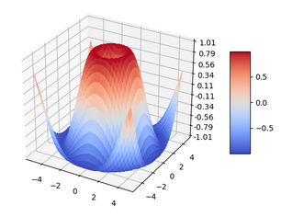
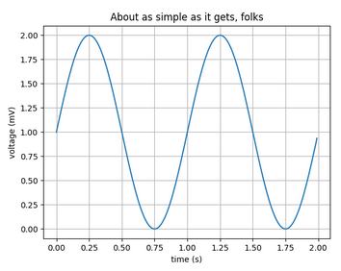
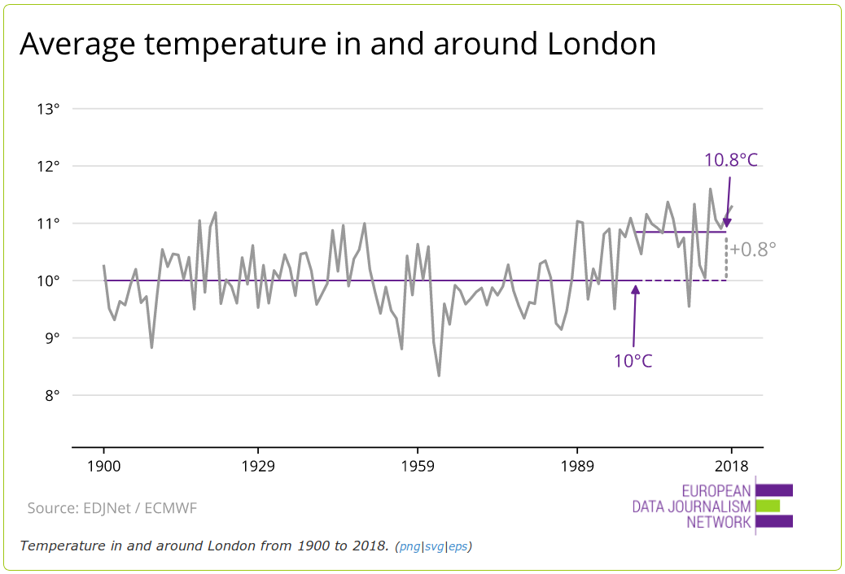
matplotlib
PYCON UK | Cardiff | Sept 2019
matplotlib.org
“Matplotlib tries to make easy things easy and hard things possible.”
The pyplot module provides a MATLAB-like interface
Customisable labels, lines and annotations...
import matplotlib
import matplotlib.pyplot as plt
import numpy as np
# Data for plotting
t = np.arange(0.0, 2.0, 0.01)
s = 1 + np.sin(2 * np.pi * t)
fig, ax = plt.subplots()
ax.plot(t, s)
ax.set(xlabel='time (s)', ylabel='voltage (mV)',
title='About as simple as it gets, folks')
ax.grid()
fig.savefig("test.png")
plt.show()
matplotlib.axes.Axes.axhline
ax.axhline(y=10yrs_average, color='#6f2c91',
linewidth=1.5)
matplotlib.pyplot.annotate
ax.annotate(f'{temperature}°C',
Xy=(3, 1), xycoords='data',
xytext=(0.8, 0.95),
arrowprops=dict(facecolor='#6f2c91'),
horizontalalignment='right',
verticalalignment='top')
onedegreewarmer.eu
@EleonoreMayola | github.com/eleonore9 | Elle-est-au-nord.com

Slide 5
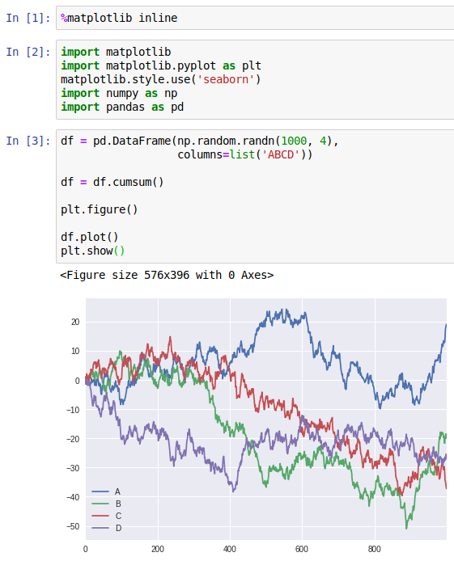
pandas
PYCON UK | Cardiff | Sept 2019
pandas.pydata.org
“[…] high-performance, easy-to-use data structures and data analysis tools for the Python programming language.”
Uses Matplotlib for plotting
import matplotlib.pyplot as plt
DataFrame.plot(x=None, y=None, kind='line', ax=None, subplots=False, sharex=None, sharey=False, layout=None, figsize=None, use_index=True, title=None, grid=None, legend=True,
style=None, logx=False, logy=False, loglog=False, xticks=None, yticks=None,
xlim=None, ylim=None, rot=None, fontsize=None, colormap=None,
table=False, yerr=None, xerr=None, secondary_y=False, sort_columns=False, **kwds)
@EleonoreMayola | github.com/eleonore9 | Elle-est-au-nord.com

Slide 6
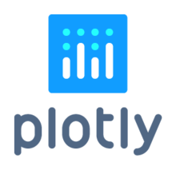
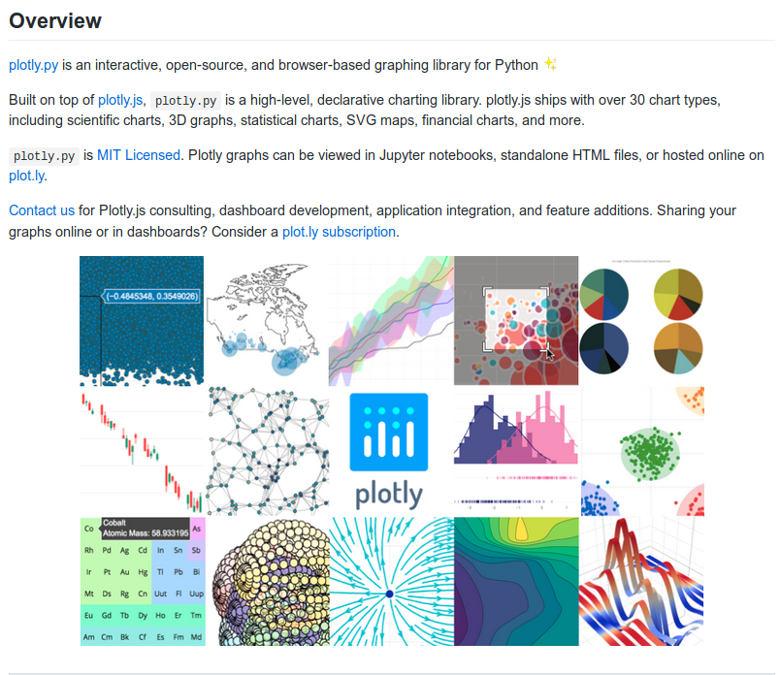
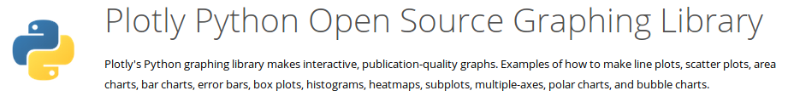
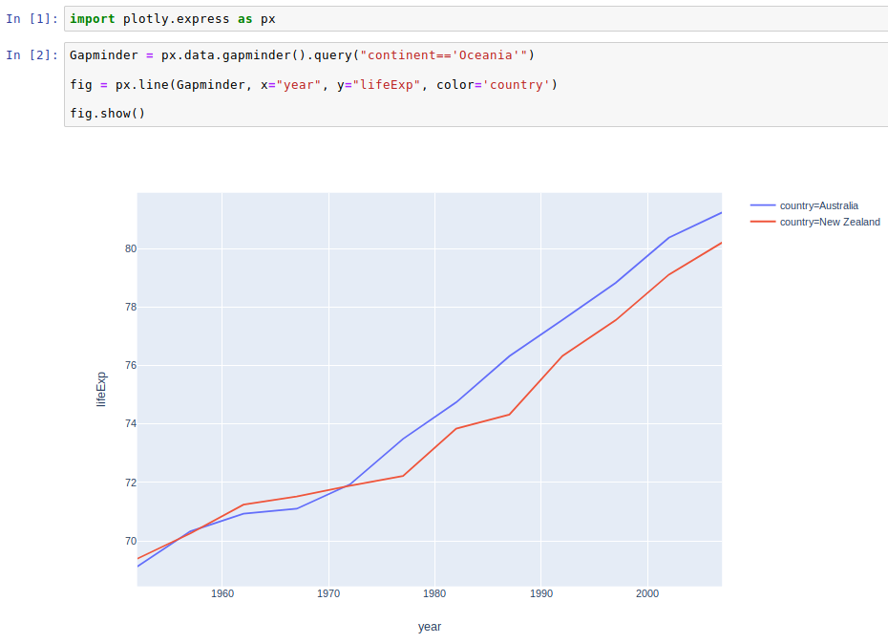
plotly
PYCON UK | Cardiff | Sept 2019
plot.ly/python
plotly.py
github.com/plotly/plotly.py
pip install plotly==4.1.0
Plotly Express
github.com/plotly/plotly_express
pip install plotly_express==0.4.1
@EleonoreMayola | github.com/eleonore9 | Elle-est-au-nord.com

Slide 7

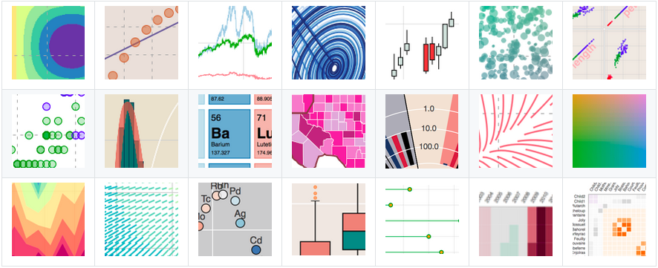
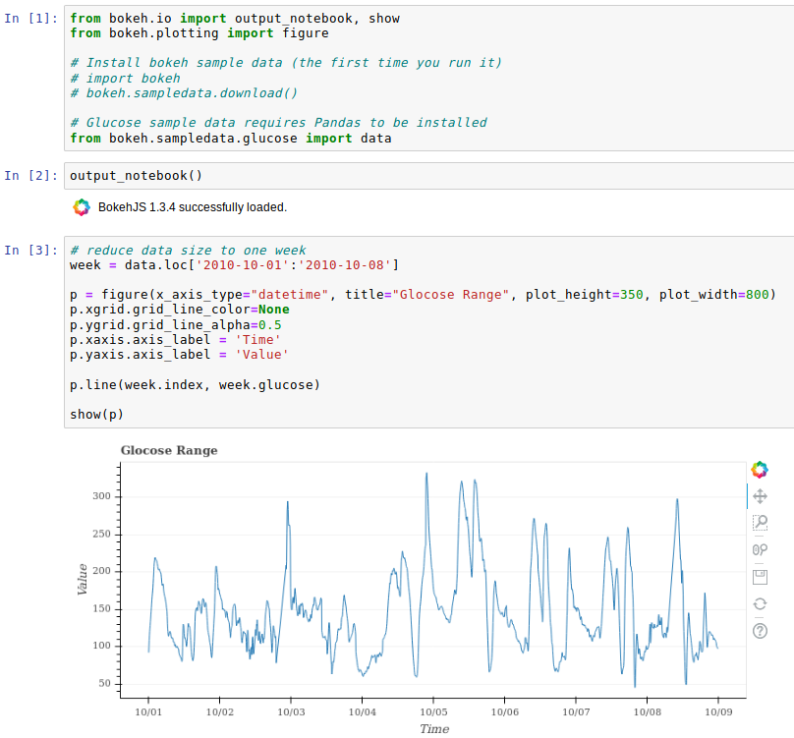
bokeh
PYCON UK | Cardiff | Sept 2019
bokeh.org
github.com/bokeh/bokeh
“Bokeh is an interactive visualization library for Python that enables beautiful and meaningful visual presentation of data in modern web browsers.”
@EleonoreMayola | github.com/eleonore9 | Elle-est-au-nord.com

Slide 8
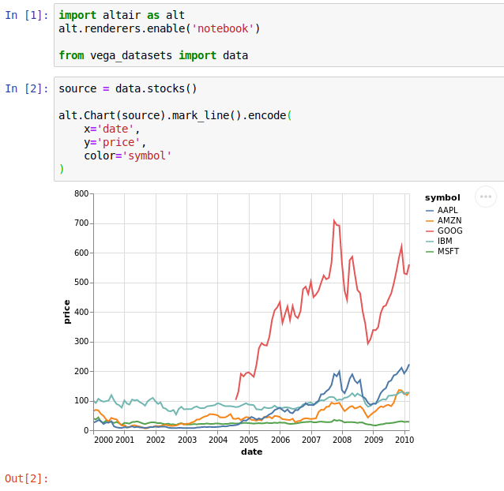
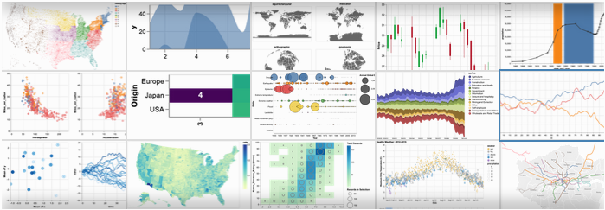
altair
PYCON UK | Cardiff | Sept 2019
altair-viz.github.io
“Altair is a declarative statistical visualization library for Python, based on Vega and Vega-Lite.”
vega.github.io/vega
“Vega is a visualization grammar, a declarative language for creating, saving, and sharing interactive visualization designs.”
@EleonoreMayola | github.com/eleonore9 | Elle-est-au-nord.com

Slide 9
summary
PYCON UK | Cardiff | Sept 2019
Best for
Challenges
Complex or customised plots
Syntax can become tricky
Plotting during data analysis
Not the most aesthetic
→ try Seaborn
Notebook or plain html report
Mainained by a private company
Interactive plots or dashboards
Tricky to create dashboard apps
Interactive plots and maps
One main maintainer
@EleonoreMayola | github.com/eleonore9 | Elle-est-au-nord.com

Slide 10

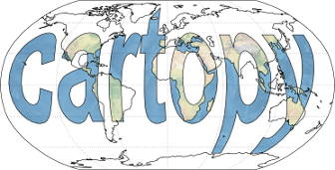
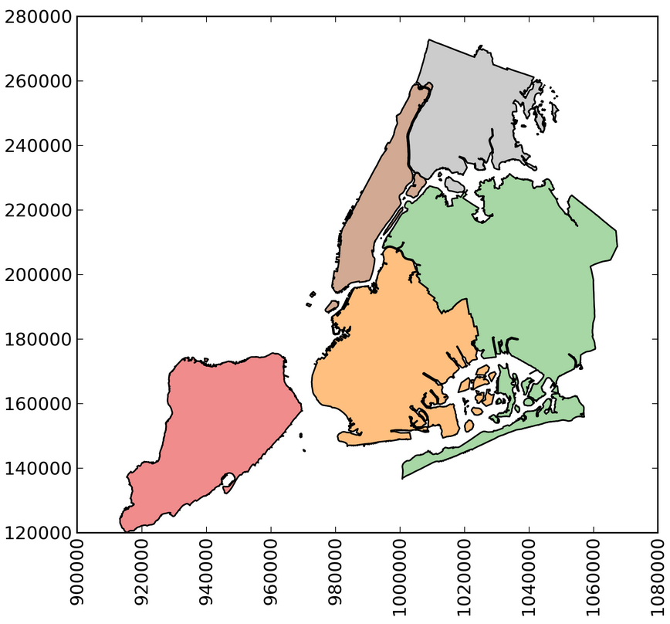
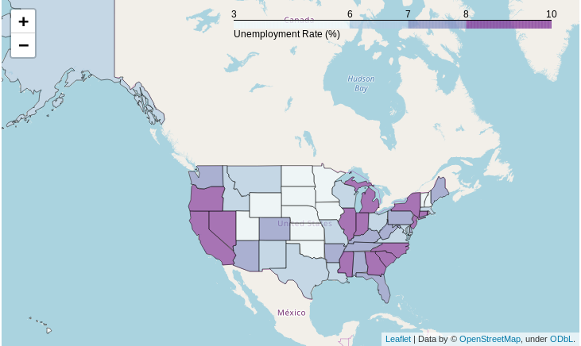
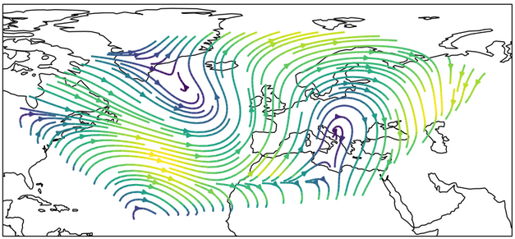

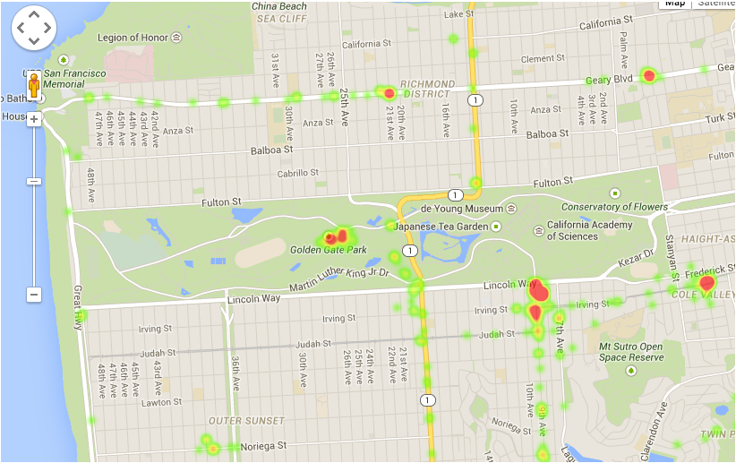
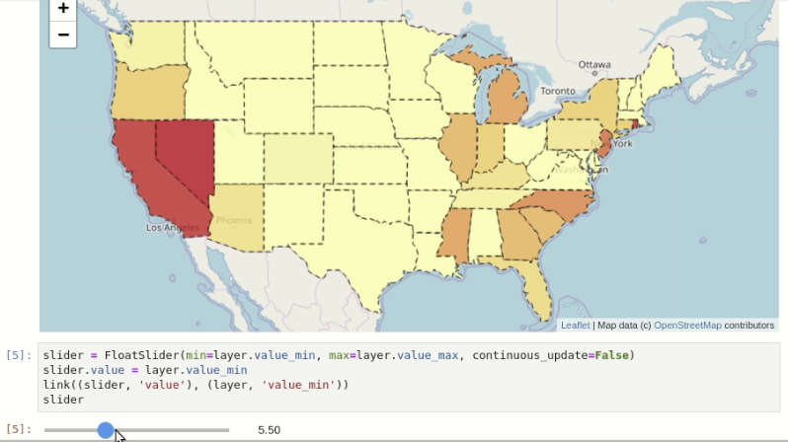
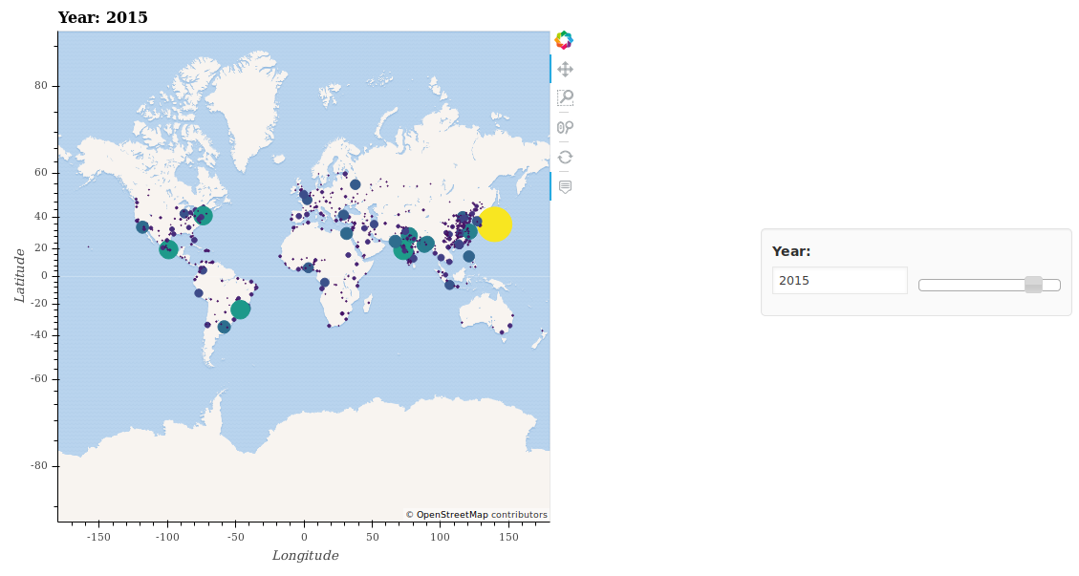
geospatial
PYCON UK | Cardiff | Sept 2019
GeoPandas
https://github.com/geopandas/geopandas
Folium
https://github.com/python-visualization/folium
CartoPy
https://github.com/SciTools/cartopy
gmplot
https://github.com/vgm64/gmplot
ipyleaflet
https://github.com/jupyter-widgets/ipyleaflet
geoviews
https://github.com/pyviz/geoviews
@EleonoreMayola | github.com/eleonore9 | Elle-est-au-nord.com

Slide 11

resources
PYCON UK | Cardiff | Sept 2019
Thank you
github.com/Eleonore9/tour_dataviz_python
Exhaustive list of Python tools for data viz: pyviz.org/tools.html
Libraries mentioned:
matplotlib.org
pandas.pydata.org
plot.ly
bokeh.org
altair-viz.github.io
@EleonoreMayola | github.com/eleonore9 | Elle-est-au-nord.com

