Slide 1
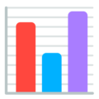


PyLadies Stockholm | August 29th 2019
A tour of data viz in Python
Éléonore Mayola
@EleonoreMayola | github.com/eleonore9 | Elle-est-au-nord.com

Slide 2









hello
PyLadies Stockholm | August 29th 2019
Developer + Data scientist
Python, Clojure, JS, HTML/CSS
Freelance work
Community volunteering
Endeavour
web + data
art + tech + data
@EleonoreMayola | github.com/eleonore9 | Elle-est-au-nord.com

Slide 3


overview
PyLadies Stockholm | August 29th 2019
Different needs for different use cases
* yourself
* your colleagues
* your manager
* your clients
* exploring a dataset
* writing an internal report
* writing a client report
* writing a research article
@EleonoreMayola | github.com/eleonore9 | Elle-est-au-nord.com

Slide 4
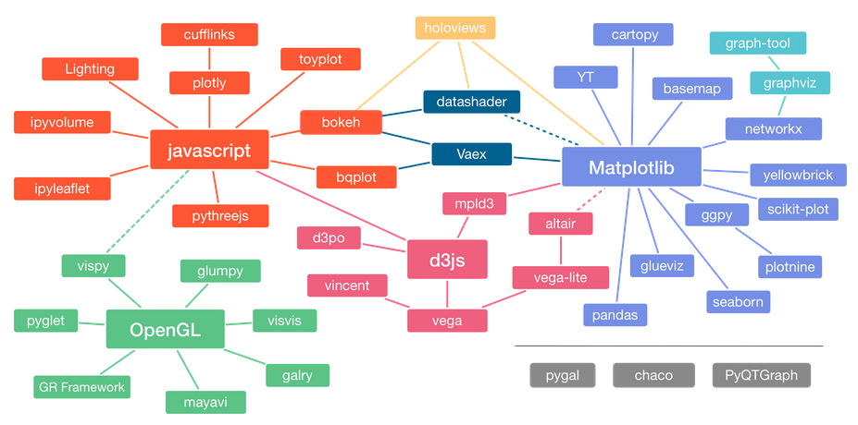

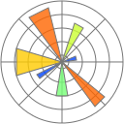



overview
PyLadies Stockholm | August 29th 2019
Adaptation of Jake VanderPlas graphic about the Python visualization landscape, by Nicolas P. Rougier
Source: https://pyviz.org/overviews/index.html
@EleonoreMayola | github.com/eleonore9 | Elle-est-au-nord.com

Slide 5

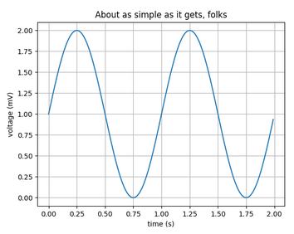
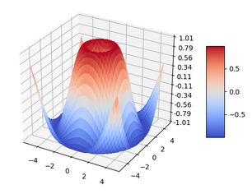
matplotlib
PyLadies Stockholm | August 29th 2019
matplotlib.org
“Matplotlib tries to make easy things easy and hard things possible.”
@EleonoreMayola | github.com/eleonore9 | Elle-est-au-nord.com

Slide 6
matplotlib
PyLadies Stockholm | August 29th 2019
The pyplot module provides a MATLAB-like interface
import matplotlib
import matplotlib.pyplot as plt
import numpy as np
# Data for plotting
t = np.arange(0.0, 2.0, 0.01)
s = 1 + np.sin(2 * np.pi * t)
fig, ax = plt.subplots()
ax.plot(t, s)
ax.set(xlabel='time (s)', ylabel='voltage (mV)',
title='About as simple as it gets, folks')
ax.grid()
fig.savefig("test.png")
plt.show()
@EleonoreMayola | github.com/eleonore9 | Elle-est-au-nord.com

Slide 7
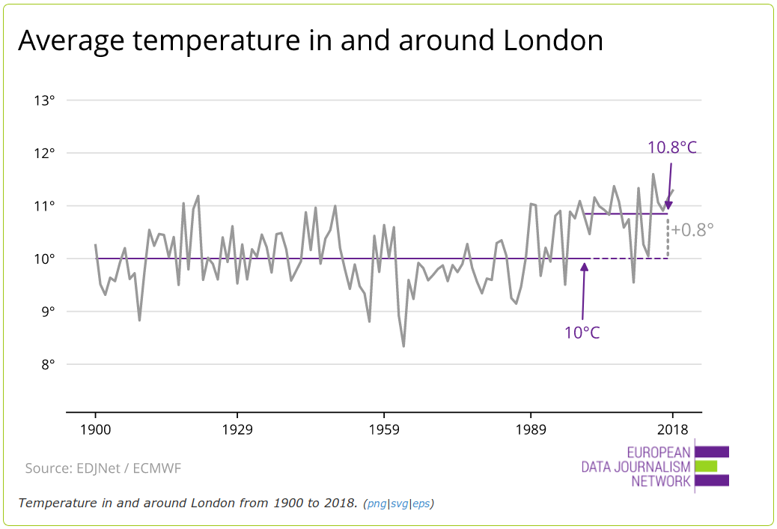
matplotlib
PyLadies Stockholm | August 29th 2019
onedegreewarmer.eu
Customisable
Example: add labels, lines and annotations
matplotlib.axes.Axes.axhline
ax.axhline(y=10yrs_average, color='#6f2c91',
linewidth=1.5)
matplotlib.pyplot.annotate
ax.annotate(f'{temperature}°C',
Xy=(3, 1), xycoords='data',
xytext=(0.8, 0.95),
arrowprops=dict(facecolor='#6f2c91'),
horizontalalignment='right',
verticalalignment='top')
Look up the rich gallery of examples: matplotlib.org/gallery/index.html
@EleonoreMayola | github.com/eleonore9 | Elle-est-au-nord.com

Slide 8
matplotlib
PyLadies Stockholm | August 29th 2019
Best for
Challenge
Complex or customised plots
Syntax can become tricky
@EleonoreMayola | github.com/eleonore9 | Elle-est-au-nord.com

Slide 9
pandas
PyLadies Stockholm | August 29th 2019
pandas.pydata.org
“[…] high-performance, easy-to-use data structures and data analysis tools for the Python programming language.”
Uses Matplotlib for plotting
import matplotlib.pyplot as plt
@EleonoreMayola | github.com/eleonore9 | Elle-est-au-nord.com

Slide 10
pandas
PyLadies Stockholm | August 29th 2019
pandas.DataFrame.plot
DataFrame.plot(x=None, y=None, kind='line', ax=None, subplots=False,
sharex=None, sharey=False, layout=None, figsize=None,
use_index=True, title=None, grid=None, legend=True, style=None,
logx=False, logy=False, loglog=False, xticks=None, yticks=None,
xlim=None, ylim=None, rot=None, fontsize=None, colormap=None,
table=False, yerr=None, xerr=None, secondary_y=False,
sort_columns=False, **kwds)
https://pandas.pydata.org/pandas-docs/version/0.23/generated/pandas.DataFrame.plot.html
@EleonoreMayola | github.com/eleonore9 | Elle-est-au-nord.com

Slide 11
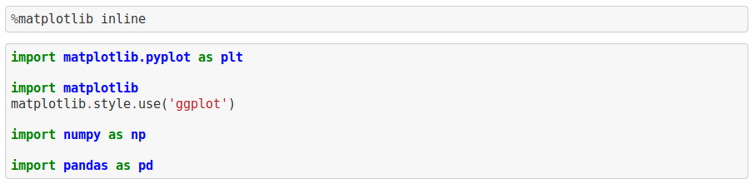
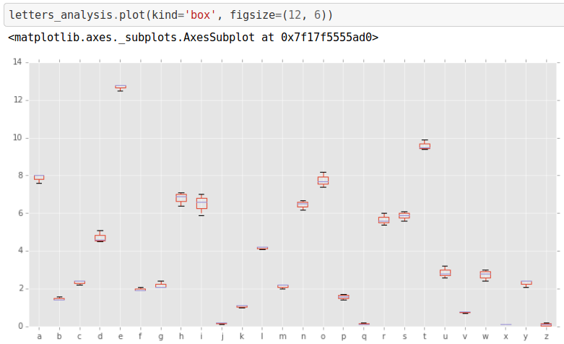
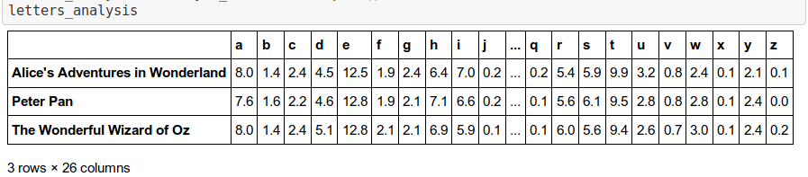
pandas
PyLadies Stockholm | August 29th 2019
Example Pandas in Jupyter notebook
@EleonoreMayola | github.com/eleonore9 | Elle-est-au-nord.com

Slide 12
pandas
PyLadies Stockholm | August 29th 2019
Best for
Challenge
Plotting during data analysis
Not the most aesthetic
→ try Seaborn
@EleonoreMayola | github.com/eleonore9 | Elle-est-au-nord.com

Slide 13
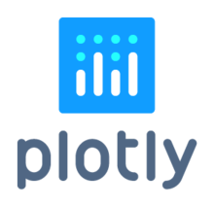
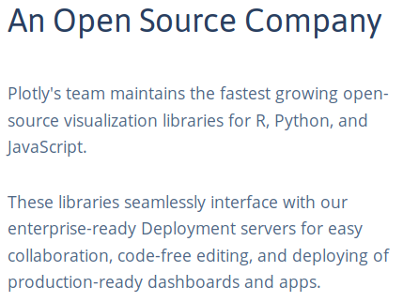
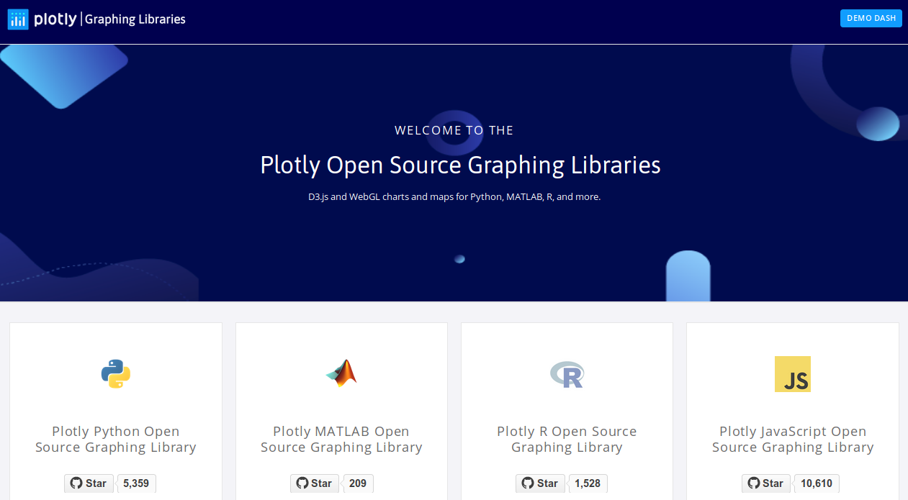
plotly
PyLadies Stockholm | August 29th 2019
plot.ly
@EleonoreMayola | github.com/eleonore9 | Elle-est-au-nord.com

Slide 14
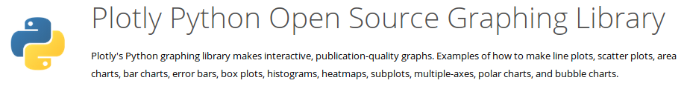
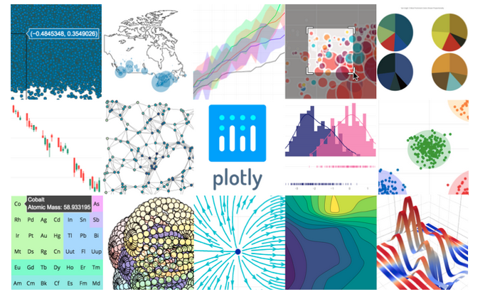
plotly
PyLadies Stockholm | August 29th 2019
plot.ly/python
plotly.py
High-level, declarative charting library with over 30 chart types, including scientific charts, 3D graphs, statistical charts, SVG maps, financial charts, and more.
@EleonoreMayola | github.com/eleonore9 | Elle-est-au-nord.com

Slide 15
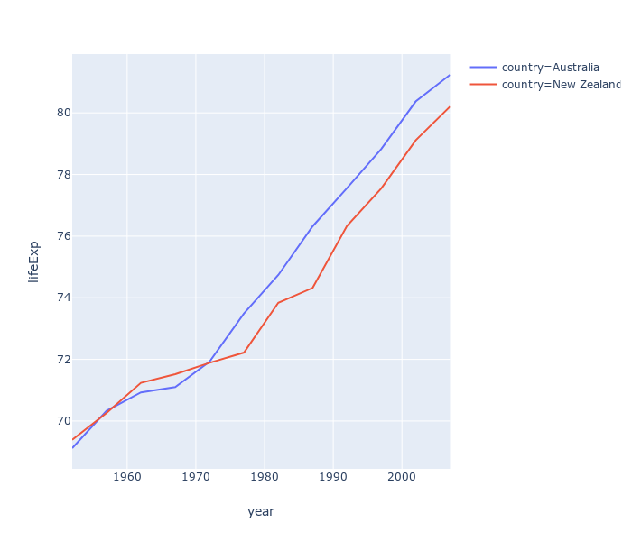
plotly
PyLadies Stockholm | August 29th 2019
plotly.py
Plotly Express
github.com/plotly/plotly.py
github.com/plotly/plotly_express
pip install plotly==4.1.0
pip install plotly_express==0.4.1
import plotly.graph_objects as go
Gapminder = go.data.gapminder().query("continent=='Oceania'")
fig = go.Figure(data=go.Scatter(x=Gapminder["year"], y=Gapminder["lifeExp"], mode='lines', name='country'))
fig.show()
import plotly.express as px
Gapminder = px.data.gapminder().query("continent=='Oceania'")
fig = px.line(Gapminder, x="year", y="lifeExp",
color='country')
fig.show()
@EleonoreMayola | github.com/eleonore9 | Elle-est-au-nord.com

Slide 16
plotly
PyLadies Stockholm | August 29th 2019
Best for
Challenge
Notebook or plain html report
Mainained by a private company
@EleonoreMayola | github.com/eleonore9 | Elle-est-au-nord.com

Slide 17

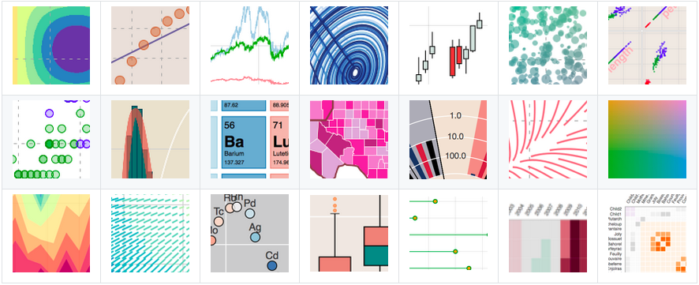
bokeh
PyLadies Stockholm | August 29th 2019
bokeh.org
“Bokeh is an interactive visualization library for Python that enables beautiful and meaningful visual presentation of data in modern web browsers.”
@EleonoreMayola | github.com/eleonore9 | Elle-est-au-nord.com

Slide 18


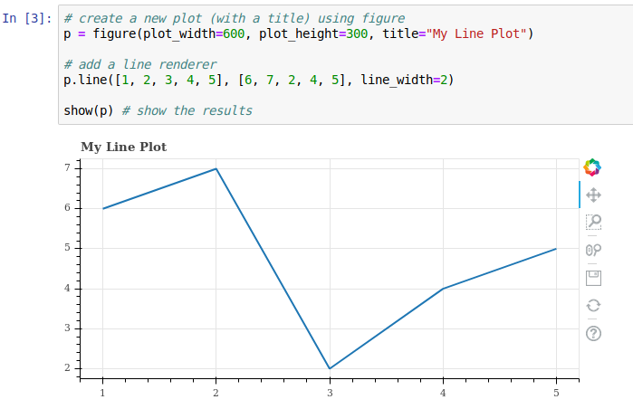
bokeh
PyLadies Stockholm | August 29th 2019
github.com/bokeh/bokeh
Interactive notebook tutorial
@EleonoreMayola | github.com/eleonore9 | Elle-est-au-nord.com

Slide 19
bokeh
PyLadies Stockholm | August 29th 2019
Best for
Challenge
Interactive plots or dashboards
Tricky to create dashboard apps
@EleonoreMayola | github.com/eleonore9 | Elle-est-au-nord.com

Slide 20
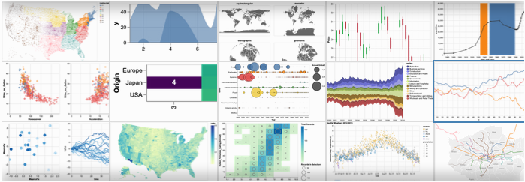
altair
PyLadies Stockholm | August 29th 2019
altair-viz.github.io
vega.github.io/vega
“Altair is a declarative statistical visualization library for Python, based on Vega and Vega-Lite.”
“Vega is a visualization grammar, a declarative language for creating, saving, and sharing interactive visualization designs.”
@EleonoreMayola | github.com/eleonore9 | Elle-est-au-nord.com

Slide 21
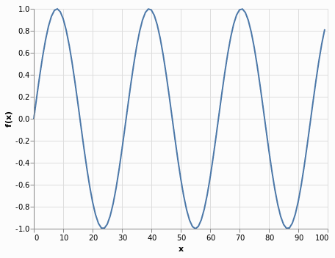
altair
PyLadies Stockholm | August 29th 2019
import altair as alt
import numpy as np
import pandas as pd
x = np.arange(100)
source = pd.DataFrame({
'x': x,
'f(x)': np.sin(x / 5)
})
alt.Chart(source).mark_line().encode(
x='x',
y='f(x)'
)
@EleonoreMayola | github.com/eleonore9 | Elle-est-au-nord.com

Slide 22
altair
PyLadies Stockholm | August 29th 2019
Best for
Challenge
Interactive plots and maps
One main maintainer
@EleonoreMayola | github.com/eleonore9 | Elle-est-au-nord.com

Slide 23
summary
PyLadies Stockholm | August 29th 2019
Best for
Challenges
Complex or customised plots
Syntax can become tricky
Plotting during data analysis
Not the most aesthetic
→ try Seaborn
Notebook or plain html report
Mainained by a private company
Interactive plots or dashboards
Tricky to create dashboard apps
Interactive plots and maps
One main maintainer
@EleonoreMayola | github.com/eleonore9 | Elle-est-au-nord.com

Slide 24

resources
PyLadies Stockholm | August 29th 2019
Thank you
github.com/Eleonore9/tour_dataviz_python
* Exhaustive list of Python tools for data viz: pyviz.org/tools.html
* Libraries mentioned:
matplotlib.org
pandas.pydata.org
plot.ly
bokeh.org
altair-viz.github.io
@EleonoreMayola | github.com/eleonore9 | Elle-est-au-nord.com

