Slide 1
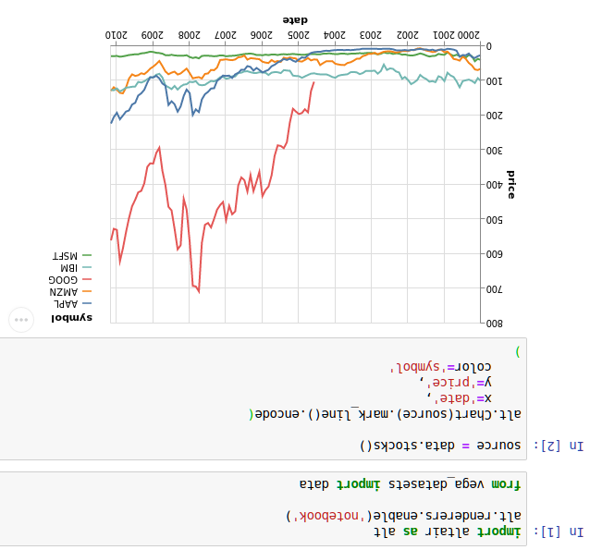
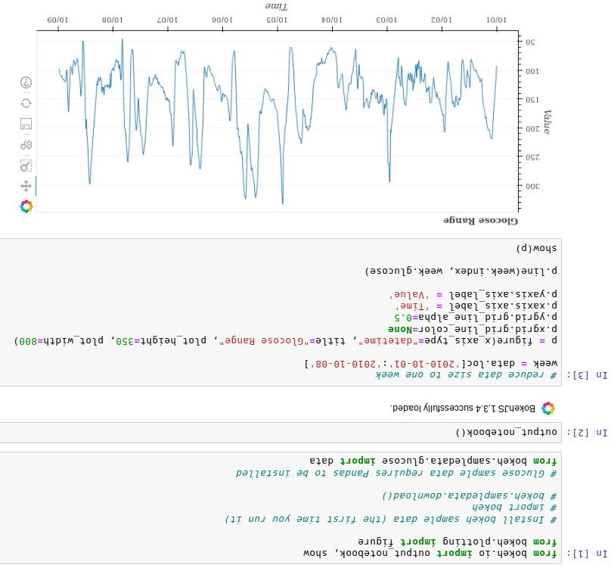



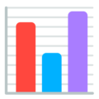








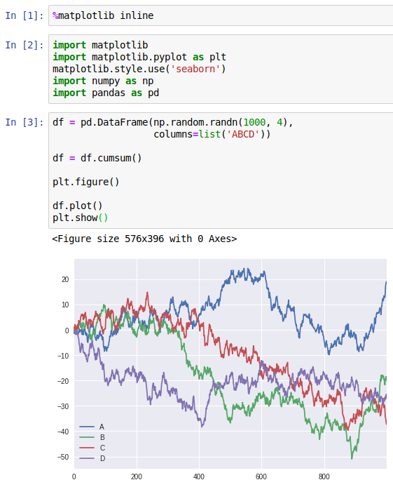
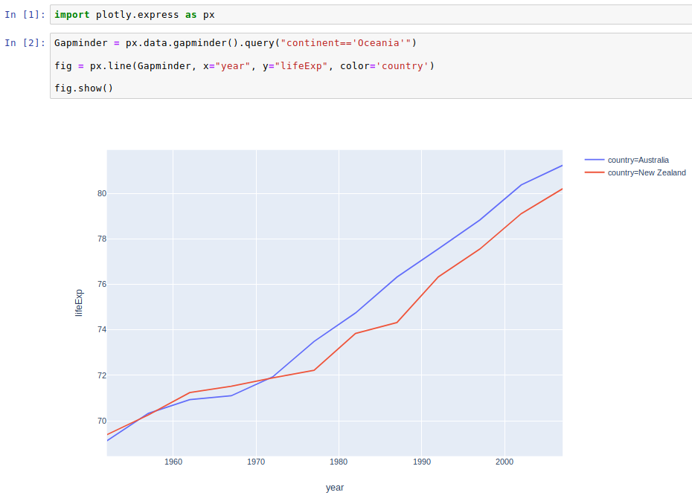
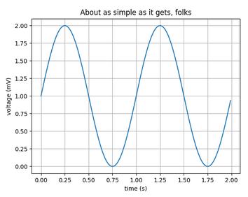
7
6
5
@EleonoreMayola | github.com/eleonore9 | Elle-est-au-nord.com
Interactive plots and maps
One main maintainer
Interactive plots or dashboards
Tricky to create dashboard apps
Geospatial libraries for Python:
Geopandas, Folium, CartoPy, gmplot, ipyleaflet, geoviews
Libraries mentioned:
matplotlib.org
pandas.pydata.org
plot.ly
bokeh.org
altair-viz.github.io
Éléonore Mayola
A tour of data viz in Python
Exhaustive list of Python tools for data viz: pyviz.org/tools.html
“Altair is a declarative statistical visualization library for Python, based on Vega and Vega-Lite.”
“Bokeh is an interactive visualization library for Python that enables beautiful and meaningful visual presentation of data in modern web browsers.”
github.com/Eleonore9/tour_dataviz_python
PYCON UK | Cardiff | Sept 2019
PYCON UK | Cardiff | Sept 2019
PYCON UK | Cardiff | Sept 2019
PYCON UK | Cardiff | Sept 2019
PYCON UK | Cardiff | Sept 2019
PYCON UK | Cardiff | Sept 2019
PYCON UK | Cardiff | Sept 2019
PYCON UK | Cardiff | Sept 2019
Different needs for different use cases
“Matplotlib tries to make easy things easy and hard things possible.”
“[…] high-performance, easy-to-use data structures and data analysis tools for the Python programming language.”
High-level, declarative charting library with over 30 chart types, including scientific charts, 3D graphs, statistical charts, SVG maps, financial charts, and more.
import matplotlib
import matplotlib.pyplot as plt
import numpy as np
# Data for plotting
t = np.arange(0.0, 2.0, 0.01)
s = 1 + np.sin(2 * np.pi * t)
fig, ax = plt.subplots()
ax.plot(t, s)
ax.set(xlabel='time (s)', ylabel='voltage (mV)',
title='About as simple as it gets, folks')
ax.grid()
fig.savefig("test.png")
plt.show()
yourself
your colleagues
your manager
your clients
exploring a dataset
writing an internal report
writing a client report
writing a research article
Complex or customised plots
Syntax can become tricky
Plotting during data analysis
Not the most aesthetic → try Seaborn
Notebook or plain html report
Maintained by a private company
1
2
3
4

