Slide 1

Customer Booking Prediction
Pospelkova Elizaveta Sergeevna

Slide 2
Project Goal
Predict the probability of booking completion
Identify key factors influencing customer behavior
Improve business decision-making

Slide 3
Dataset
Booking details (sales_channel, booking_origin, route, trip_type)
Customer choices (extra baggage, preferred seat, in-flight meals)
Flight information (duration, departure hour, day of week)
Booking behavior (purchase_lead, length_of_stay, num_passengers)
Target: booking_complete (1 – completed, 0 – not completed)

Slide 4
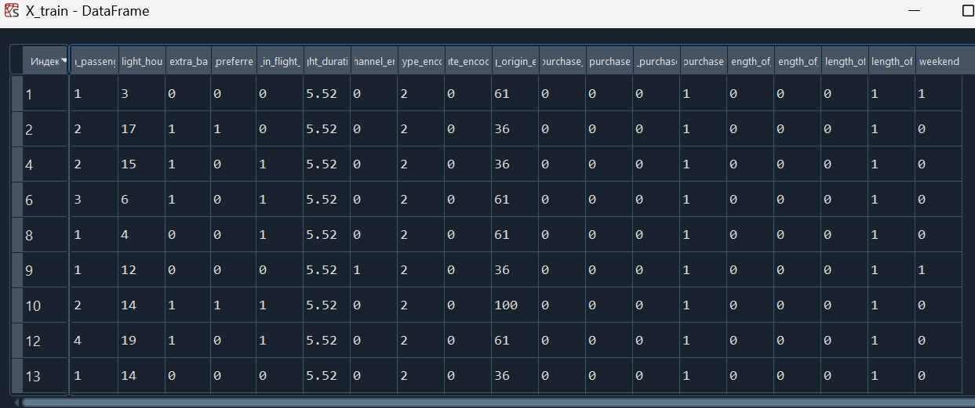
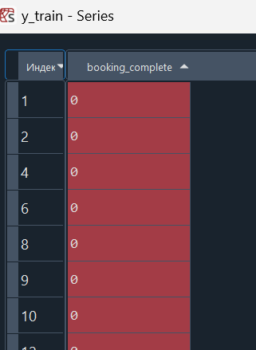
Data Preprocessing
Encoded categorical variables (Label Encoding)
Feature engineering:
purchase_lead → bins (0–3, 4–14, 15–60, >60)
weelength_of_stay → bins (0–3, 4–7, 8–14, >14)
kend flight → Sat/Sun vs. weekday
Final dataset: X features + target (y)

Slide 5
Random Forest Classifier
Handling class imbalance: class_weight = "balanced“
Hyperparameter tuning: GridSearchCV (5-fold CV): n_estimators (10–100) max_depth (1–11) min_samples_leaf (1–4) min_samples_split (2–8)

Slide 6
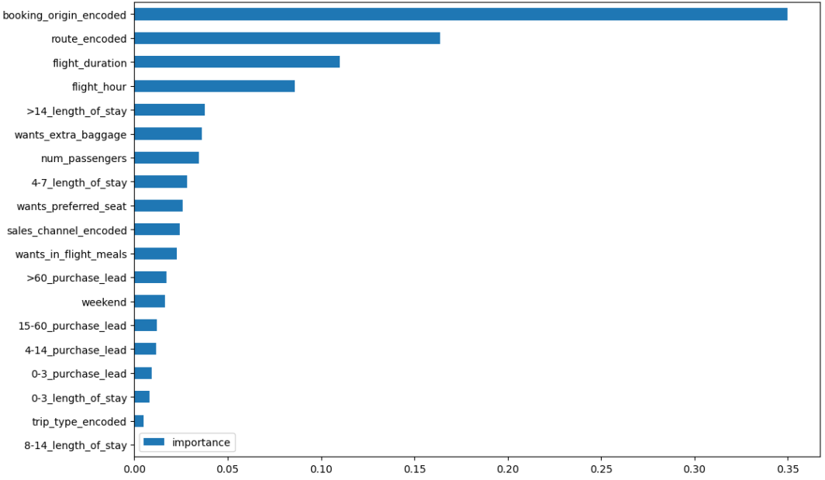
Feature Importance

Slide 7
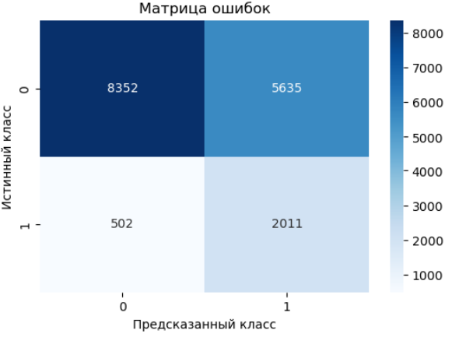
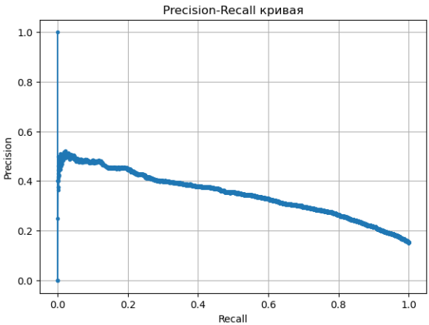
Model Evaluation
pred = (y_proba >= 0.406)
precision: 0.26321989528795814 recall: 0.8002387584560287

Slide 8
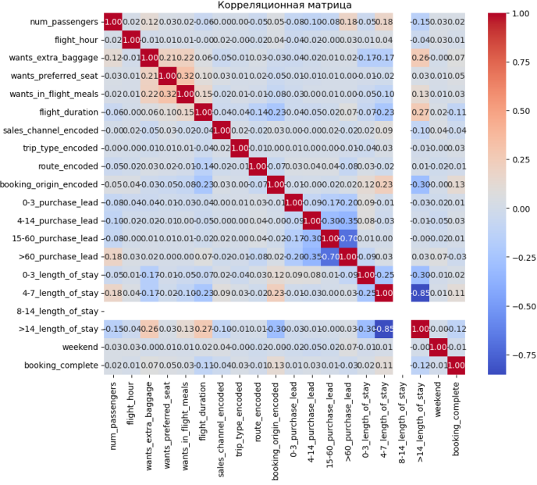
Key Findings
Goal: Identify relationships between features and booking completion
Most features have weak correlation with the target booking_complete (≤ 0.2)
Slight positive correlation:
4-7_length_of_stay, booking_origin_encoded→ more likely to complete booking
wants_extra_baggage, wants_preferred_seat → slight positive effect
Negative correlation:
flight_duration (-0,11), >60_purchase_lead

Slide 9
Thank You
https://github.com/Elesheva/British_airways/blob/main/task_2_DAY_2.py

