Slide 1

EduTech Demo - Landing

Slide 2
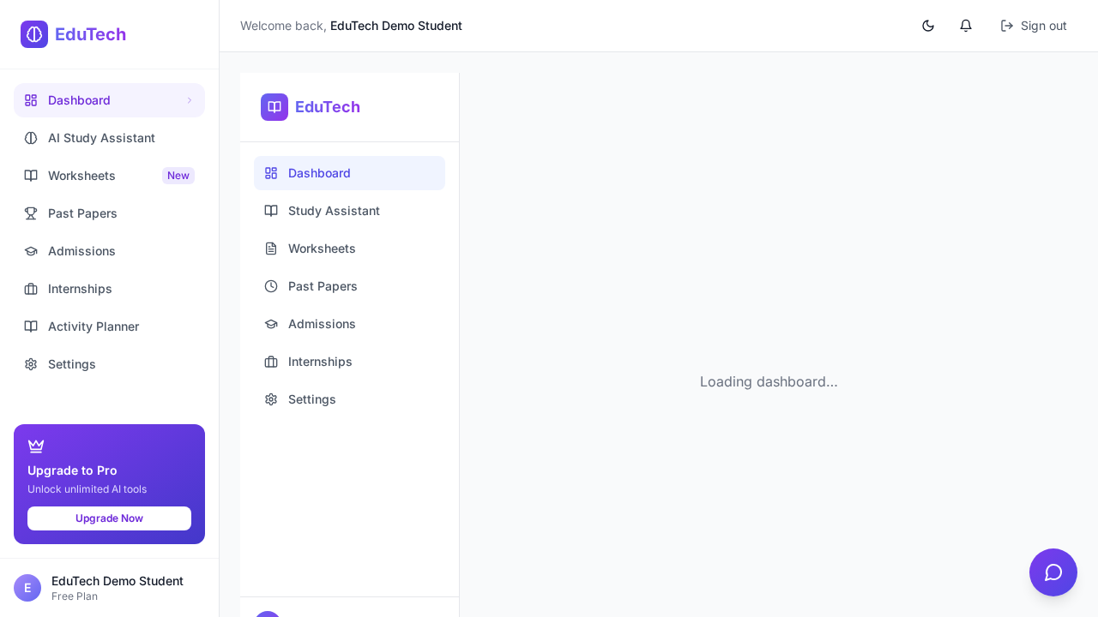
Dashboard

Slide 3
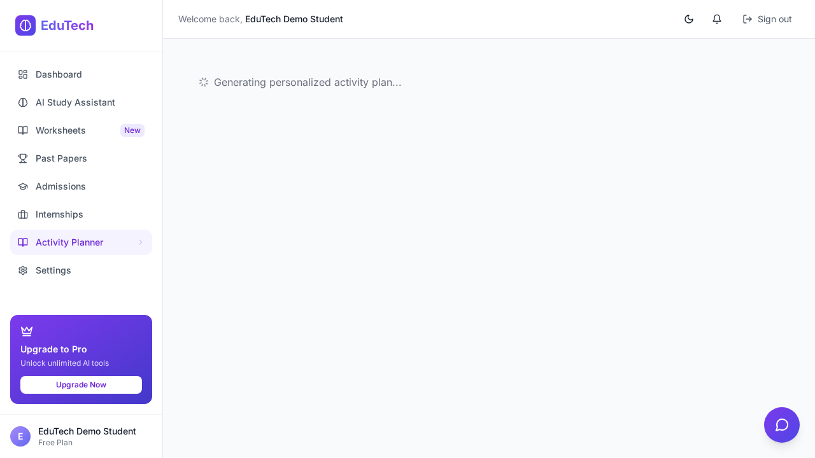
Activity Planner

Slide 4

Settings / Student Profile

