Slide 1
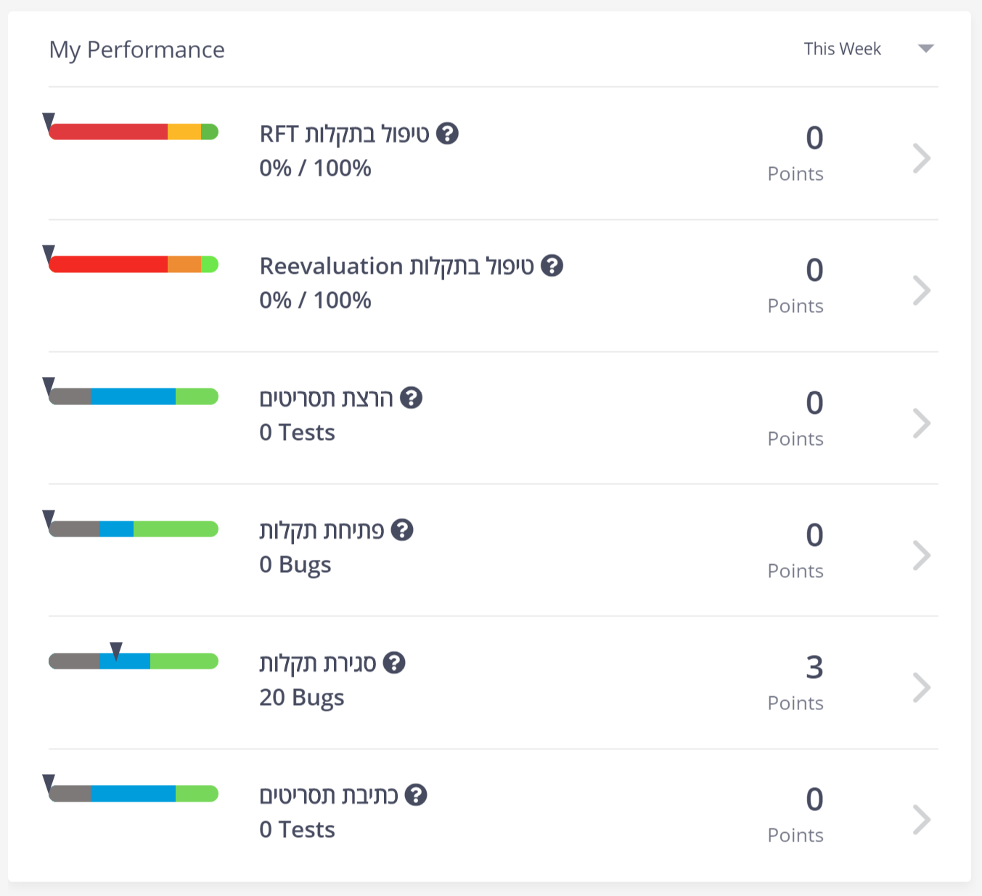
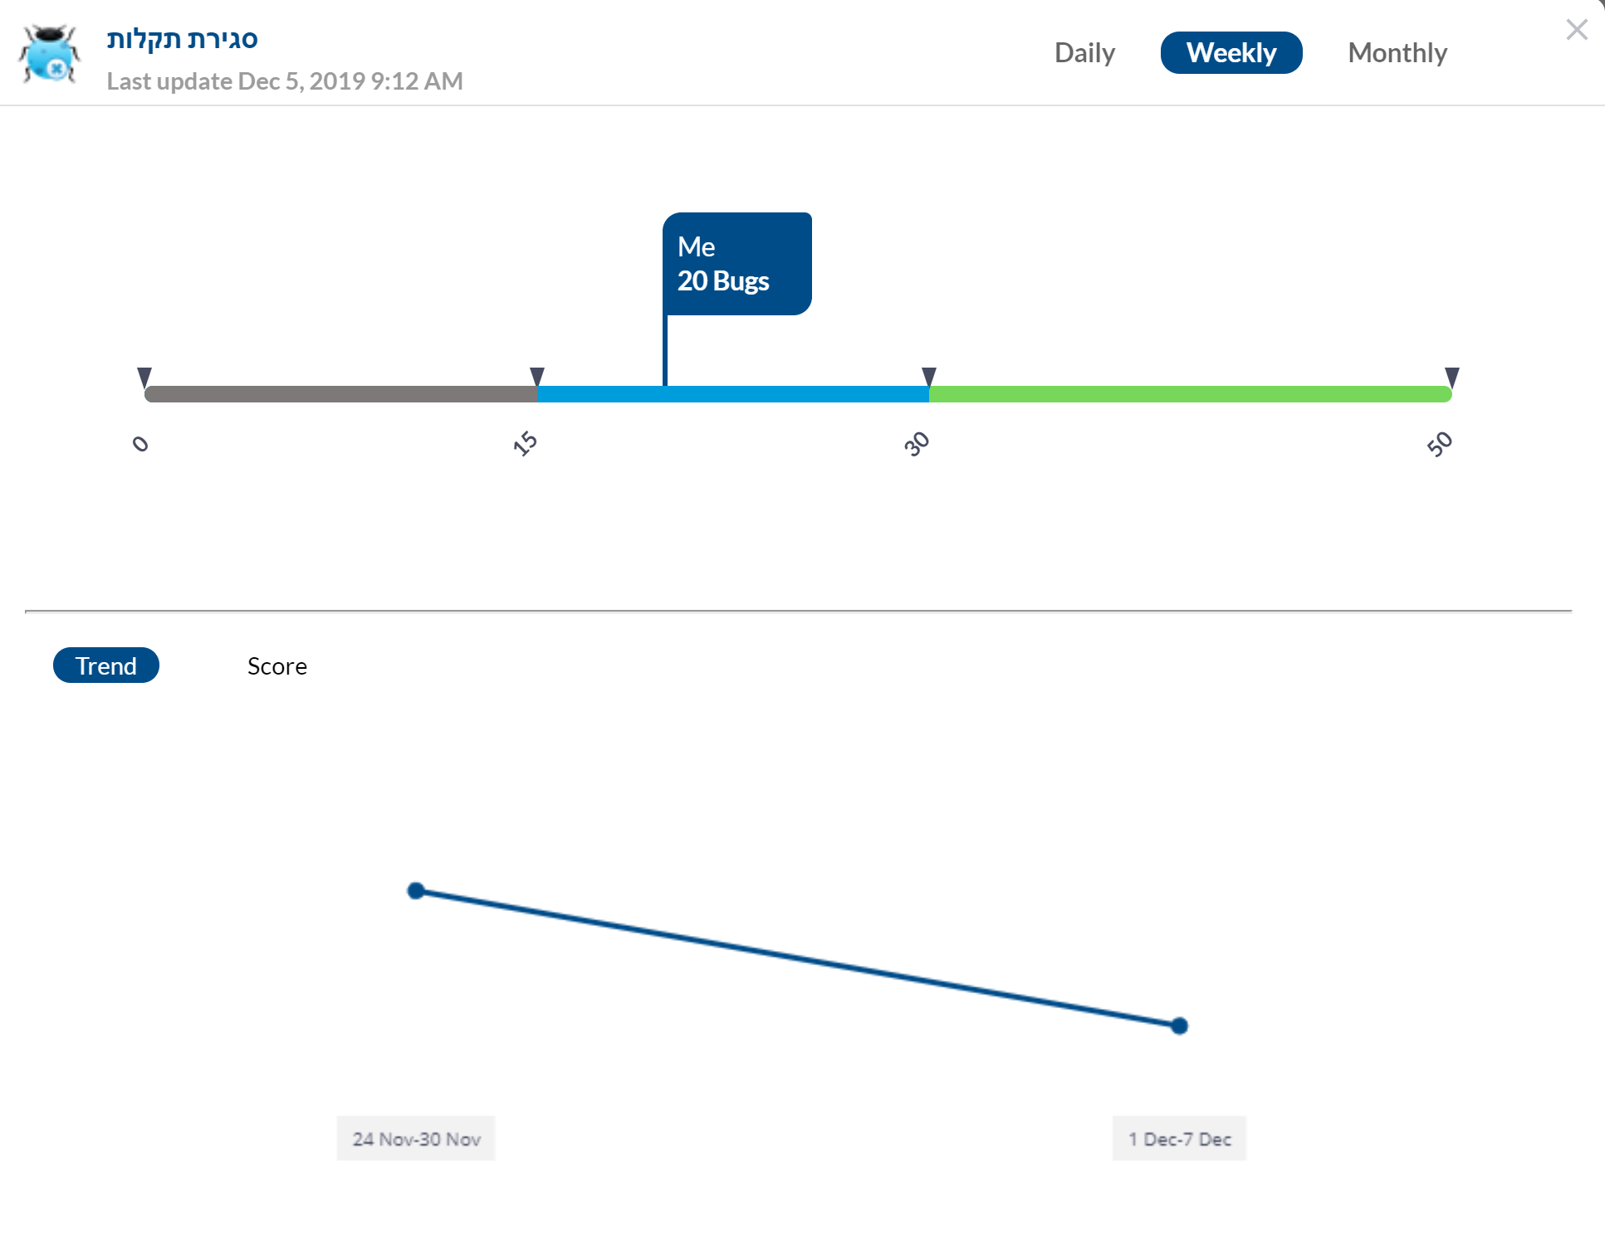
KPI (Key Performance Indicators) Component
Dor Shriki, Oron Yaakov, Avi Moore, Zafrir Freits, Chen Ozeri , Inbar Komoron

Slide 2
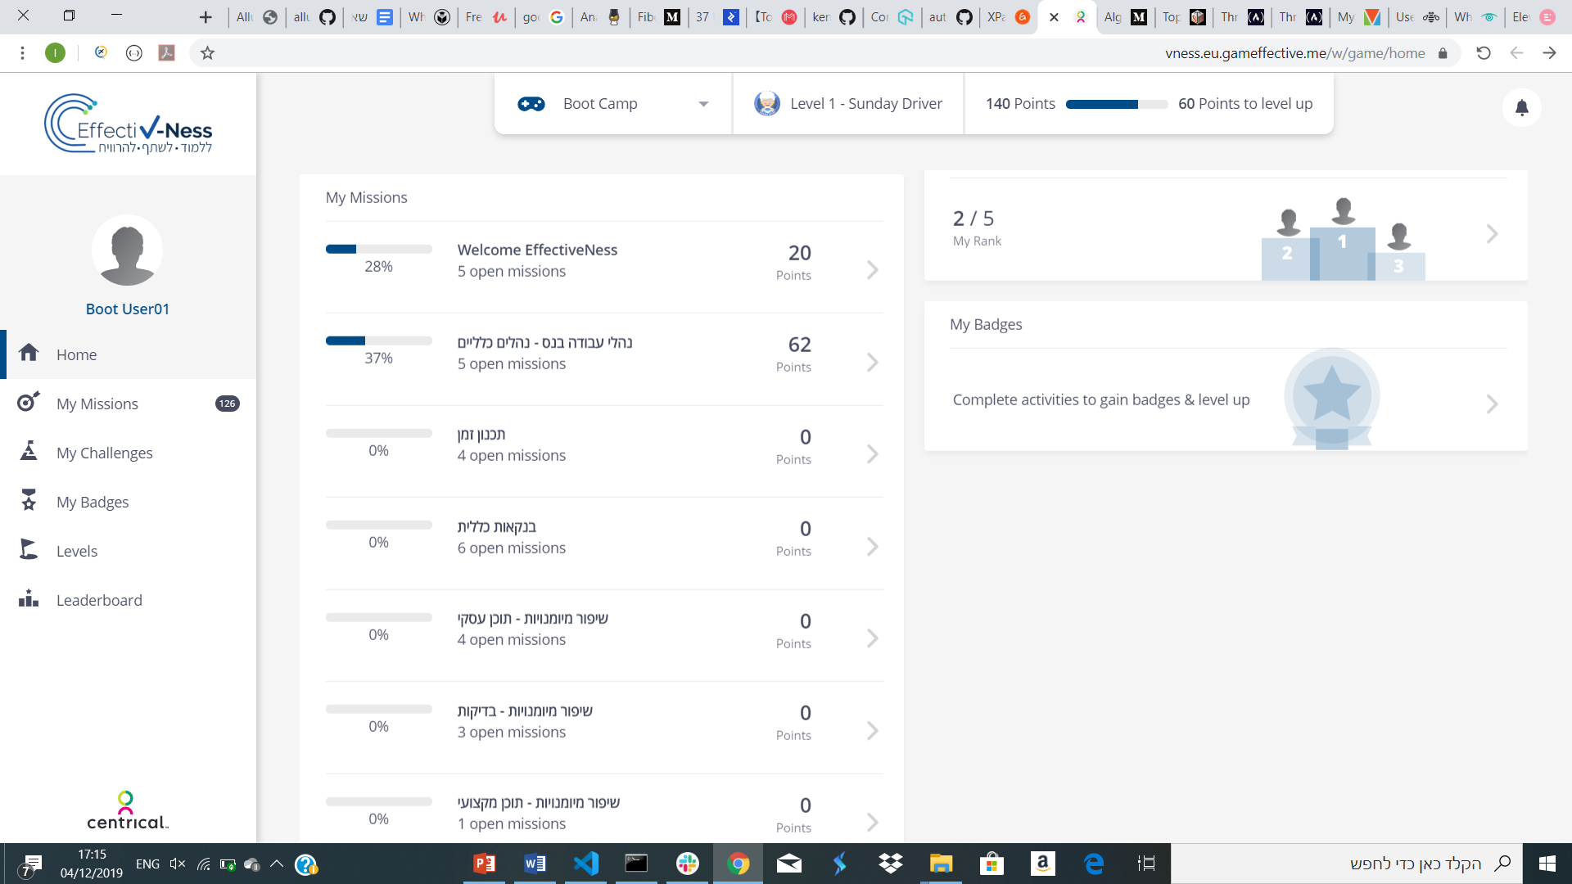
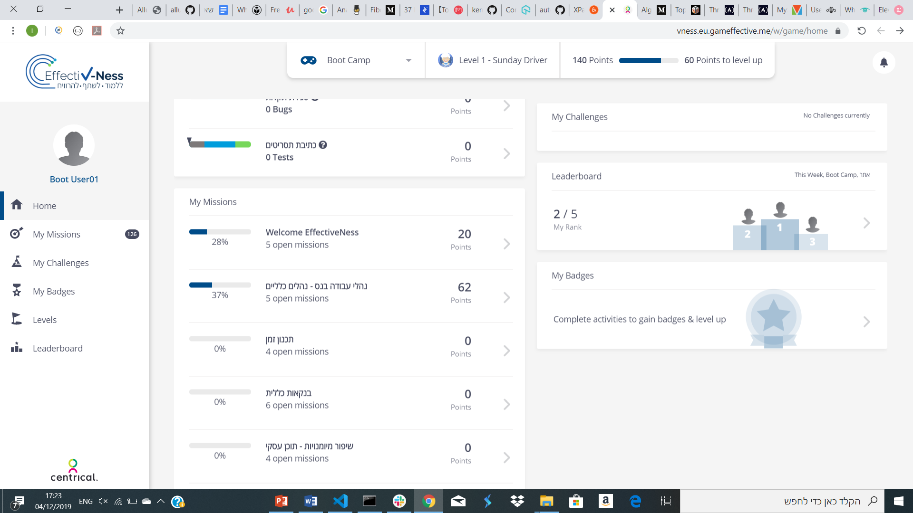
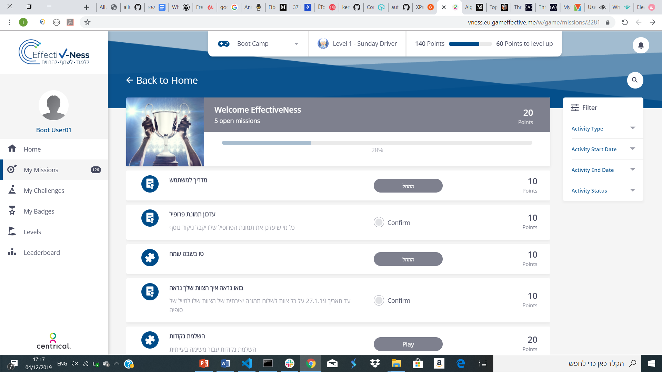
My Missions Component
Or Halag, Ilya Livshitz, Marina Paz, Adi Yaacobi, Mahmoud Shakdan

Slide 3

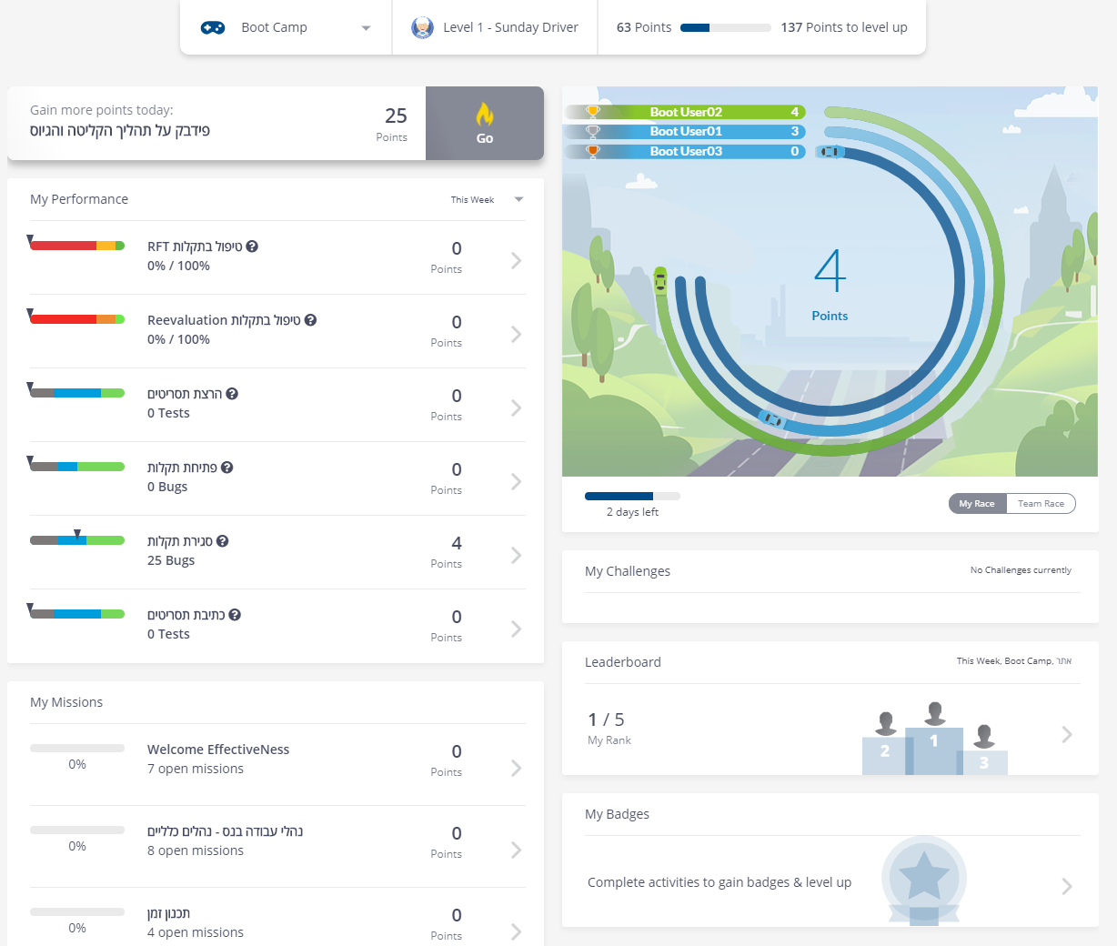
Home Page Components
Shay Naimark, Shiraz Sperling, Eli Koitich, Evyatar Malihi, Eldad Cohen

Slide 4
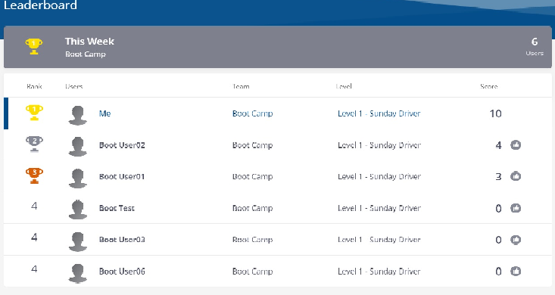
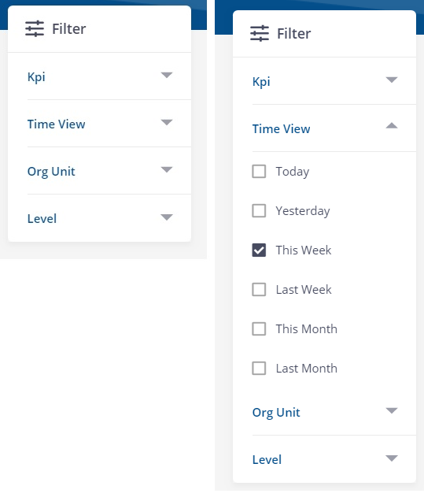
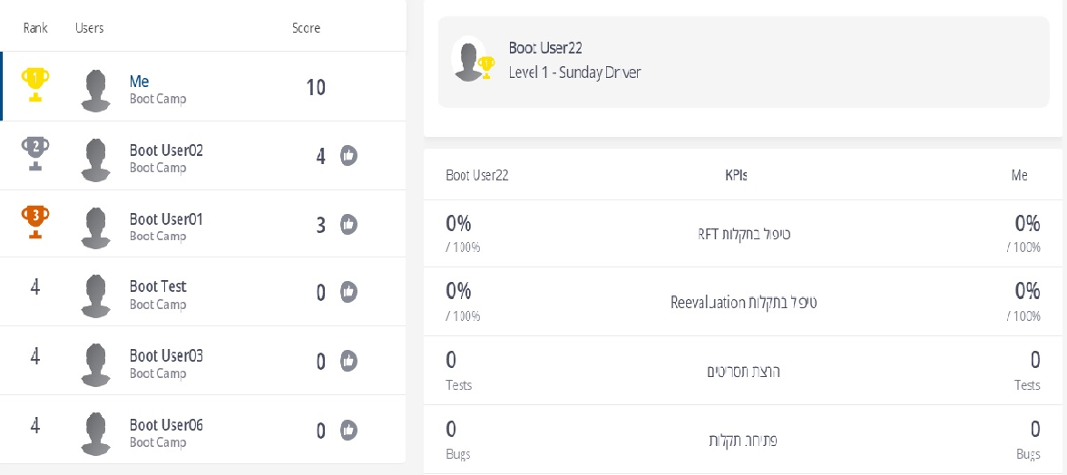
Leader Board Component Yuval Dahan, Valeria Basov, Rebecca Nahom, Daniel Manor, Doron Cohen
Filter
Leaderboard
User’s KPI’s

