Slide 1


Ameer Jamal Younis

Slide 2


The Problem
Imagine this scenario :
A query that takes a very long time (30-60 seconds)
Not an Ideal Situation.
Web App
Database
In a lot of situations these queries have been ran before by the user

Slide 3

Redis
Redis is an open source (BSD licensed), in-memory data structure store, used as a database, cache.
It is a NO-SQL DB.

Slide 4
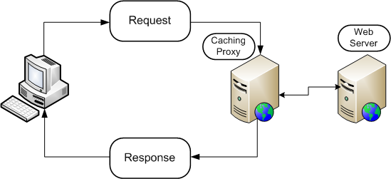
Cache
a cache is a hardware or software component that stores data so that future requests for that data can be served faster. It is a special storage space for temporary files that makes a device, browser, or app run faster and more efficiently.

Slide 5
Redis Storage
Redis provides data structures such as strings, hashes, lists, sets, sorted sets with range queries, bitmaps, hyperloglogs, geospatial indexes, and streams.

Slide 6
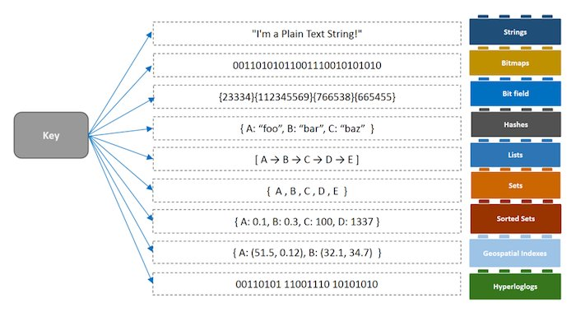
Redis Storage
It works in the KEY-VALUE store
Name = John
It can be reterivied using a SET / GET command.

Slide 7

How it works?
Imagine this scenario :
We introduce a Redis instance into our flow
Web App
Database
We save query results in our Redis and retrieve it from Redis if the query we are requesting exists.

Slide 8
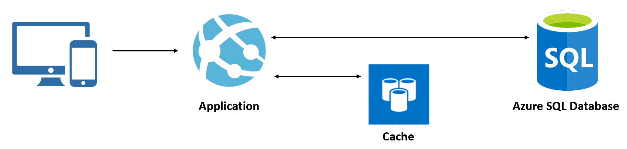
How to populate it?
Our Redis instance is created empty , so how do we populate it and make use of it?
On first request we try to retrieve from our Redis the data, if it doesn’t contain it is a situation that is referred to as “cache miss”. And then the web retrieves it from the Database and adds it to our Redis. When we are able to successfully retrieve it from the Redis it is referred to as “cache hit”

Slide 9
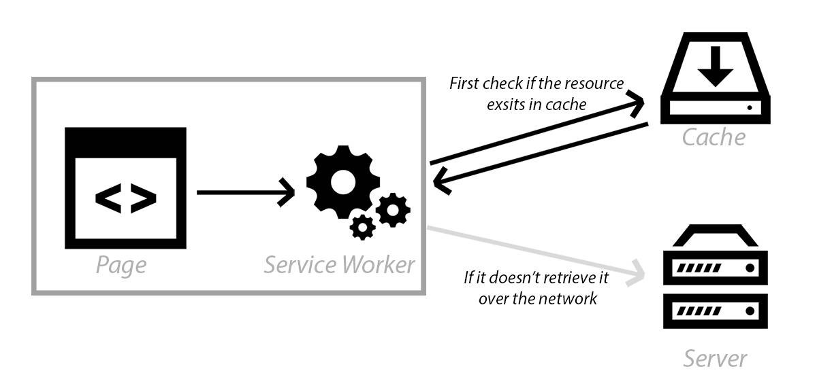
How to populate it?
Another way to populate the Redis is a cache worker.
In between the Redis and the Database we add something called a cache worker.
It is an architecture that is based off service worker which works to monitor changes between the data in the DB and the data in the cache.
The cache worker populates the Redis instance when a change occurs in the DB.

Slide 10
Special Features of Redis
Optimized for speed Redis is designed and implemented for performance. The data structures used internally by Redis are implemented for maximum performance and the majority of data operations require constant time and space
NO SQL Database
Support for arbitrary data stored in Redis can be in any form and size.
Data expiration Keys in Redis can be set with a time to live (TTL), after which they are expired. Until they expire
Redis can be scaled horizontally to meet any increase in demand for RAM, computation or network resources.

Slide 11
Thanks!
Do you have any questions?
Lets see an example

