Slide 1
ElasticSearch
Made by: Afeef , Bahaa

Slide 2
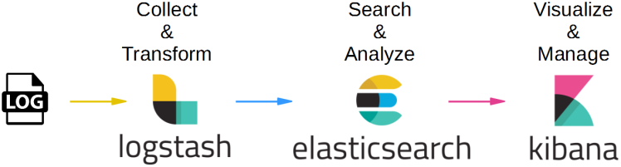
What is ElasticSearch?
Elasticsearch is a distributed, open-source search and analytics engine built on Apache Lucene and developed in Java.
Elasticsearch allows you to store, search, and analyze huge volumes of data quickly and in near real-time and give back answers in milliseconds.
It’s often used for enabling search functionality for applications.
big data solution.

Slide 3
Why ElasticSearch?
Easy to scale (Distributed)
Everything is one JSON call away (RESTful API)
Configurable and Extensible
Document Oriented
Schema free

Slide 4
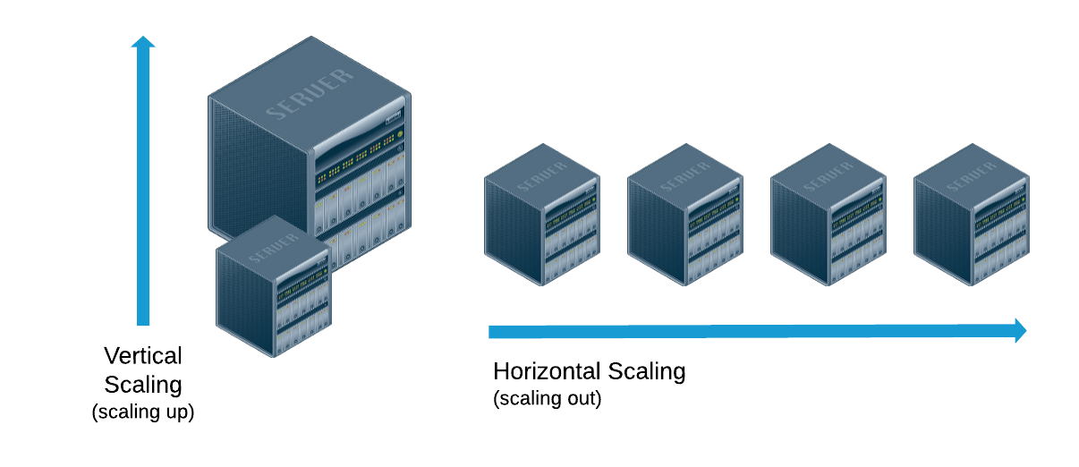
Horizontal & Vertical scaling
Horizontal scaling - scale by adding more machines to your pool of resources.
Vertical scaling - scale by adding more power (CPU, RAM, etc.) to your existing machine.
Horizontal scaling is easier to scale dynamically by adding more machines into the existing pool.
Vertical scaling is often limited to the capacity of a single machine
Horizontal scaling are the Cloud data stores, e.g. DynamoDB, Cassandra , MongoDB
Vertical scaling is MySQL - Amazon RDS (The cloud version of MySQL)

Slide 5
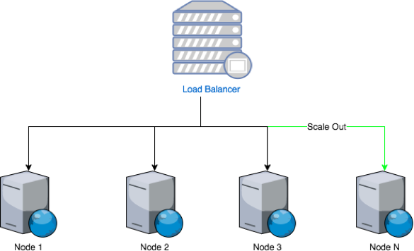
Easy to Scale (Distributed) Scale horizontally
Elastic Search is built to scale horizontally out of the box. When ever you need to increase capacity, just add more nodes, and let the cluster reorganize itself to take advantage of the extra hardware.

Slide 6
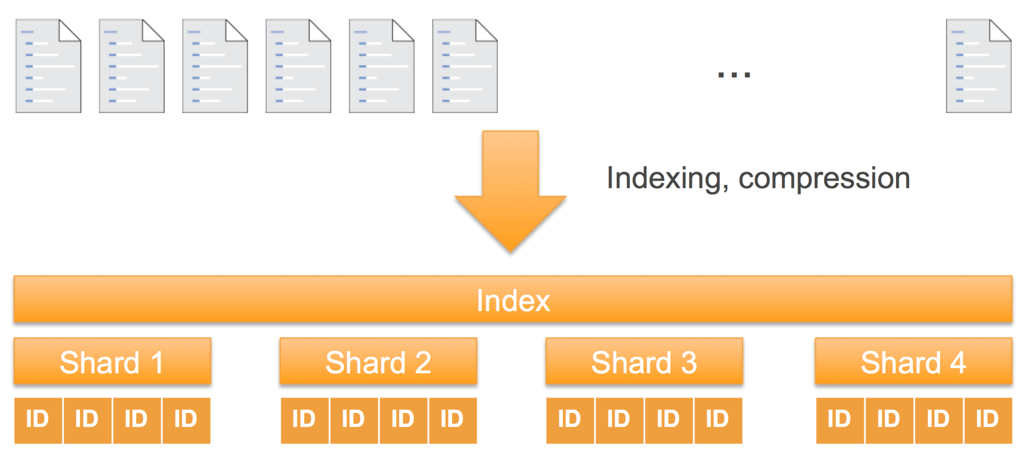

Slide 7
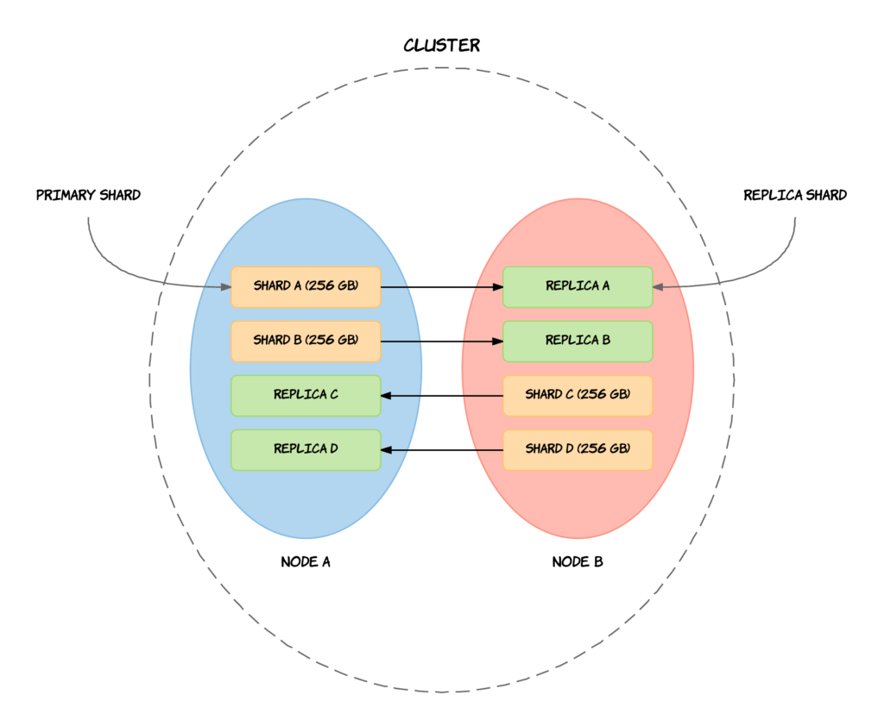
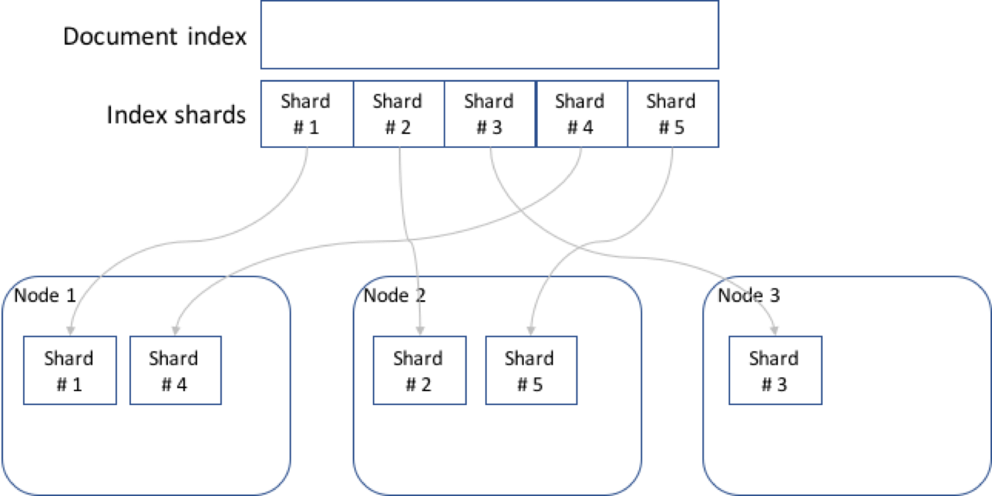
SHards

Slide 8
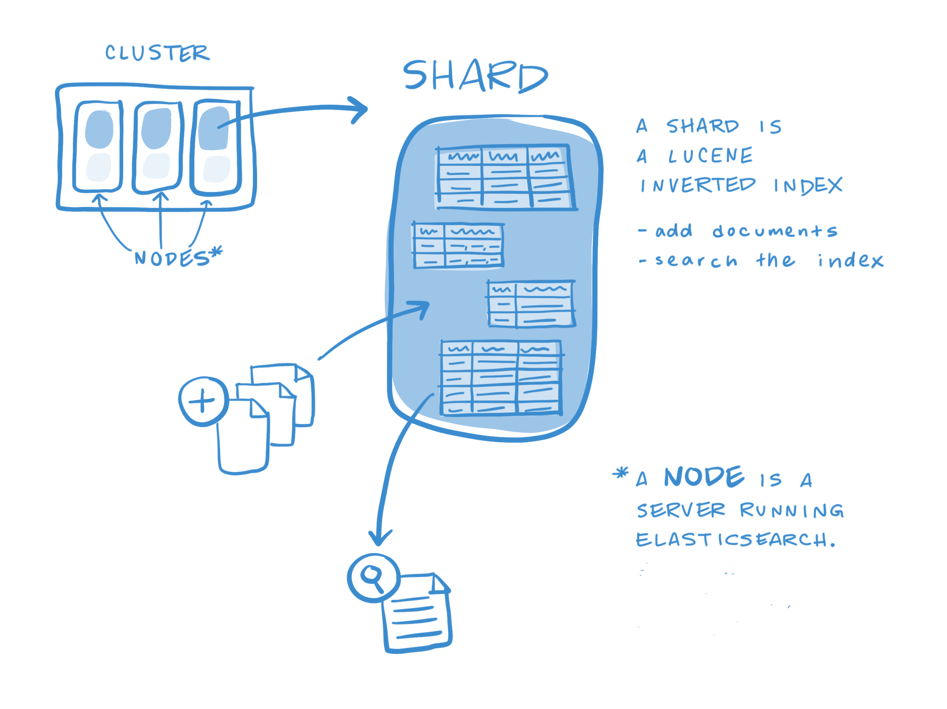

Slide 9
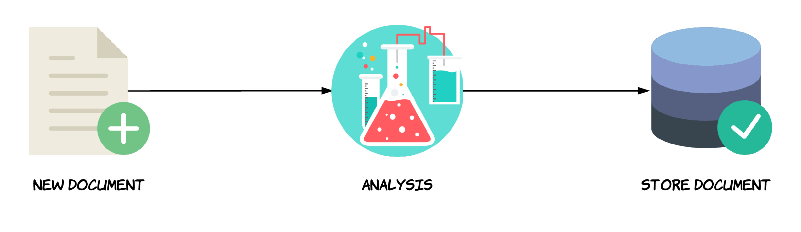
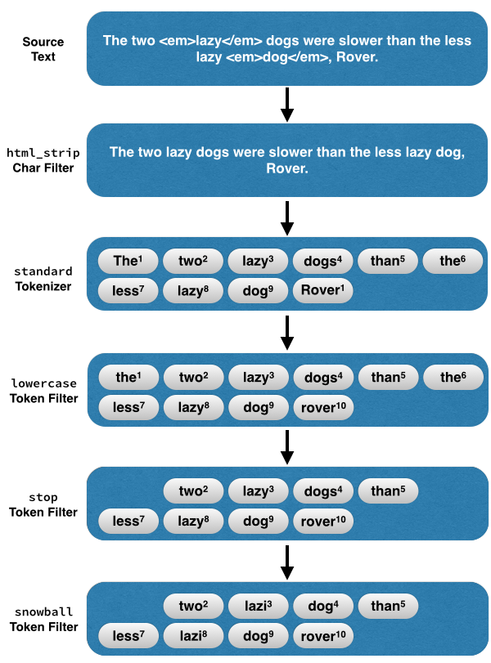
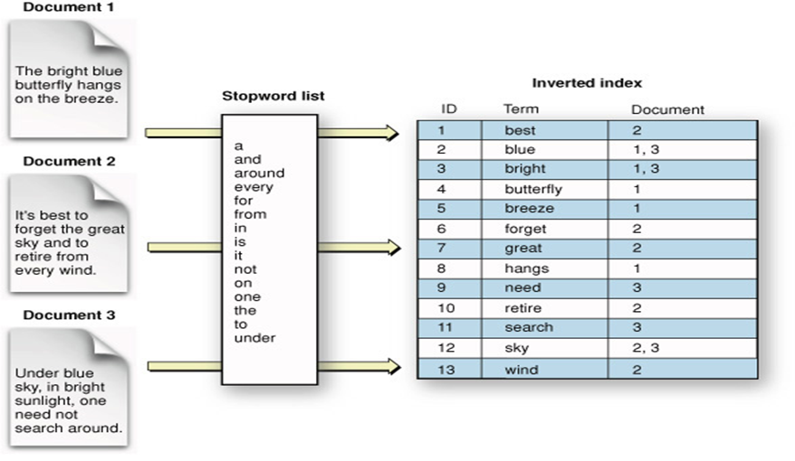

Slide 10
Basic Concepts
Cluster : In Elasticsearch, we store our data in nodes, there can be n number of nodes in a machine. And each node is related to the cluster. So the Cluster is a set of nodes.
Node : A node is a JVM Process running an instance of the Elasticsearch runtime, independently accessible over a network by other machines or nodes in a cluster.
Index : It is a collection of different type of documents and their properties. Index also uses the concept of shards to improve the performance. For example, a set of document contains data of a social networking application.
Type : A type is like a ‘table’ in a relational database. Each type has a list of fields that can be specified for documents of that type. The mapping defines how each field in the document is analyzed.

Slide 11
Basic Concepts
Document : It is a collection of fields in a specific manner defined in JSON format. Every document belongs to a type and resides inside an index. Every document is associated with a unique identifier called the UID.
Field: A document contains a list of fields, or key-value pairs. The value can be a simple ,string, integer, date, or a nested structure like an array or an object. A field is similar to a column in a table in a relational database. The mapping for each field has a field ‘type’ (not to be confused with document type) which indicates the type of data that can be stored in that field, integer, string, object. The mapping also allows you to define (amongst other things) how the value for a field should be analyzed.
Mapping : Mapping is the process of defining document, and its fields. Just like defining table-schema in RDBMS.

Slide 12
Basic Concepts
Shard: A shard is a single Lucene instance. It is a low-level “worker” unit which is managed automatically by Elastic Search. An index is a logical namespace which points to primary and replica shards. Elastic Search distributes shards amongst all nodes in the cluster, and can move shards automatically from one node to another in the case of node failure, or the addition of new nodes.
Primary Shard: Each document is stored in a single primary shard. When a document is send for indexing, it is indexed first on the primary shard, then on all replicas of the primary shard. By default, an index has 5 primary shards. You can specify fewer or more primary shards to scale the number of documents that your index can handle.
Replica Shard: Each primary shard can have zero or more replicas. A replica is a copy of the primary shard, and has two purposes: a. increase failover: a replica shard can be promoted to a primary shard if the primary fails. b. increase performance: get and search requests can be handled by primary or replica shards.

Slide 13
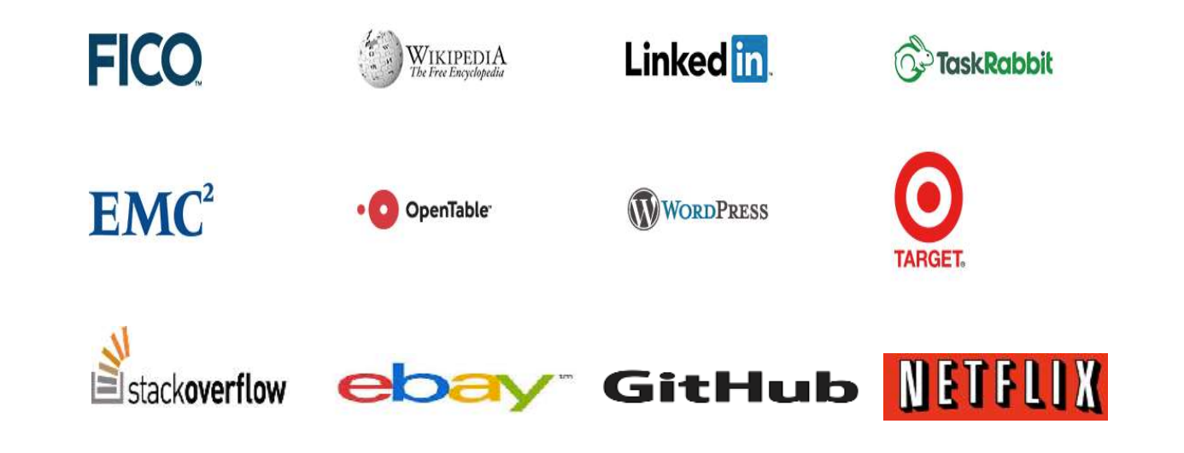
Who is using ?

Slide 14


